Slide 1
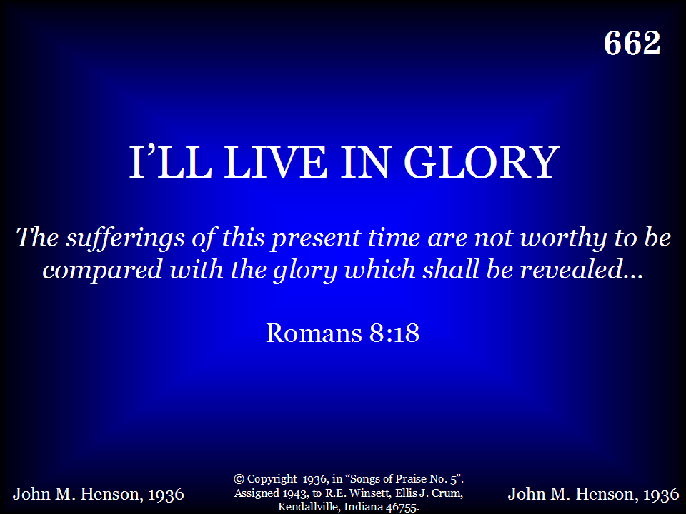
662 - I'll Live In Glory - Title

Slide 2
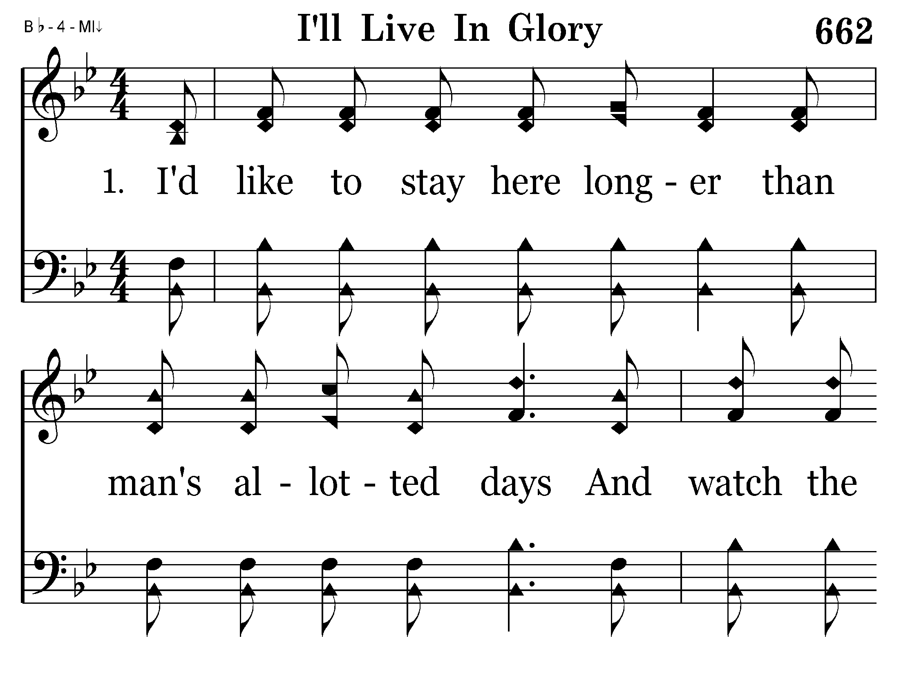
662 - I'll Live In Glory - 1.1

Slide 3
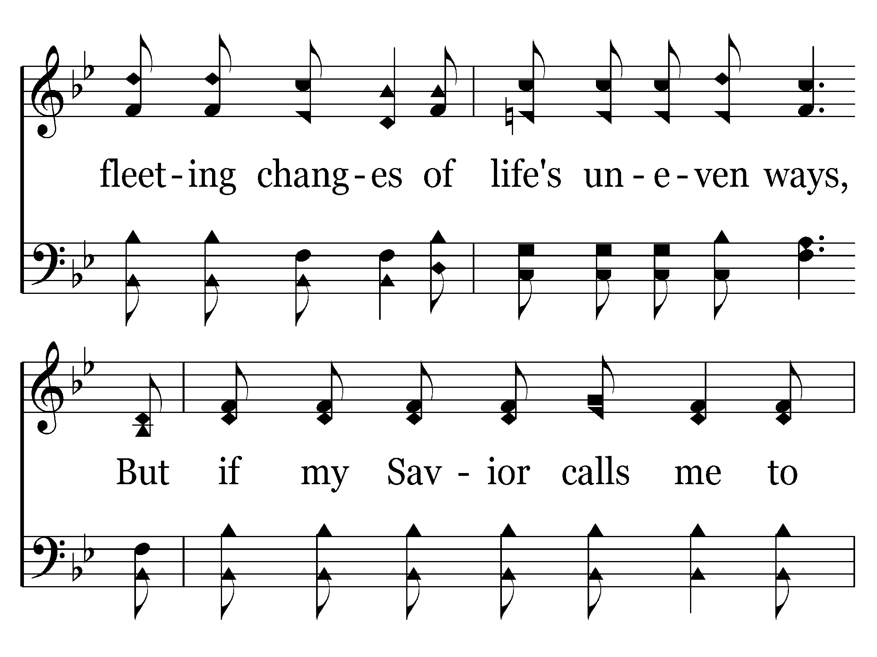
662 - I'll Live In Glory - 1.2

Slide 4
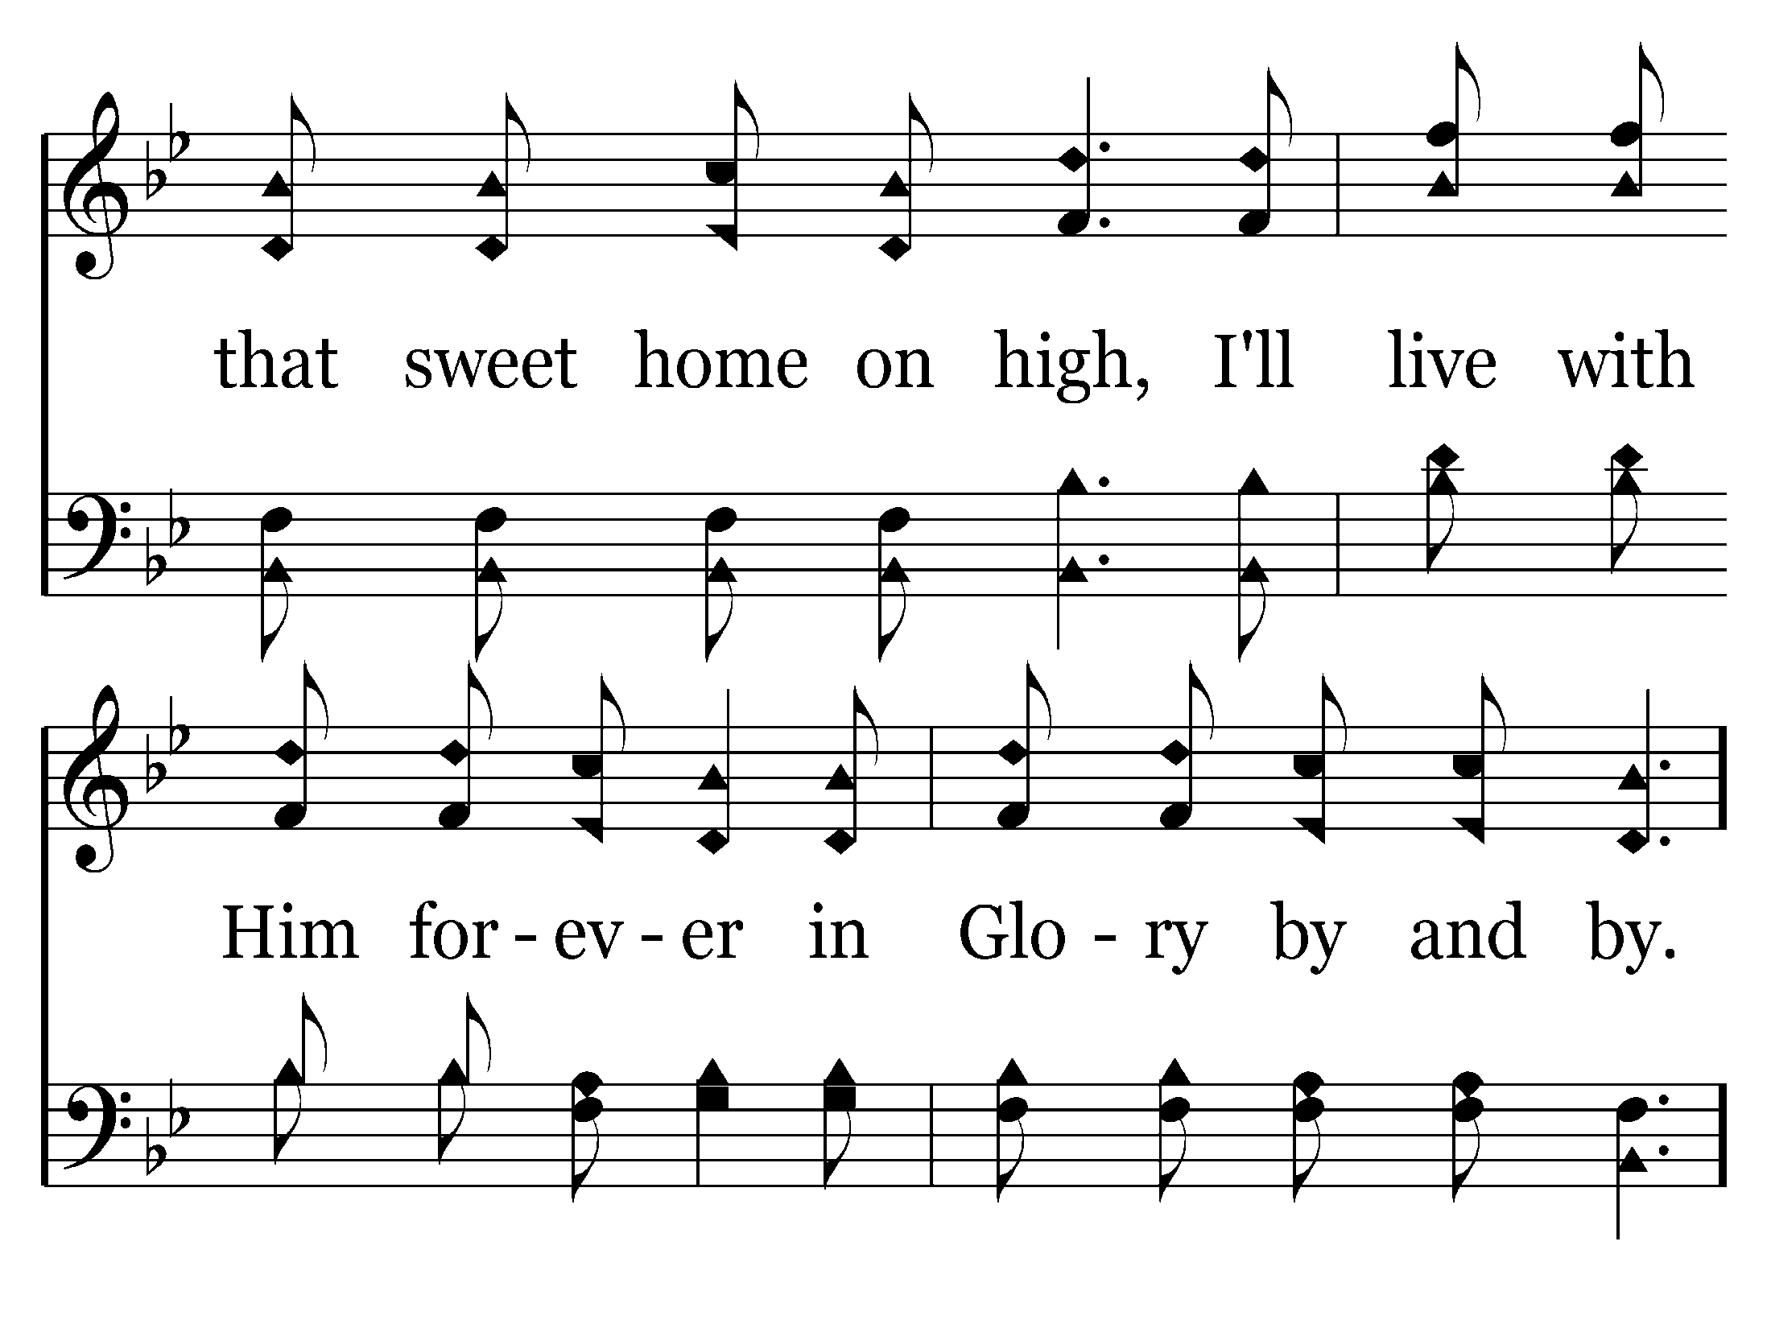
662 - I'll Live In Glory - 1.3

Slide 5
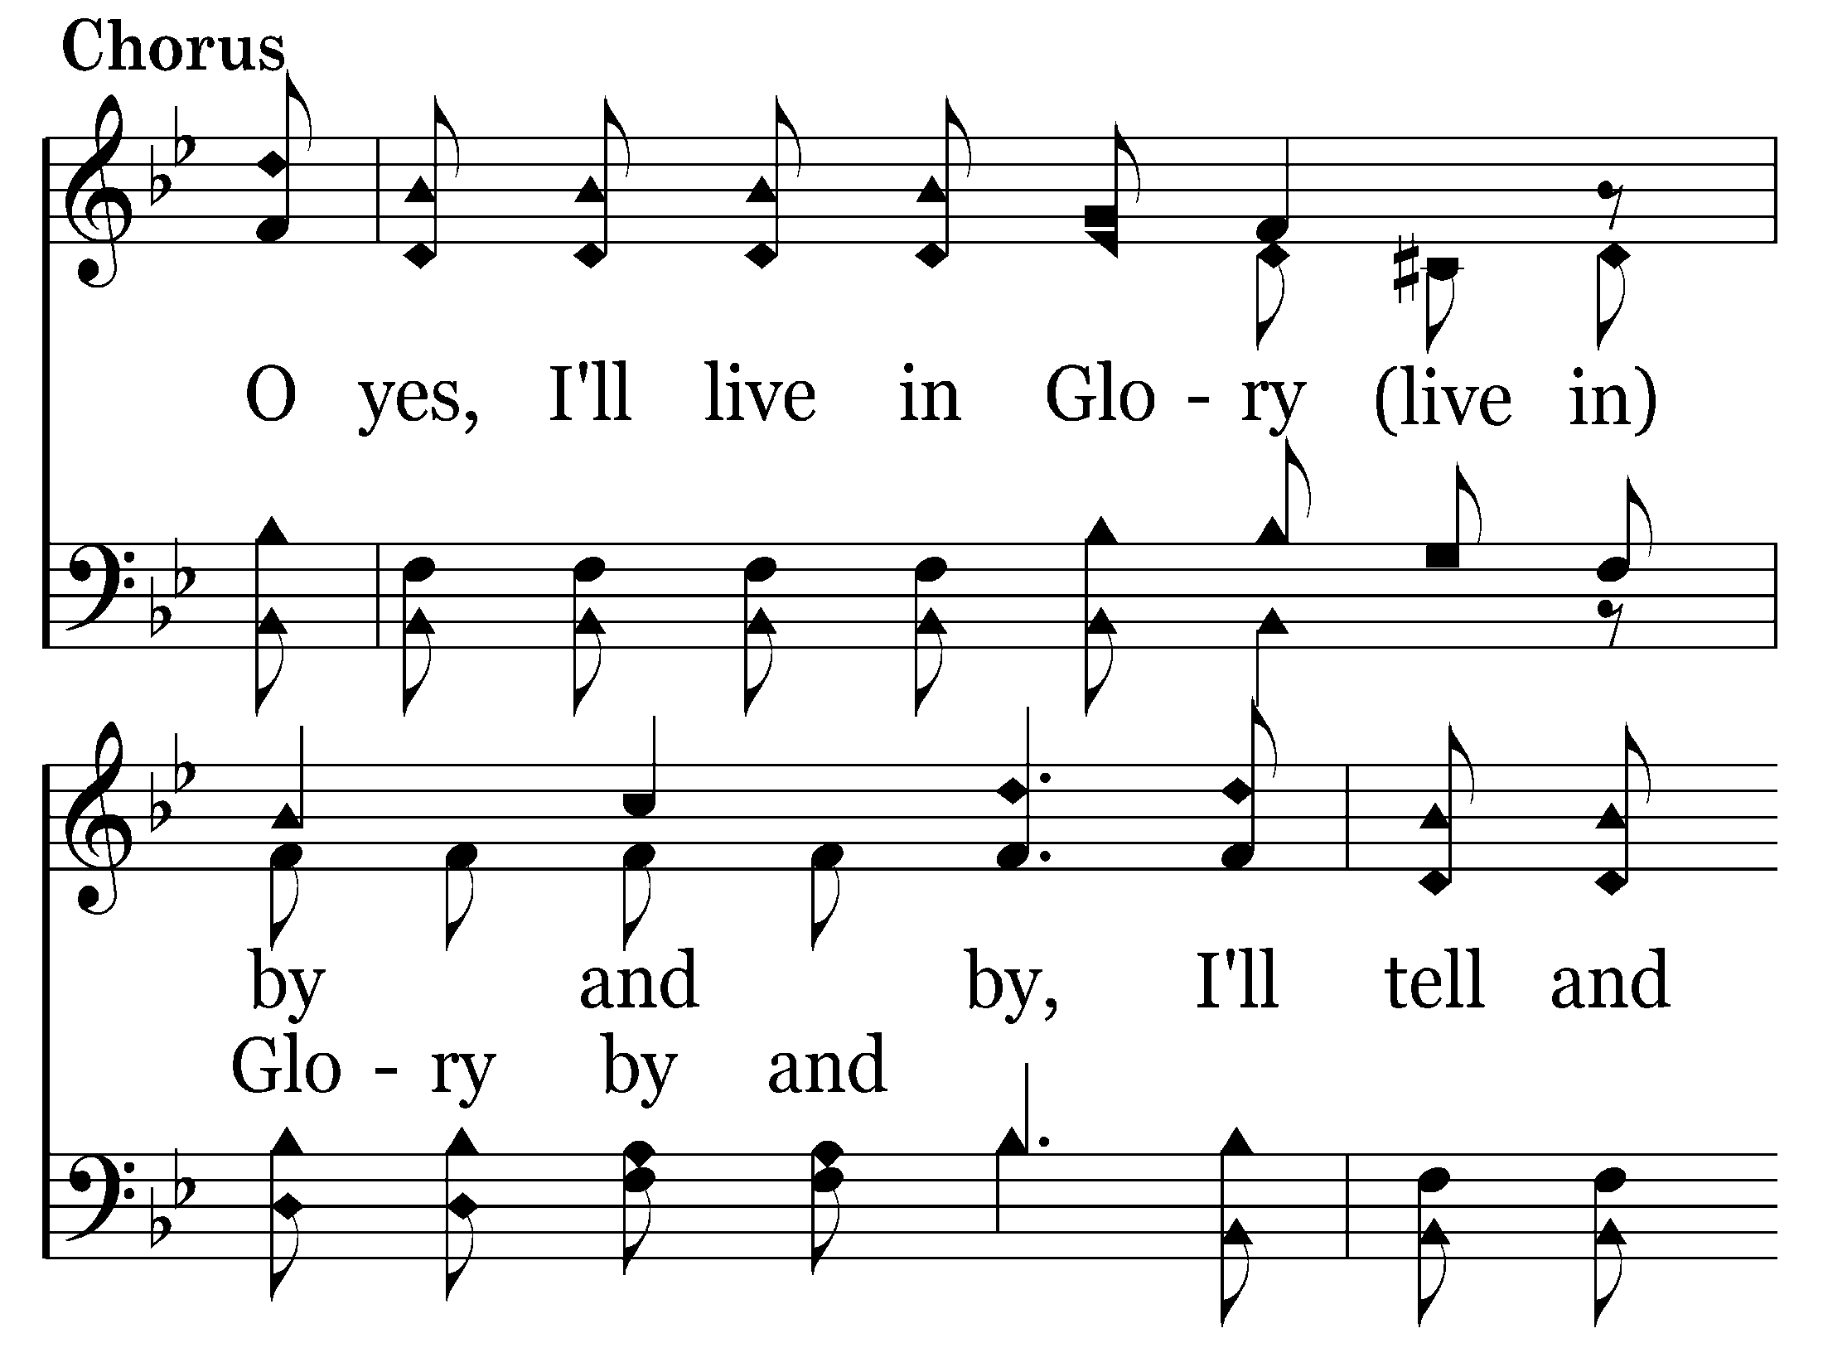
662 - I'll Live In Glory - C.1

Slide 6
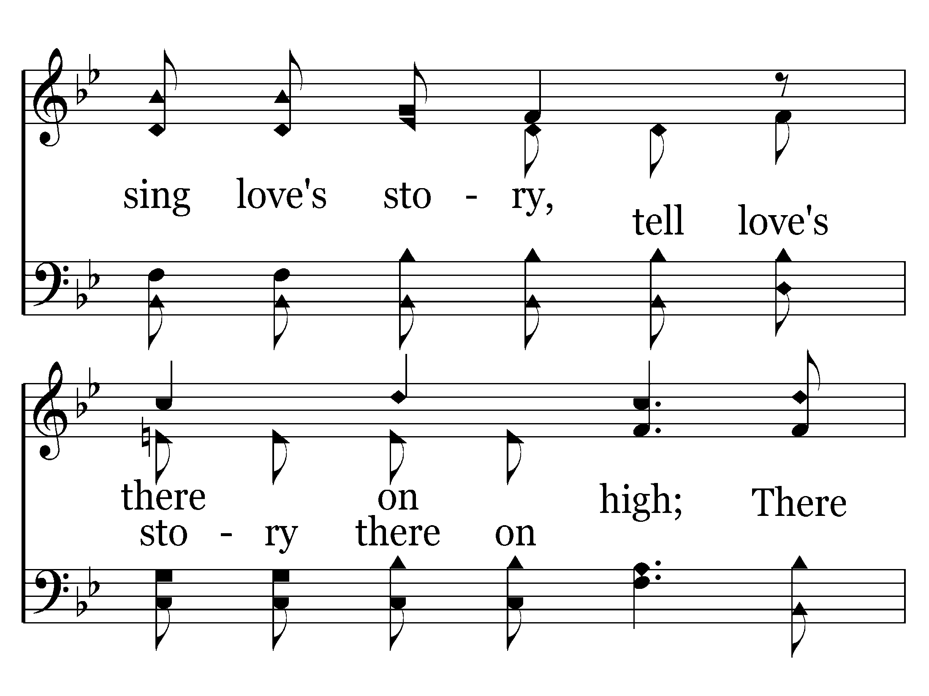
662 - I'll Live In Glory - C.2

Slide 7
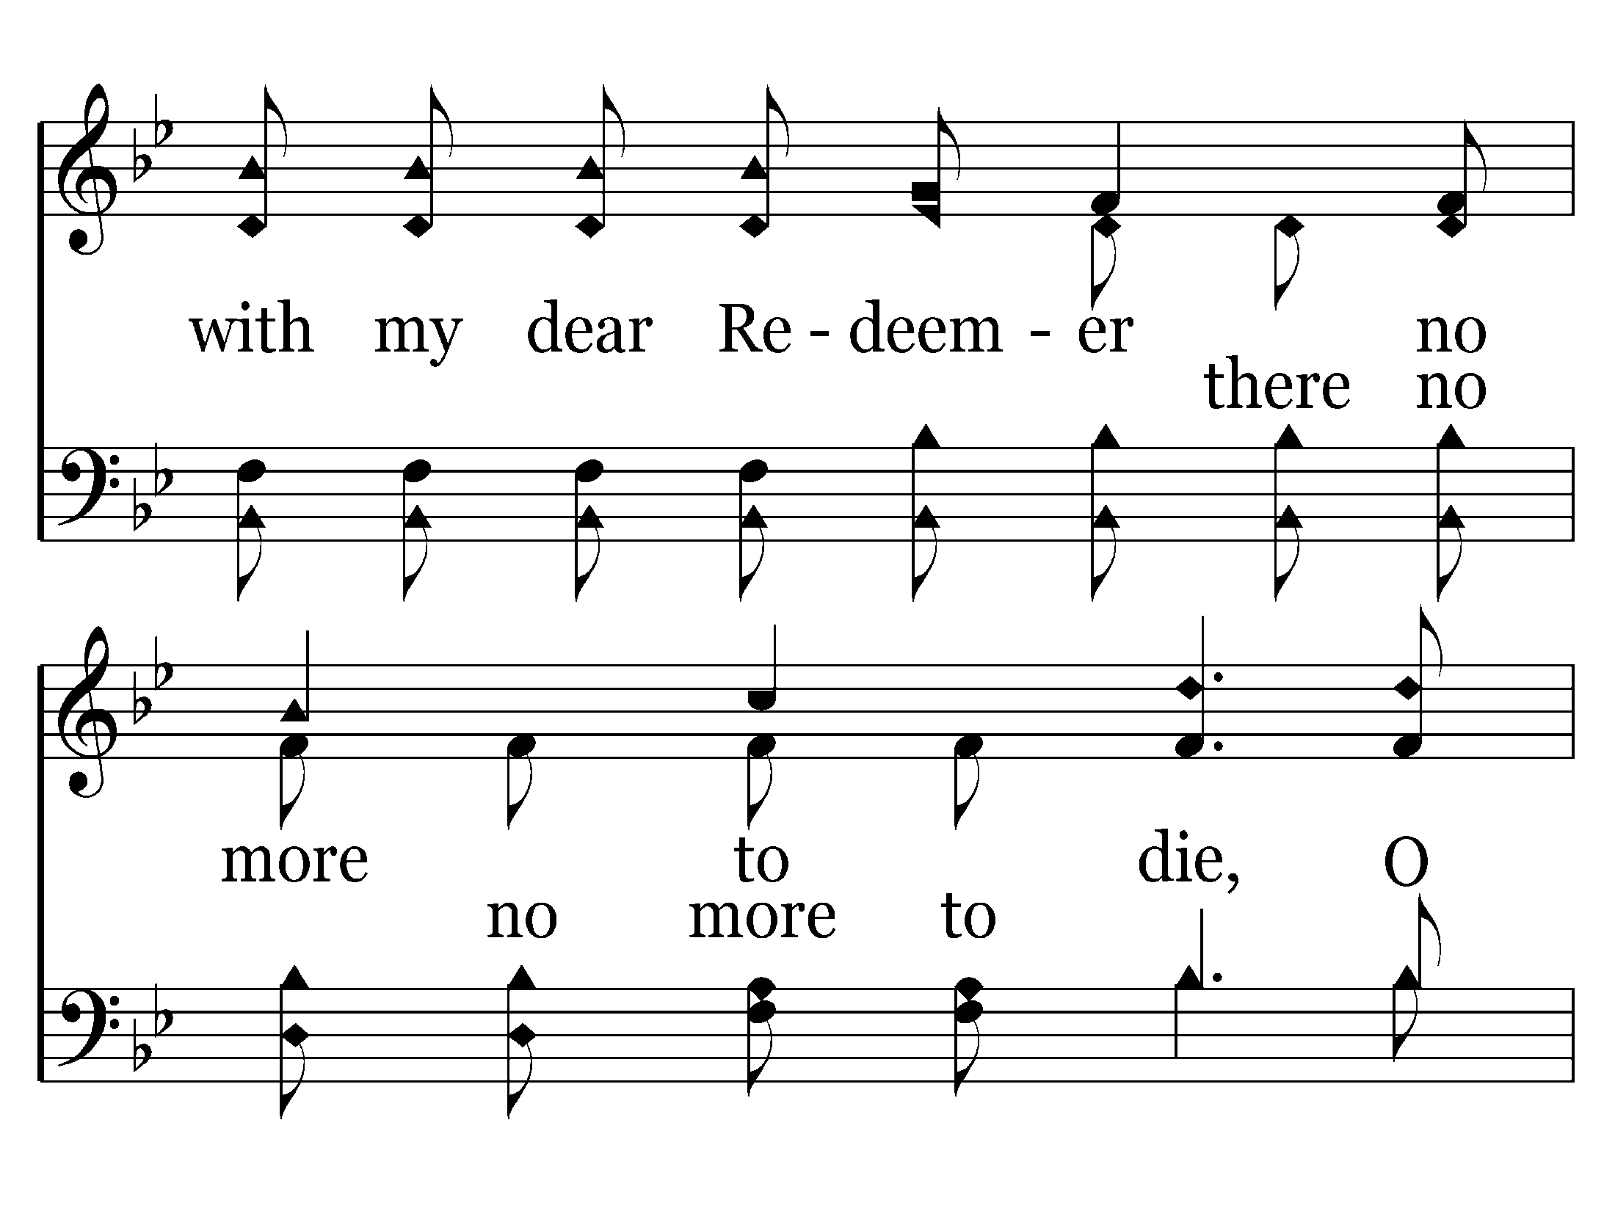
662 - I'll Live In Glory - C.3

Slide 8
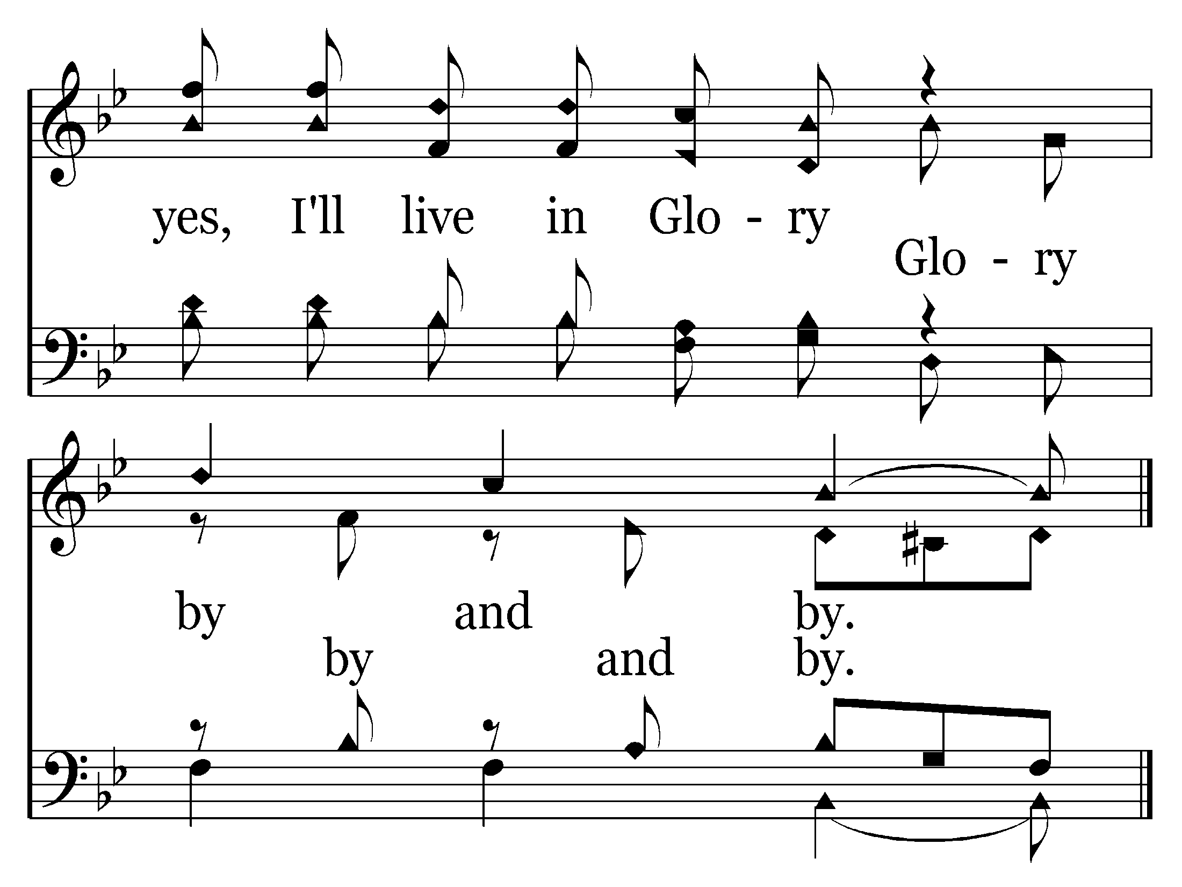
662 - I'll Live In Glory - C.4
End of Verse 1

Slide 9
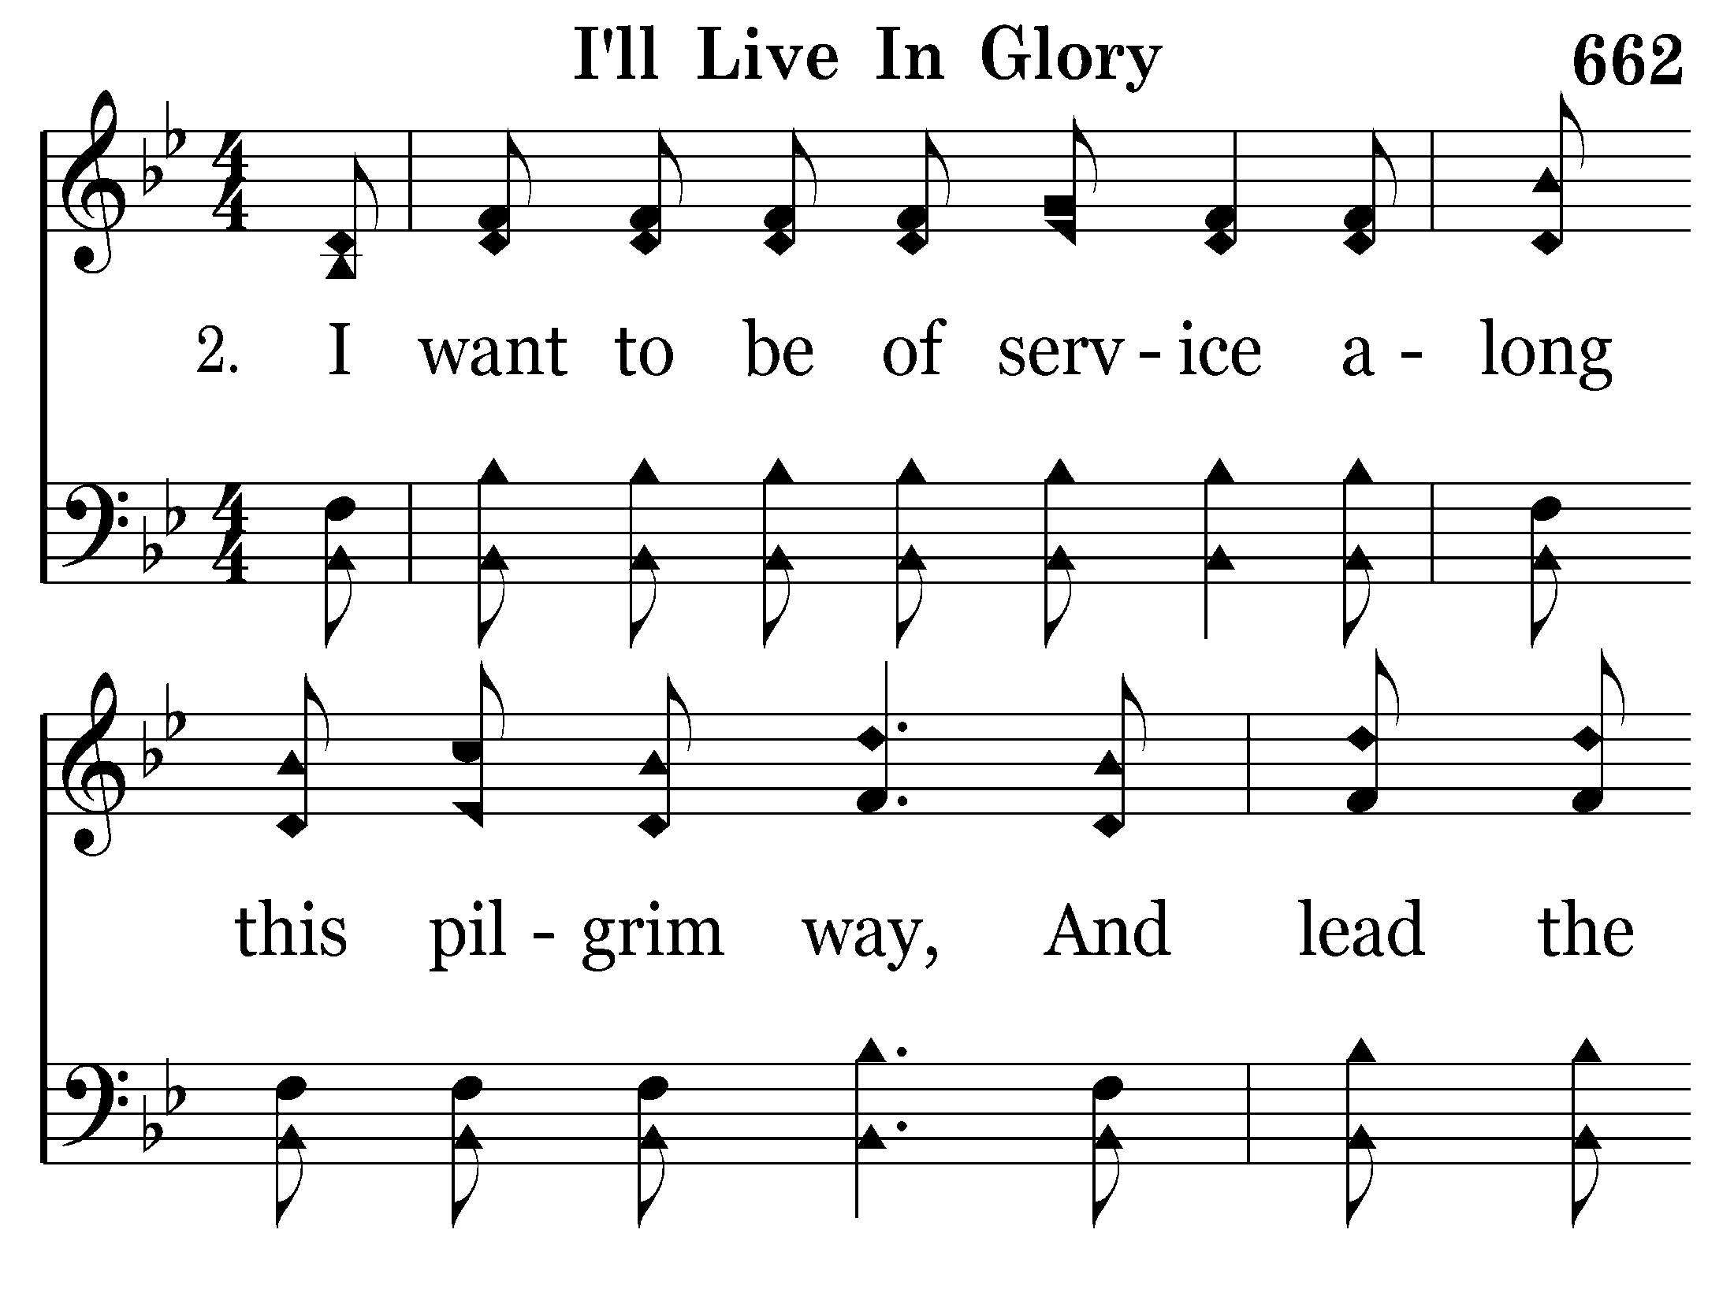
662 - I'll Live In Glory - 2.1

Slide 10
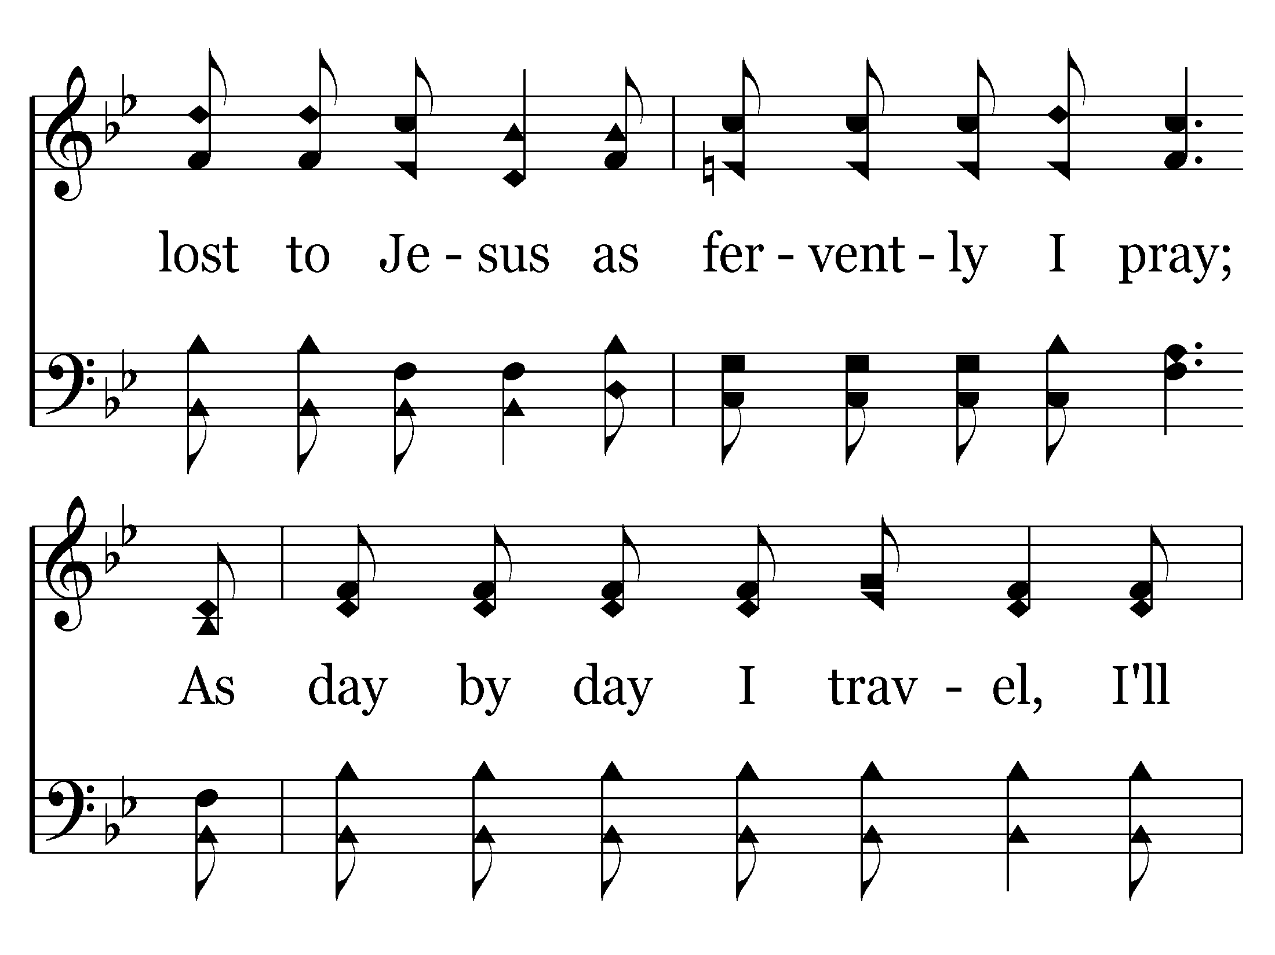
662 - I'll Live In Glory - 2.2

Slide 11
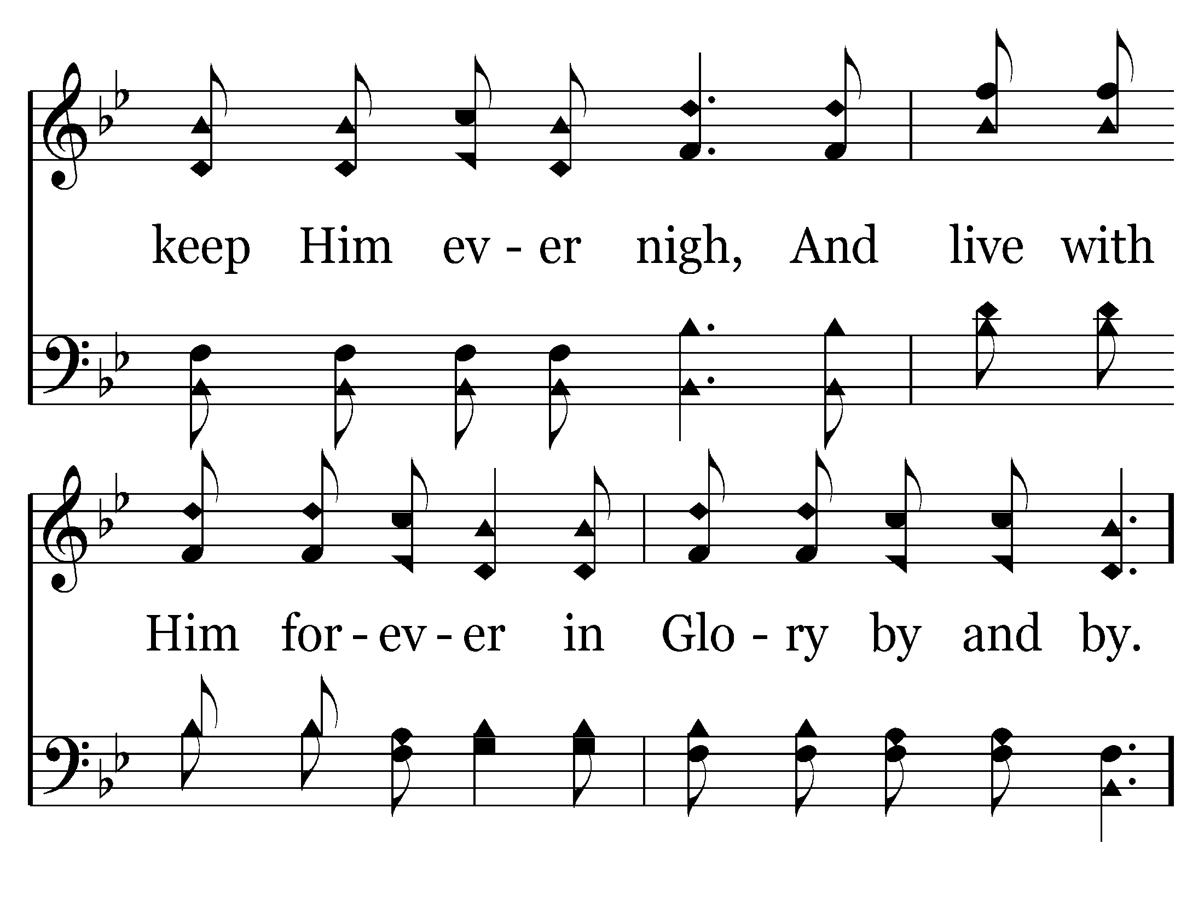
662 - I'll Live In Glory - 2.3

Slide 12
662 - I'll Live In Glory - C.1

Slide 13
662 - I'll Live In Glory - C.2

Slide 14
662 - I'll Live In Glory - C.3

Slide 15
662 - I'll Live In Glory - C.4
End of Verse 2

Slide 16
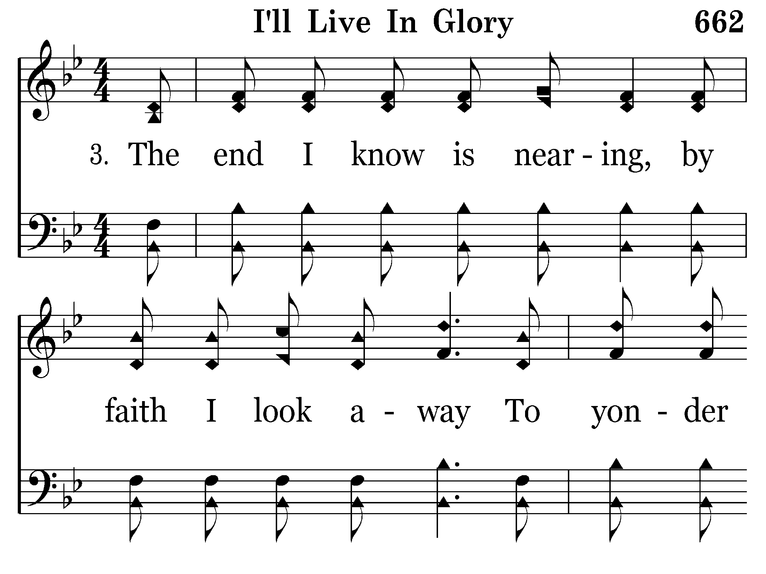
662 - I'll Live In Glory - 3.1

Slide 17
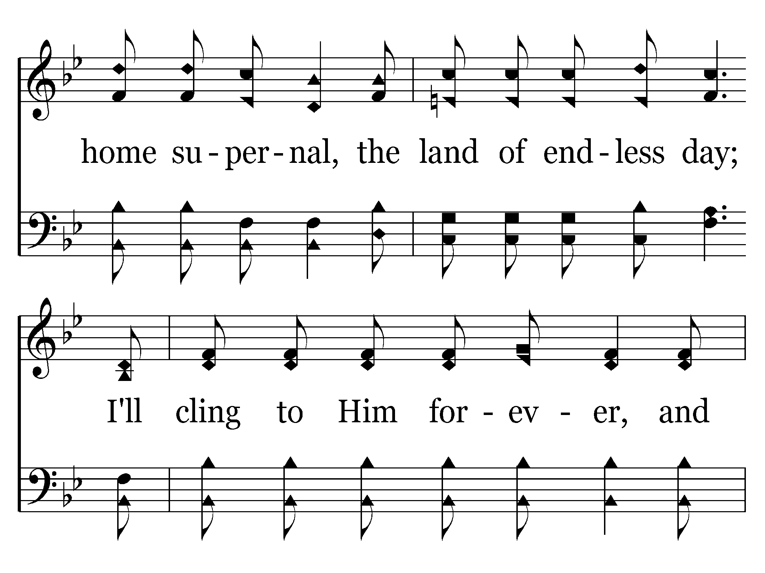
662 - I'll Live In Glory - 3.2

Slide 18
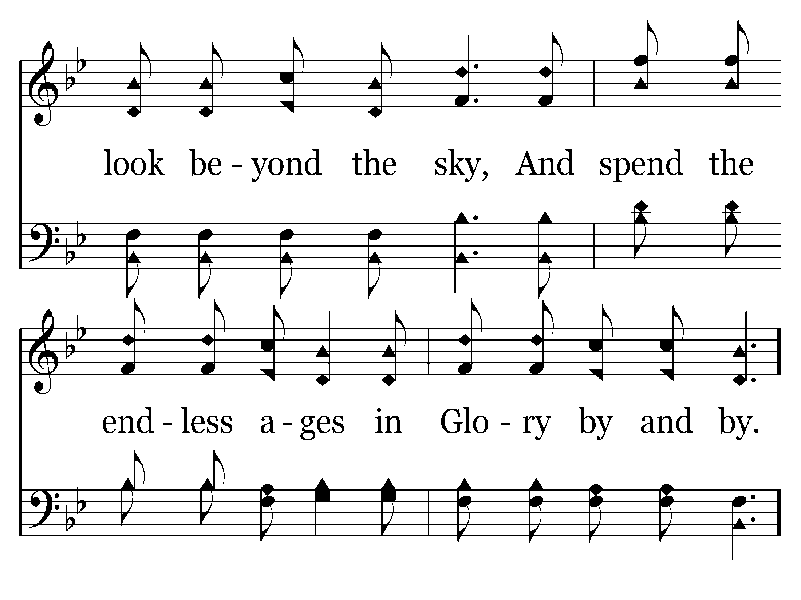
662 - I'll Live In Glory - 3.3

Slide 19
662 - I'll Live In Glory - C.1

Slide 20
662 - I'll Live In Glory - C.2

Slide 21
662 - I'll Live In Glory - C.3

Slide 22
662 - I'll Live In Glory - C.4
End of Song

Slide 23
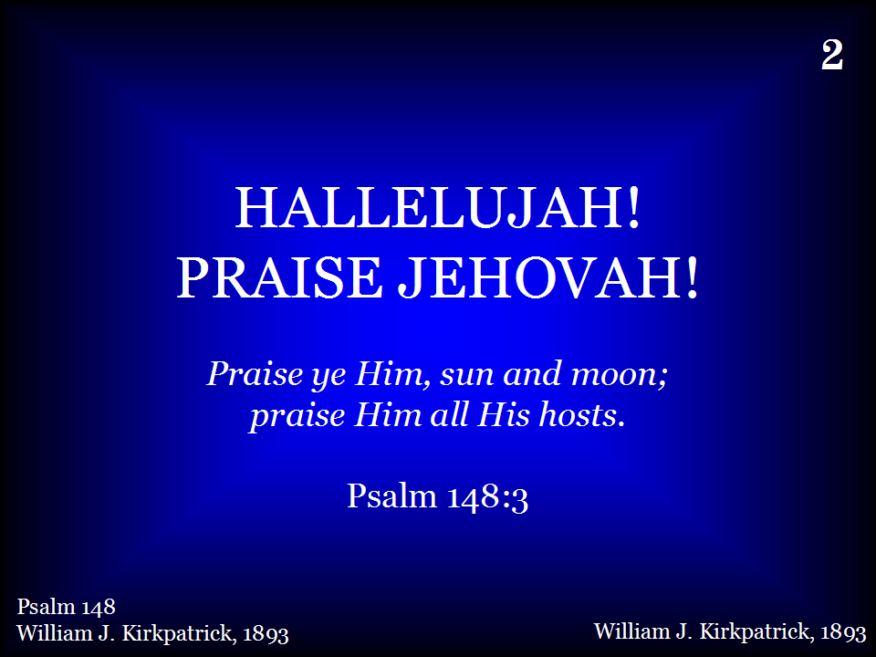
002 - Hallelujah! Praise Jehovah - Title

Slide 24
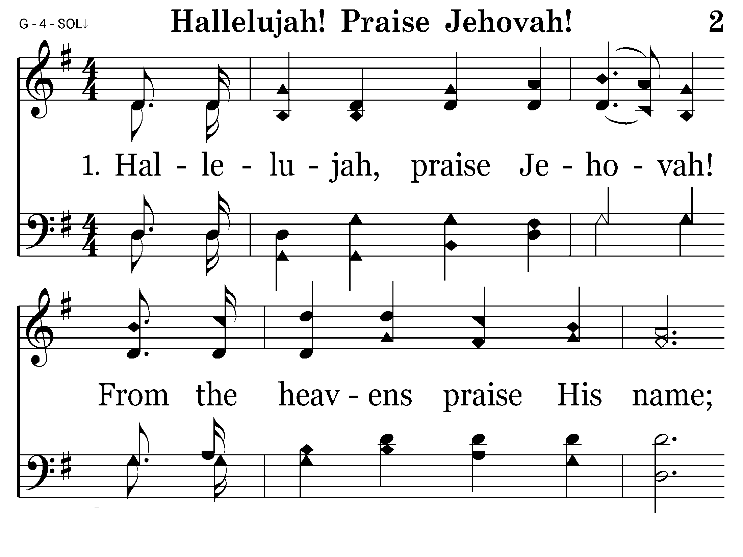
002 - Hallelujah! Praise Jehovah - 1.1

Slide 25
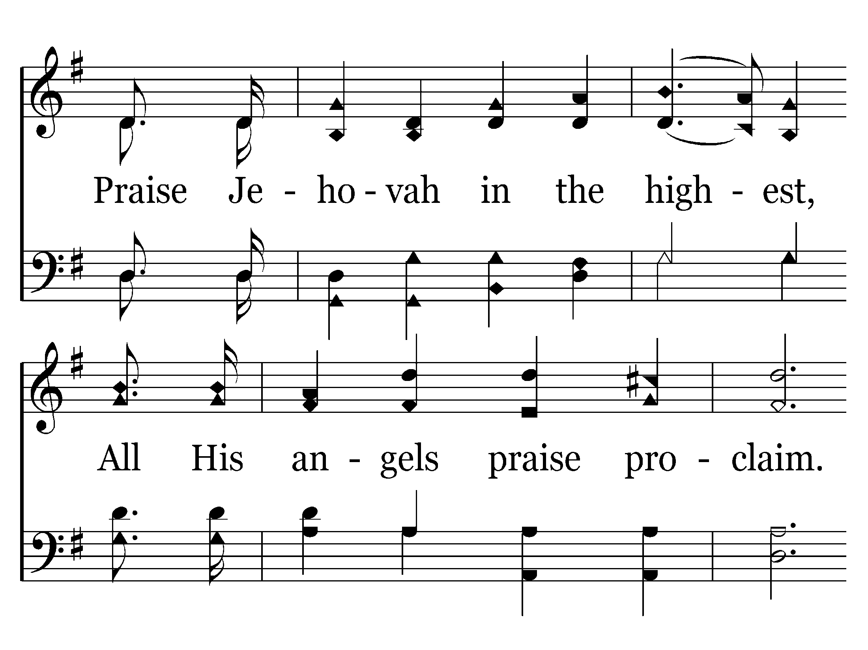
002 - Hallelujah! Praise Jehovah - 1.2

Slide 26
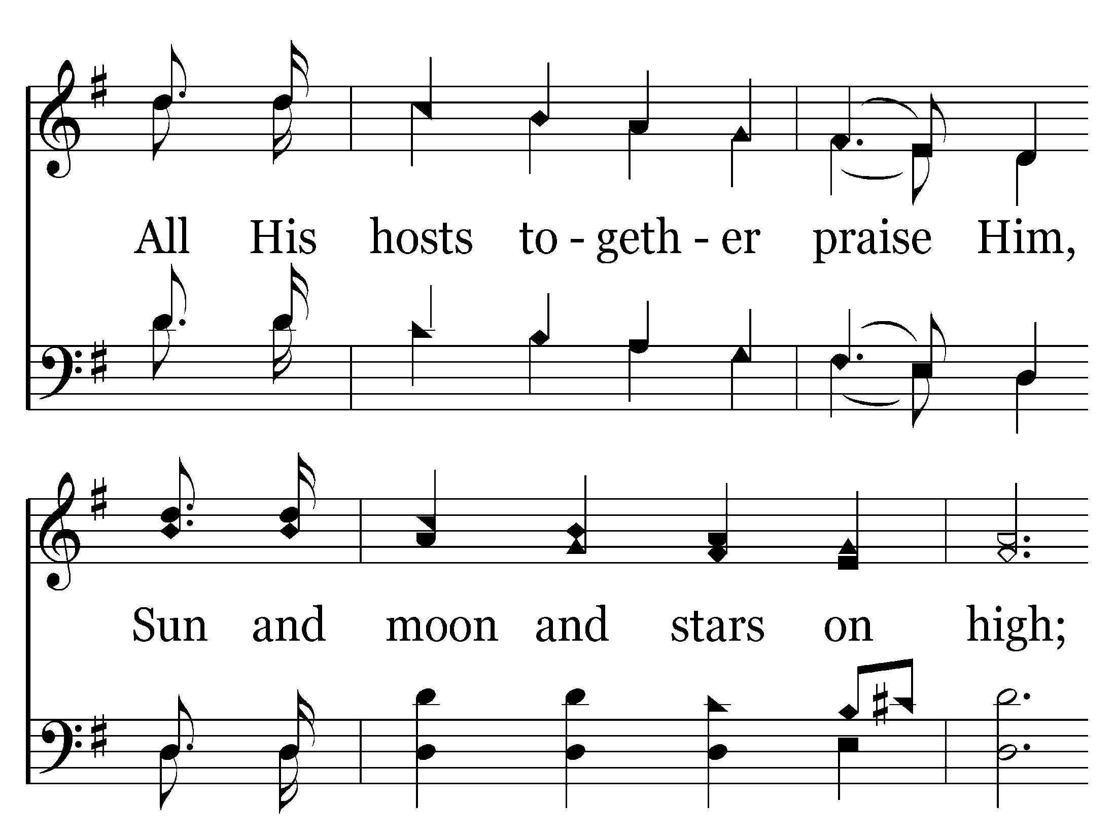
002 - Hallelujah! Praise Jehovah - 1.3

Slide 27
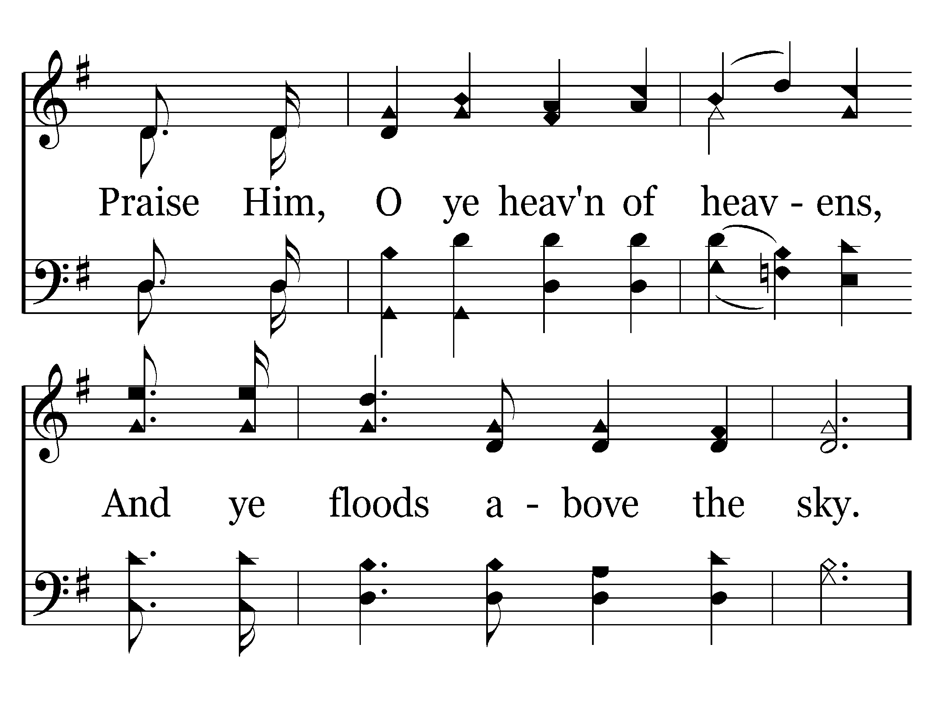
002 - Hallelujah! Praise Jehovah - 1.4

Slide 28
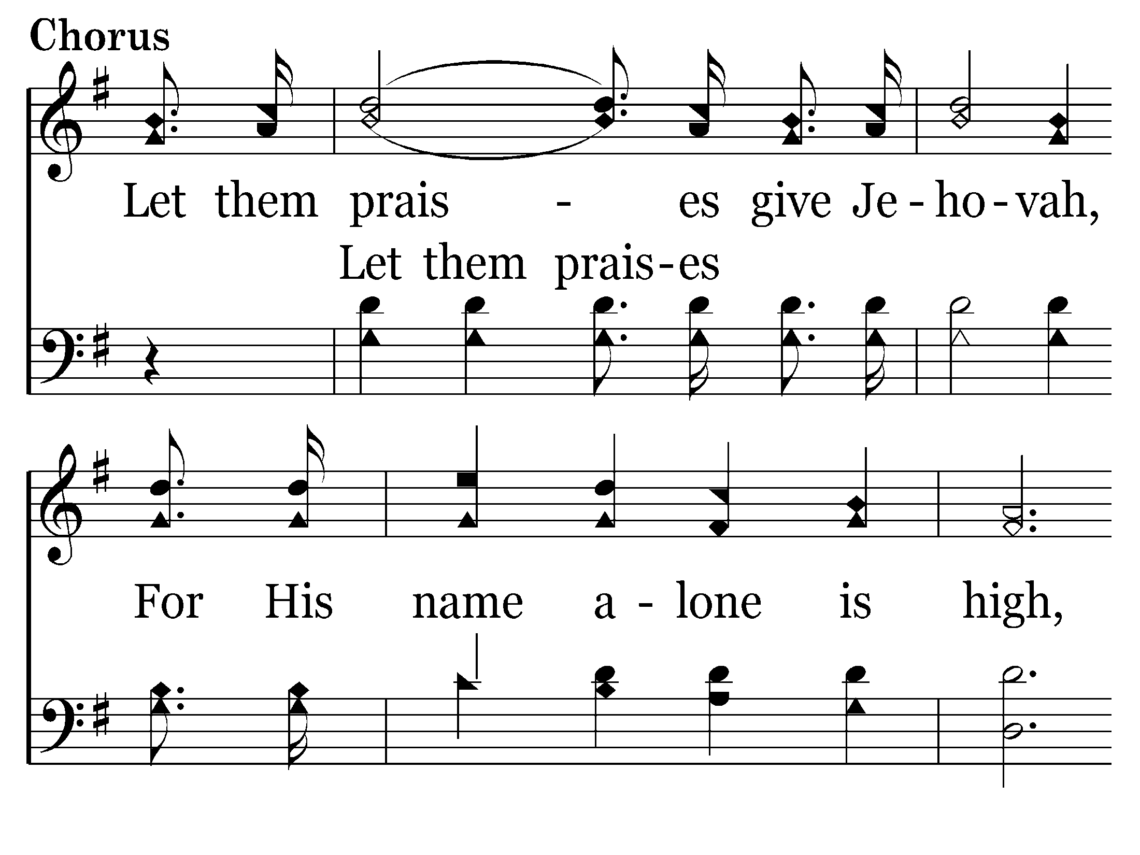
002 - Hallelujah! Praise Jehovah - C.1

Slide 29
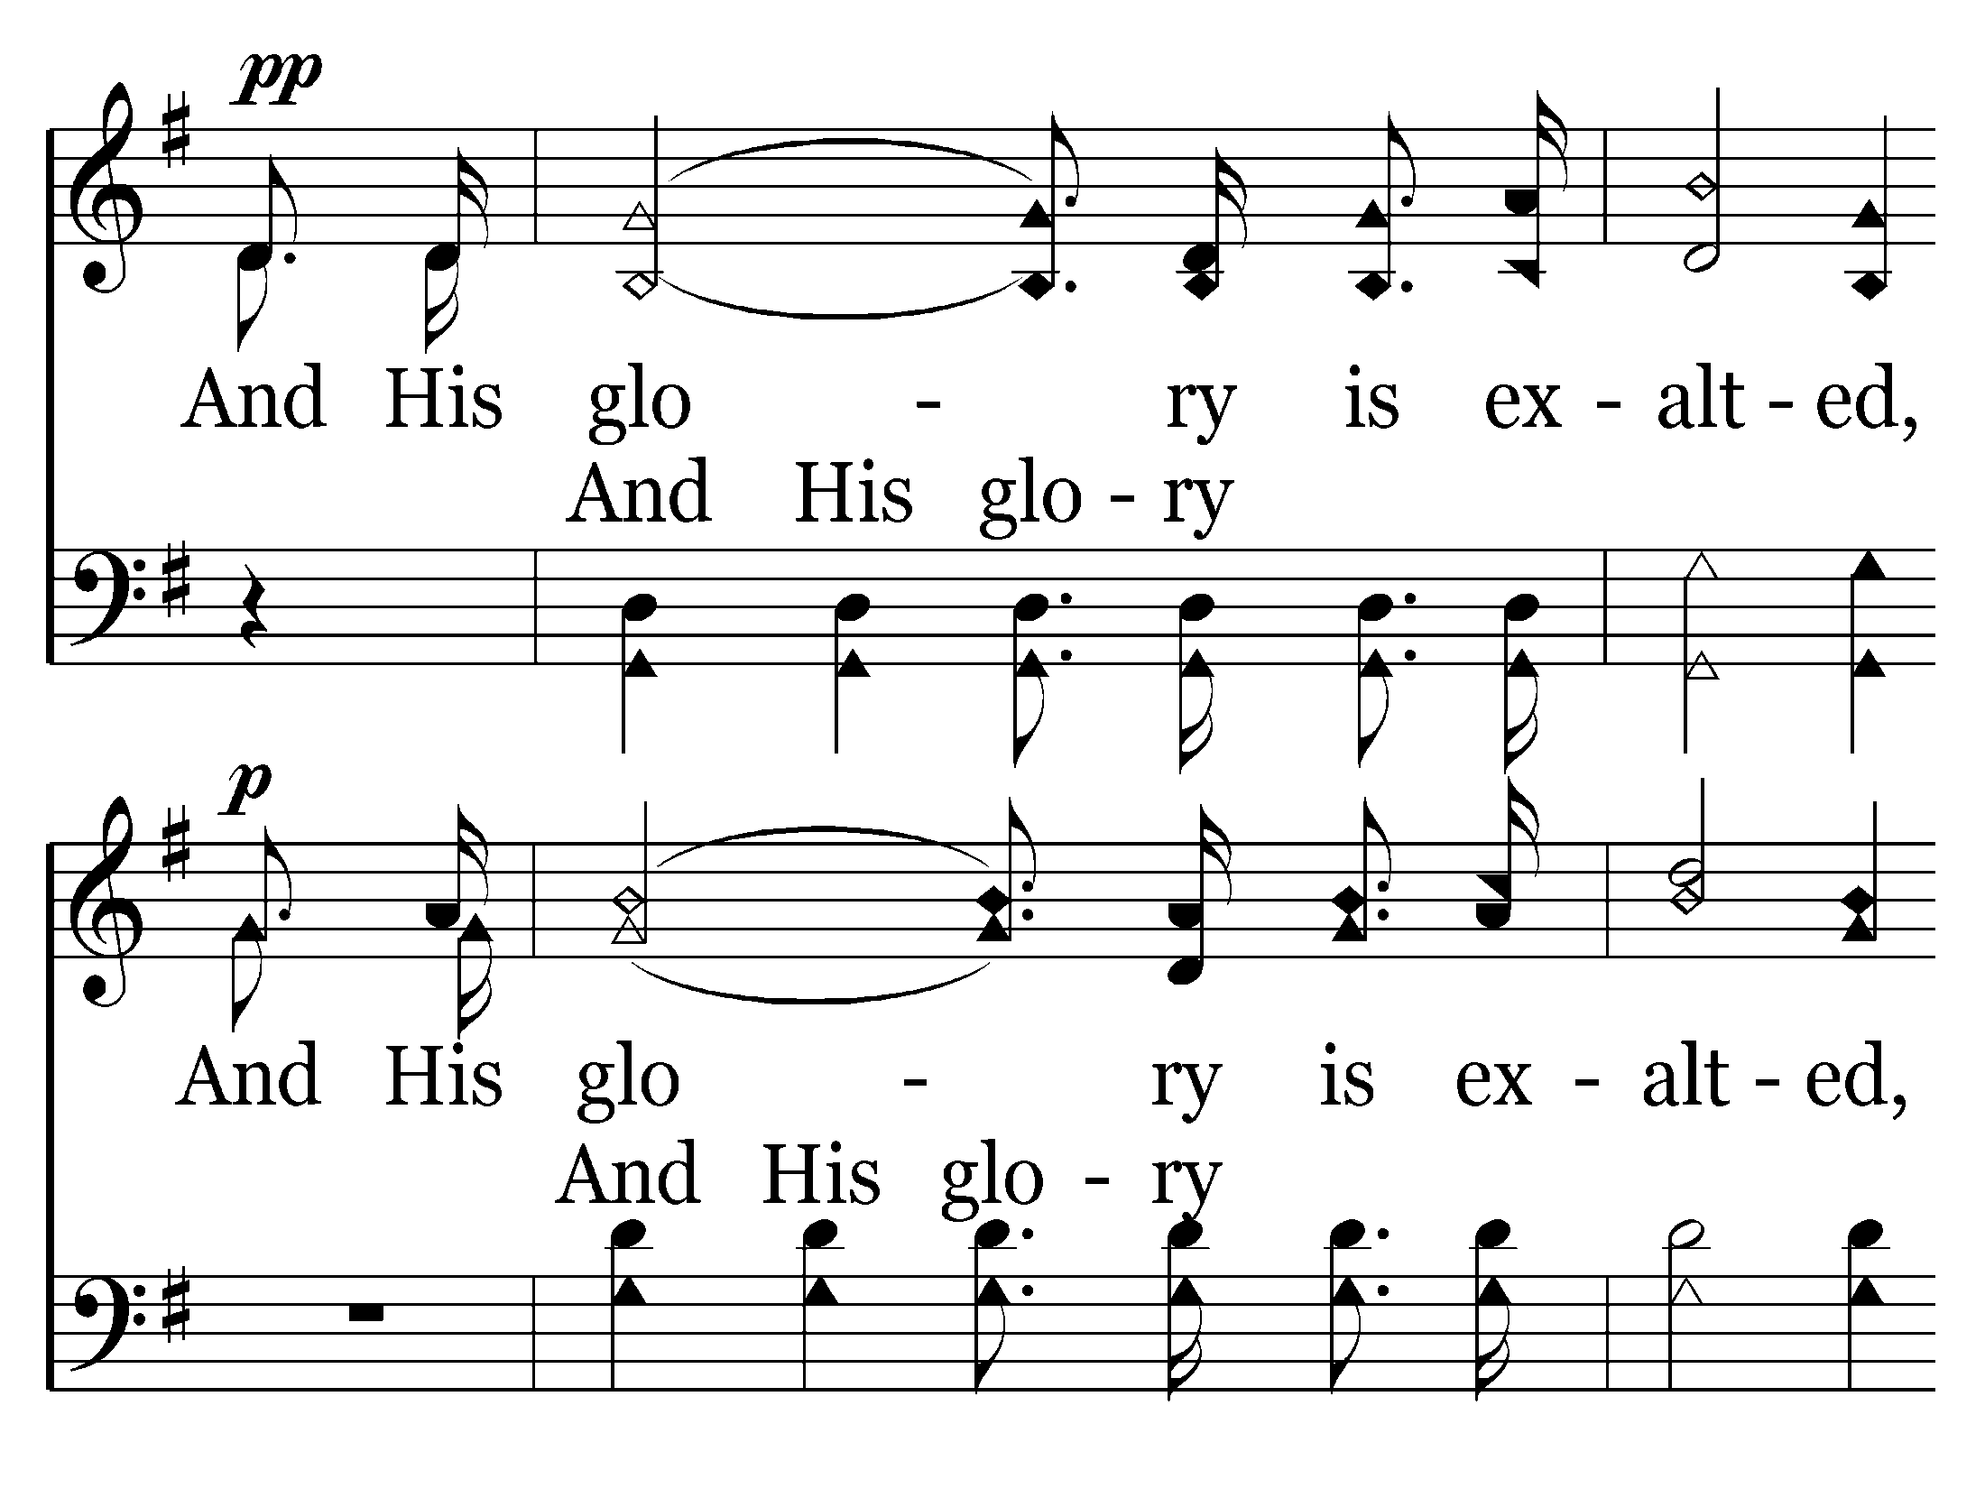
002 - Hallelujah! Praise Jehovah - C.2

Slide 30
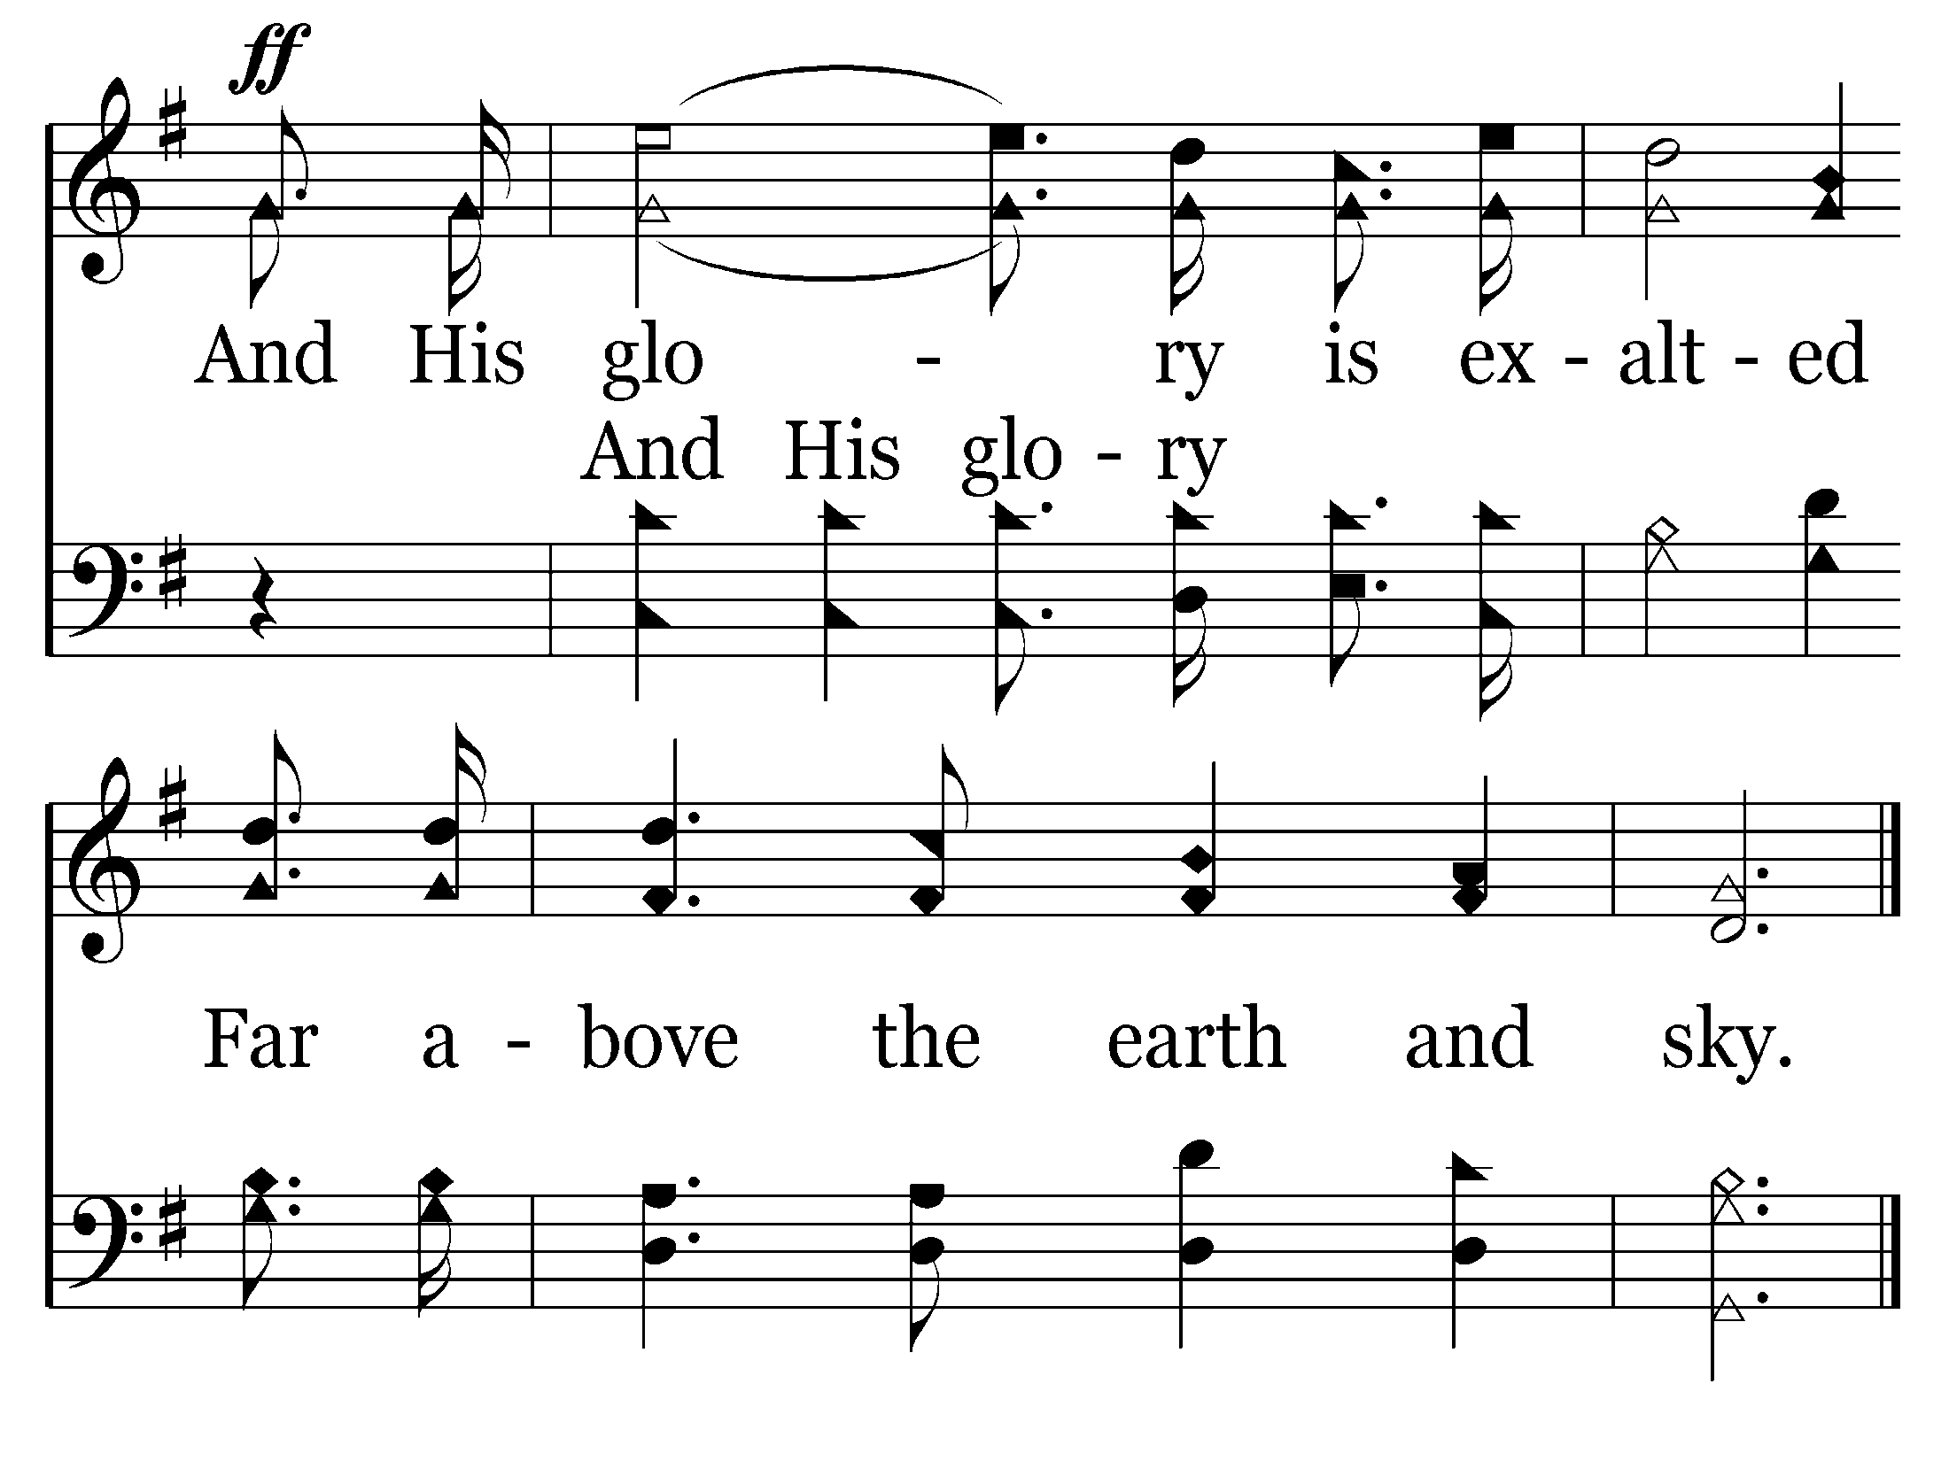
002 - Hallelujah! Praise Jehovah - C.3
End of Verse 1

Slide 31
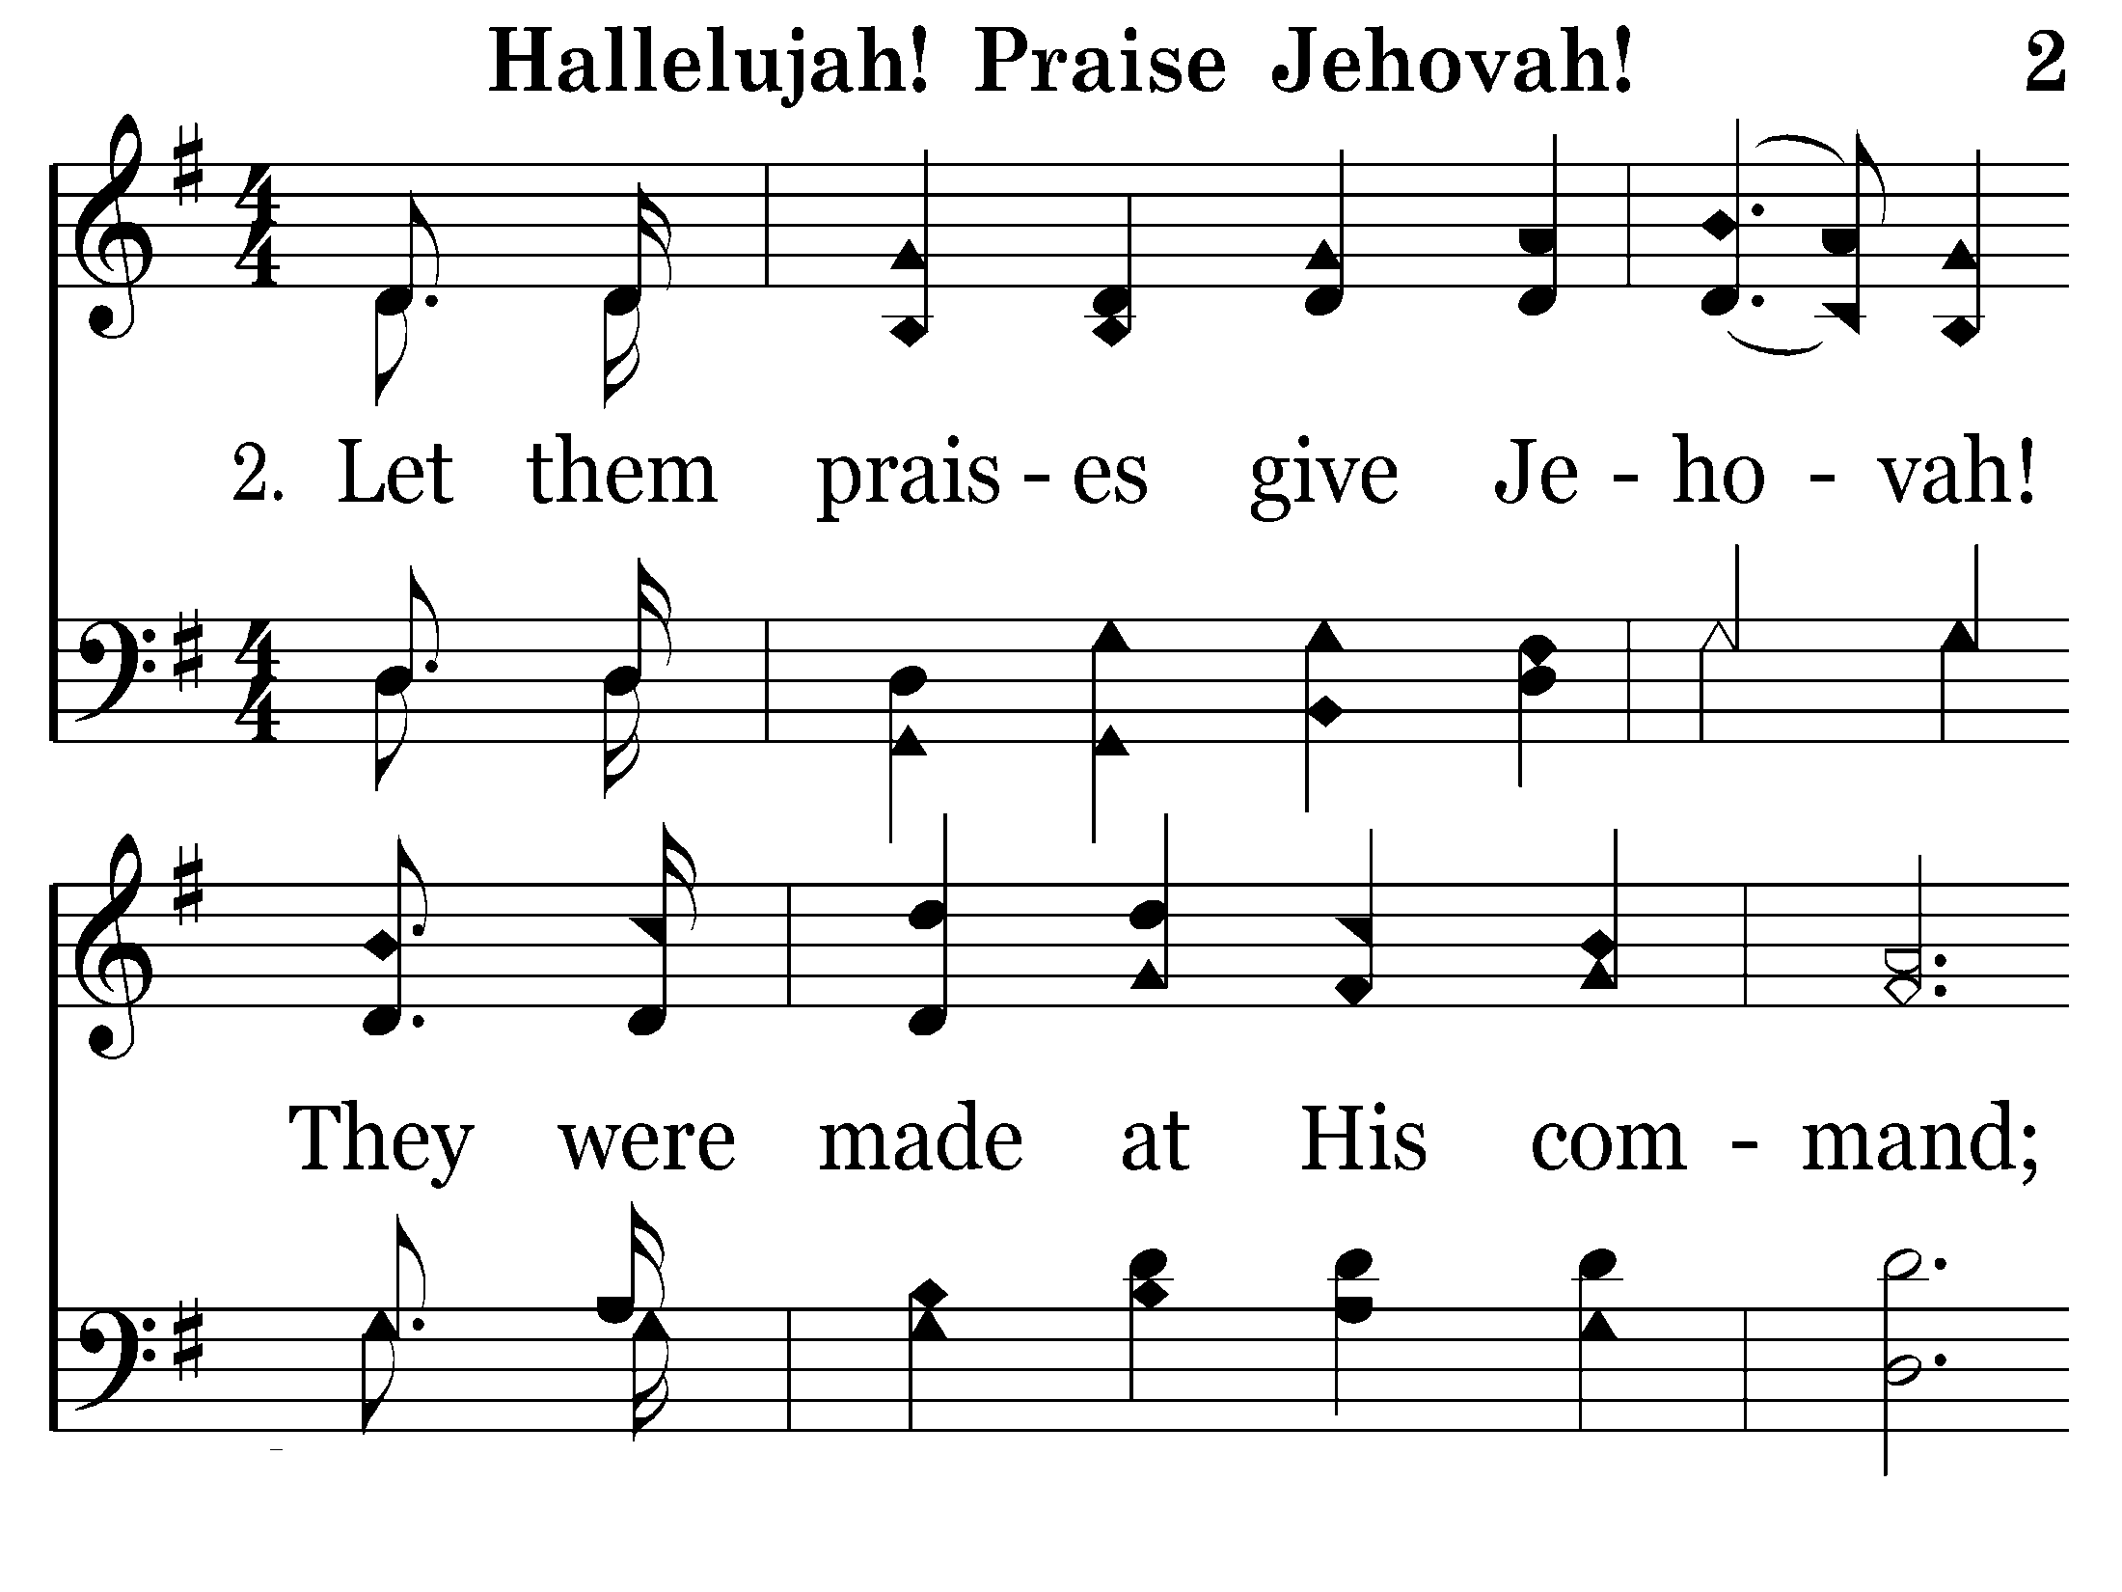
002 - Hallelujah! Praise Jehovah - 2.1

Slide 32
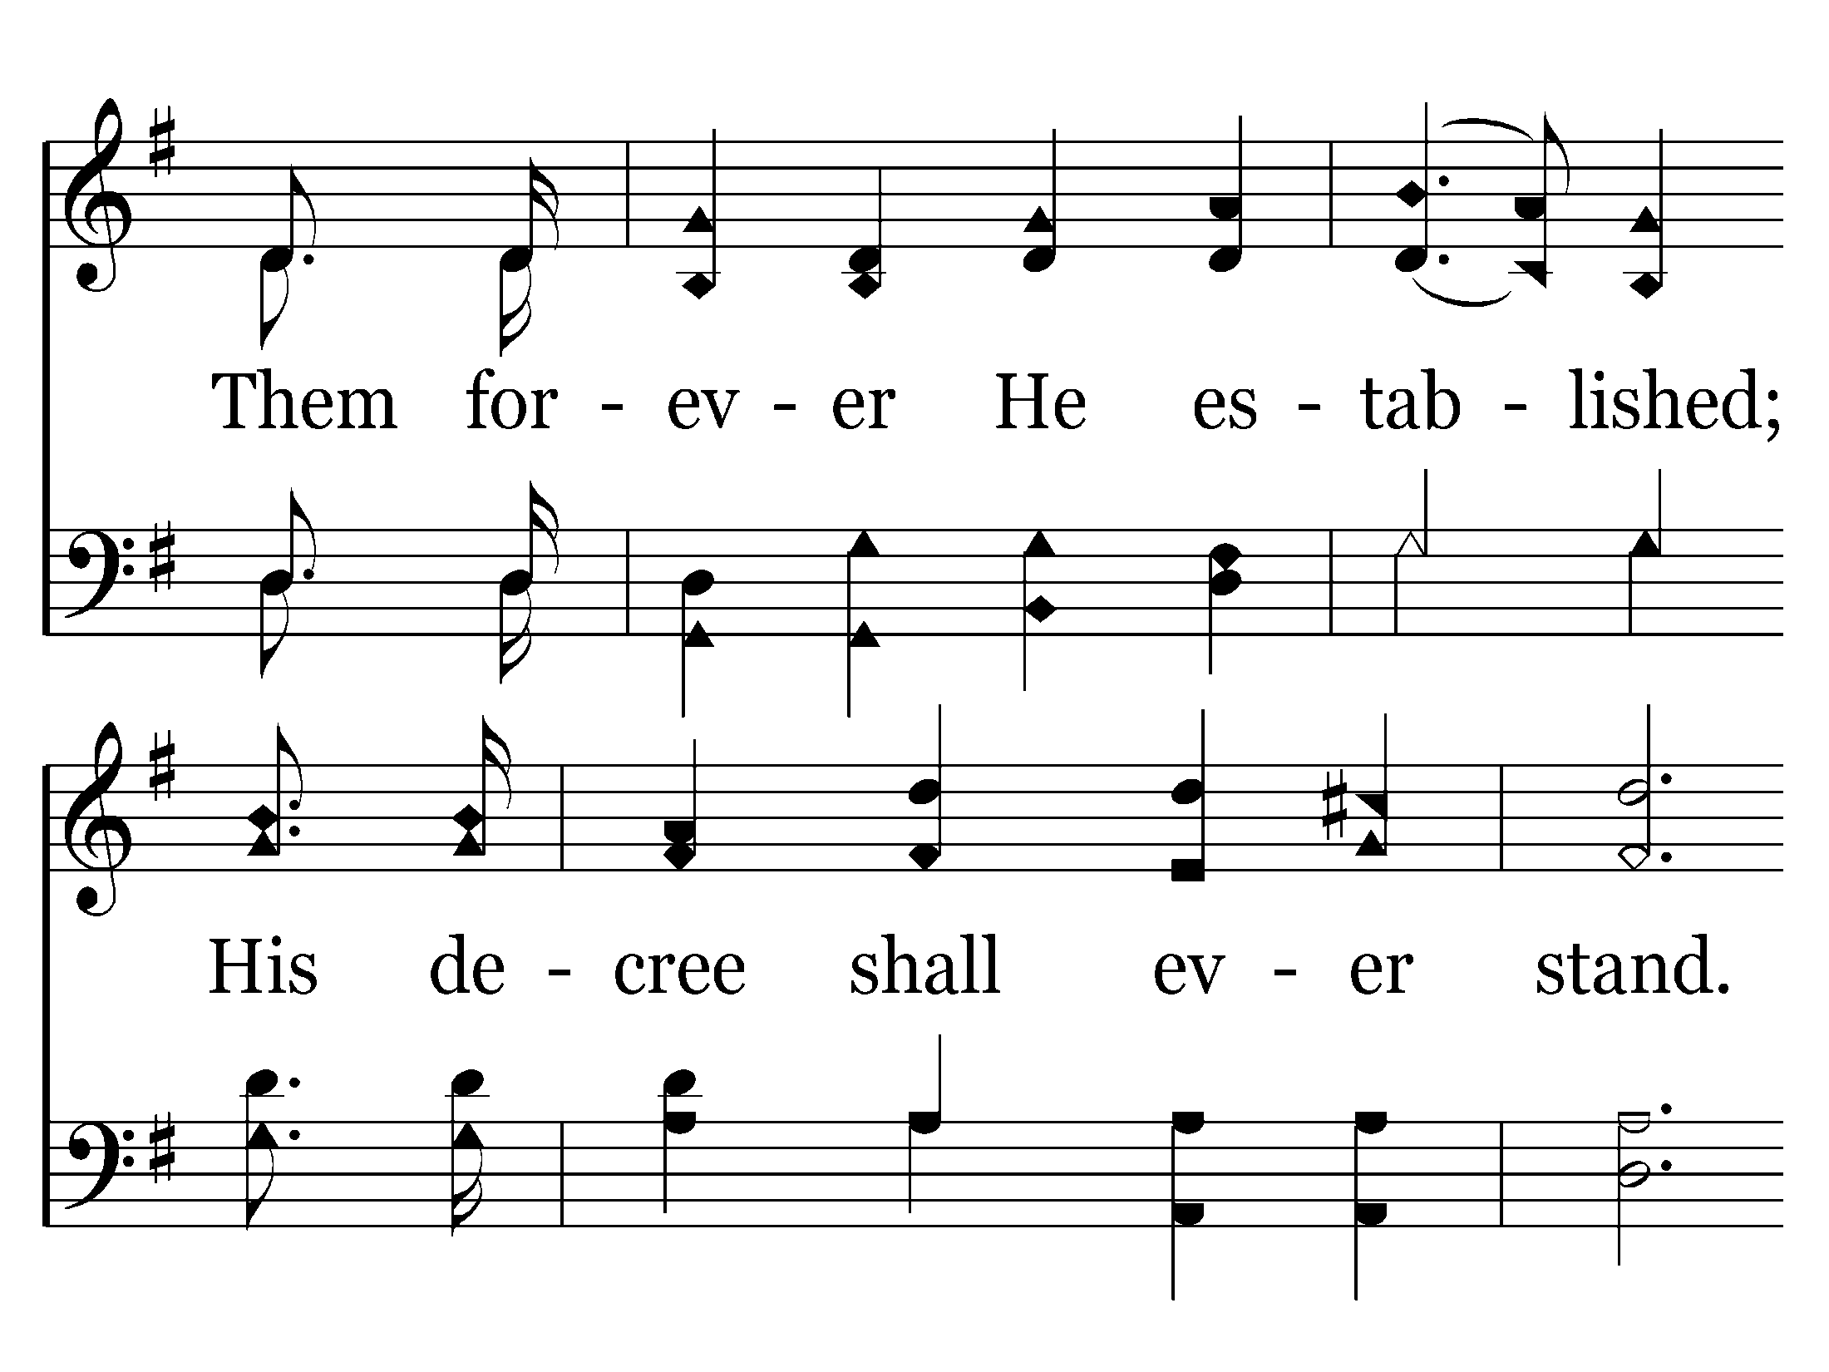
002 - Hallelujah! Praise Jehovah - 2.2

Slide 33
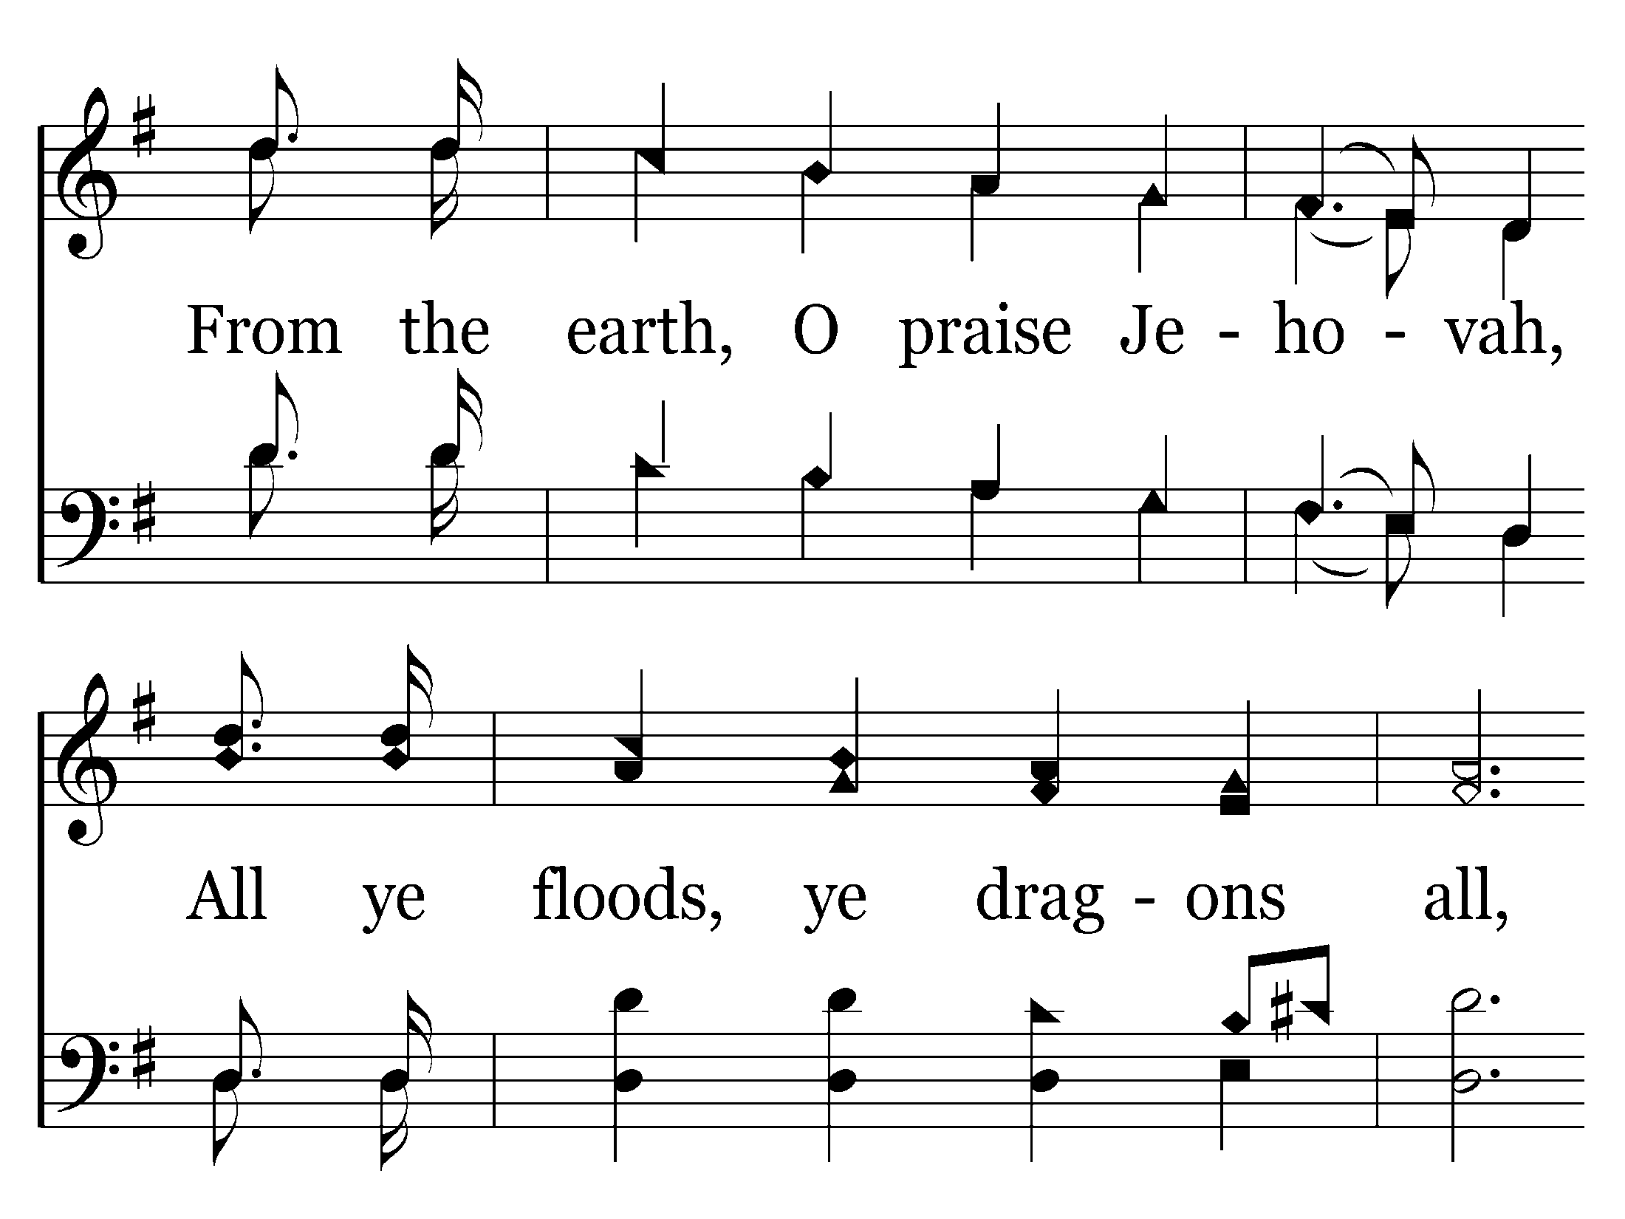
002 - Hallelujah! Praise Jehovah - 2.3

Slide 34
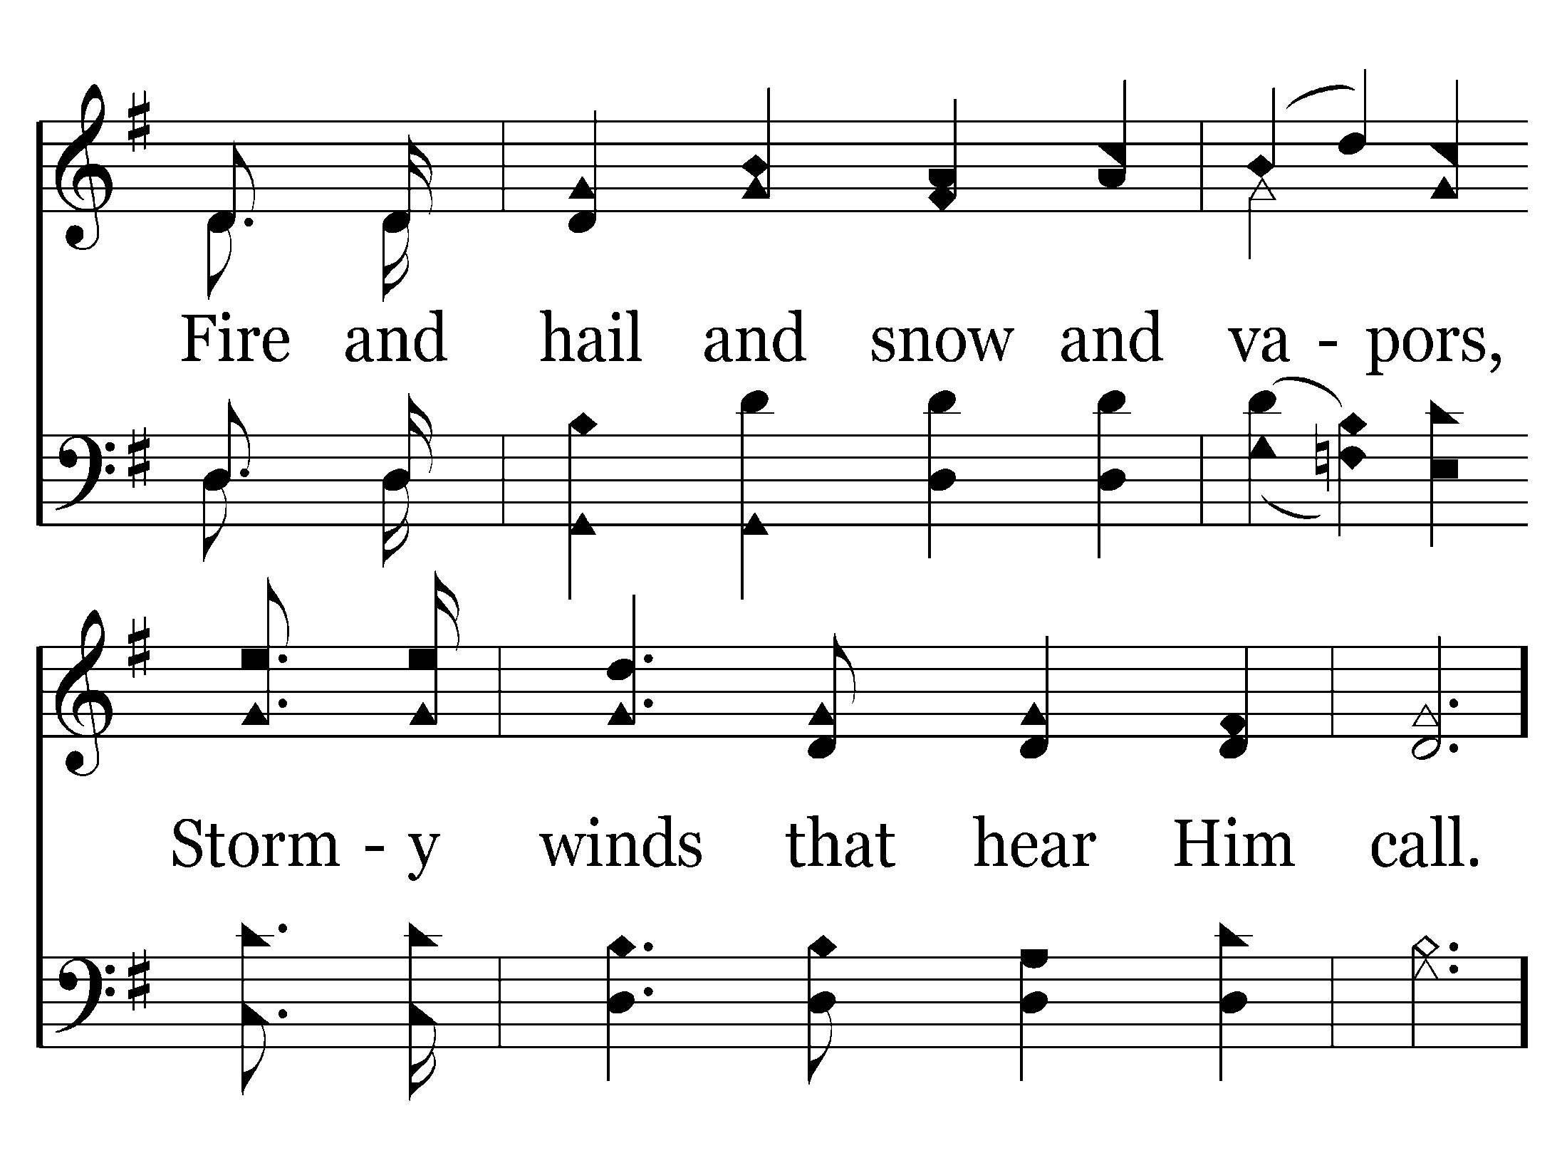
002 - Hallelujah! Praise Jehovah - 2.4

Slide 35
002 - Hallelujah! Praise Jehovah - C.1

Slide 36
002 - Hallelujah! Praise Jehovah - C.2

Slide 37
002 - Hallelujah! Praise Jehovah - C.3
End of Verse 2

Slide 38
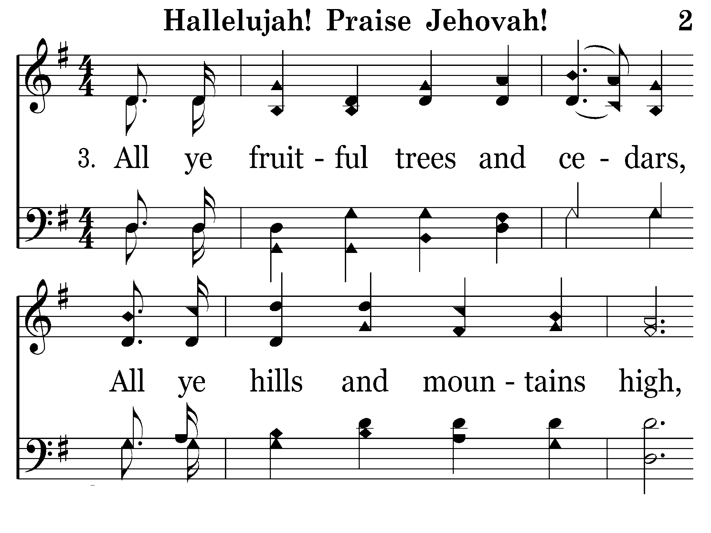
002 - Hallelujah! Praise Jehovah - 3.1

Slide 39
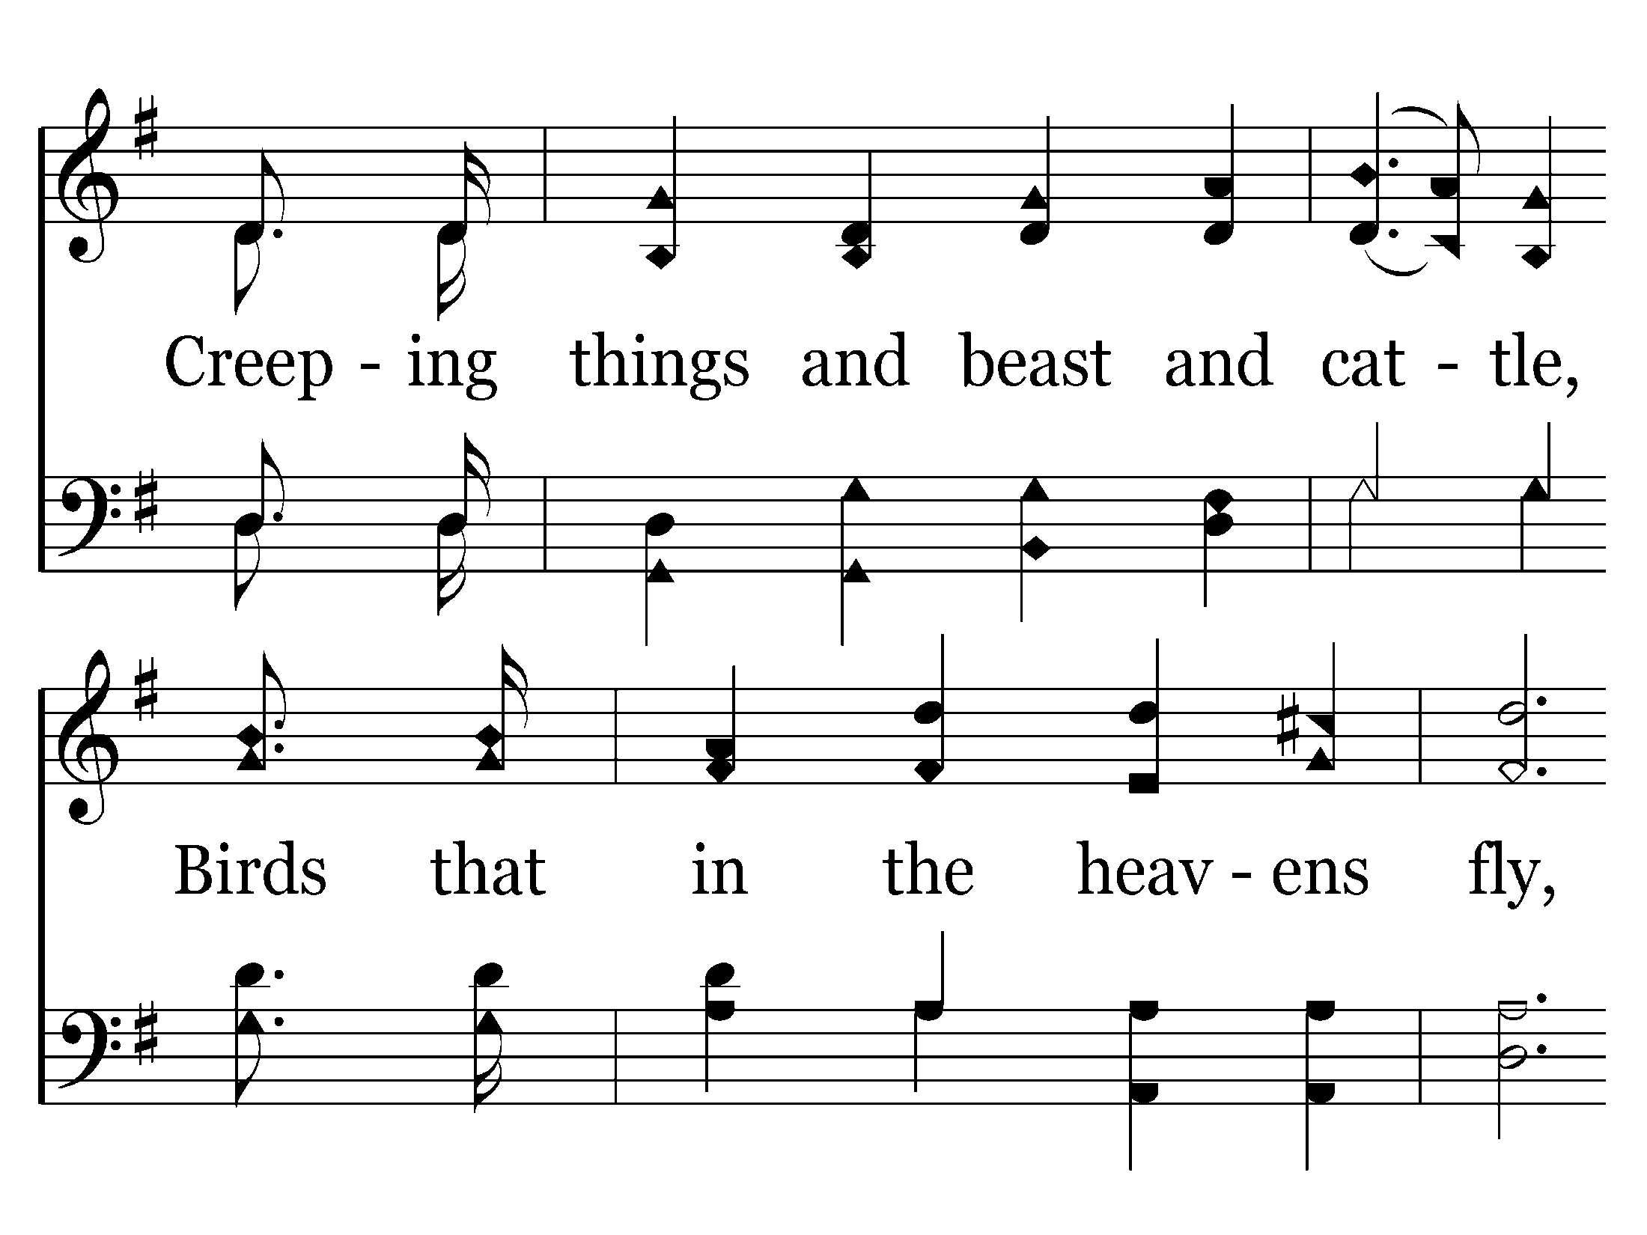
002 - Hallelujah! Praise Jehovah - 3.2

Slide 40
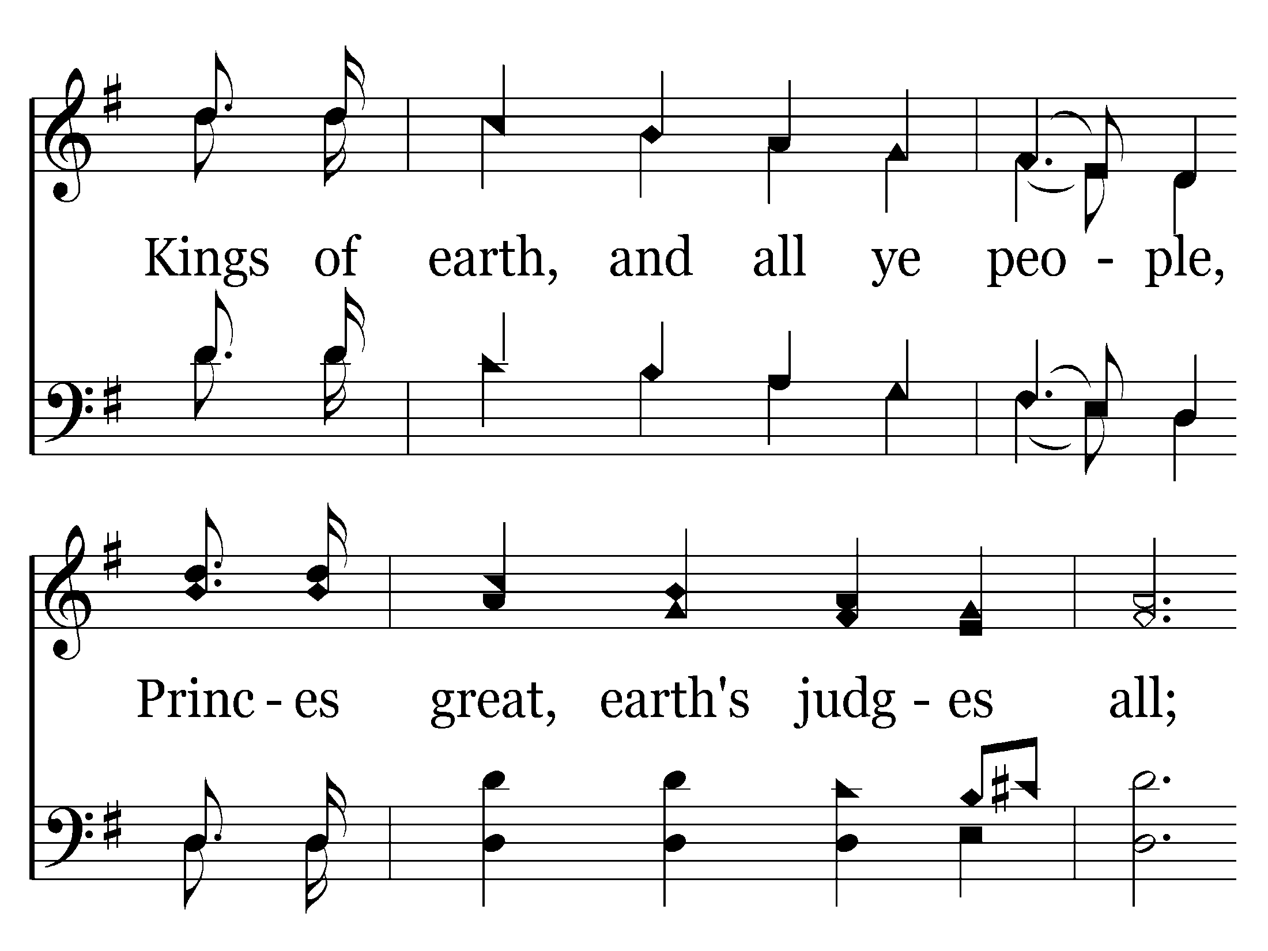
002 - Hallelujah! Praise Jehovah - 3.3

Slide 41
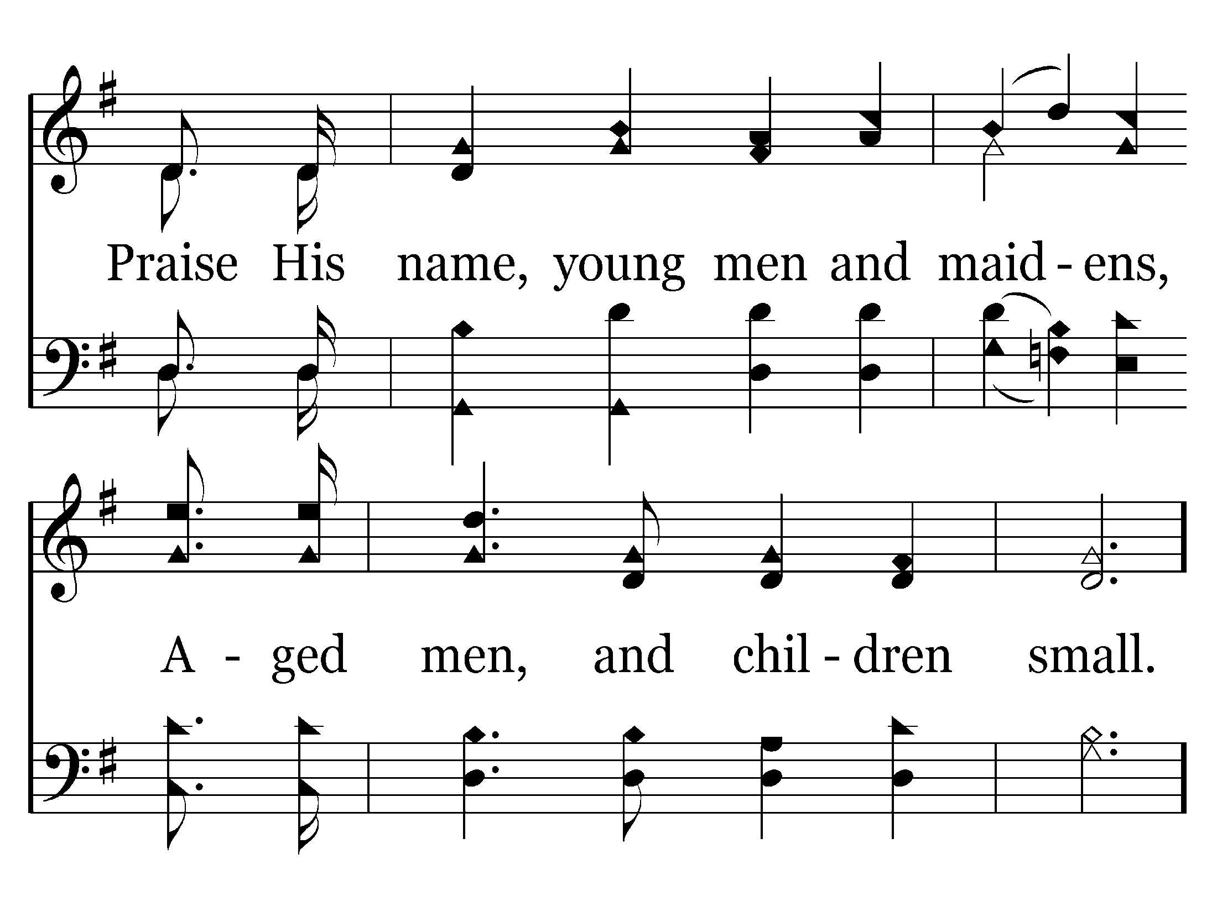
002 - Hallelujah! Praise Jehovah - 3.4

Slide 42
002 - Hallelujah! Praise Jehovah - C.1

Slide 43
002 - Hallelujah! Praise Jehovah - C.2

Slide 44
002 - Hallelujah! Praise Jehovah - C.3
End of Song

Slide 45
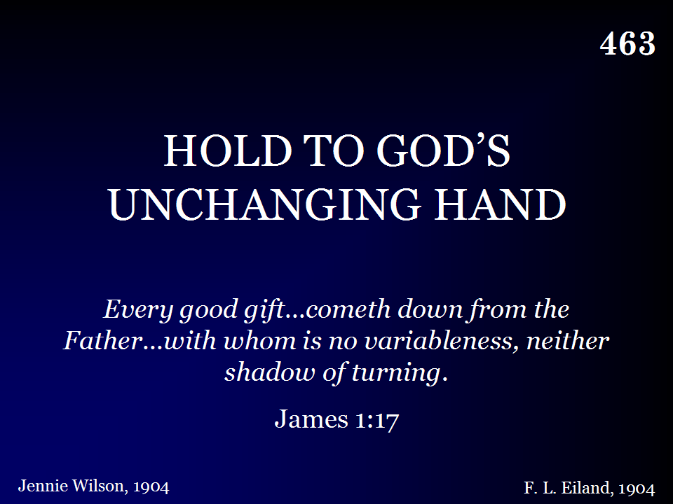
463 - Hold To God's Unchanging Hand - Title

Slide 46
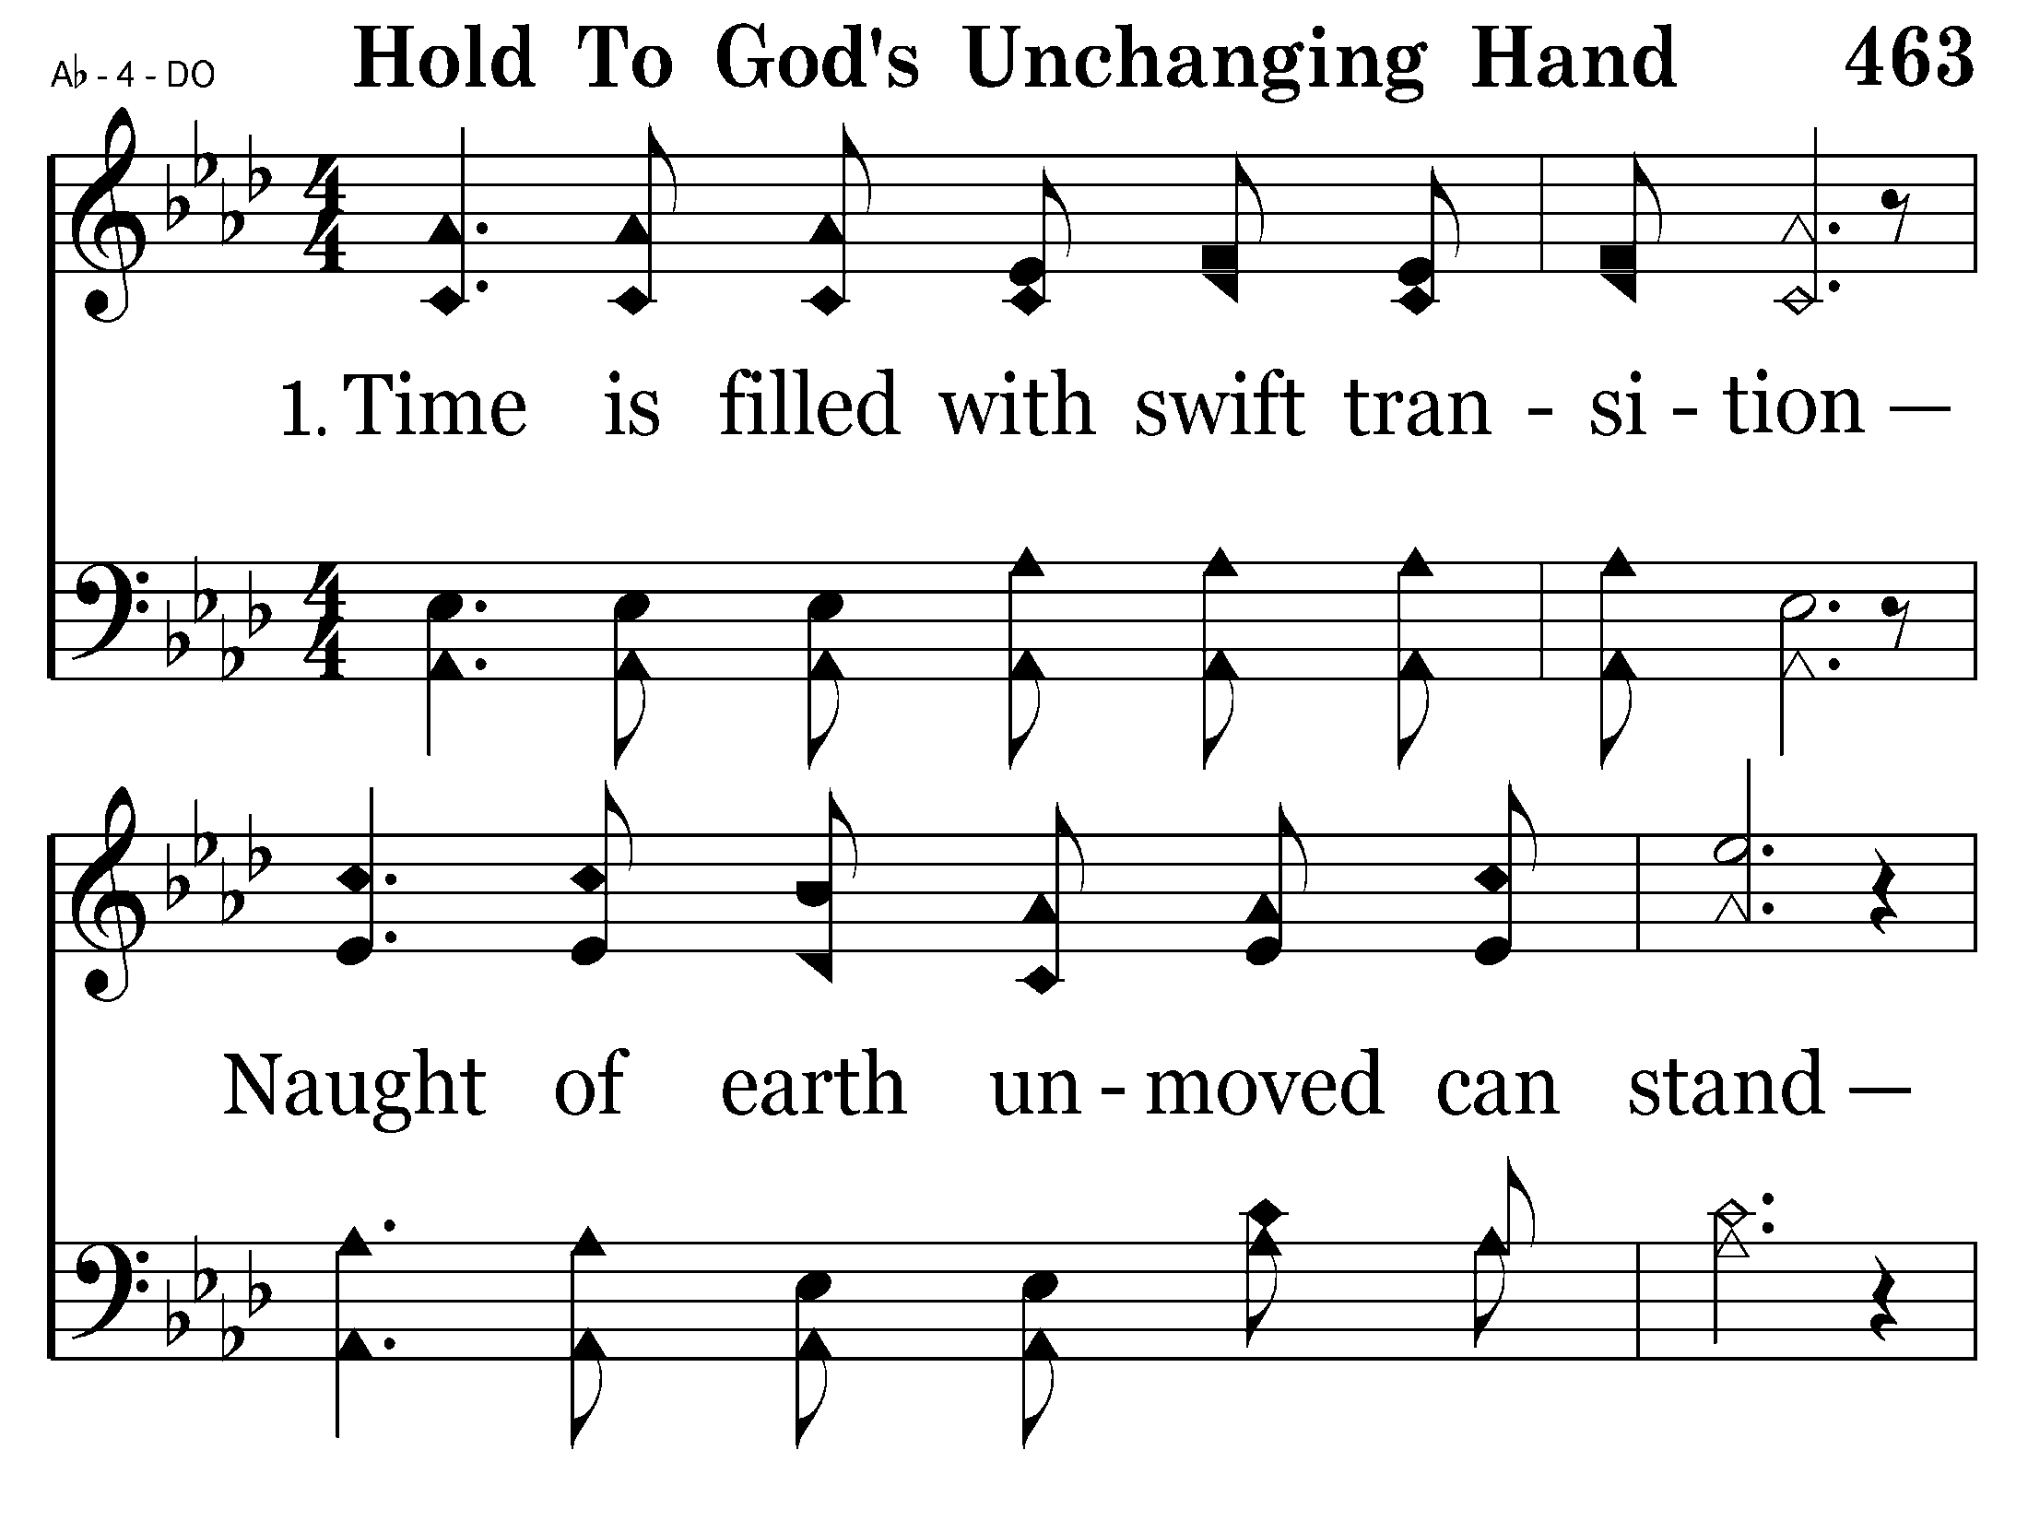
463 - Hold To God's Unchanging Hand - 1.1

Slide 47
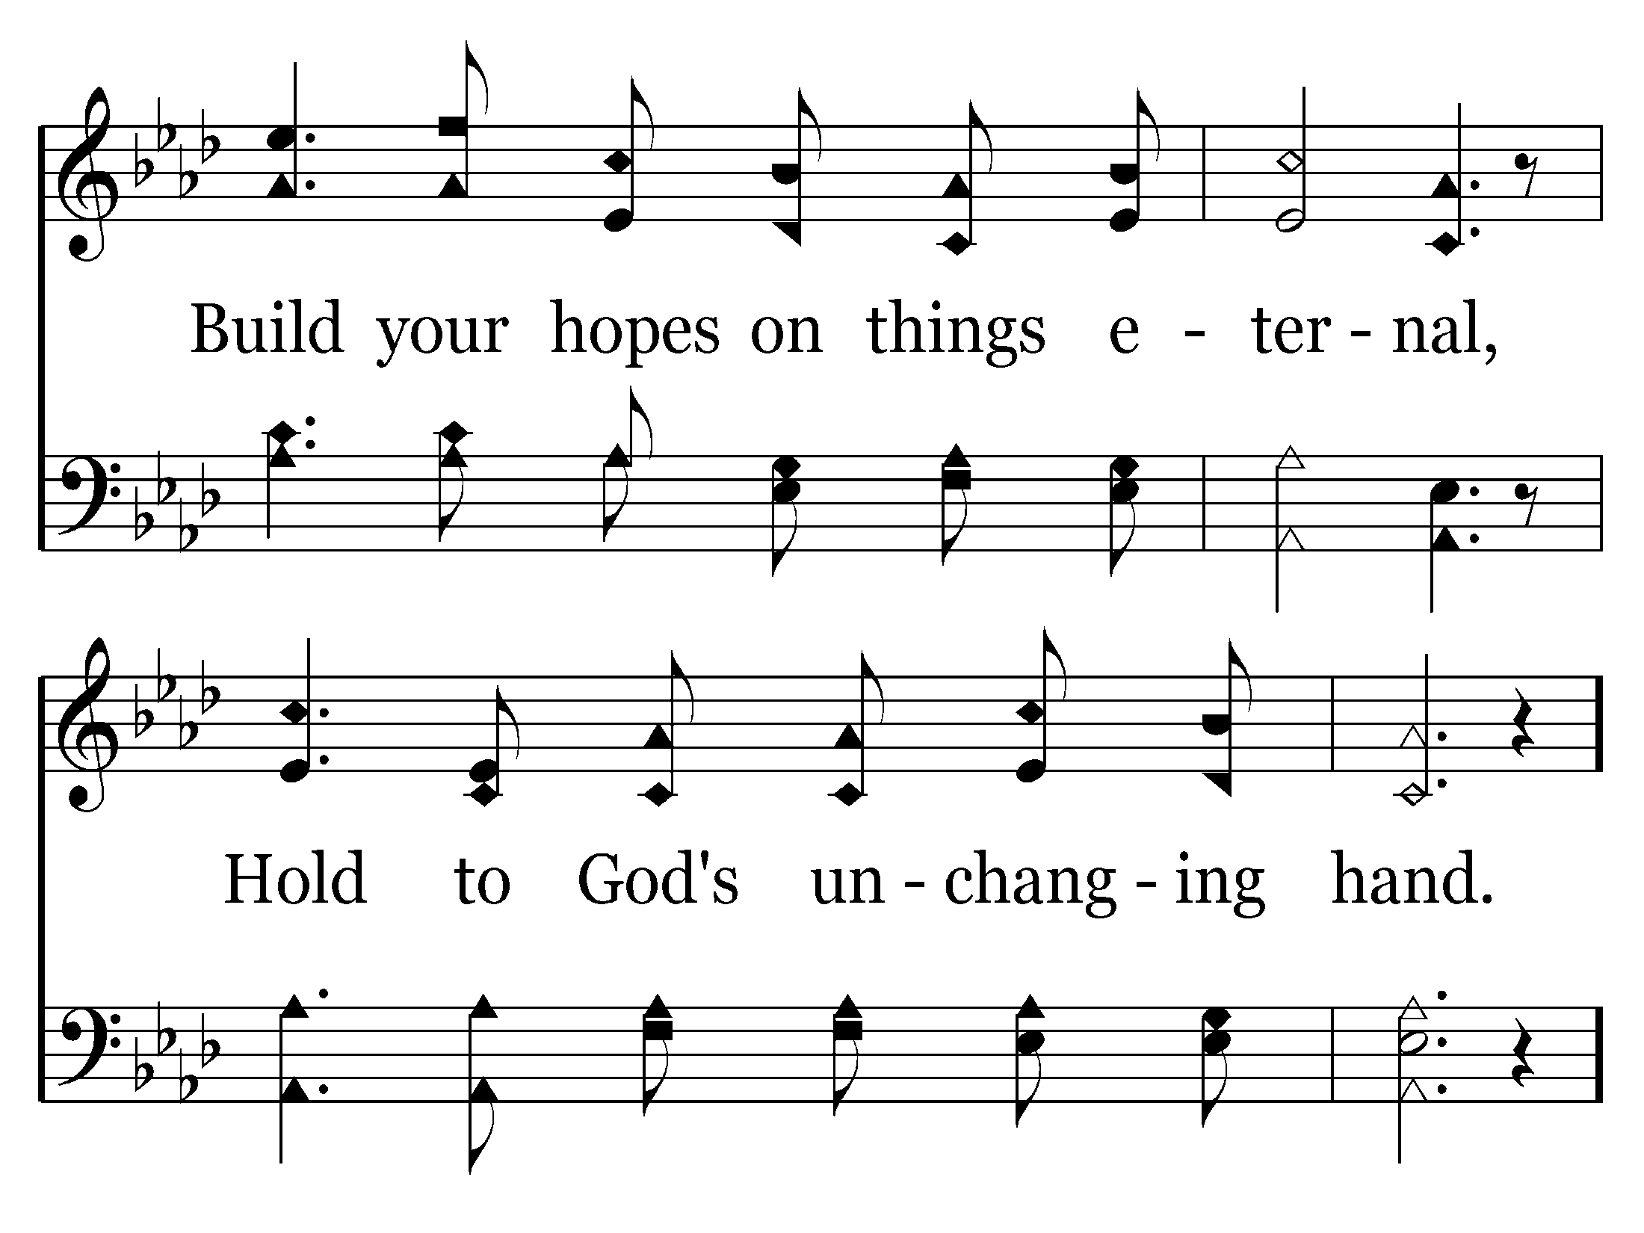
463 - Hold To God's Unchanging Hand - 1.2

Slide 48
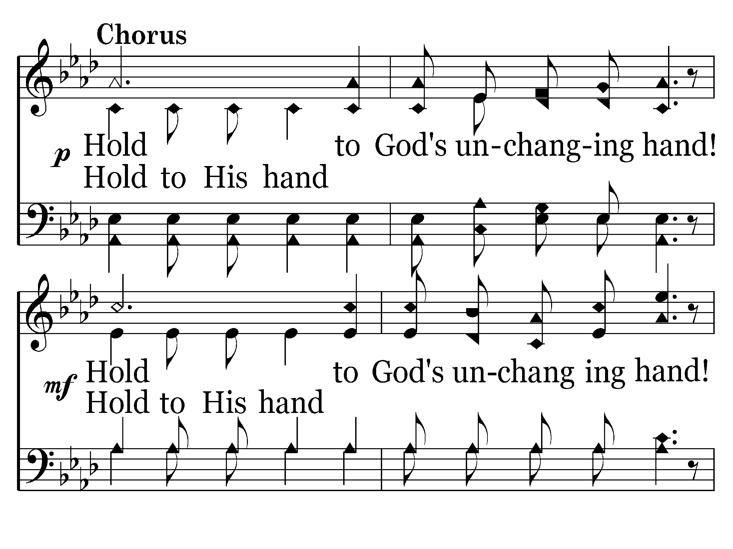
463 - Hold To God's Unchanging Hand - C.1

Slide 49
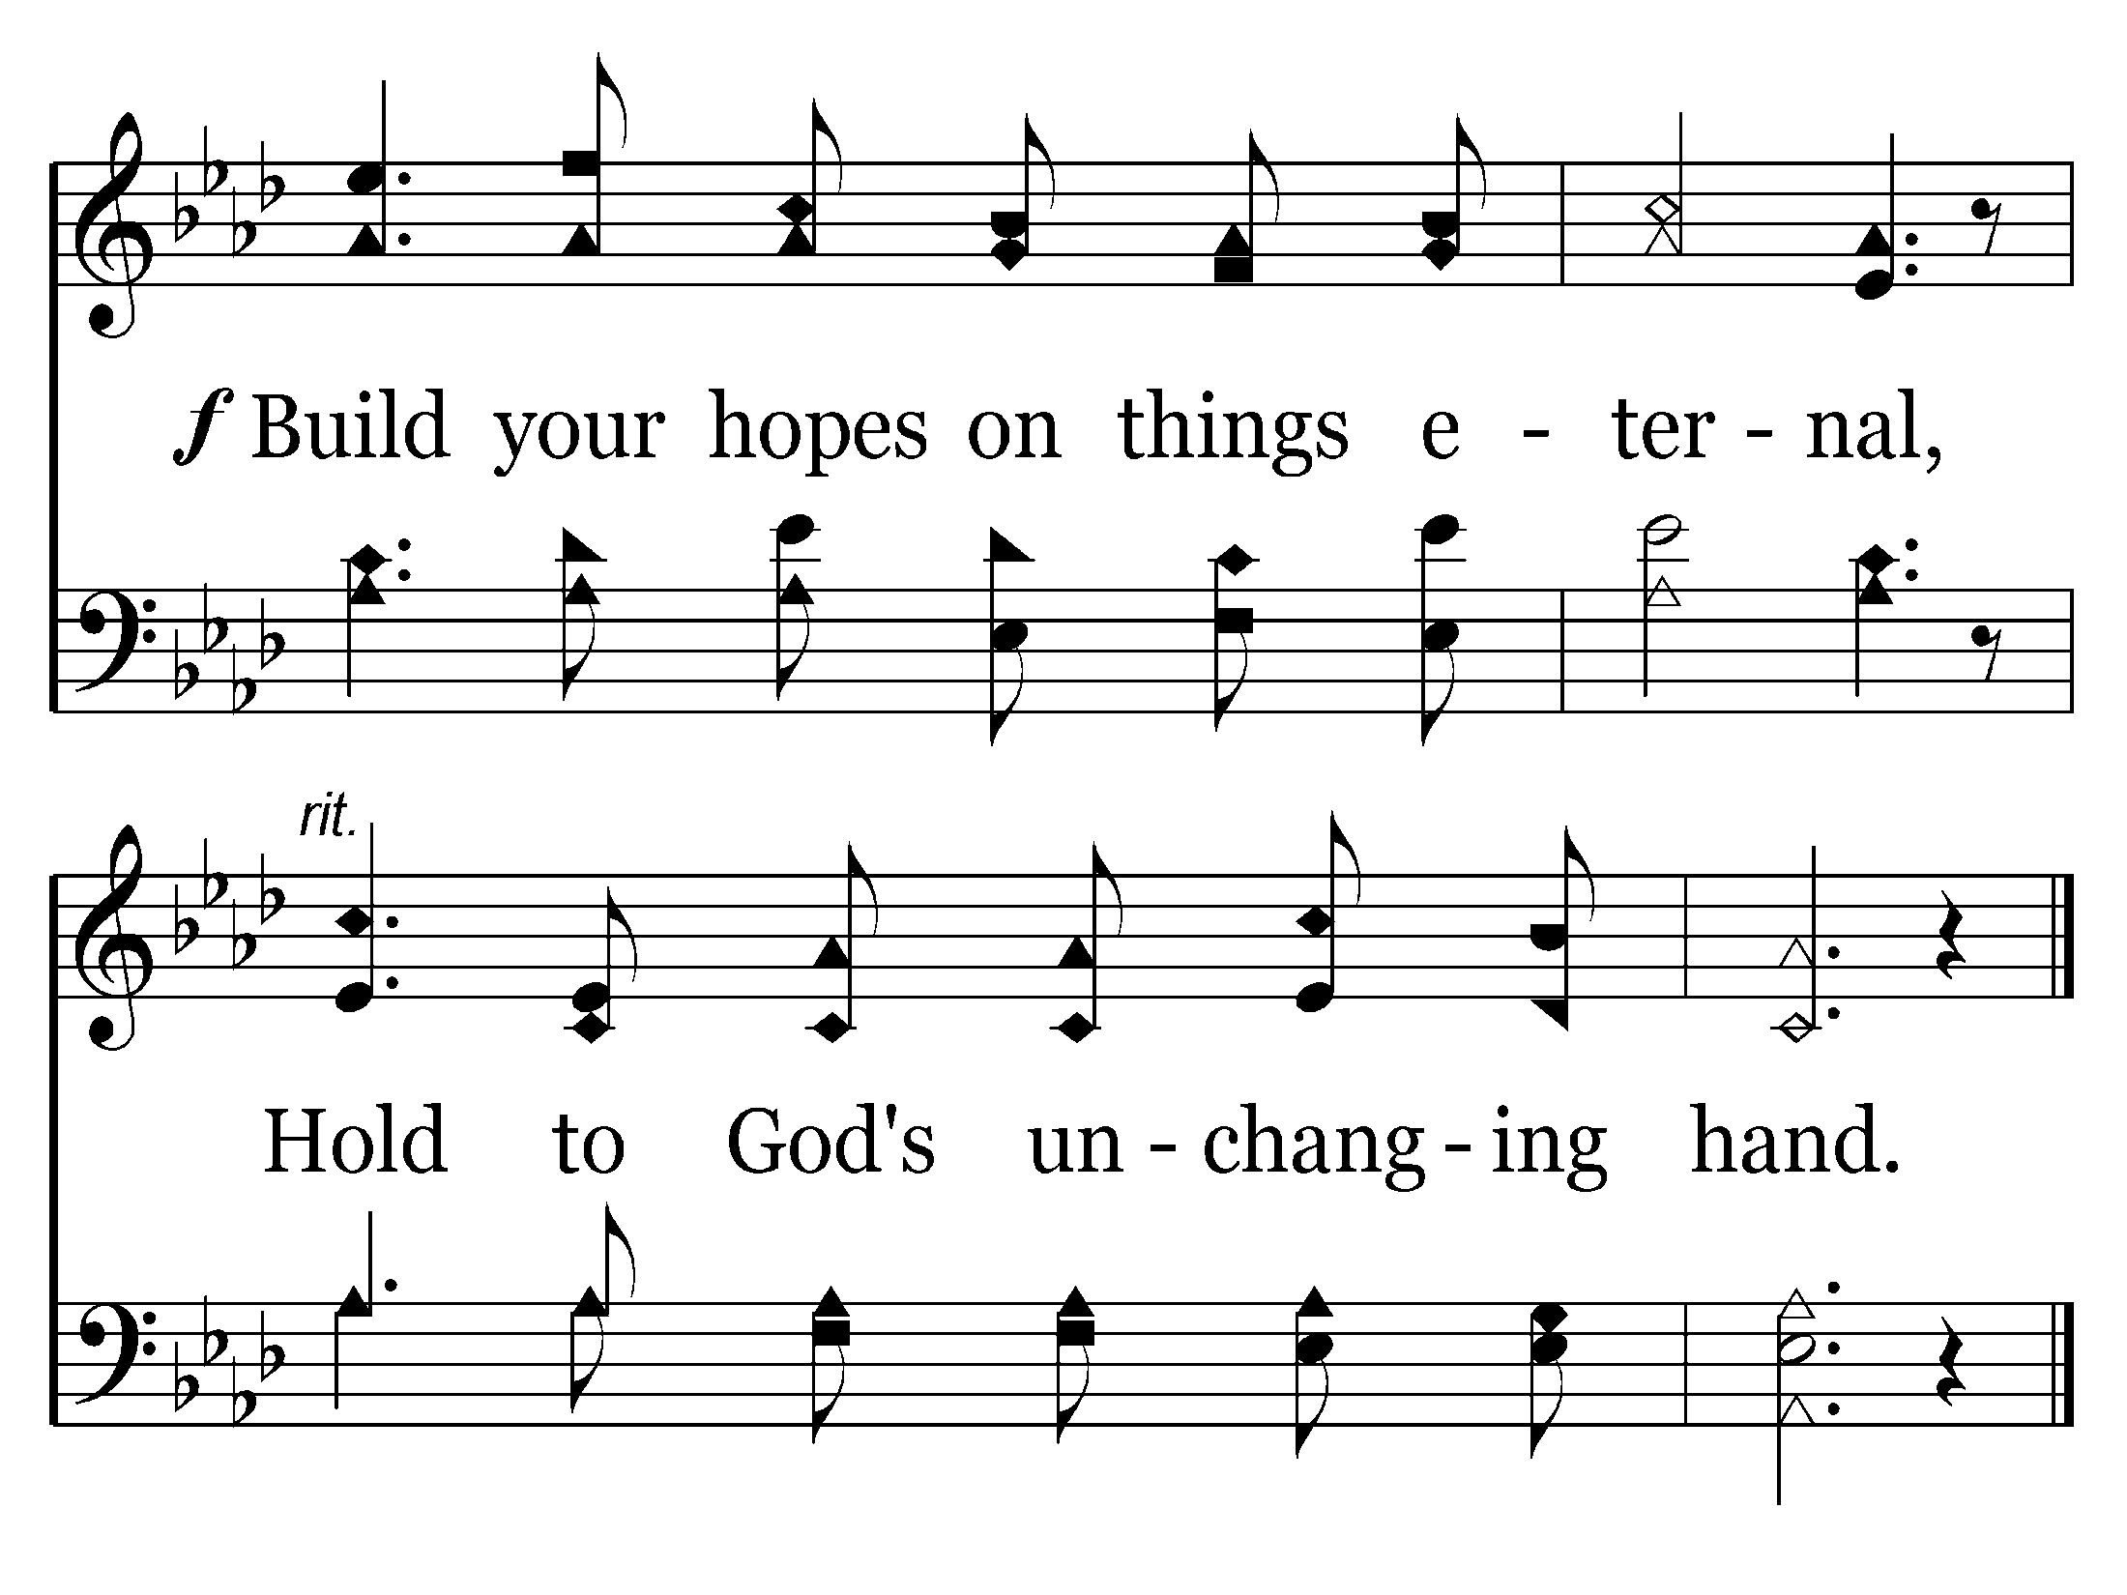
463 - Hold To God's Unchanging Hand - C.2
End of Verse 1

Slide 50
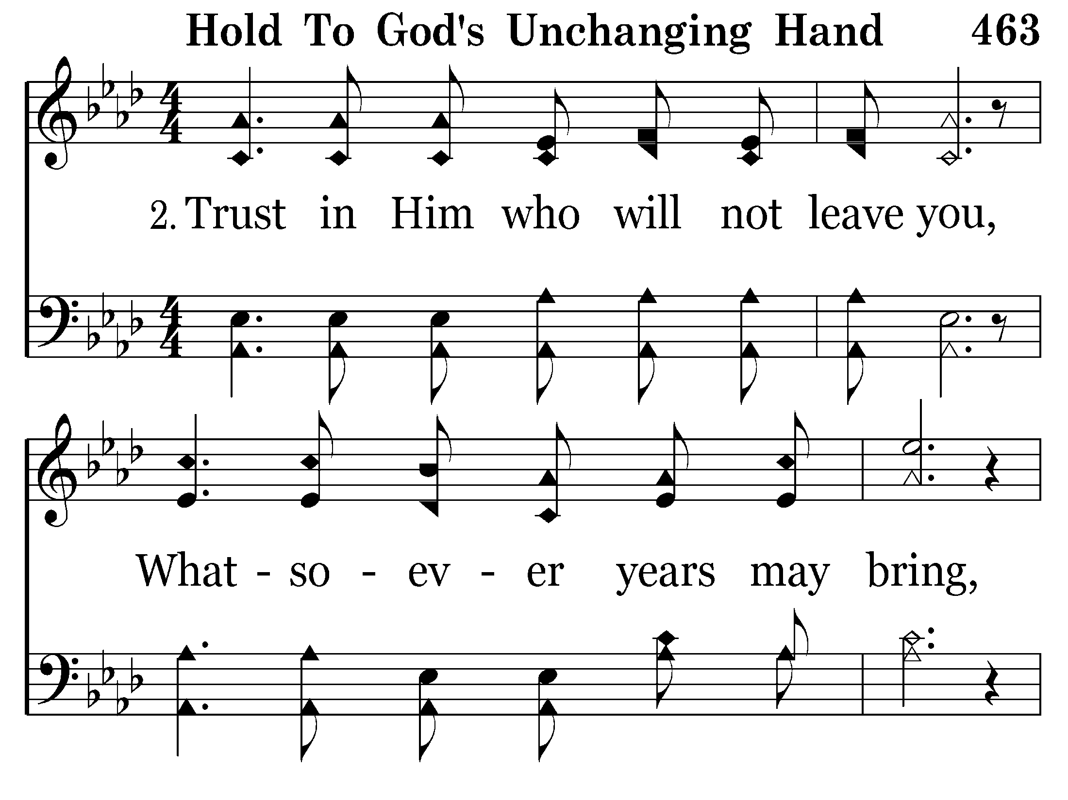
463 - Hold To God's Unchanging Hand - 2.1

Slide 51
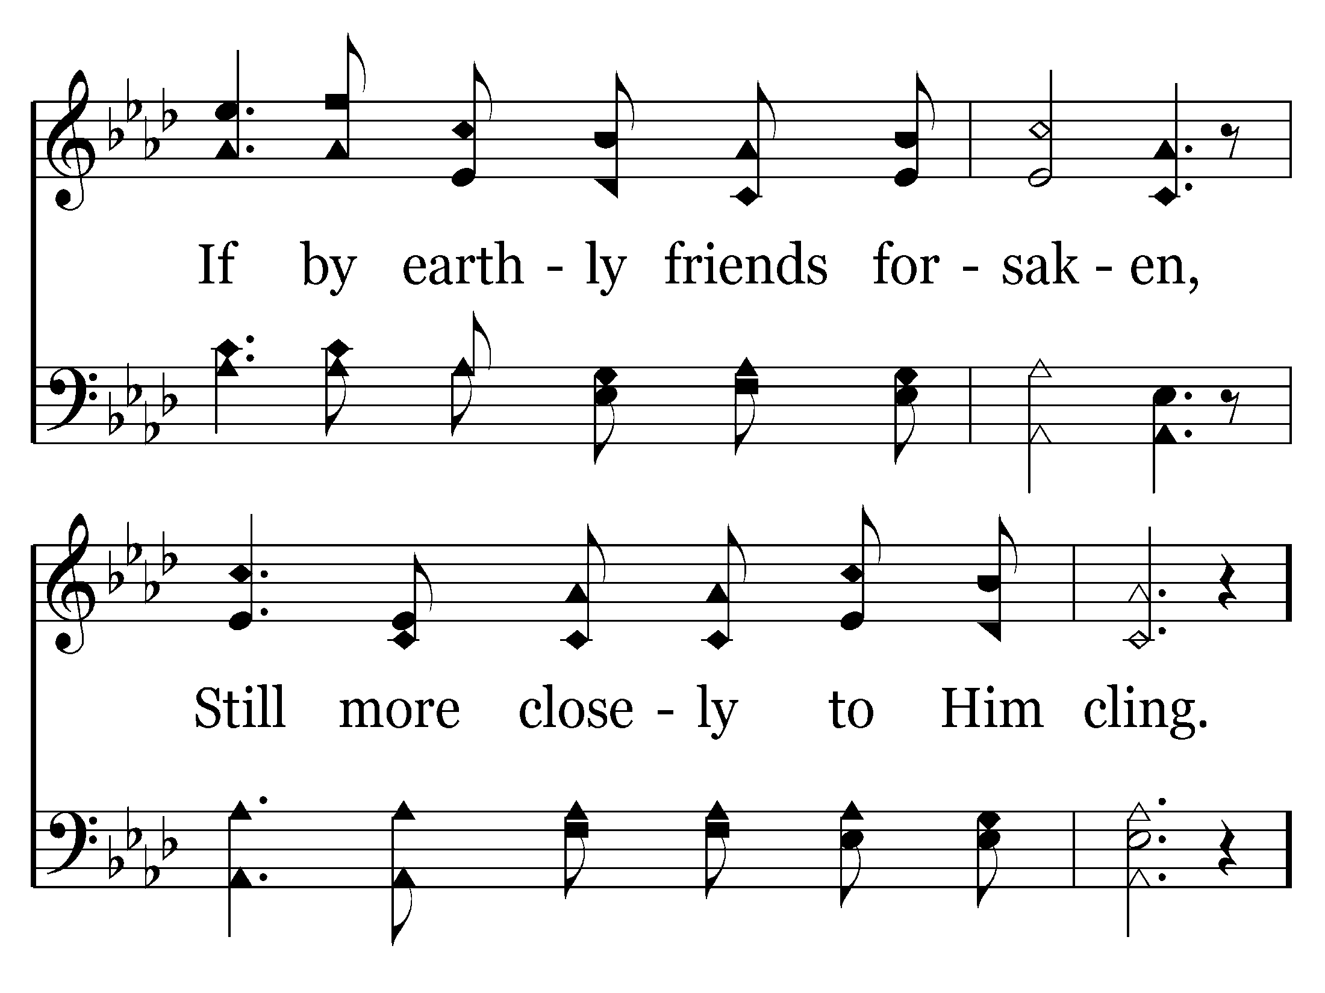
463 - Hold To God's Unchanging Hand - 2.2

Slide 52
463 - Hold To God's Unchanging Hand - C.1

Slide 53
463 - Hold To God's Unchanging Hand - C.2
End of Verse 2

Slide 54
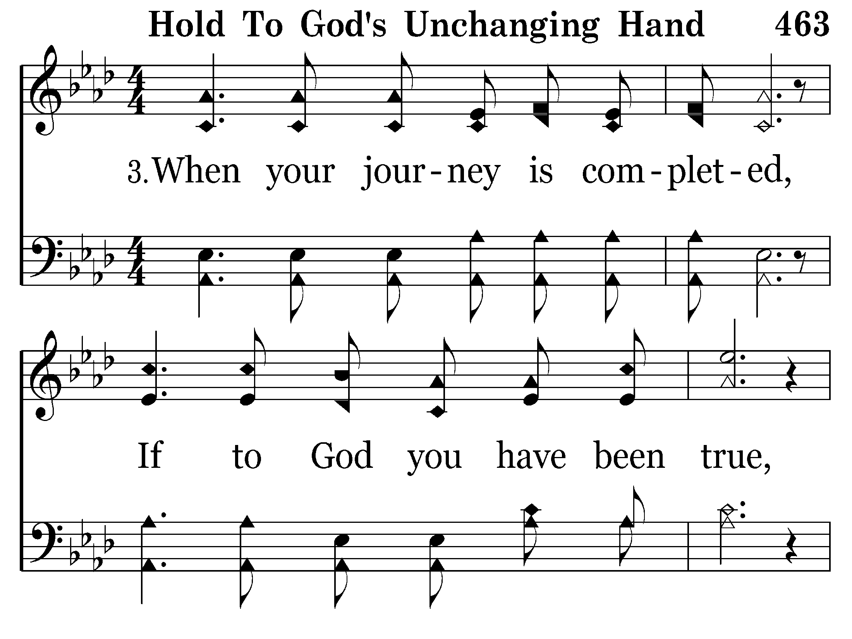
463 - Hold To God's Unchanging Hand - 3.1

Slide 55
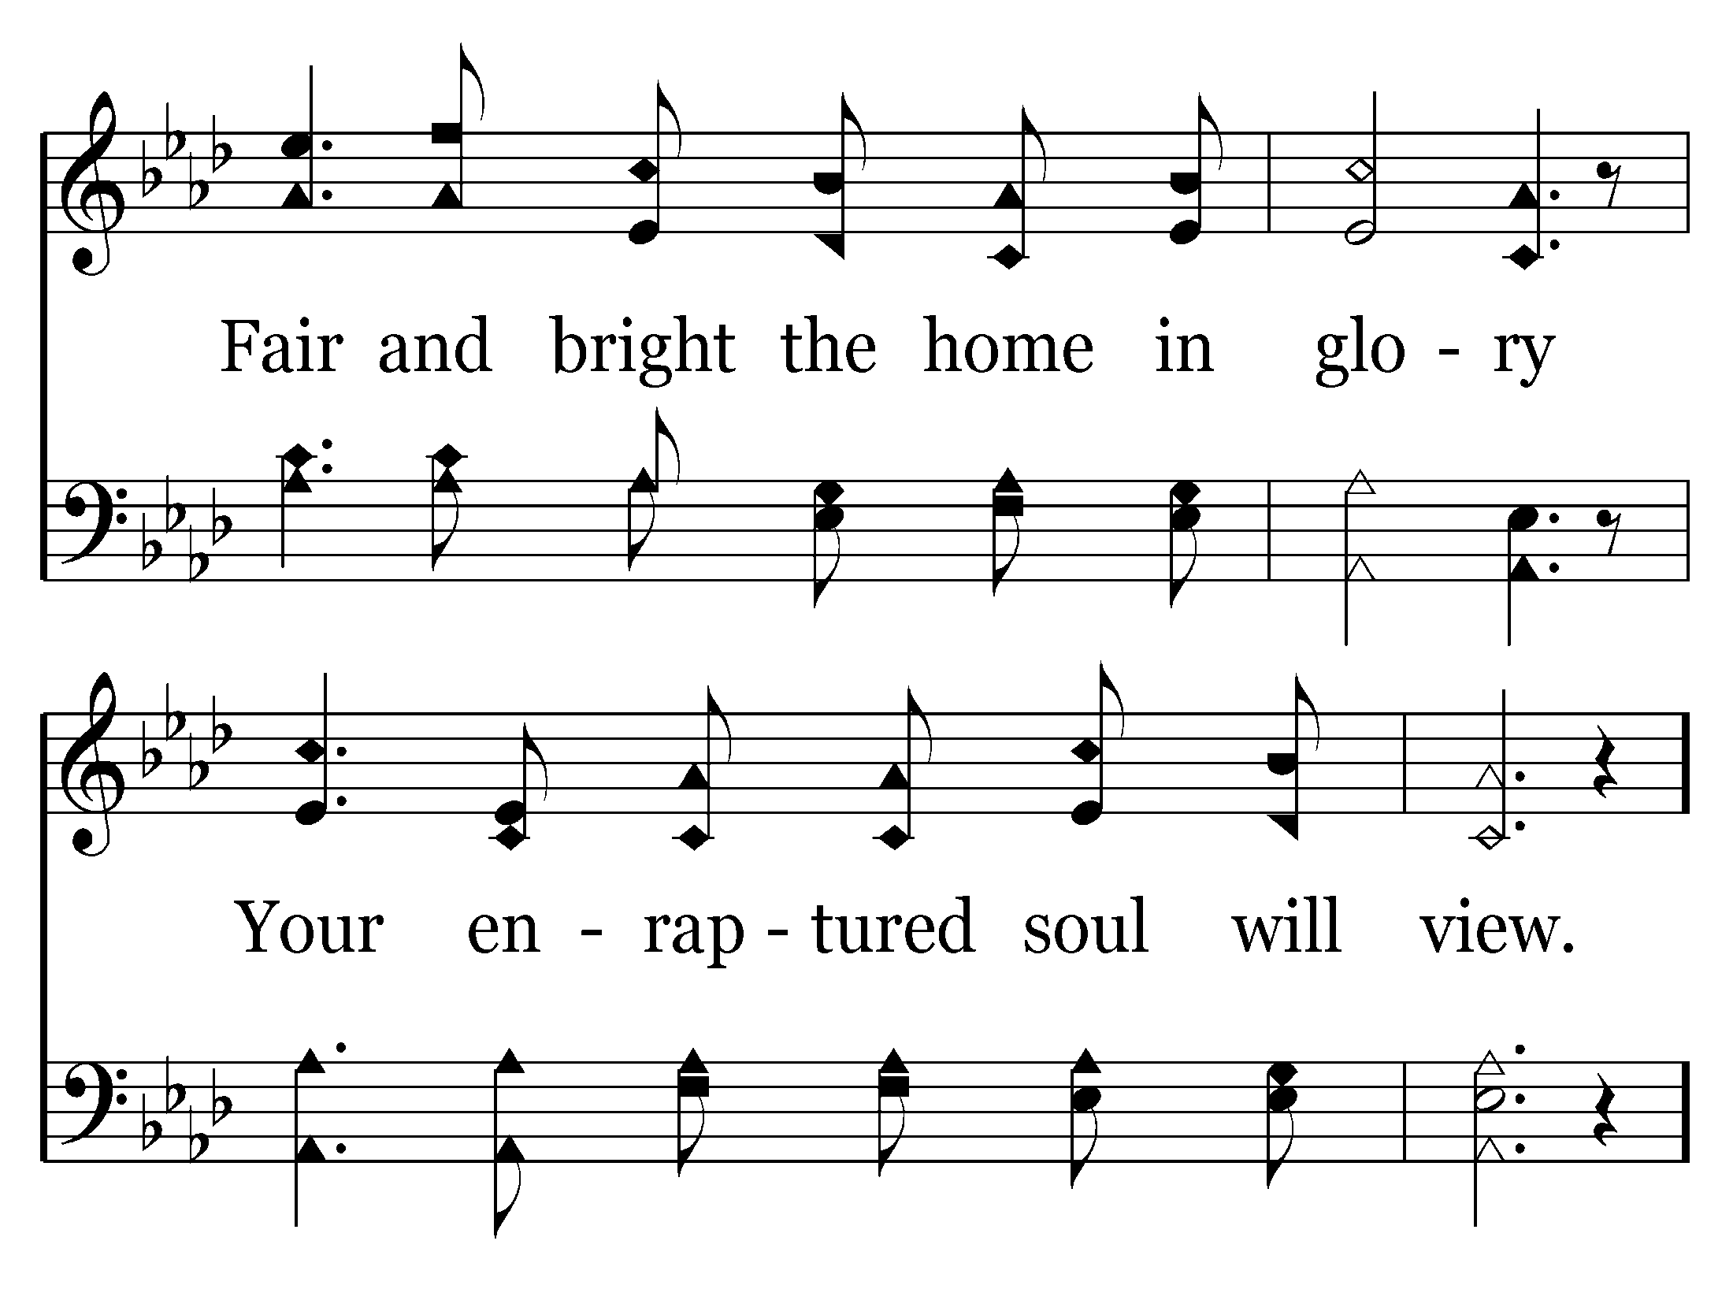
463 - Hold To God's Unchanging Hand - 3.2

Slide 56
463 - Hold To God's Unchanging Hand - C.1

Slide 57
463 - Hold To God's Unchanging Hand - C.2
End of Song

Slide 58


Slide 59
Qualities of the
Contributing Member

Slide 60
“And let our people also learn to maintain good works, to meet urgent needs, that they may not be unfruitful.”
Titus 3:14

Slide 61
“Ask not what your country can do for you, but what you can do for your country”
John F. Kennedy

Slide 62
Congregations are blessed when they have even a handful of “contributors”
Characteristics of those who contribute to the work of a local congregation – they all start with
I

Slide 63
NTEREST
I
The Lord’s Work
  “Want to” OR “Have to”
Is the Lord’s work our “first love?”
  Revelation 2:4
What outward indicators are there of our interest in the local work?
Significant contributions are made by those who have a genuine interest in the work

Slide 64
NVOLVEMENT
I
“Membership” in the Lord’s body is an active thing – rather than passive.
We are “individually members of one another”.
  Romans 12:3-5; Ephesians 4:25
We may be guilty of avoiding commitments.
  Not wanting to be “tied down”
  Not “attached” or “connected”

Slide 65
NVOLVEMENT
I
Proper contribution to the Lord’s work is accomplished when we are involved with the work of others in the body as a whole.
  Ephesians 4:11-16
We must strive to do our share:
  Personal evangelism
  Leadership and Teaching
  Other necessary works

Slide 66
NTENSITY
I
“Pure in heart” have eliminated the general concerns in order to focus on “one thing” (Matt. 5:8).
  Philippians 3:13
Lukewarmness is not pleasing to God.
  Revelation 3:15-16
Solomon advised:

Slide 67
“Whatever your hand finds to do, do it with your might; for there is no work or device or knowledge or wisdom in the grave where you are going.”
(Ecclesiastes 9:10)

Slide 68
It takes inner growth to make a worthwhile contribution.
(2 Peter 1:5-8)

Slide 69
Every member is responsible to do their part in the body.
(1 Cor. 12:20-27)

Slide 70
“Ask not what the church can do for me, but what I can do for the church”
Every Christian

Slide 71
What “contribution” to the local congregation have we made?
I
truly a “contributing member of this local congregation?
Am

