Slide 1
The Four “G’s” That Control Our Behavior
Behavior
Goals
Genes
Groups
Guidelines
Various Elements are a part of who we are:
Our family
Our peers & heroes
Our physical characteristics
Our conduct
Our thoughts
Our values
Our character

Slide 2
Children Are From The Lord!
Psalm 127

Slide 3
God’s Teaching To Israel…
"Hear, O Israel: The LORD our God, the LORD is one! "You shall love the LORD your God with all your heart, with all your soul, and with all your strength. "And these words which I command you today shall be in your heart. "You shall teach them diligently to your children, and shall talk of them when you sit in your house, when you walk by the way, when you lie down, and when you rise up. "You shall bind them as a sign on your hand, and they shall be as frontlets between your eyes. "You shall write them on the doorposts of your house and on your gates. (Deuteronomy 6:4-9 NKJV)

Slide 4
Teaching and Training
My son, hear the instruction of your father, And do not forsake the law of your mother; (Proverbs 1:8 NKJV)
My son, keep your father's command, And do not forsake the law of your mother. (Proverbs 6:20 NKJV)
Train up a child in the way he should go, And when he is old he will not depart from it. (Proverbs 22:6 NKJV)

Slide 5
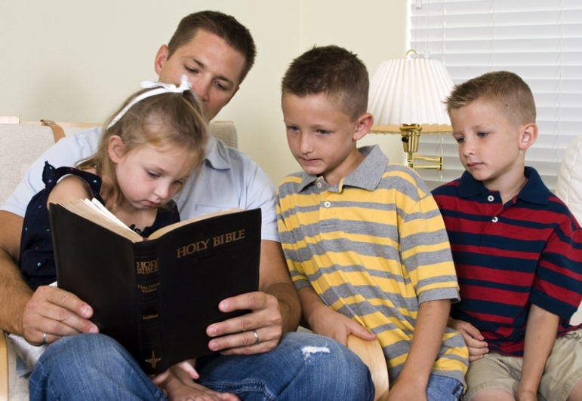
Importance of Teaching Early…
Hear, my children, the instruction of a father, And give attention to know understanding; For I give you good doctrine: Do not forsake my law. When I was my father's son, Tender and the only one in the sight of my mother, He also taught me, and said to me: "Let your heart retain my words; Keep my commands, and live. (Proverbs 4:1-4 NKJV)

Slide 6
Five Blessings From Godly Parents
Basic needs of food, clothing, shelter and education.
A safe harbor to which the children can retreat when in danger.
A relationship with parents wherein the children are to honor them and learn obedience.
Reasonable expectations
Appropriate appreciation
But if anyone does not provide for his own, and especially for those of his household, he has denied the faith and is worse than an unbeliever. (1 Timothy 5:8 NKJV)
And you, fathers, do not provoke your children to wrath, but bring them up in the training and admonition of the Lord. (Ephesians 6:4 NKJV)

Slide 7
What We Owe Our Children…
We Owe Our Children Unconditional Love
We Owe Our Children Time And An Example
We Owe Our Children Spiritual Development

Slide 8
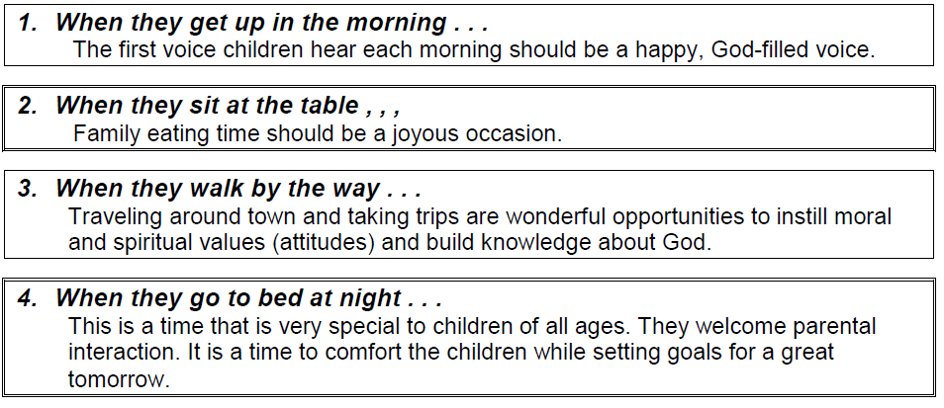
Take Advantage of Every Opportunity…
Deuteronomy 6:7-9

Slide 9
The Most Important Words…
Greatest word is GOD
Longest word is ETERNITY
Swiftest word is TIME
Nearest word is NOW
Darkest word is SIN
Meanest word is HYPOCRISY
Deepest word is SOUL.”
(Quoted in Caprock Church Bulletin, Feb. 19, 1986, 18:8:2)

Slide 10
Good Scripture To Memorize!
Trust in the LORD with all your heart, and do not rely on your own insight. In all your ways acknowledge him, and he will make straight your paths. Be not wise in your own eyes; fear the LORD, and turn away from evil. (Proverbs 3:5-7 RSV)

Slide 11
Sources
New Life Behavior – Course XII – Unit 46 – Lesson 2 – Parental and Family Influences
Raising Children Right – Outline by Kevin Kay
Outline by Steve Higginbotham

