Slide 2
The Parable of the Talents Matthew 25:14-30
Whoopwhoopblog.com
Church of Christ at Medina
October 16th, 2016

Slide 3
Matthew 25:14-25
For it will be like a man going on a journey, who called his servants and entrusted to them his property. To one he gave five talents, to another two, to another one, to each according to his ability. Then he went away. He who had received the five talents went at once and traded with them, and he made five talents more. So also he who had the two talents made two talents more. But he who had received the one talent went and dug in the ground and hid his master's money.
Now after a long time the master of those servants came and settled accounts with them. And he who had received the five talents came forward, bringing five talents more, saying, ‘Master, you delivered to me five talents; here, I have made five talents more.’ His master said to him, ‘Well done, good and faithful servant. You have been faithful over a little; I will set you over much. Enter into the joy of your master.’ And he also who had the two talents came forward, saying, ‘Master, you delivered to me two talents; here, I have made two talents more.’ His master said to him, ‘Well done, good and faithful servant. You have been faithful over a little; I will set you over much. Enter into the joy of your master.’

Slide 4
Matthew 25:14-25
He also who had received the one talent came forward, saying, ‘Master, I knew you to be a hard man, reaping where you did not sow, and gathering where you scattered no seed, so I was afraid, and I went and hid your talent in the ground. Here, you have what is yours.’ But his master answered him, ‘You wicked and slothful servant! You knew that I reap where I have not sown and gather where I scattered no seed? Then you ought to have invested my money with the bankers, and at my coming I should have received what was my own with interest. So take the talent from him and give it to him who has the ten talents. For to everyone who has will more be given, and he will have an abundance. But from the one who has not, even what he has will be taken away. And cast the worthless servant into the outer darkness. In that place there will be weeping and gnashing of teeth.’

Slide 5
The Parable of the Talents
The Master
He was “traveling to a far country.”
The Servants
They were bond-servants. Hence, they belonged to the Master.
The Task
The master provided to each servant a measure of money. It was the master’s money, but it was given to each servant for use.
Each servant was given a different amount, according to their own ability.
When the master left, two of the servants “went at once” working with their assets. One servant went and hid his talent in the ground.

Slide 6
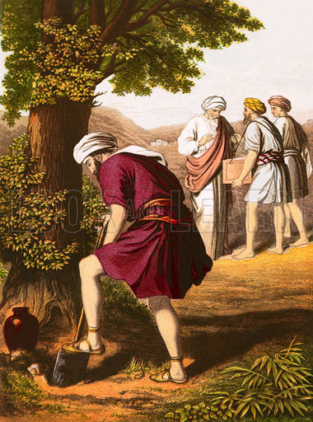
The Parable of the Talents
The Return
After a long time, the master returned “settle accounts” which indicates they knew they would be held responsible.
The Reward
The five talent servant had gained five more.
“Well done”: Bravo!
Good and Faithful Servant:
His actions had been good in that the talents were used properly.
His actions had been faithful in that the talents were used to the Master’s expectations.
Rewards
Faithful over little, set over much: Servant would be provided more responsibility and opportunity to serve.
Joy of the Master: He would share in the delight of the Master.
The two talent man received exactly the same reward!

Slide 7
The Parable of the Talents
The Punishment
The one talent man was the last to report.
He came with excuses and blame…
“I knew you to be a hard man…”
“I was afraid…”
“Here is what you gave me…I didn’t lose it.” (Ben’s translation)
Master’s Reaction
Wicked – Evil in a moral sense
Slothful – Unwillingness to give effort
Punishment
Lost what he had been given
Cast into outer darkness
“He did not deliberately do evil; but by doing nothing he miserably failed in his responsibility.”
- Chumbley

Slide 8
Lessons from The Parable of the Talents
Our Master is also returning.
Acts 1:6-11
Revelation 1:7
We are His servants.
We are his bond-servants. (1 Corinthians 7:22-23, 1 Peter 2:16)
We have been bought with a price. (1 Corinthians 6:19-20, Acts 20:28)
We do not all have the same ability, but we all have the same responsibility!
Faithful Stewards (1 Corinthians 4:1-2, 1 Peter 4:10)
“Although not all equally able, we are all equally responsible to faithfully invest what has been given to us.”
- Earnhart

Slide 9
Lessons from The Parable of the Talents
Rewards
Our reward is a heavenly home!
Revelation 21:1-4
Matthew 25:34
Punishment
Punishment does await the wicked and lazy.
What is your view of God? Harsh? Expects too much? Unreasonable to ask for self-control, self-denial, and self-sacrifice?
Do you think that since you cannot do as great things as others, that God will not require anything?
Do you think that as long as you don’t do wrong, God will be pleased? Not doing wrong is not the same as doing right.
God expects us to do what we can. (Mark 14:8)
Matthew 25:31-46
“It is sometimes true that those who have small ability neglect their opportunity for service. All He expects is that one shall do his best.”
- Chumbley

Slide 10
Conclusion
“Can one stand before God on the Day of Judgment and debate on why he should be allowed to go to heaven in spite of laziness, neglect and waste?”
- Quinn

