Slide 1
Giving An Answer For Our Faith
But sanctify the Lord God in your hearts, and always be ready to give a defense to everyone who asks you a reason for the hope that is in you, with meekness and fear; (1 Peter 3:15 NKJV)

Slide 2
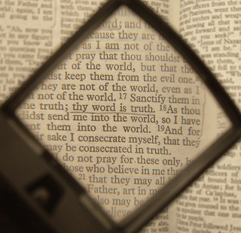
Building A Defense For The Word Of God…
The Nature of Inspiration (Matt. 10:19,20; 1 Cor. 2:1-13)
The Reliability of the Bible (John 10:35; Matt. 24:35)
The Authority of the Bible (2 Cor. 4:6; Jude 3; 1 Peter 1:3; 2 Timothy 3:16-17)
The Understandability of the Bible (Eph. 5:17; John 8:32)

Slide 3
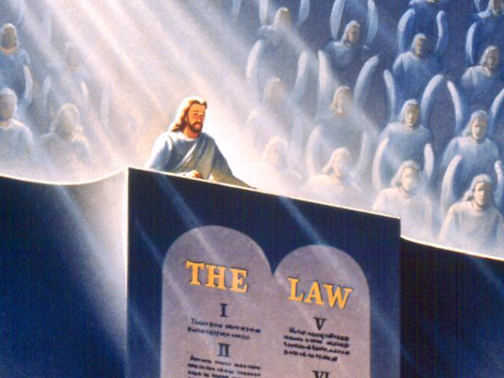
One Day The Word Of God Will Be Our Judge…
"He who rejects Me, and does not receive My words, has that which judges him--the word that I have spoken will judge him in the last day. (John 12:48 NKJV)

Slide 4
Sources
Outline by Steve Higginbotham

