Slide 2
The Preparation for Worship
Who are we going to worship?
God is the only one worthy of our worship. (Matthew 4:1-11, Exodus 20:1-4, Revelation 19:10)
Why is He worthy of our praise and adoration?
He is our Father. (Ps. 95:1-7)
He has delivered us. (Ps. 22:20-31)
His character. (Ps. 29:1-2, 66:1-4, 86:8-10)
Congregational worship is a requirement!
God seeks people to worship Him. (John 4:23-24)
The Bible speaks of congregational worship. (Hebrews 10:24-25, Acts 2:42-47, 1 Cor. 11:17-20, 14:23, 16:1-2)

Slide 3
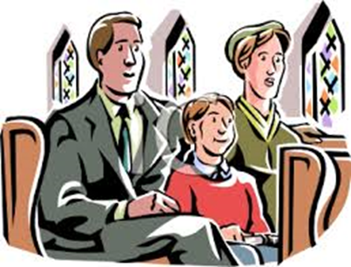
The Pattern of Worship
The way in which we worship is an indication of the respect and reverence we have toward God.
Reverence of the people of Israel (Nehemiah 9:3)
Nadab and Abihu did not sanctify or glorify God in their worship. (Leviticus 10:1-11)
Colossians 3:17
God has always prescribed the way He wants to be worshipped. (John 4:23-24)

Slide 4
The Passion for Worship
We must respect God by worshipping according to His will, but we must also put our hearts into it!
Mindless activity is not pleasing unto God. (Matthew 15:1-9)
God is always watching us and He knows whether we are worshipping in “spirit and truth.”

Slide 5
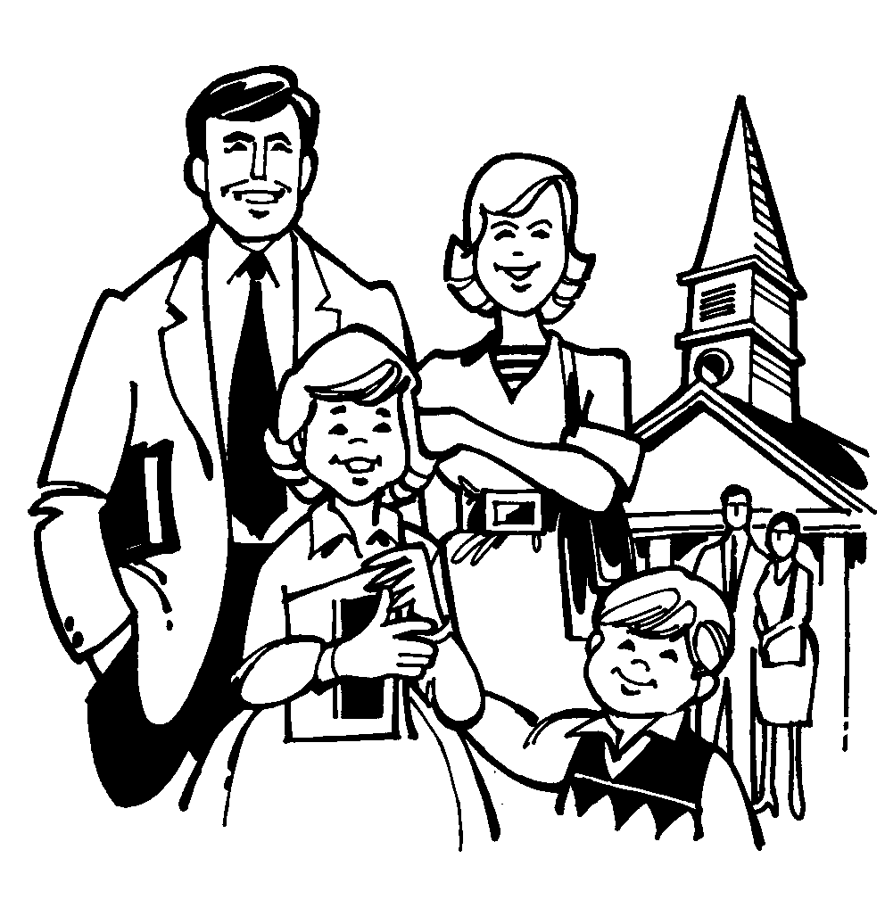
The Productivity of Worship
Worship and service are not the same thing, but they are forever connected.
Matthew 4:1-11
Romans 12:1-2
We cannot serve ourselves through the week and expect our worship to God on the Lord’s Day to be acceptable.
We become more like the things we worship.
Our worship will help us to become realigned to God. (Psalm 73:13-17)
Our worship should always praise God, and also build us up! (Hebrews 10:24)

Slide 6
Conclusion
“I was glad when they said to me, ‘Let us go to the house of the Lord.’”
(Psalm 122:1, ESV)

