Slide 1
The Ark of the Covenant
Exodus 25:10-22
God gave specific instructions on how the Ark should be built.
It was a holy object to the Israelites that housed the tablets of the Law written by Moses.
God designated the space between the cherubim as the place He would meet with Israel known as the mercy seat.
God also gave specific instructions on how the Ark was to be transported. (Numbers 4:4-15)

Slide 2
The Ark was captured by the Philistines during the days when Eli judged Israel. (1 Samuel 4)
As a result, the Philistines suffered because of the Ark’s presence. (1Samuel 5)
Their idol Dagon fell face forward twice.
The people suffered from tumors.
The Philistines decided to send the Ark back to Israel. (1Samuel 6)
The Ark came to Keriath-jearim, to the house of Abinadab and remained there for around 40 years until the time of King David.

Slide 3
Lessons from the Death of Uzzah
2Samuel 6:1-15

Slide 4
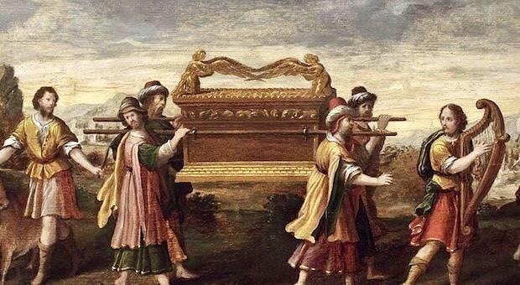
When God gives man a pattern, He expects man to follow that pattern.
In the days of Aaron, God gave Israel a pattern for transporting the Ark.
Numbers 4:4-15 gives them specific instructions on how to transport the Ark.
Poles were to be inserted
Sons of Kohath (Aaron’s son) were to carry on their shoulders

Slide 5
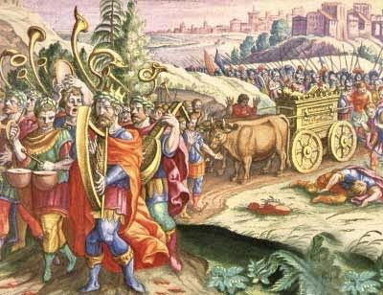
When God gives man a pattern, He expects man to follow that pattern.
The Ark was not transported according to the Bible pattern.
Could have been a long journey
Maybe they thought that God’s instructions were old, outdated, and no longer relevant
Maybe they thought that the
cart was a better way to
transport the Ark than what
God had authorized

Slide 6
When God gives man a pattern, He expects man to follow that pattern.
God punished Uzzah because of his disobedience.
When the people placed the Ark on their cart, they were going beyond what was authorized.
Col. 3:17 “And whatever you do, in word or deed, do everything in the name of the Lord Jesus, giving thanks to God the Father through Him.”
David did not seek God’s counsel before transporting the Ark, and a man died because of this.

Slide 7
Sins committed with good intentions are punishable by God.
It is a popular belief that works done with a good and honest heart do not jeopardize a man’s soul.
Paul had good intentions when he persecuted the church. (Acts 23:1)
Matthew 7:21-23
Paul commended the Romans for their zeal but not their knowledge. Romans 10:1-3

Slide 8
Sins committed with good intentions are punishable by God.
I believe it’s safe to say that Uzzah had a sincere heart. The danger is that we can all have a sincere heart, and we can be sincerely wrong.
We must show reverence for the will of God.

Slide 9
The popular way is not always the right way.
David consulted with prominent men before transporting the Ark. 1 Chronicles 13:1-4
Matthew 7:13-14
“Enter by the narrow gate. For the gate is wide and the way is easy that leads to destruction, and those who enter by it are many. For the gate is narrow and the way is hard that leads to life, and those who find it are few.”

Slide 10
Conclusion
Uzzah lived many years ago, but his actions still teach us today.
We must treat God with reverence and make sure we are obeying His word completely.
We must remember that God is a just God and He will do exactly what He says He will do.
Hebrews 5:9

Slide 11
David learned from this experience. Will we?

