Slide 2
The Claims of Jesus
He was equal with the Father.
He is the only Son of God – a special relationship.
He is able to forgive sins, which is reserved for God alone.
He was worshipped, which is only accepted when given to God.
He spoke with the authority of God, because He is God.

Slide 3
Jesus did more than just claim deity…
“But the testimony that I have is greater than that of John. For the works that the Father has given me to accomplish, the very works that I am doing, bear witness about me that the Father has sent me. And the Father who sent me has himself borne witness about me. His voice you have never heard, his form you have never seen, and you do not have his word abiding in you, for you do not believe the one whom he has sent. You search the Scriptures because you think that in them you have eternal life; and it is they that bear witness about me, yet you refuse to come to me that you may have life.”
- John 5:36-40, ESV

Slide 4
A Question from the Baptizer
“John’s followers told him about all these things. He called for two of his followers and sent them to the Lord to ask, ‘Are you the One who is to come, or should we wait for someone else?’ When the men came to Jesus, they said, ‘John the Baptist sent us to you with this question: Are you the One who is to come, or should we wait for someone else?’ At that time, Jesus healed many people of their sicknesses, diseases, and evil spirits, and he gave sight to many blind people. Then Jesus answered John’s followers, ‘Go tell John what you saw and heard here. The blind can see, the crippled can walk, and people with skin disease are healed. The deaf can hear, the dead are raised to life, and the Good News is preached to the poor. Those who do not stumble in their faith because of me are blessed.’”
- Luke 7:18-23, NCV

Slide 5
“But Who Do You Say That I Am? The Miracles of Jesus
Church of Christ at Medina
March 12th, 2017

Slide 6
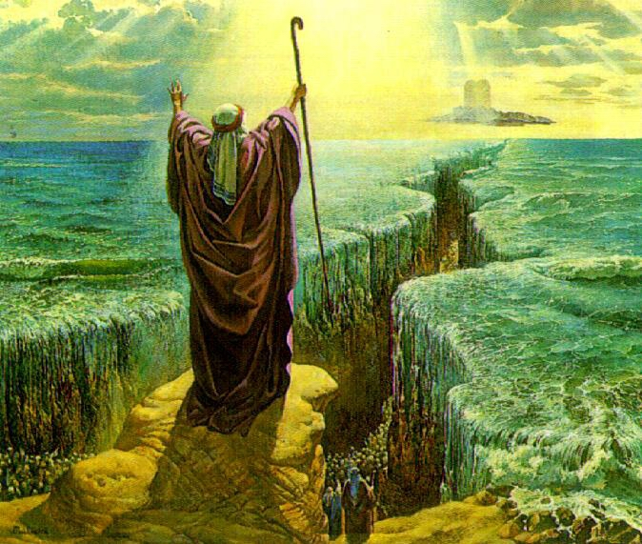
What is a miracle?
Miracles are not science…
Science is based upon that which is limited to the natural order of things and is typically repeatable.
Miracles are not just acts of wonder
A miracle is not just something that is so terrific that is produces wonder (birth of a child, etc.).
Miracles
‘A miracle involves God reaching down and doing something beyond what normally would happen in nature…”
They are immediate, and obvious to all.
Miracles are the intervention of God, and they are given for a specific purpose – to produce faith in God!
“Now Jesus did many other signs in the presence of the disciples, which are not written in this book; but these are written so that you may believe that Jesus is the Christ, the Son of God, and that by believing you may have life in His name.”
- John 20:30-31, ESV

Slide 7
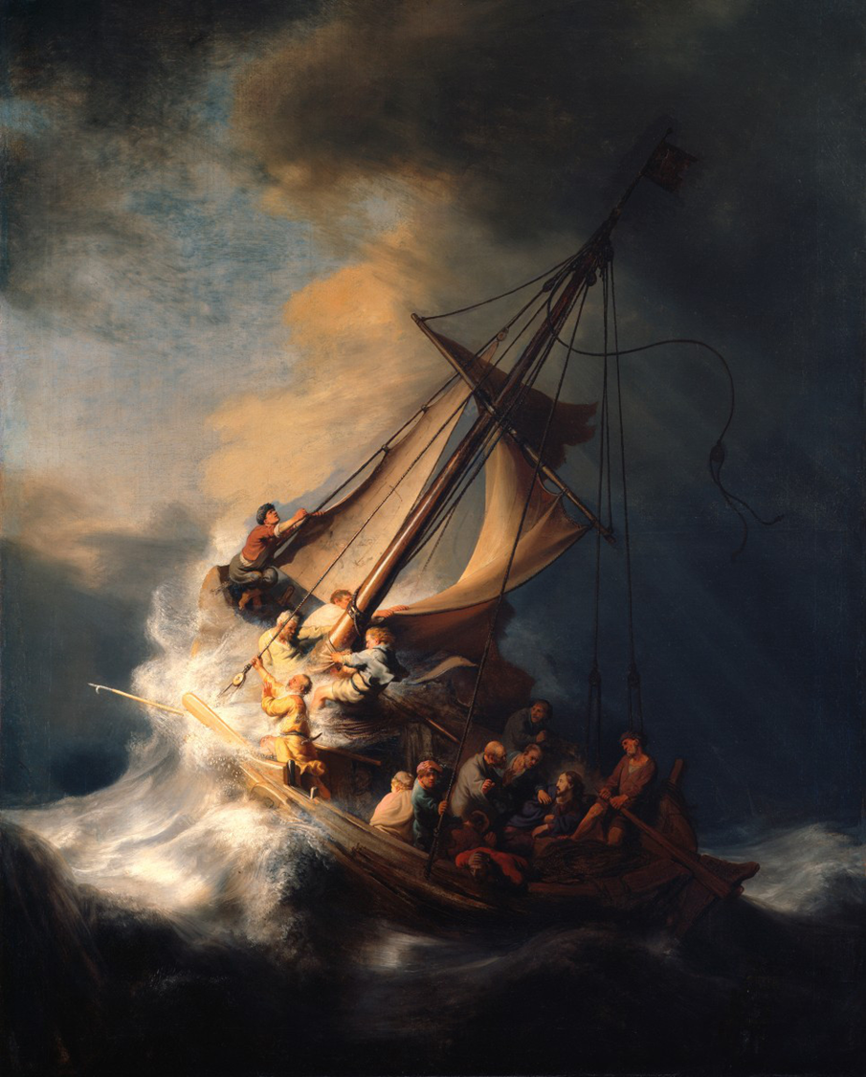
The Miracles of Jesus: Over Nature
Jesus calms the storm (Mark 4:35-41)
“And He awoke and rebuked the wind and said to the sea, ‘Peace! Be still!’ And the wind ceased, and there was a great calm. He said to them, ‘Why are you so afraid? Have you still no faith?’ And they were filled with great fear and said to one another, ‘Who then is this, that even the wind and the sea obey him?’”
Jesus showed His power over nature in many other miracles including…
Turning water into wine (John 2:1-11)
Miraculous catch of fish (Luke 5, John 21)
Feeding the multitudes (Luke 9:12-17)
Withering of the fig tree (Matthew 21:18-22)

Slide 8
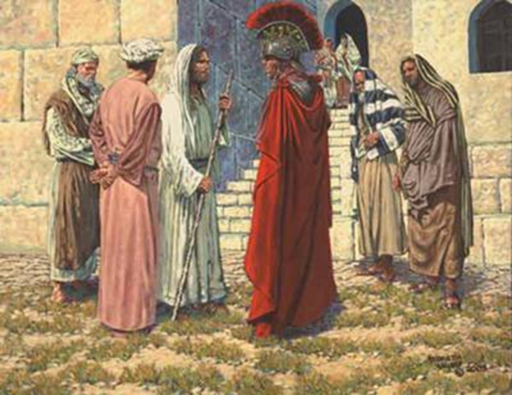
The Miracles of Jesus: Over the Body
Jesus heals the Centurion’s servant (Matthew 8:5-13)
The Centurion requested healing from Jesus on behalf of his servant who was “lying paralyzed at home, suffering terribly.” (8:6)
Jesus was willing to come to the man’s house, but the man did not want to hinder Jesus. He believed so much in the power of Jesus over physical things that he knew Jesus could simply speak the command, and it would be done.
Jesus marveled at the faith of the Centurion, which was greater than those of the Jewish faith.
Jesus shows His power of disease by healing the servant – even from a distance.
There are many other examples as well.
Healing of the lame man (John 5)
Healing of the blind man (John 9)
“…with a great crowd of his disciples and a great multitude of people…who came to hear Him and to be healed of their diseases…for power came out from Him and healed them all.”
- Luke 6:17-19, ESV

Slide 9
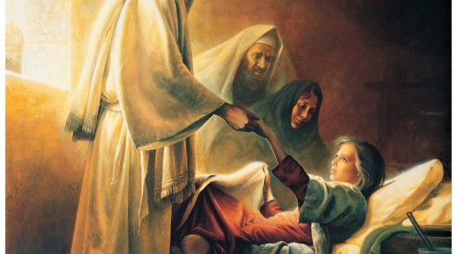
The Miracles of Jesus: Over Death
Jesus raises Jairus’s Daughter(Mark 5:21-43)
Jairus, one of the rulers of the synagogue, implored Jesus to come and help his daughter.
On the way, a messenger came saying – “Your daughter is dead. Why trouble the Teacher any further?” (5:35)
Jesus reassures Jairus: “Do not fear, only believe.” (5:36)
When Jesus arrives, there is a great commotion including weeping and wailing.
Having put the people out, Jesus raises the child and she immediately begins to walk around
Jesus also raised the widow’s son (Luke 7:11-17) and also Lazarus (John 11).
“…for he has been dead four days…’Father, I thank you that you have heard me. I knew that you always hear me, but I said this on account of the people standing around, that they may believe that you sent me…Lazarus, come out.’”
John 11:39-43, ESV

Slide 10
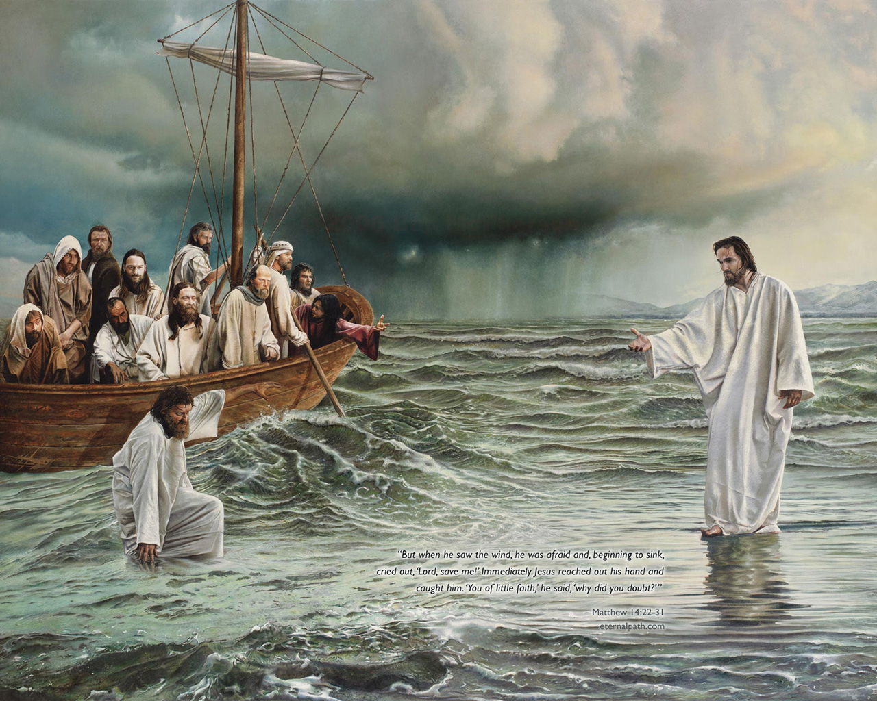
The Miracles of Jesus: Their Validity
Skeptics today question the validity of every word of the Bible, including the miracles of Jesus.
The apostles didn’t doubt their validity. (Matthew 14:33)
The people didn’t doubt their validity. (Matthew 15:29-31)
Even the enemies of Jesus did not reject their validity, but tried to accuse Him of other things. (John 5:16)
There is great danger in rejecting the power and miracles of Jesus. (Matthew 11:20-24)
If we believe that God created everything through the power of the Son, then why would we doubt His ability to perform miracles?
“For if the mighty works done in you had been done in Sodom, it would have remained until this day. But I tell you that it will be more tolerable on the day of judgment for the land of Sodom than for you.’”
Matthew 11:23b-24, ESV

Slide 11
The Miracles of Jesus
Jesus not only claimed to be the Son of God, He proved it through His good works and the miraculous power He showed.
“Rabbi, we know that you are a teacher come from God, for no one can do these signs that you do unless God is with Him.” (John 3:2)
“Now Jesus did many other signs in the presence of the disciples, which are not written in this book; but these are written so that you may believe that Jesus is the Christ, the Son of God, and that by believing you may have life in His name.” (John 20:30-31, ESV)

