Slide 1
Finding The True JOY Of A Christian
Lessons From Philippians

Slide 2
Order of Worship Service
Bible Reading: Phil. 1:1-11 - Landon
Prayer: Garrett
1st Song: Eli
2nd Song: Garrett
Lord’s Supper: Ryan / Jeb
3rd Song: Jace
Introduction: Theme – Rejoice in the Lord: Caleb
4th Song: Cam
1st Point: Jace
5th Song: Eli
2nd Point: Jeb
6th Song: Derek #189
3rd Point: Derek
7th Song: Perrin
4th Point: Perrin
Invitation: Taylor
8th Song: Invitation: Landon
Announcements: Cam
Closing Prayer: Ryan

Slide 3
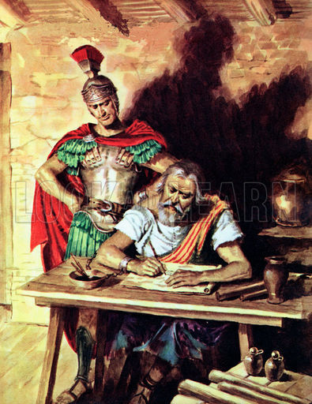
Context: Paul Wrote Philippians In Prison…
I want you to know, brethren, that what has happened to me has really served to advance the gospel, so that it has become known throughout the whole praetorian guard and to all the rest that my imprisonment is for Christ; and most of the brethren have been made confident in the Lord because of my imprisonment, and are much more bold to speak the word of God without fear. (Philippians 1:12-14 RSV)

Slide 4
Theme: Rejoice in the Lord…
Rejoice in the Lord always. Again I will say, rejoice! (Philippians 4:4 NKJV)
I thank my God upon every remembrance of you, always in every prayer of mine making request for you all with joy, (Philippians 1:3-4 NKJV)
“Joy” and / or “Rejoice” at least 14 times in the book.

Slide 5
How Do We Find True Joy In The Lord?
Christ is the Answer!
Rejoice in the Lord always; again I will say, Rejoice. (Philippians 4:4 RSV)

Slide 6
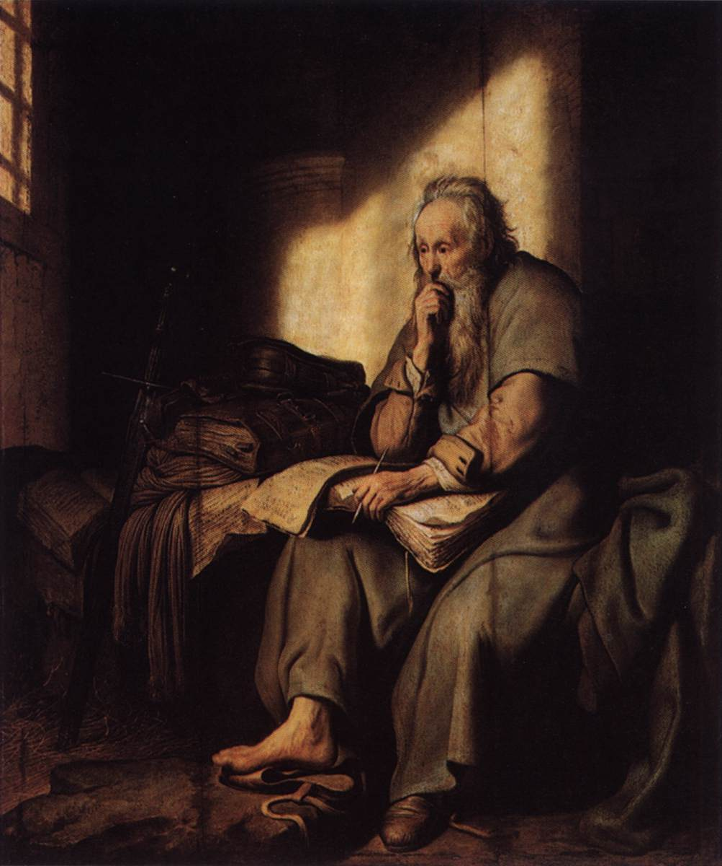
1. Christ Is The Purpose of My Life…
Read Philippians 1:19-26
Define the word “Purpose”
Make the application
“For to me, to live is Christ, and to die is gain.” (1:21)
Other Supporting Scriptures:
Colossians 3:1-4

Slide 7
2. Christ is the Pattern of My Life…
Read Philippians 2:1-11
Define the word “Pattern”
Make the application
Let this mind be in you which was also in Christ Jesus, (Philippians 2:5 NKJV)
Other Supporting Scriptures:
2 Timothy 1:13
1 Corinthians 11:1

Slide 8
3. Christ is the Prize of My Life…
Philippians 3:7-14
Define the word “Prize”
Make the application
I press toward the goal for the prize of the upward call of God in Christ Jesus. (Philippians 3:14 NKJV)
Other Supporting Scriptures:
2 Timothy 4:6-8
Revelation 2:10

Slide 9
4. Christ is the Power of My Life…
Philippians 4:10-13
Define the word “Power”
Make the application
I can do all things through Christ who strengthens me. (Philippians 4:13 NKJV)
Other Supporting Scriptures:
Ephesians 6:10,11
John 15:5

Slide 10
Final Exhortations: Rejoice!
Rejoice in the Lord always. Again I will say, rejoice! (Philippians 4:4 NKJV)
Christ Is The Answer:
Christ Is My Purpose.
Christ Is My Pattern.
Christ Is My Prize.
Christ Is My Power.

