Slide 1
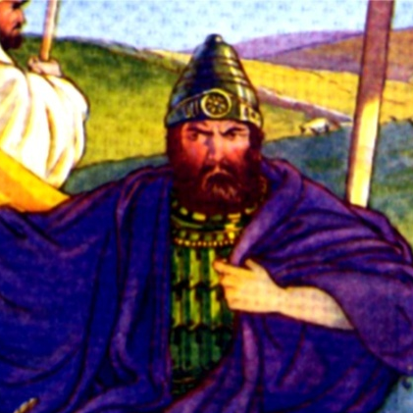
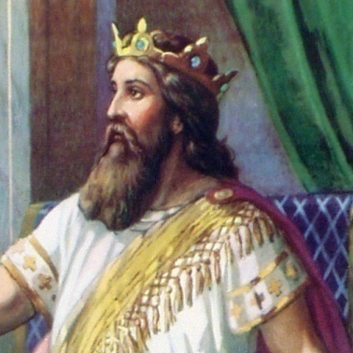
The End Of The United Kingdom
The kingdom lasted 120 years before dividing
Saul reigned 40 years (Acts 13:21)
David reigned 40 years (2 Sam. 5:4)
Solomon reigned 40 years (1 Kings 11:22)
10 Tribes formed the Northern Kingdom called Israel
The Southern Kingdom was the tribe of Judah
SAUL
DAVID
SOLOMON

Slide 2
The kingdom divided immediately after the death of Solomon.
I Kings 11-12
Dan
ISRAEL
Shechem
King Jeroboam
Solomon’s son, Rehoboam reigned over Judah in Jerusalem.
Solomon’s servant, Jeroboam reigned from Shechem over the 10 tribes of Israel and provided idols at Dan and Bethel as places of worship to keep Israel from going to Jerusalem to worship the true God in the temple.
Bethel
JUDAH
Jerusalem
King Rehoboam
EGYPT

Slide 3
SYRIA
JEROBOAM
Solomon’s Servant
King Of Israel
King Over 10 tribes
ISRAEL
Shechem
MAN OF GOD From Judah
Bethel
Jerusalem
1 Kings 13
“¹And, behold, there came a man of God out of Judah by the word of the LORD unto Bethel: and Jeroboam stood by the altar to burn incense.”
Dead Sea
AMMON
JUDAH
MOAB
EGYPT
EDOM
THE DIVIDED KINGDOM

Slide 4
1 Kings 13
“¹¹Now there dwelt an old prophet in Bethel; and his sons came and told him all the works that the man of God had done that day in Bethel: the words which he had spoken unto the king, them they told also to their father.”
The OLD PROPHET lived in Bethel, the same place that King Jeroboam had his altar to the idol!
OLD PROPHET

Slide 5
And he went after the man of God, and found him sitting under an oak; and he said to him, "Are you the man of God who came from Judah?" And he said, "I am." Then he said to him, "Come home with me and eat bread." And he said, "I may not return with you, or go in with you; neither will I eat bread nor drink water with you in this place; for it was said to me by the word of the LORD, 'You shall neither eat bread nor drink water there, nor return by the way that you came.'" And he said to him, "I also am a prophet as you are, and an angel spoke to me by the word of the LORD, saying, 'Bring him back with you into your house that he may eat bread and drink water.'" But he lied to him. (1 Kings 13:14-18 RSV)
OLD PROPHET

Slide 6
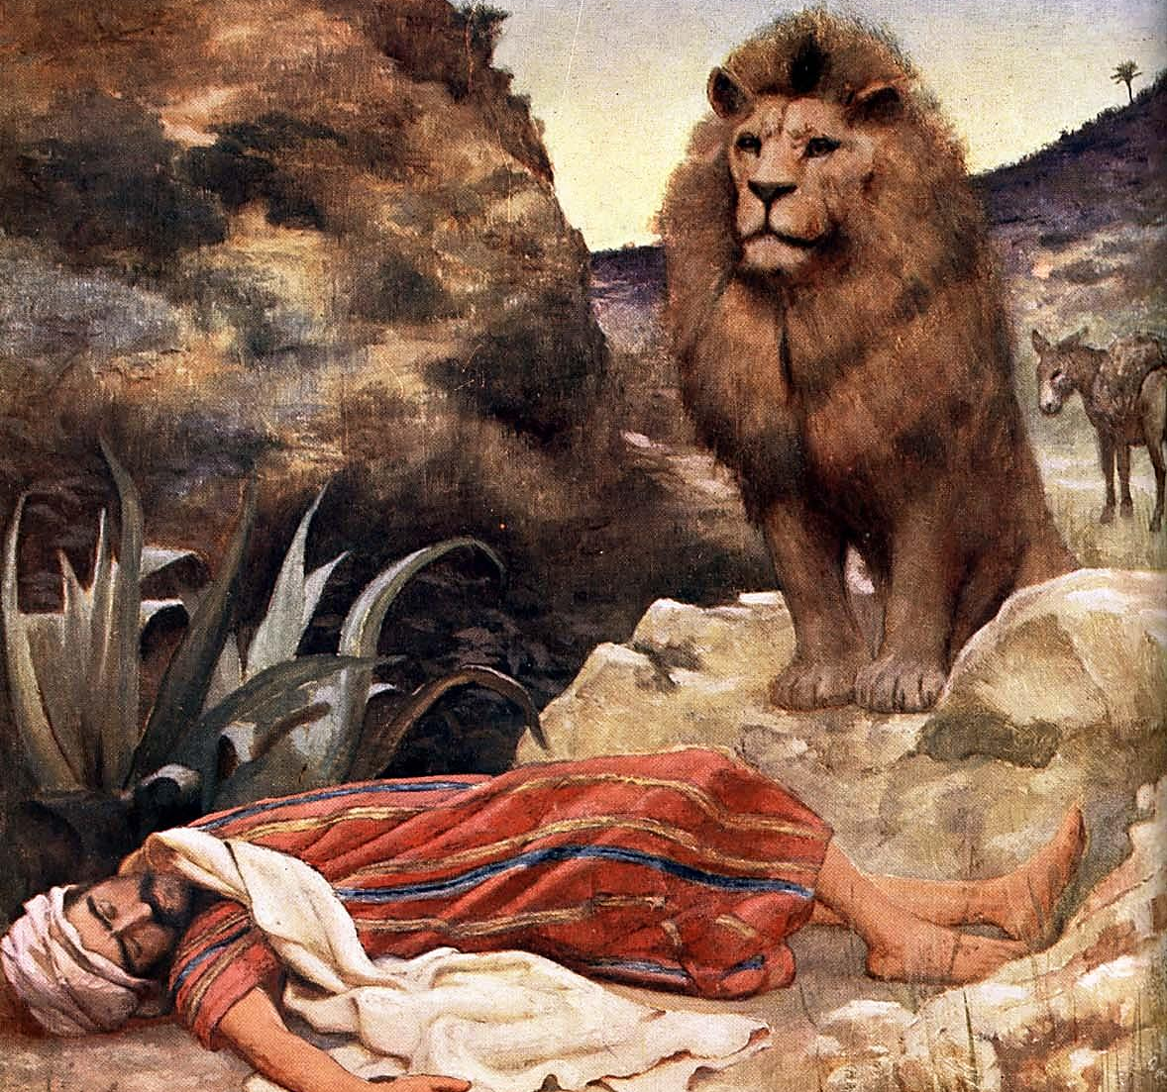
So he went back with him, and ate bread in his house, and drank water. And as they sat at the table, the word of the LORD came to the prophet who had brought him back; and he cried to the man of God who came from Judah, "Thus says the LORD, 'Because you have disobeyed the word of the LORD, and have not kept the commandment which the LORD your God commanded you, but have come back, and have eaten bread and drunk water in the place of which he said to you, "Eat no bread, and drink no water"; your body shall not come to the tomb of your fathers.'" And after he had eaten bread and drunk, he saddled the ass for the prophet whom he had brought back. And as he went away a lion met him on the road and killed him. And his body was thrown in the road, and the ass stood beside it; the lion also stood beside the body. (1 Kings 13:19-24 RSV)

Slide 7
What Caused the Young Prophet to Disobey?
What Was The Young Prophet’s Mistake?

Slide 8
Exchanging The Truth of God…
Lessons From Two Prophets:
We are subject to being deceived.
In determining truth, nothing is more important than God's Word.
A stubborn faith in God's word will prevent deception.
Believing a lie has the same effect on the mind as the Truth.
Because of a falsehood believed, some find the truth unbelievable.
A lie believed and obeyed causes one to be lost.
OLD PROPHET
MAN OF GOD
And he said to him, "I also am a prophet as you are, and an angel spoke to me by the word of the LORD, saying, 'Bring him back with you into your house that he may eat bread and drink water.'" But he lied to him. (1 Kings 13:18 RSV)

Slide 9
Sources
Exchanging the Truth of God For A Lie – Jim Deason
Bible Visualized – Slides
Men and Women of the Bible (Lives - Times - Events – Principles) – Edited by Karl Hennecke

