Slide 1
God And Authority
The power to enforce obedience, right to command or act.
We must recognize the need for authority and have respect for authority once it is established.
God
Jesus
Holy Spirit
Apostles
Word
Faith
To act with authority is to act by the order or instruction of one who has legal or rightful power.
Heb 11:6 “Without faith it is impossible to please God…”
(2 John 1:9) Whoever transgresses and does not abide in the doctrine of Christ does not have God. He who abides in the doctrine of Christ has both the Father and the Son. (NKJV)
Notes:
1

Slide 2
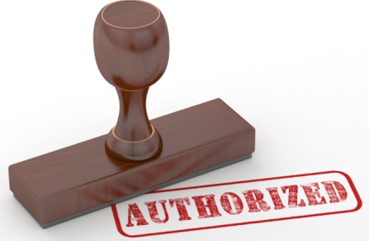
Three Possibilities
If We Love God, when it comes to anything we practice, we should ask the question, “Does this please God?”
“Yes,” the practice is authorized.
“No,” the practice is condemned.
“I don’t know,” the practice is unauthorized.
Everyone would agree that we can practice things that are authorized.
We should not practice things that are condemned.
What about the third category? Many say that as long as God does not specifically condemn a practice…

Slide 3
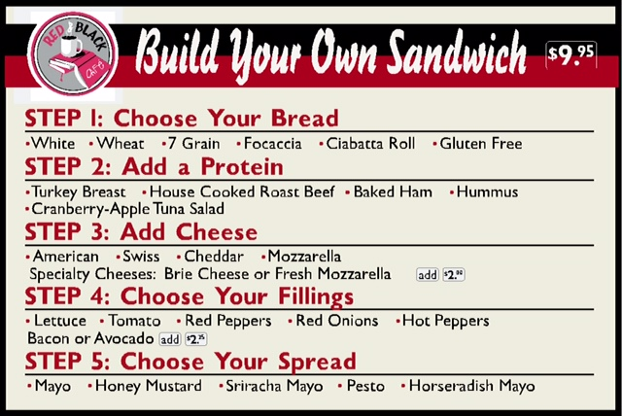
Food Illustration
Lance’s Order:
White
Ham
Swiss
Lettuce & Tomato
Mayo
How many of us are happy when our sandwich comes to us with items that we had specifically condemned or not authorized?
Likewise, if God has specifically revealed what pleases Him on a matter, we should not presume to do something that He has not authorized.

Slide 4
Acts 15 and Establishing God’s Approval.
Is it necessary to be circumcised in order to be saved?
God’s Approval
Necessarily Implied
The First Speech – Peter (v.7-11)
The 2nd Speech – Paul & Barnabas (v.7-11)
God’s Approval
Apostolic Example
God’s Approval
Direct Statement
The 3rd Speech – James (v.13-19)

Slide 5
How To Determine What Is
Authorized
Acts 15
Circumcision
Illustrated
Lord’s Supper
Command/
Direct
Statement
Approved
Example
Necessary
Inference
Observance
1 Cor. 11:23-24
Time of Ob.
Acts 20:7
Frequency
Acts 20:7
vv. 13-21
v. 12
vv. 7-11

Slide 6
The Lord Has Given Us A Pattern:
Follow the pattern of the sound words which you have heard from me, in the faith and love which are in Christ Jesus; (2 Timothy 1:13 RSV)
Study to shew thyself approved unto God, a workman that needeth not to be ashamed, rightly dividing the word of truth. (2 Timothy 2:15 KJV)

Slide 7
Warnings Found In The New Testament
We must abide in the doctrine of Christ!
(2 John 1:9) Whoever transgresses and does not abide in the doctrine of Christ does not have God. He who abides in the doctrine of Christ has both the Father and the Son. (NKJV)
We must not allow “traditions of men” to make the “commands of God” of no effect!
(Mark 7:7-9) And in vain they worship Me, Teaching as doctrines the commandments of men.' "For laying aside the commandment of God, you hold the tradition of men--the washing of pitchers and cups, and many other such things you do." He said to them, "All too well you reject the commandment of God, that you may keep your tradition. (NKJV)

Slide 8
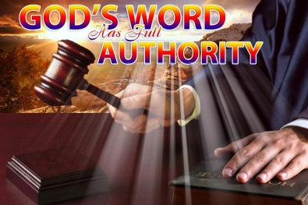
He who rejects me and does not receive my sayings has a judge; the word that I have spoken will be his judge on the last day. (John 12:48 RSV)

Slide 9
“We must speak where the Bible speaks, and be silent where the Bible is silent.”
This is the only way to truly glorify God in all we do!

Slide 10
Resources
Outline by Donnie Rader
Outline by Jim Deason
Outline by Gary Henry
Outline by Mark Copeland

Slide 11
Generic & Specific Authority
Command | Generic | Specific
Build ark - Gen. 6:14 | Wood | Gopher
Wash 7 Times - 2 Kings 5 | River | Jordan
Offer – Lev. 14:12-13 | Animal | Lamb
Praise – Eph. 5:19 | Music | Sing
Buy me a canned drink | Cola (Soda) | Pepsi

Slide 12
Aids Are Authorized,
Additions Are Not
An Addition Involves Another Element Being Added!
Command | Aid | Addition
Eat Bread – 1 Cor. 11 | Table, plates … | Jam, beef, cola
Baptize – Matt. 28:19 | Baptistry, heater | Sprinkling
Build an ark – Gen. 6:14 | Tool, Animal | Oak, Cedar
Sing – Eph. 5:19 | Books, Tuner | Instrumental Music
Contribute – 1 Cor. 16 | Basket, Account | Mon. / Sat.

Slide 13
God’s Silence Is Not Authority
Two Mindsets
Permissive
At liberty to do what
is not
condemned
Prohibitive
Forbidden to act
Without authority
Heb. 7:14
For it is evident that our Lord arose from Judah, of which tribe Moses spoke nothing concerning priesthood

