Slide 2
Think It Over…
God made the sun – it gives.
God made the moon – it gives.
God made the stars – they give.
God made the air – it gives.
God made the clouds – they give.
God made the earth – it gives.
God made the sea – it gives.
God made the trees – they give.
God made the flowers – they give.
God made the fowls – they give.
God made the beasts – they give.
God made the plan – He gives.
God made man – he…???

Slide 3
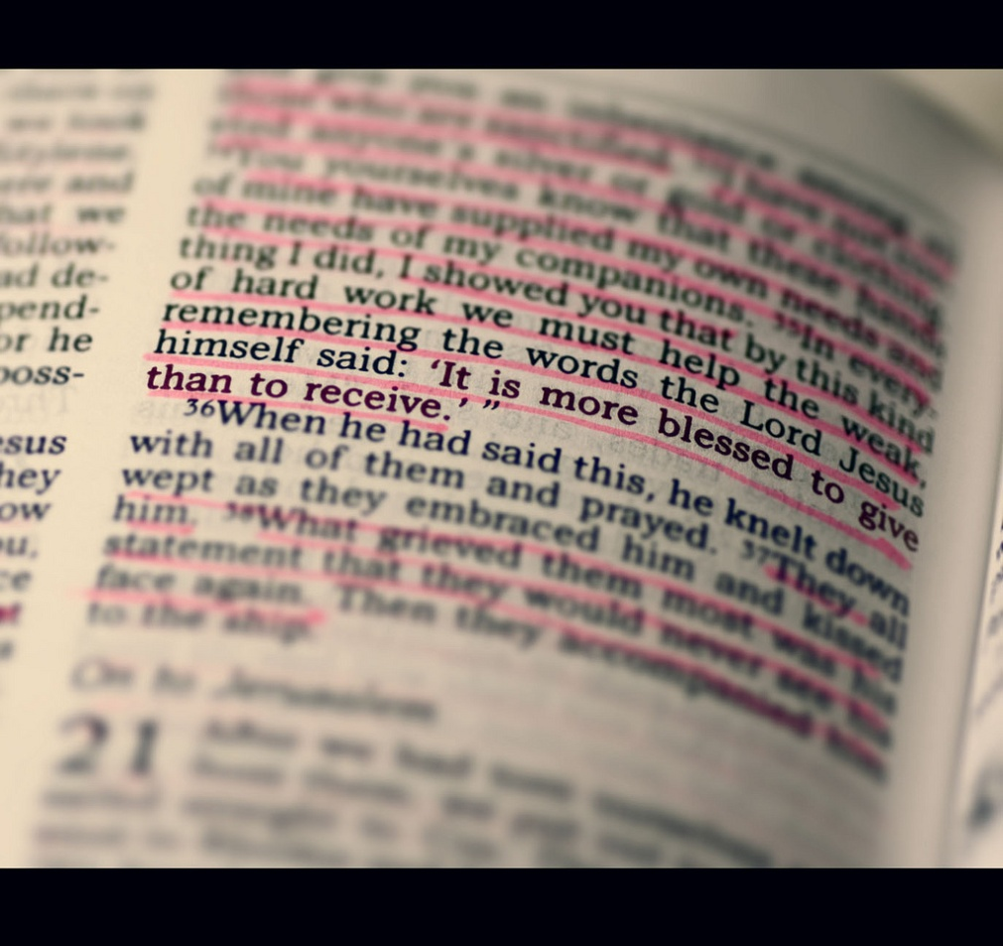
The Subject of Giving In The Bible…
Matthew – 33 times
Mark – 20 times
Luke – 53 times
John – 17 times
There is not a book in the N.T. where giving is not discussed.
The Bible says more about giving than any other subject!

Slide 4
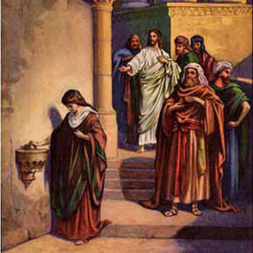
The Widow and Her Two Coins…
He looked up and saw the rich putting their gifts into the treasury; and he saw a poor widow put in two copper coins. And he said, "Truly I tell you, this poor widow has put in more than all of them; for they all contributed out of their abundance, but she out of her poverty put in all the living that she had." (Luke 21:1-4 RSV)

Slide 5
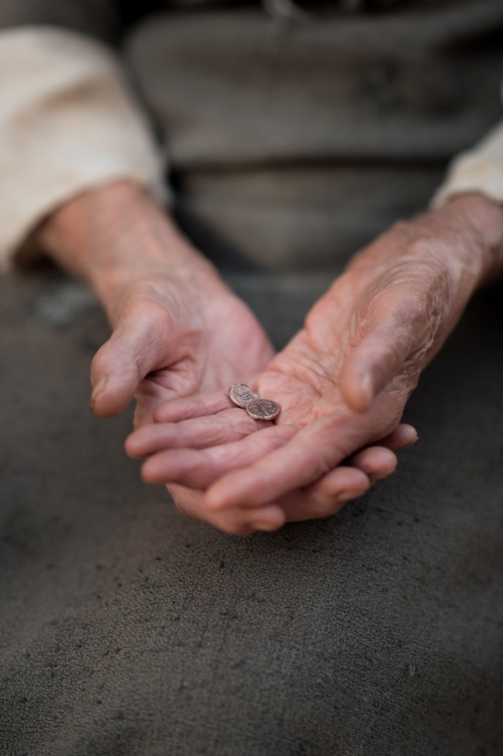
The Widow and Her Two Coins…
What We Learn:
Jesus sees our giving.
Our giving should be sacrificial.
Each person has a duty to meditate on and give according to how much he has; how much self-denial he practices, and his motive for giving.
It is our duty to devote all to God. We are only stewards.

Slide 6
God’s Plan For Giving…
GIVING SHOULD BE GIVEN PRIORITY IN OUR LIVES... Matt. 6:33
GIVING IS A PERSONAL OBLIGATION... 1 Cor. 16:1-2
GIVING IS TO BE PERIODIC... 1 Cor. 16:2
GIVING IS TO BE PURPOSED (planned)... 2 Cor. 9:7
GIVING IS TO BE DONE CHEERFULLY... 2 Cor. 9:7
GIVING IS TO BE PLENTIFUL... 2 Cor. 9:6
What Does Your Giving Say To God?

Slide 7
What Our Giving Says…
Adapted from Greg Gwin
IF I GIVE NOTHING:
I’m really saying, "Let's close the doors and disband the church".
I take a "free ride" based on what others have given.
WHEN I GIVE LESS THAN 10% OF MY INCOME:
I am doing less than was required of the poorest Jew under the Law of Moses.
I show that I do not appreciate the "better" blessings I enjoy in Christ Jesus (Hebrew 8:6).
IF I’M NOT GIVING MORE THAN I DID LAST YEAR:
I’m saying that I am not any better off financially than I was 12 months ago - no raise, no bonus, etc. Is this true?
Or is it a problem of priorities?
IF I GIVE, BUT DO SO GRUDGINGLY:
I miss out on the joy of giving.
I disappoint God, for He "loves a cheerful giver" (2 Cor. 9:7).
WHEN I DON'T "PURPOSE" WHAT I GIVE IN ADVANCE:
I’m not following God's plan (2 Cor. 9:7). I’m likely to take on obligations which will prevent me from giving as I should.
I make it difficult for the church to have any long range program of work.
IF I DON'T GIVE PROPORTIONATELY AS I’VE PROSPERED:
I commit sin (1 Cor. 16:2).
I hinder the important work of the church.
I deprive myself of some of the satisfaction and fulfillment of being a faithful servant. -

Slide 8
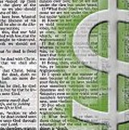
A Small Challenge To All…
What if each member here increased their giving by only $5.00 above their present giving each week:
80 members x $5 = $400 per week
Extra $1,733.33 per month
Extra $20,800 per year
How much more could we do for the Lord?
Support more preachers…
Help more needy saints…
Edify one another…
Reach more souls with the Gospel…
But the king said to Araunah, "No, but I will buy it of you for a price; I will not offer burnt offerings to the LORD my God which cost me nothing….” (2 Samuel 24:24a RSV)

Slide 9
Have You Given Your Heart To The Lord?
The Bible is clear. Our gift will measure our reward.
But this I say: He who sows sparingly will also reap sparingly, and he who sows bountifully will also reap bountifully. (2 Corinthians 9:6 NKJV)
In addition, we should decide in our heart what to give, do not give reluctantly, and give cheerfully:
So let each one give as he purposes in his heart, not grudgingly or of necessity; for God loves a cheerful giver. (2 Corinthians 9:7 NKJV)
WAKE UP: We never read of any people in any age of the world who ever gave less than a tenth of their income to God, and at the same time met the approval of God!

Slide 10
Sources
“What Our Giving Says” Article by Greg Gwin
Rust as a Witness – Steve Higginbotham
Material from Shawn Bain
Why The Early Church Gave Liberally by Bobby Thompson
Material from Jim Deason – God’s Plan for Giving

