Slide 2
Truth Is A Valuable Commodity…
Then Jesus said to those Jews who believed Him, "If you abide in My word, you are My disciples indeed. "And you shall know the truth, and the truth shall make you free." (John 8:31-32 NKJV)

Slide 3
It Is Important For Us To…
Love the Truth – 2 Thess. 2:8-12
Learn the Truth – 2 Tim. 2:15
Obey the Truth – Matt. 7:24

Slide 4
Lessons About The Truth
2 Kings 5

Slide 5
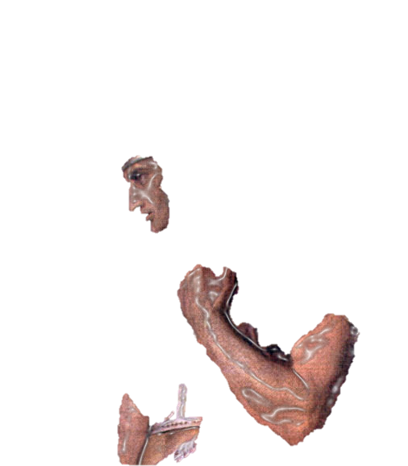
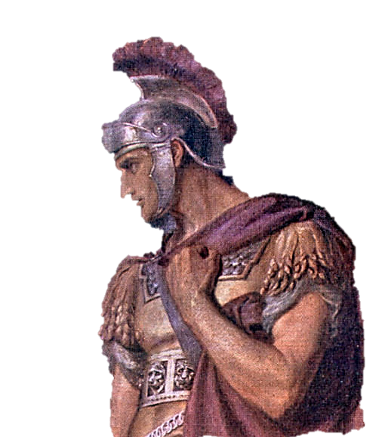
2 Kings 5
¹Now Naaman, captain of the host of the king of Syria, was a great man with his master, and honourable, because by him the LORD had given deliverance unto Syria: he was also a mighty man in valour, but he was a leper.

Slide 6
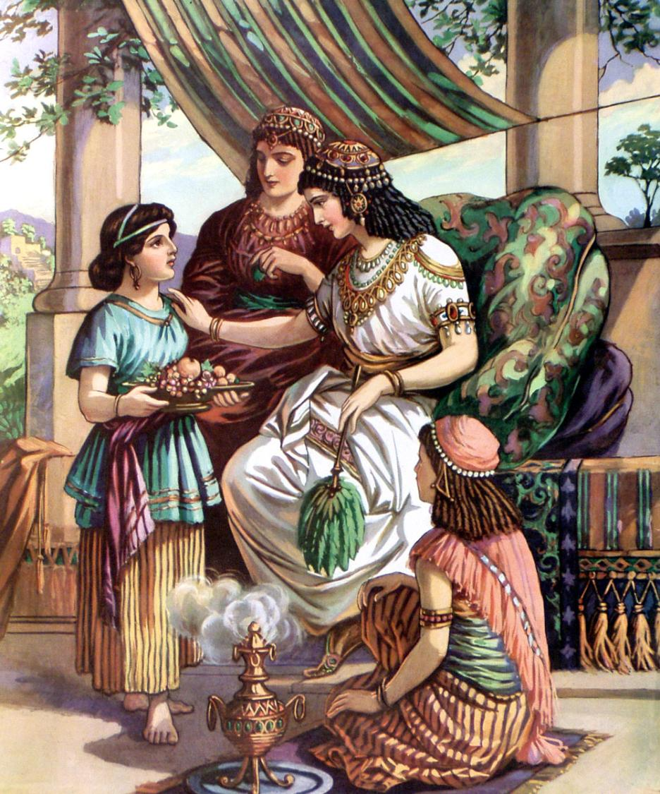
2 Kings 5
“²And the Syrians had gone out by companies, and had brought away captive out of the land of Israel a little maid; and she waited on Naaman’s wife.”

Slide 7
2 Kings 5
“³And she said unto her mistress, Would God my lord were with the prophet that is in Samaria! for he would recover him of his leprosy.”
Luke 4:27
“And many lepers were in Israel in the time of Elisha the prophet; and none of them was cleansed, saving Naaman the Syrian.”
This little Israelite maid who was a captive, a slave, knew of the power of God. Possibly she had heard or even seen the miracles of Elisha. But, she had never heard of him healing leprosy (see Luke 4:27).

Slide 8
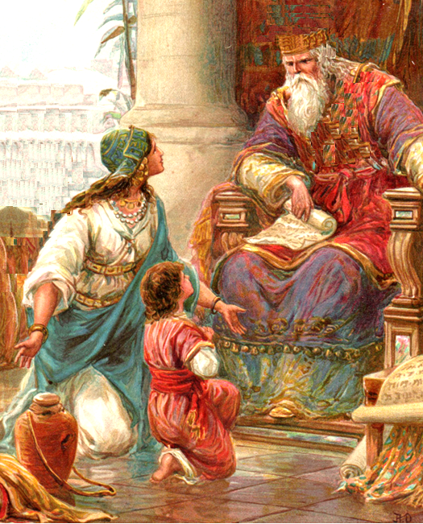
2 Kings 5
“⁴And one went in, and told his lord, saying, Thus and thus said the maid that is of the land of Israel. ⁵And the king of Syria said, Go to, go, and I will send a letter unto the king of Israel. And he departed, and took with him ten talents of silver, and six thousand pieces of gold, and ten changes of raiment. ⁶And he brought the letter to the king of Israel, saying, Now when this letter is come unto thee, behold, I have therewith sent Naaman my servant to thee, that thou mayest recover him of his leprosy.”
When the King of Syria heard that the maid said she knew of a prophet in Israel that could heal Naaman’s leprosy, instead of looking for the prophet, he sent a letter to the King of Israel asking for him to heal Naaman!

Slide 9
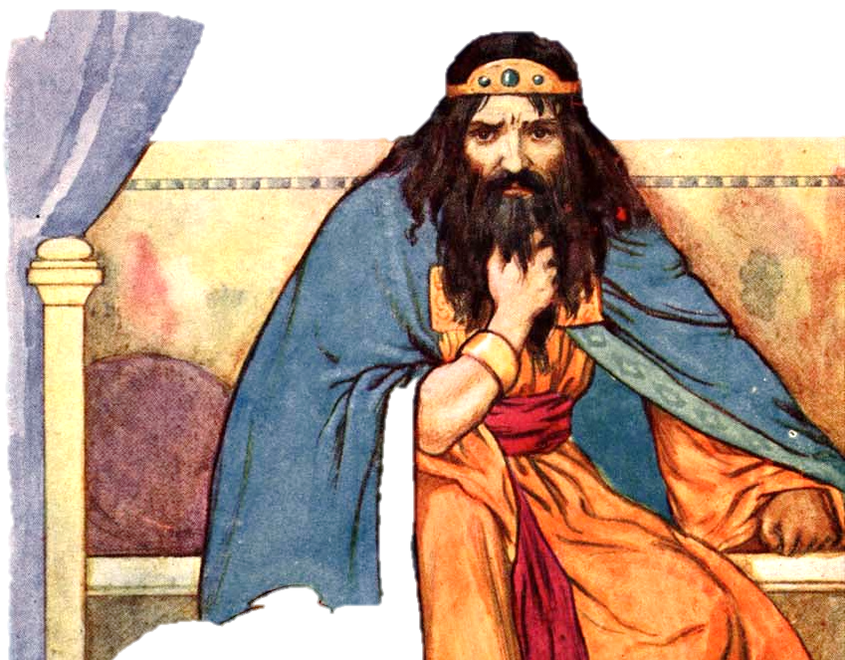
2 Kings 5
“⁷And it came to pass, when the king of Israel had read the letter, that he rent his clothes, and said, Am I God, to kill and to make alive, that this man doth send unto me to recover a man of his leprosy? wherefore consider, I pray you, and see how he seeketh a quarrel against me.”
Well, the King of Israel was terrified. The captain of his enemy’s army shows up with ten talents of silver, six thousand pieces of gold, ten changes of raiment, and a letter from the King of Syria saying, heal this man of leprosy!
What an ignorant, stubborn king of Israel. It never dawned on him to call upon Elisha! The little maid knew of Elisha’s miracles, but the king didn’t?

Slide 10
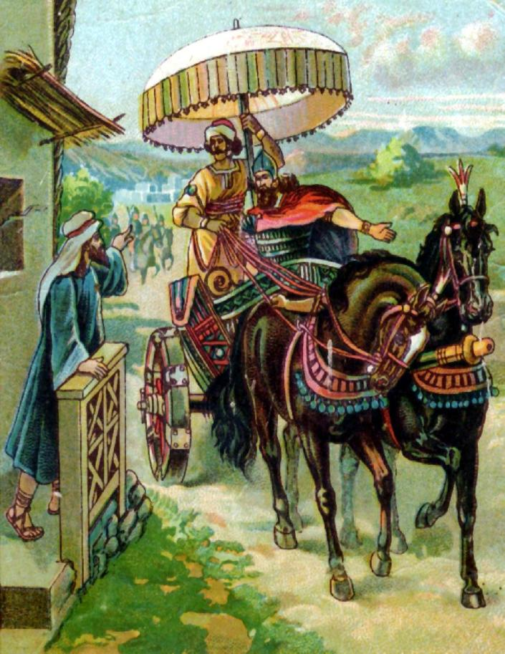
2 Kings 5
“⁹So Naaman came with his horses and with his chariot, and stood at the door of the house of Elisha. ¹⁰And Elisha sent a messenger unto him, saying, Go and wash in Jordan seven times, and thy flesh shall come again to thee, and thou shalt be clean. ¹¹But Naaman was wroth, and went away, and said, Behold, I thought, He will surely come out to me, and stand, and call on the name of the LORD his God, and strike his hand over the place, and recover the leper.”
2 Kings 5
“⁸And it was so, when Elisha the man of God had heard that the king of Israel had rent his clothes, that he sent to the king, saying, Wherefore hast thou rent thy clothes? let him come now to me, and he shall know that there is a prophet in Israel.”

Slide 11
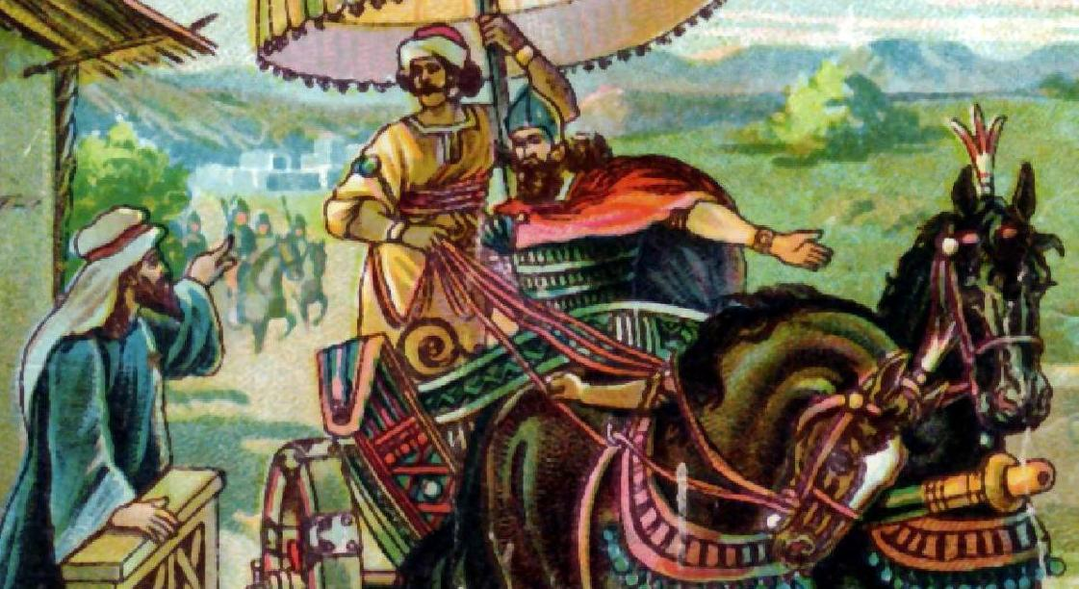
2 Kings 5
“¹²Are not Abana and Pharpar, rivers of Damascus, better than all the waters of Israel? may I not wash in them, and be clean? So he turned and went away in a rage.”

Slide 12
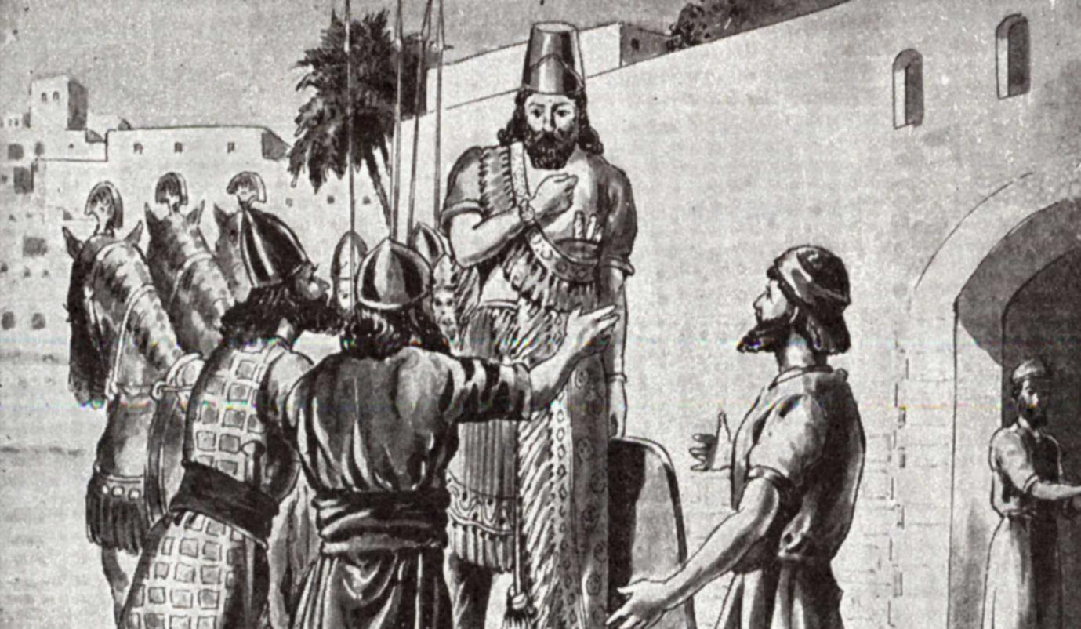
2 Kings 5
“¹³And his servants came near, and spake unto him, and said, My father, if the prophet had bid thee do some great thing, wouldest thou not have done it? how much rather then, when he saith to thee, Wash, and be clean?”

Slide 13
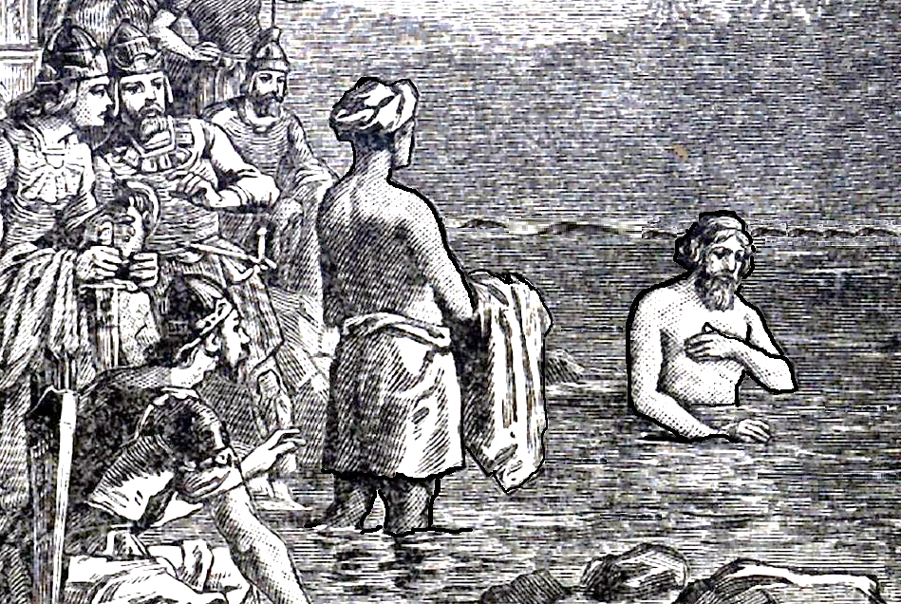
2 Kings 5
“¹⁴Then went he down, and dipped himself seven times in Jordan, according to the saying of the man of God: and his flesh came again like unto the flesh of a little child, and he was clean.”

Slide 14
Lessons About Truth From Naaman…
Truth is truth, even though you don’t like the one who states it.
Truth is truth, even though you don’t like it.
Truth is always truth, even though you think you know a better way.
Truth is the most powerful force in the world when believed and obeyed.
Truth is recognized by a honest heart!

Slide 15
Sources
Lessons from Naaman – Jim Deason
The Bible Visualized

