Slide 2
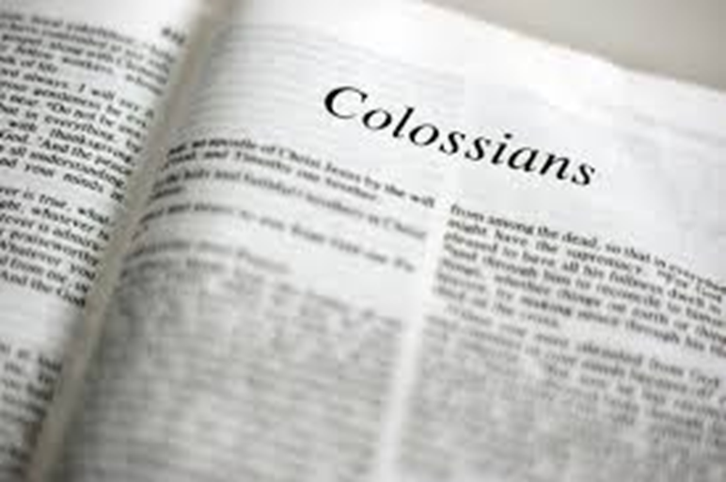
“…Christ is all, and in all.”
Church of Christ at Medina
September 24th, 2017

Slide 3
The city of Colossae
x
Colossae was a city about 100 miles east of Ephesus, in the Roman province of Asia.
It was situated in the Lycus River valley, straddling the east-west trade route connecting Ephesus to Mesopotamia.
Because of the conglomeration of people, there mixtures of religious beliefs including Christianity, Judaism, Stoicism, Epicureanism, Oriential religions and Greek religions.

Slide 4
General Notes on Colossians
Purpose
Paul’s purpose was to remind the Colossians that their salvation was in Christ alone.
It was a response to information that false teaching existed in Colossae. False teaching consisted of:
“…philosophy and empty deceit, according to human tradition, according to the elemental spirits of the world…” (2:8)
“…in questions of food and drink, or with regard to a festival or a new moon or a Sabbath.” (2:16)
“…insisting on asceticism and worship of angels, going on in detail about visions, puffed up without reason by his sensuous mind..” (2:18)

Slide 5
Key Notes from Colossians 1
Greeting (1:1-2)
¹Paul, an apostle of Christ Jesus by the will of God, and Timothy our brother, ² To the saints and faithful brothers in Christ at Colossae: Grace to you and peace from God our Father.
The letter was written by Paul to the Christians in Colossae.
Although it appears that Paul had never visited Colossae (2:1), he was still very concerned for their spiritual welfare.

Slide 6
Key Notes from Colossians 1
Thanksgiving (1:3-8)
³We always thank God, the Father of our Lord Jesus Christ, when we pray for you, ⁴ since we heard of your faith in Christ Jesus and of the love that you have for all the saints, ⁵ because of the hope laid up for you in heaven. Of this you have heard before in the word of the truth, the gospel, ⁶ which has come to you, as indeed in the whole world it is bearing fruit and growing—as it also does among you, since the day you heard it and understood the grace of God in truth, ⁷ just as you learned it from Epaphras our beloved fellow servant. He is a faithful minister of Christ on your behalf ⁸ and has made known to us your love in the Spirit.
Through Epaphras, Paul had heard of the faith, love and hope. These three characteristics are critical in the lives of all Christians. (1 Corinthians 13:13)
These characteristics appeared in the lives of these people because they had received the “word of the truth, the gospel” and it was “bearing fruit and growing” in them.

Slide 7
Key Notes from Colossians 1
Prayer for Their Steadfastness (1:9-12)
⁹And so, from the day we heard, we have not ceased to pray for you, asking that you may be filled with the knowledge of his will in all spiritual wisdom and understanding, ¹⁰ so as to walk in a manner worthy of the Lord, fully pleasing to him, bearing fruit in every good work and increasing in the knowledge of God. ¹¹ May you be strengthened with all power, according to his glorious might, for all endurance and patience with joy, ¹² giving thanks to the Father, who has qualified you to share in the inheritance of the saints in light.”
Paul was encouraged by what he heard about the Colossians, but he wanted their knowledge to increase.
If their knowledge of Christ increased, it would allow the Colossians to maintain their walk in the Lord.
He also prayed for them to be strengthened so they might be able to endure.

Slide 8
Key Notes from Colossians 1
Christ as Lord and Savior (1:13-14)
¹³ He has delivered us from the domain of darkness and transferred us to the kingdom of his beloved Son, ¹⁴ in whom we have redemption, the forgiveness of sins.
The Colossians who had received and obeyed the gospel were granted entrance into the “kingdom of his beloved Son” and forgiveness.

Slide 9
Christ as Lord and Redeemer (1:15-23)
¹⁵He is the image of the invisible God, the firstborn of all creation. ¹⁶ For by him all things were created, in heaven and on earth, visible and invisible, whether thrones or dominions or rulers or authorities—all things were created through him and for him. ¹⁷ And he is before all things, and in him all things hold together. ¹⁸ And he is the head of the body, the church. He is the beginning, the firstborn from the dead, that in everything he might be preeminent. ¹⁹ For in him all the fullness of God was pleased to dwell, ²⁰ and through him to reconcile to himself all things, whether on earth or in heaven, making peace by the blood of his cross. ²¹ And you, who once were alienated and hostile in mind, doing evil deeds, ²² he has now reconciled in his body of flesh by his death, in order to present you holy and blameless and above reproach before him, ²³ if indeed you continue in the faith, stable and steadfast, not shifting from the hope of the gospel that you heard, which has been proclaimed in all creation under heaven, and of which I, Paul, became a minister.

Slide 10
Paul’s Suffering and Work (1:24-29)
²⁴Now I rejoice in my sufferings for your sake, and in my flesh I am filling up what is lacking in Christ's afflictions for the sake of his body, that is, the church, ²⁵ of which I became a minister according to the stewardship from God that was given to me for you, to make the word of God fully known, ²⁶ the mystery hidden for ages and generations but now revealed to his saints. ²⁷ To them God chose to make known how great among the Gentiles are the riches of the glory of this mystery, which is Christ in you, the hope of glory. ²⁸ Him we proclaim, warning everyone and teaching everyone with all wisdom, that we may present everyone mature in Christ. ²⁹ For this I toil, struggling with all his energy that he powerfully works within me.

Slide 11
Mystery of Christ (2:1-3)
¹For I want you to know how great a struggle I have for you and for those at Laodicea and for all who have not seen me face to face, ² that their hearts may be encouraged, being knit together in love, to reach all the riches of full assurance of understanding and the knowledge of God's mystery, which is Christ, ³ in whom are hidden all the treasures of wisdom and knowledge.

Slide 12
Warnings against False Teachers (2:4-8)
⁴ I say this in order that no one may delude you with plausible arguments. ⁵ For though I am absent in body, yet I am with you in spirit, rejoicing to see your good order and the firmness of your faith in Christ. ⁶ Therefore, as you received Christ Jesus the Lord, so walk in him, ⁷ rooted and built up in him and established in the faith, just as you were taught, abounding in thanksgiving. ⁸ See to it that no one takes you captive by philosophy and empty deceit, according to human tradition, according to the elemental spirits of the world, and not according to Christ.

Slide 13
Christ the Safeguard (2:9-15)
⁹ For in him the whole fullness of deity dwells bodily, ¹⁰ and you have been filled in him, who is the head of all rule and authority. ¹¹ In him also you were circumcised with a circumcision made without hands, by putting off the body of the flesh, by the circumcision of Christ, ¹² having been buried with him in baptism, in which you were also raised with him through faith in the powerful working of God, who raised him from the dead. ¹³ And you, who were dead in your trespasses and the uncircumcision of your flesh, God made alive together with him, having forgiven us all our trespasses, ¹⁴ by canceling the record of debt that stood against us with its legal demands. This he set aside, nailing it to the cross. ¹⁵ He disarmed the rulers and authorities and put them to open shame, by triumphing over them in him.

Slide 14
Warnings against False Teachers (2:16-23)
¹⁶ Therefore let no one pass judgment on you in questions of food and drink, or with regard to a festival or a new moon or a Sabbath. ¹⁷ These are a shadow of the things to come, but the substance belongs to Christ. ¹⁸ Let no one disqualify you, insisting on asceticism and worship of angels, going on in detail about visions, puffed up without reason by his sensuous mind, ¹⁹ and not holding fast to the Head, from whom the whole body, nourished and knit together through its joints and ligaments, grows with a growth that is from God. ²⁰ If with Christ you died to the elemental spirits of the world, why, as if you were still alive in the world, do you submit to regulations— ²¹ "Do not handle, Do not taste, Do not touch" ²² (referring to things that all perish as they are used)—according to human precepts and teachings? ²³ These have indeed an appearance of wisdom in promoting self-made religion and asceticism and severity to the body, but they are of no value in stopping the indulgence of the flesh.
¹⁶ Therefore let no one pass judgment on you in questions of food and drink, or with regard to a festival or a new moon or a Sabbath. ¹⁷ These are a shadow of the things to come, but the substance belongs to Christ. ¹⁸ Let no one disqualify you, insisting on asceticism and worship of angels, going on in detail about visions, puffed up without reason by his sensuous mind, ¹⁹ and not holding fast to the Head, from whom the whole body, nourished and knit together through its joints and ligaments, grows with a growth that is from God. ²⁰ If with Christ you died to the elemental spirits of the world, why, as if you were still alive in the world, do you submit to regulations— ²¹ "Do not handle, Do not taste, Do not touch" ²² (referring to things that all perish as they are used)—according to human precepts and teachings? ²³ These have indeed an appearance of wisdom in promoting self-made religion and asceticism and severity to the body, but they are of no value in stopping the indulgence of the flesh.

