Slide 1
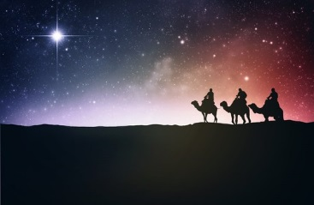
Wise Men Seek Jesus
Matthew 2:1-16

Slide 2
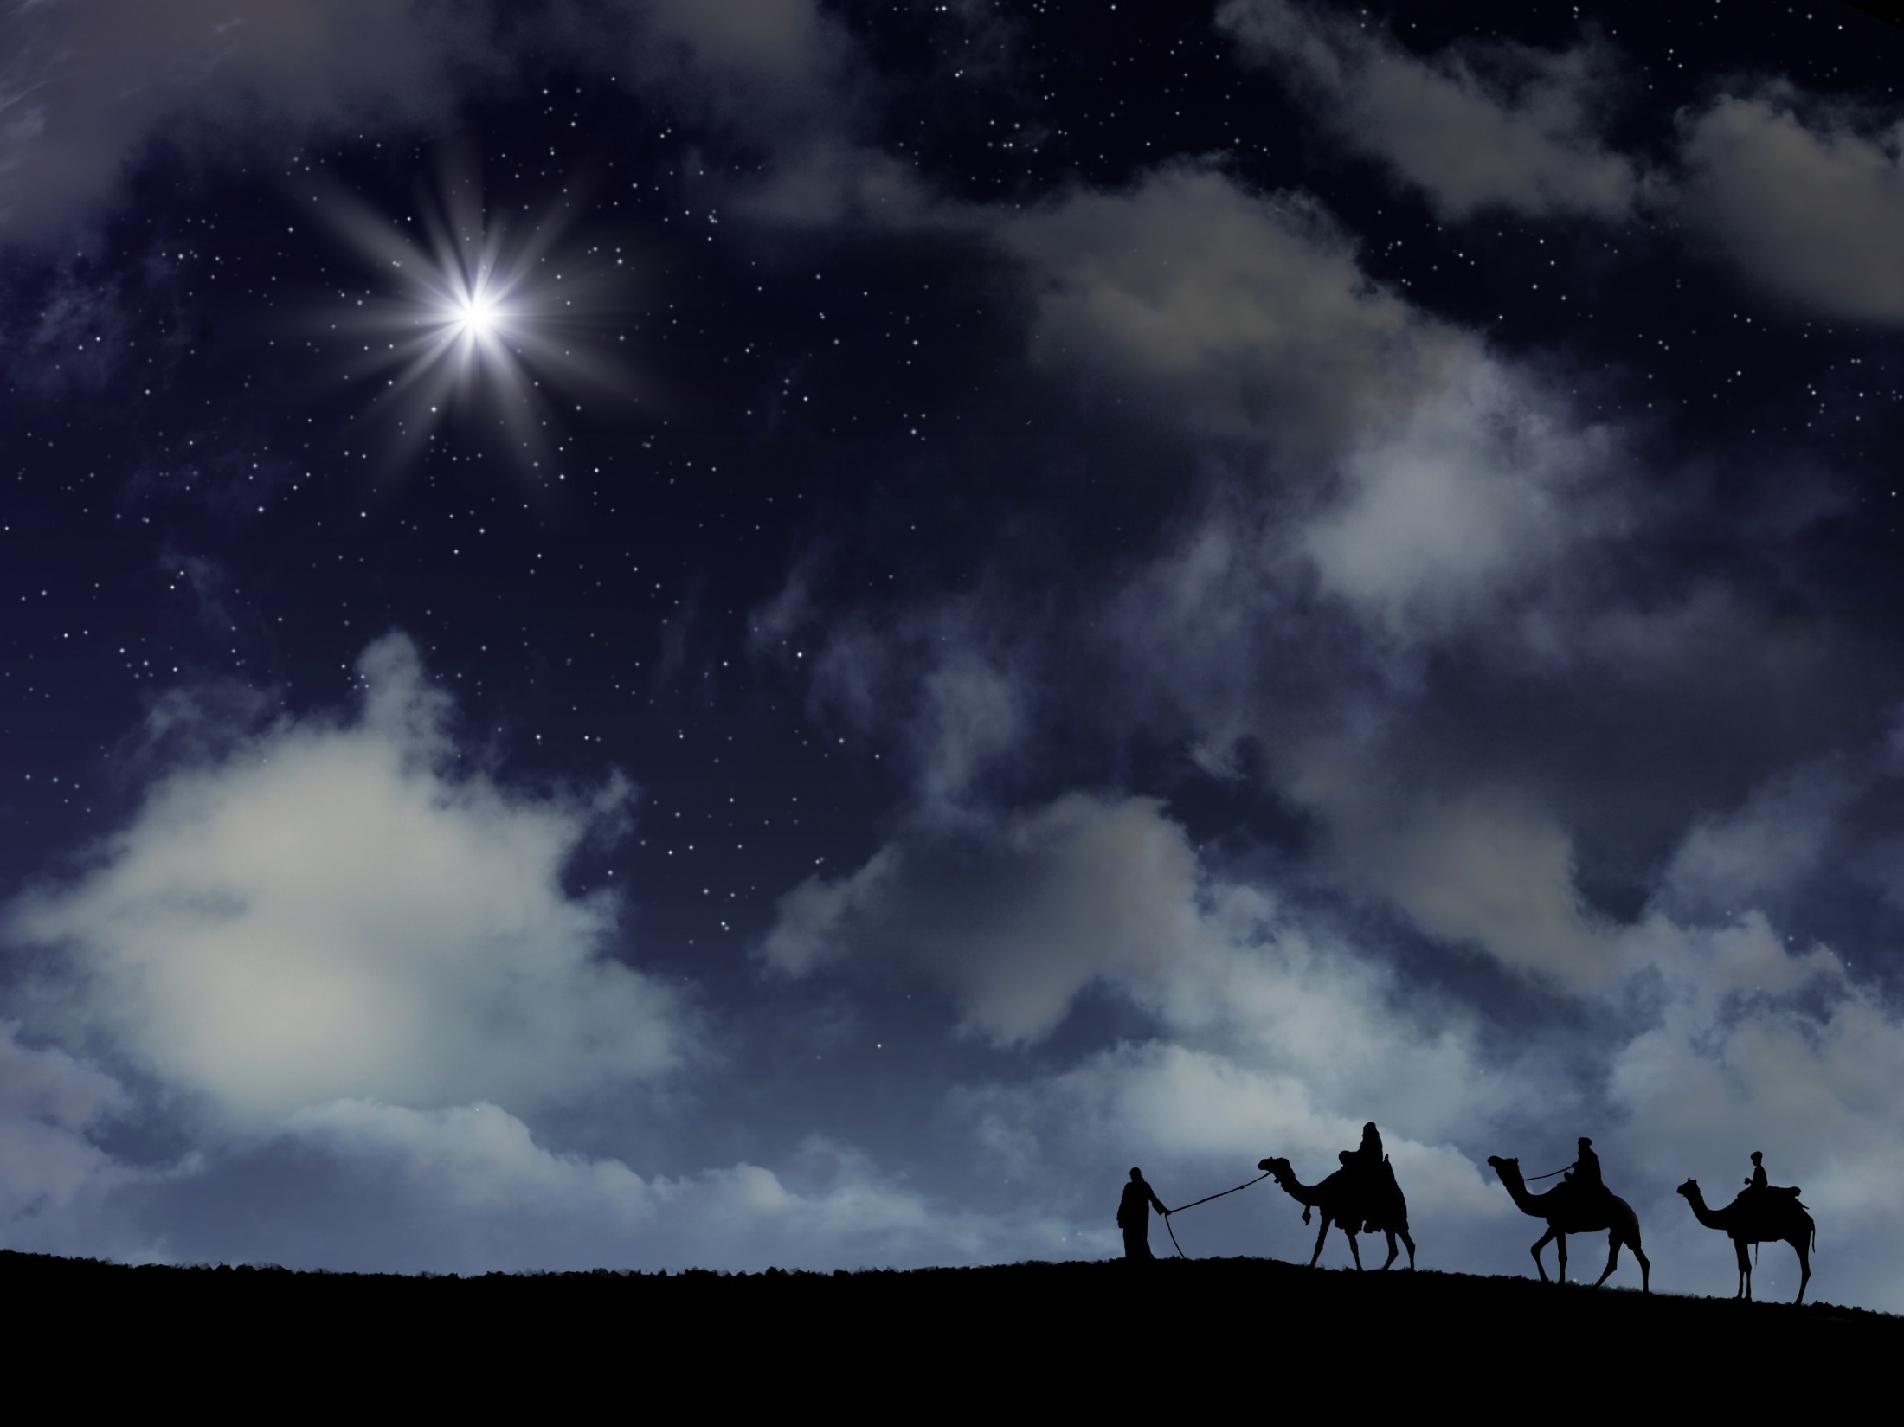
Wise Men Seek Jesus
They came a great distance
They asked a great question
They paid a great service
They followed a great guide
They experienced a great emotion
They offered a great gift
They obeyed a great voice
They stirred up a great opposition

Slide 3
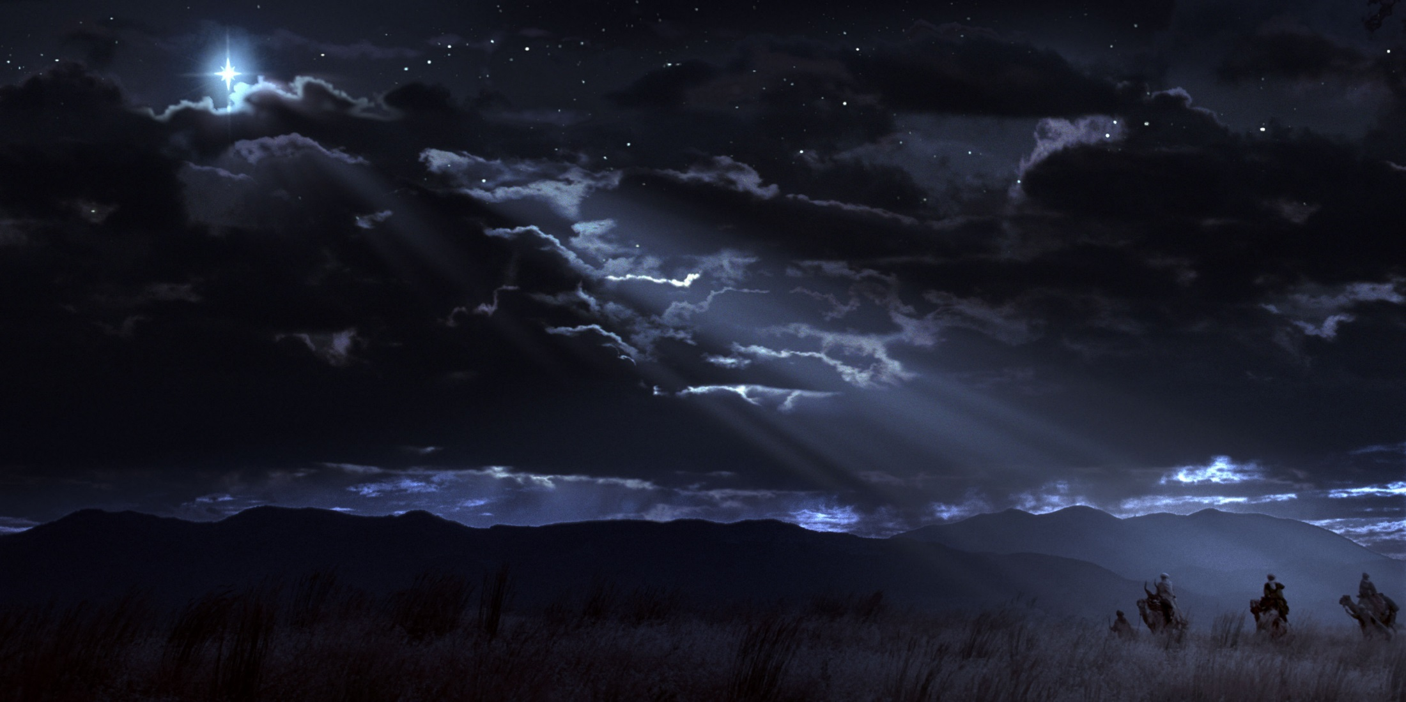
Wise Men Still Seek Jesus…
Seek. (Mt.7:7-8; Phil.2:21; Col.3:1; Heb.11:6).
Ask (Mt.7:7-8; Ac.8:34).
Worship (Rev.5:9-14).
Guide (Jn.5:39-40).
Rejoice (Lk,1:47,58; Ac.5:41; 8:39; 16:34).
Gifts (Lk.21:1-4; 2 Cor.8:5; 1 Pet.4:10)
Obey (Lk.6:46ff; Prov.12:15; Eccl.4:13).
Opposition (Mt.23:34; 2 Tim.3:12).

Slide 4
If You Are Wise…
You too will seek Jesus with all of your heart and you will find Him. (Jer. 29:13; John 14:6)
You Too Will Follow Him.
Hear – Romans 10:17
Believe – Romans 10:10
Repent – Acts 2:38
Confess – Acts 8:37
Be Baptized – 1 Peter 3:21; Acts 22:16
You Too will do all things by Jesus’ Word. (Col. 3:17)

