Slide 2
Psalm 8
¹O Lord, our Lord, how majestic is your name in all the earth! You have set your glory above the heavens. ²Out of the mouth of babes and infants, you have established strength because of your foes, to still the enemy and the avenger. ³When I look at your heavens, the work of your fingers, the moon and the stars, which you have set in place, ⁴what is man that you are mindful of him, and the son of man that you care for him? ⁵Yet you have made him a little lower than the heavenly beings and crowned him with glory and honor. ⁶You have given him dominion over the works of your hands; you have put all things under his feet, ⁷all sheep and oxen, and also the beasts of the field, ⁸the birds of the heavens, and the fish of the sea, whatever passes along the paths of the seas. ⁹ O Lord, our Lord, how majestic is your name in all the earth!

Slide 3
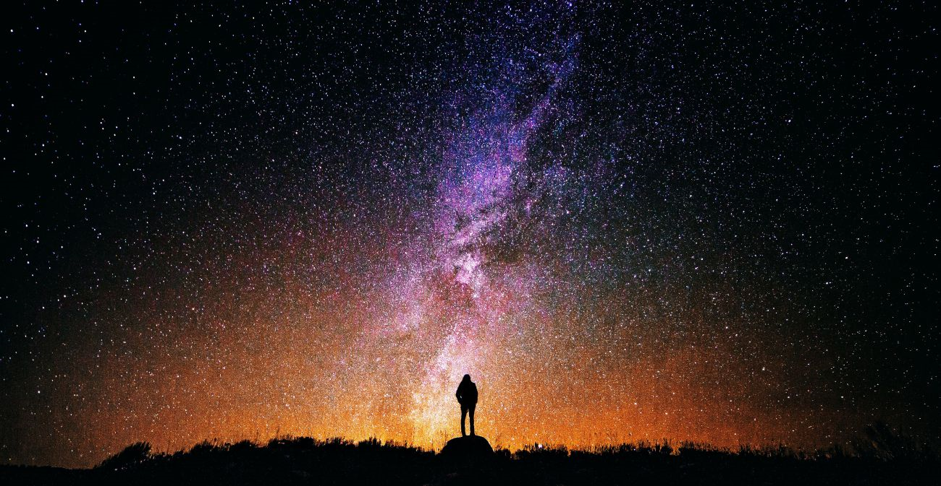
Psalm 8 The Song of the Shepherd
Church of Christ at Medina
February 4th, 2018

Slide 4
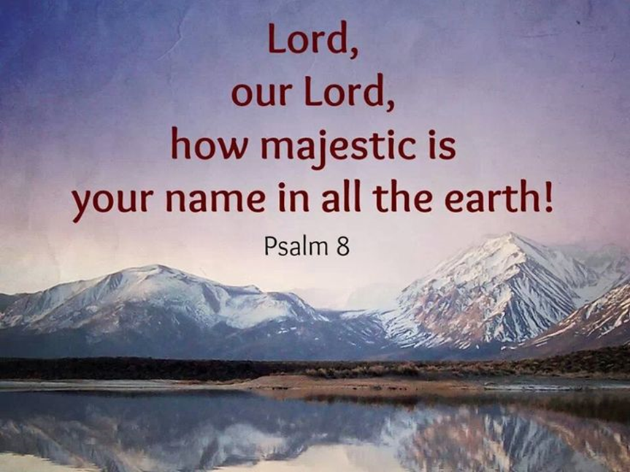
Psalm 8: A Psalm of Praise
It is an obvious Psalm that exalts the name of God!
Lord: Addressing the Lord as ruler and authority.
Our Lord: Someone the Psalmist knew.
Majestic: A name – character and nature – that is to be magnified because it is excellent.
“O Lord, our Lord, how majestic is your name in all the earth! You have set your glory above the heavens. ²Out of the mouth of babes and infants, you have established strength because of your foes, to still the enemy and the avenger.” (8:1-2, ESV)

Slide 5
Psalm 8: A Psalm of Praise
You have set your glory above the heavens…
The earth and the universe proclaim the glory of the Lord, but His glory exceeds even this. It is beyond our ability to express!
Isaiah 40:26
1 Kings 8:27
Out of the mouth of babies and infants...
Exalting and revering God comes from the mouth of the simple.
1 Corinthians 1:18-31
Matthew 21:12-17, 11:25
“O Lord, our Lord, how majestic is your name in all the earth! You have set your glory above the heavens. ²Out of the mouth of babes and infants, you have established strength because of your foes, to still the enemy and the avenger.” (8:1-2, ESV)

Slide 6
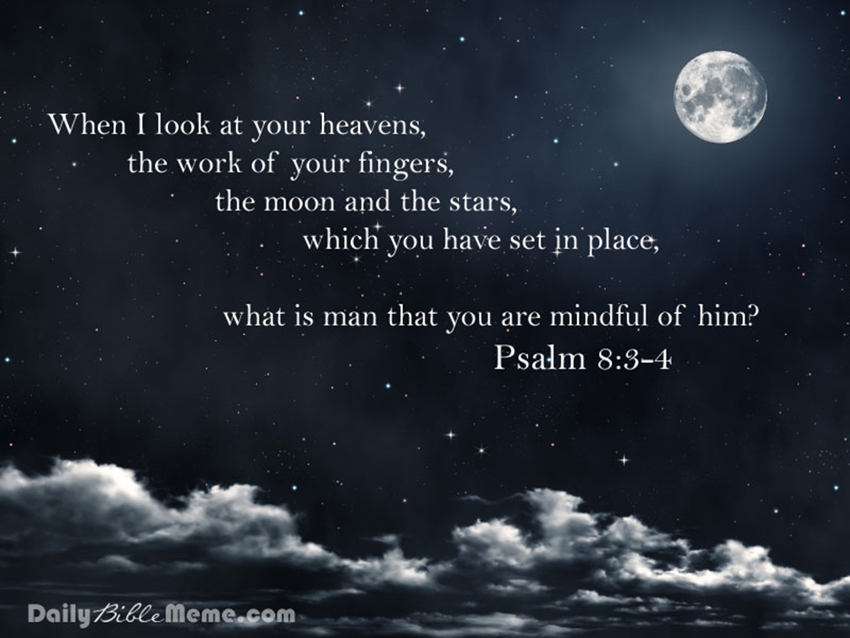
Psalm 8: A Psalm of Praise
³When I look at your heavens, the work of your fingers, the moon and the stars, which you have set in place, ⁴what is man that you are mindful of him, and the son of man that you care for him?” (8:3-4, ESV)
“³When I look at your heavens, the work of your fingers, the moon and the stars, which you have set in place, ⁴what is man that you are mindful of him, and the son of man that you care for him?” (8:3-4, ESV)

Slide 7
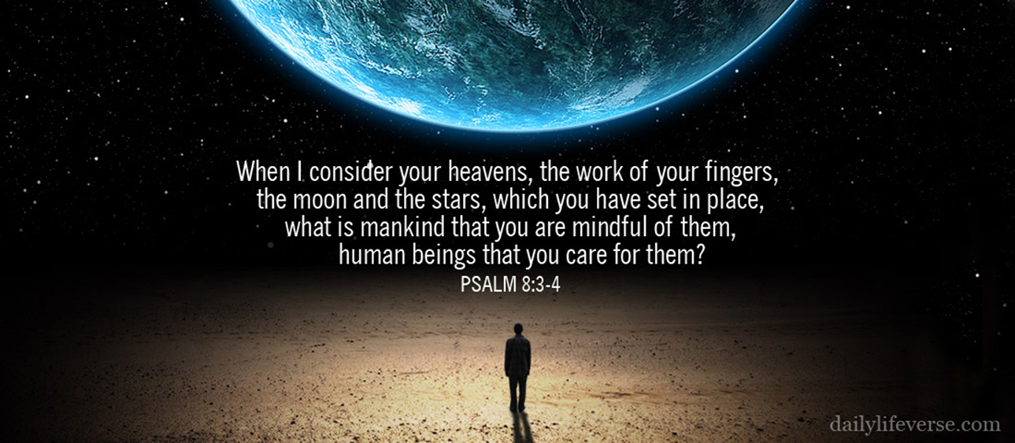
Psalm 8: A Psalm of Humility
The Position of Man
When David considers the great wonders of the visible universe, he is keenly aware of the frailty of man!
The Danger of Pride
Despite the obvious faults and weaknesses of man, we are still prone to pride and self-exaltation.
James 4:6
How we should constantly contemplate our own “smallness”! How often we should remember we are but dust! We are dependent upon God for everything! Yes, as we consider the world around us, we should be humbled!
“³When I look at your heavens, the work of your fingers, the moon and the stars, which you have set in place, ⁴what is man that you are mindful of him, and the son of man that you care for him?” (8:3-4, ESV)

Slide 8
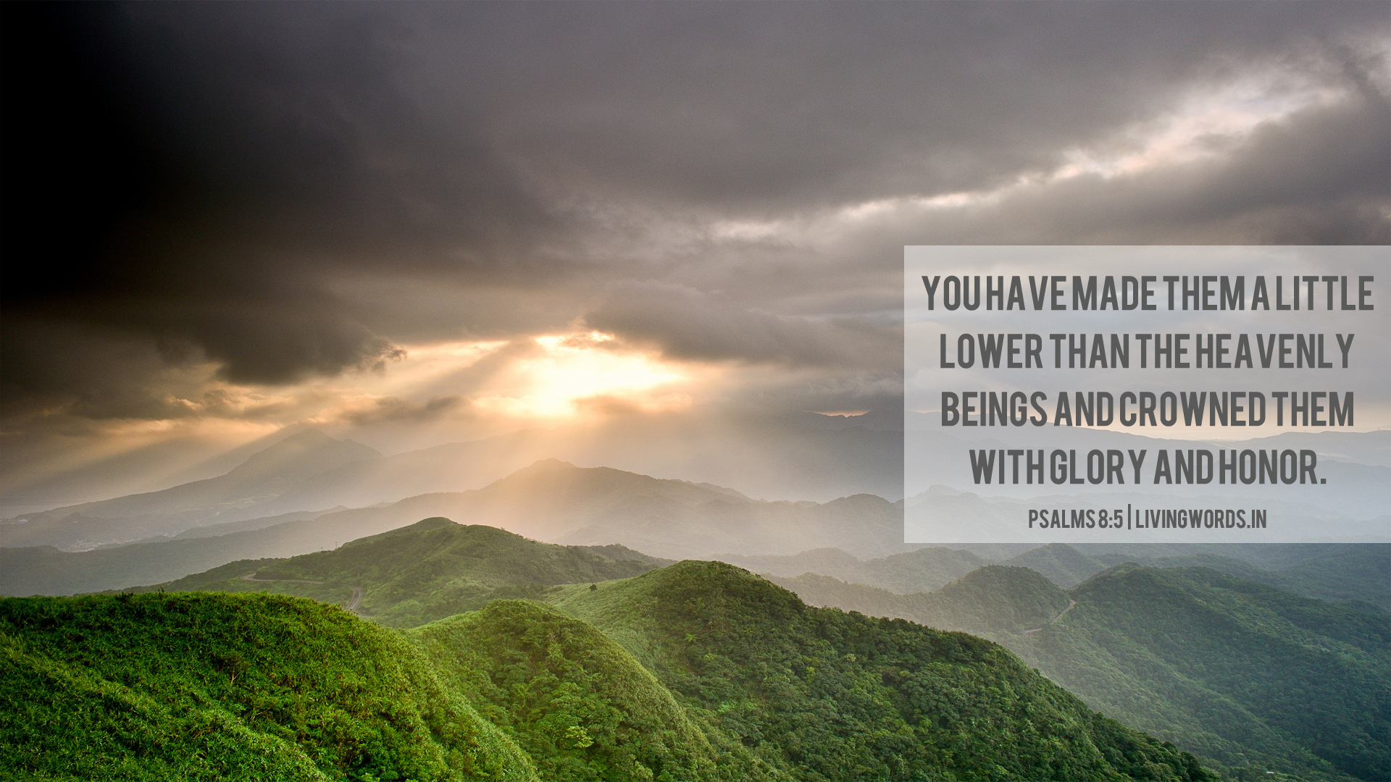
Psalm 8: A Psalm of Exaltation
Yet, God considers man…
“Man is by nature an ‘earthling’, and yet he is the particular object of God’s attention. The God who gave shape to heaven with His fingers continues to focus His attention to man.” (William VanGemeren)
Matthew 10:28-33
God provides us with dominion…
Genesis 1:26-28
Our dominion is not to the same extent as originally designed because of sin.
God exalts man…
1 Peter 5:6, James 4:10
“⁵Yet you have made him a little lower than the heavenly beings and crowned him with glory and honor. ⁶You have given him dominion over the works of your hands; you have put all things under his feet, ⁷all sheep and oxen, and also the beasts of the field, ⁸the birds of the heavens, and the fish of the sea, whatever passes along the paths of the seas.” (8:5-8, ESV)

Slide 9
Psalm 8: A Psalm of Messianic Hope
“Now it was not to angels that God subjected the world to come, of which we are speaking. ⁶ It has been testified somewhere, "What is man, that you are mindful of him, or the son of man, that you care for him? ⁷ You made him for a little while lower than the angels; you have crowned him with glory and honor, ⁸ putting everything in subjection under his feet." Now in putting everything in subjection to him, he left nothing outside his control. At present, we do not yet see everything in subjection to him. ⁹ But we see him who for a little while was made lower than the angels, namely Jesus, crowned with glory and honor because of the suffering of death, so that by the grace of God he might taste death for everyone.” (Hebrews 2:5-9, ESV)
“⁵Yet you have made him a little lower than the heavenly beings and crowned him with glory and honor. ⁶You have given him dominion over the works of your hands; you have put all things under his feet, ⁷all sheep and oxen, and also the beasts of the field, ⁸the birds of the heavens, and the fish of the sea, whatever passes along the paths of the seas.” (8:5-8, ESV)

Slide 10
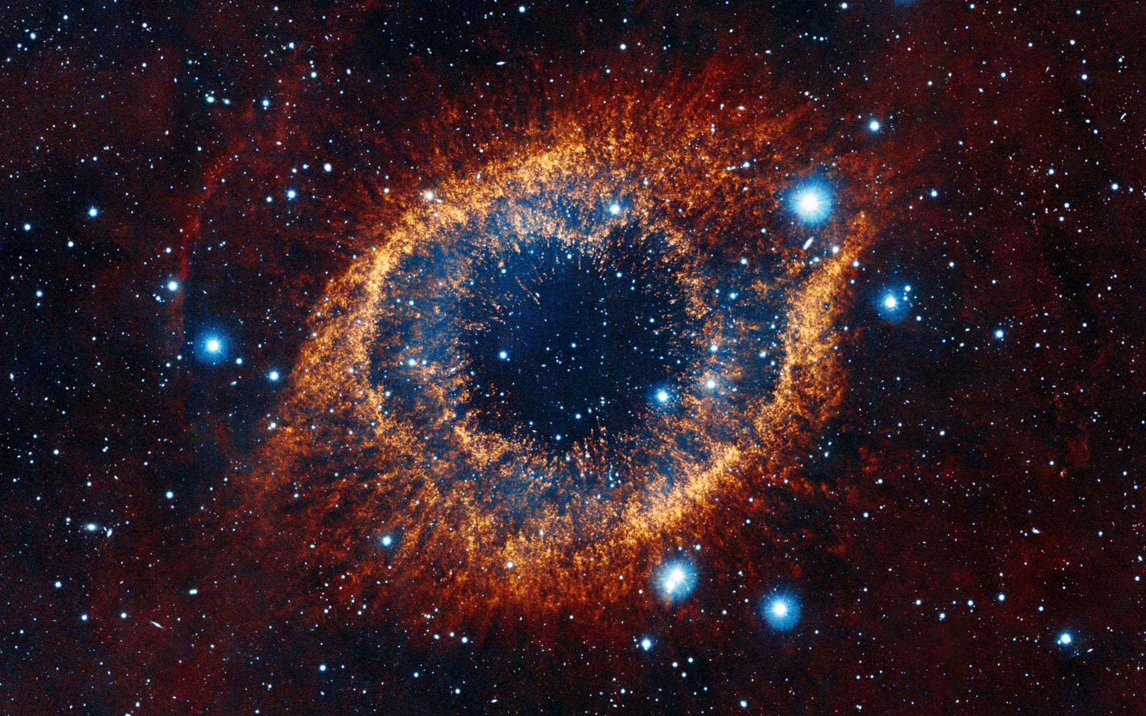
Psalm 8 The Song of the Shepherd
⁹ O Lord, our Lord, how majestic is your name in all the earth!
Church of Christ at Medina
February 4th, 2018

