Slide 2
Thinking of Heaven
These all died in faith, not having received what was promised, but having seen it and greeted it from afar, and having acknowledged that they were strangers and exiles on the earth. For people who speak thus make it clear that they are seeking a homeland. If they had been thinking of that land from which they had gone out, they would have had opportunity to return. But as it is, they desire a better country, that is, a heavenly one. Therefore God is not ashamed to be called their God, for he has prepared for them a city. (Hebrews 11:13-16 RSV)

Slide 3
The Importance of Thinking About Heaven…
Colossians 3:1-4
Hebrews 11:8-10
2 Pet. 3:12
Question:
“How often do you think about heaven?”
For our citizenship is in heaven, from which we also eagerly wait for the Savior, the Lord Jesus Christ, (Philippians 3:20 NKJV)

Slide 4
Misconceptions About Heaven…
Heaven is not real.
Heaven will be boring.
Almost everyone will be going there.
2 Cor. 4:16 - 5:11
Matt. 6:10
Luke 15:7,10
Matt. 7:13-14
Matt. 7:21-23

Slide 5
Thinking About Heaven…
What is heaven?
A place prepared.
A beautiful city.
A place of rest.
A place of no sickness and death.
Home of the soul.
It is eternal.
Where God is.
Angels are there.
Righteous are there.
The kingdom of God.
Why we should be interested in it?
Nothing is permanent here.
Material things do not satisfy.
Life is full of sorrows.
Made tired by responsibility and work.
Look forward to a better life.
Death is certain.
Judgment is coming.
Eternity is forever.

Slide 6
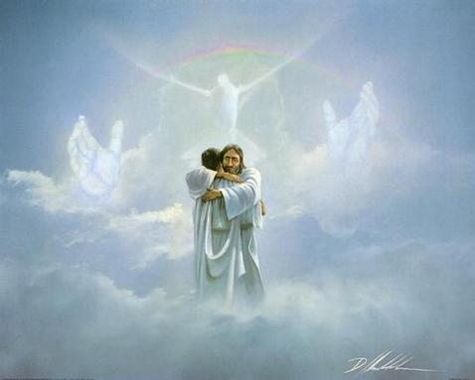
Why I Want To Go To Heaven…
Heaven Is A Place of Reward (Matt. 5:11,12; Rev. 14:13)
Heaven Is A Place of Reunion (2 Samuel 12:23; Matt. 22:29)
Heaven is where God is (Matt. 7:21)
Because of hell. (2 Cor. 5:11; Mt. 25:46)
For our citizenship is in heaven, from which we also eagerly wait for the Savior, the Lord Jesus Christ, (Philippians 3:20 NKJV)

Slide 7
210 - Alone At Eve - Title

Slide 8
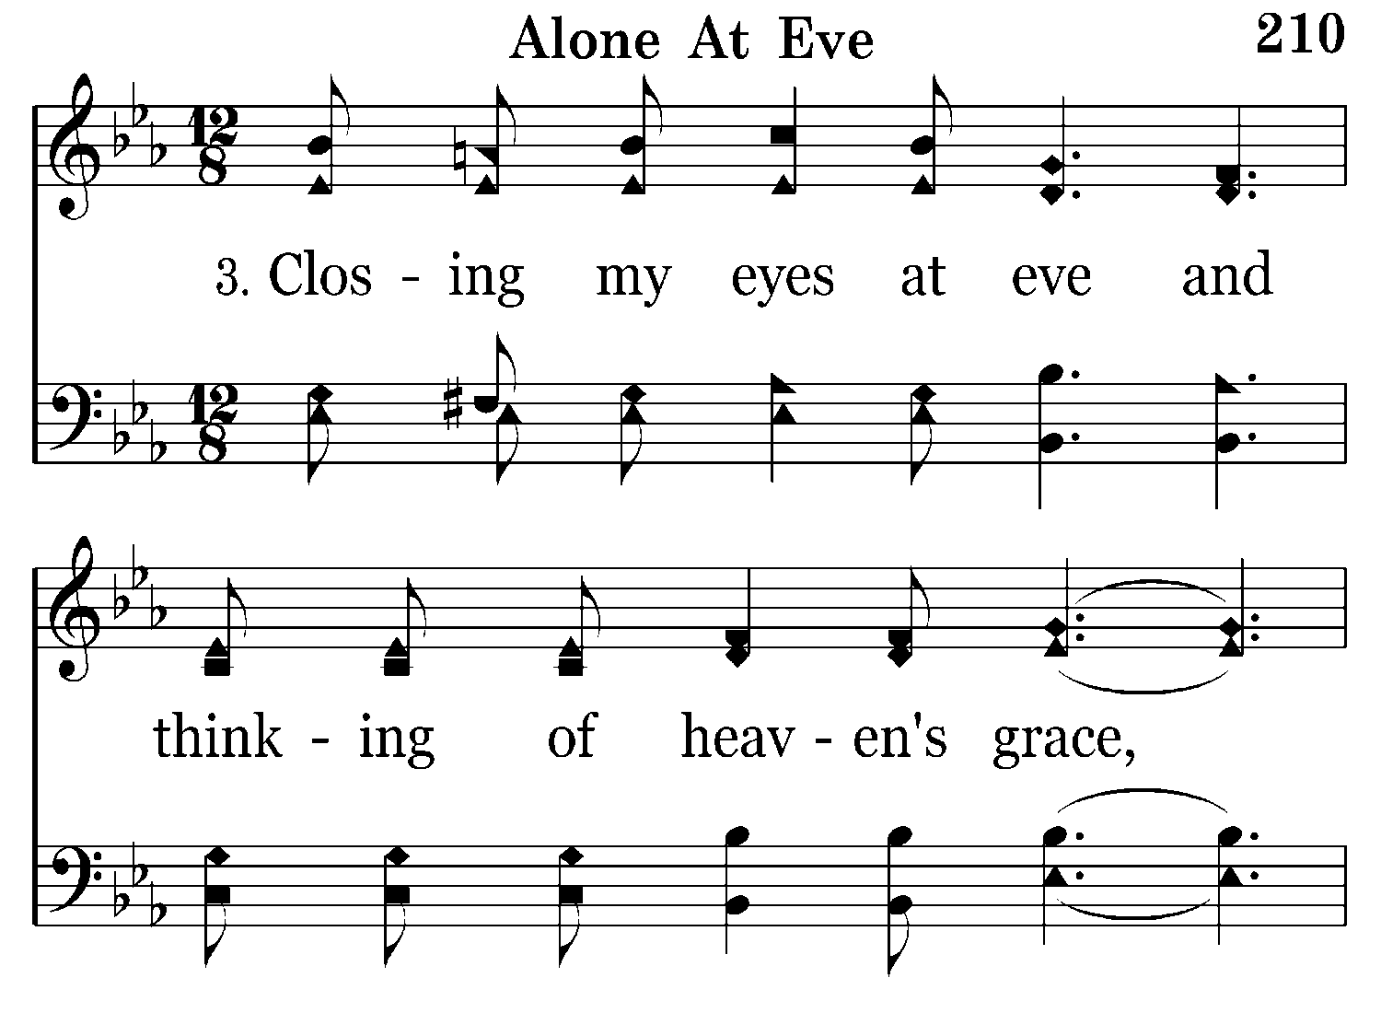
210 - Alone At Eve - 3.1

Slide 9
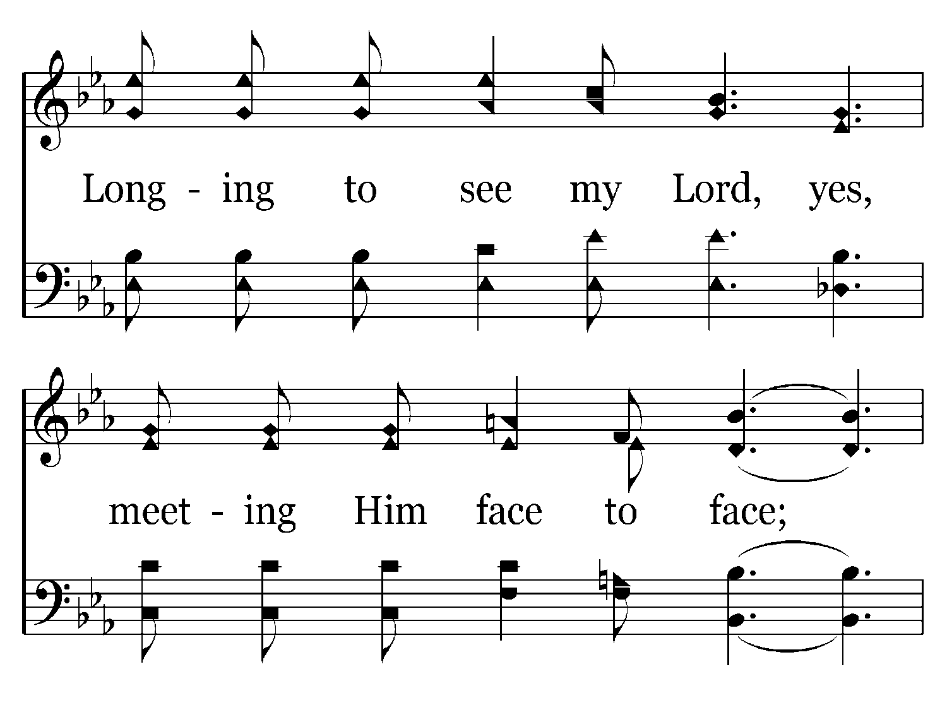
210 - Alone At Eve - 3.2

Slide 10
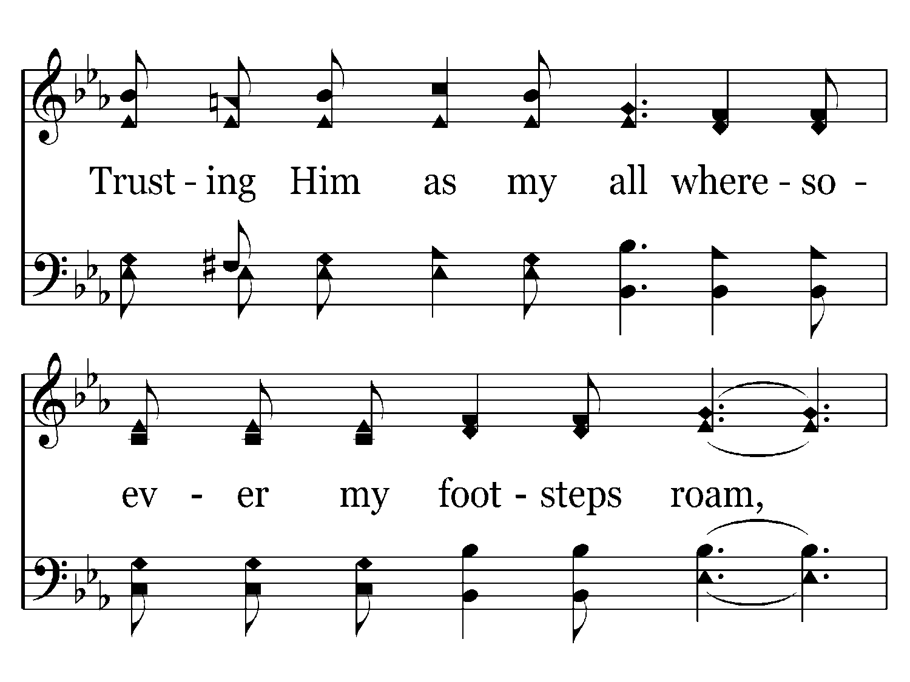
210 - Alone At Eve - 3.3

Slide 11
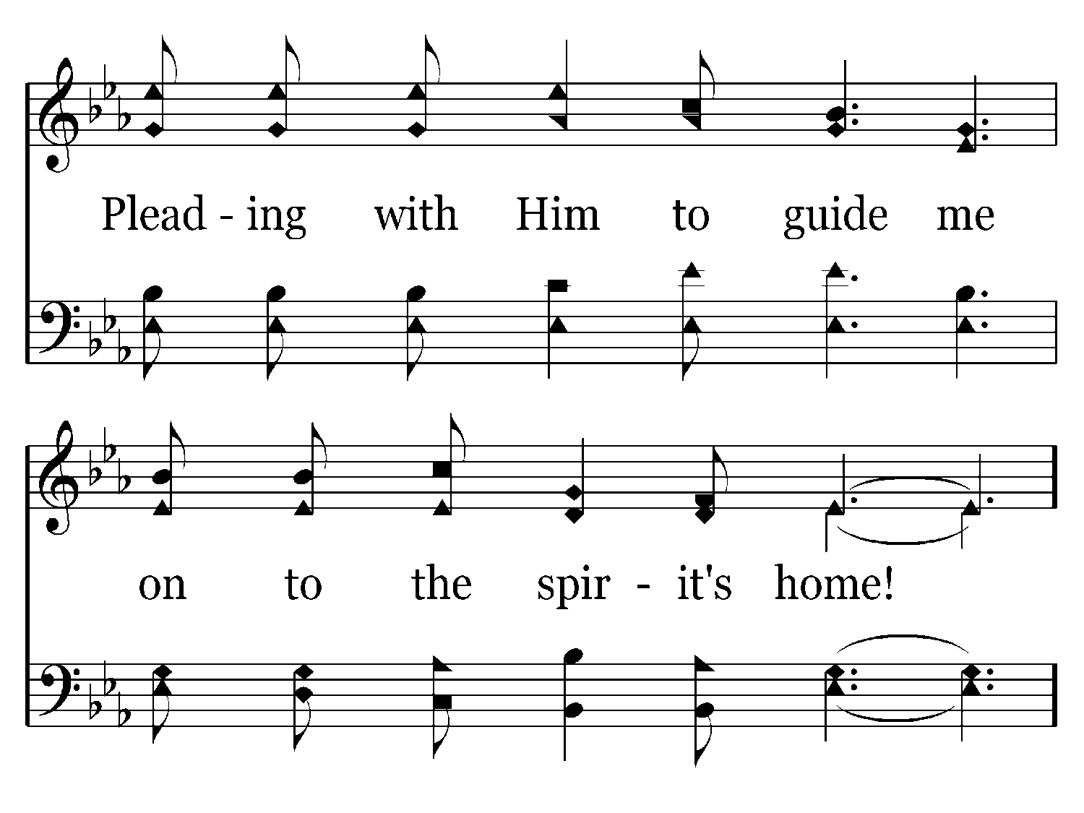
210 - Alone At Eve - 3.4

Slide 12
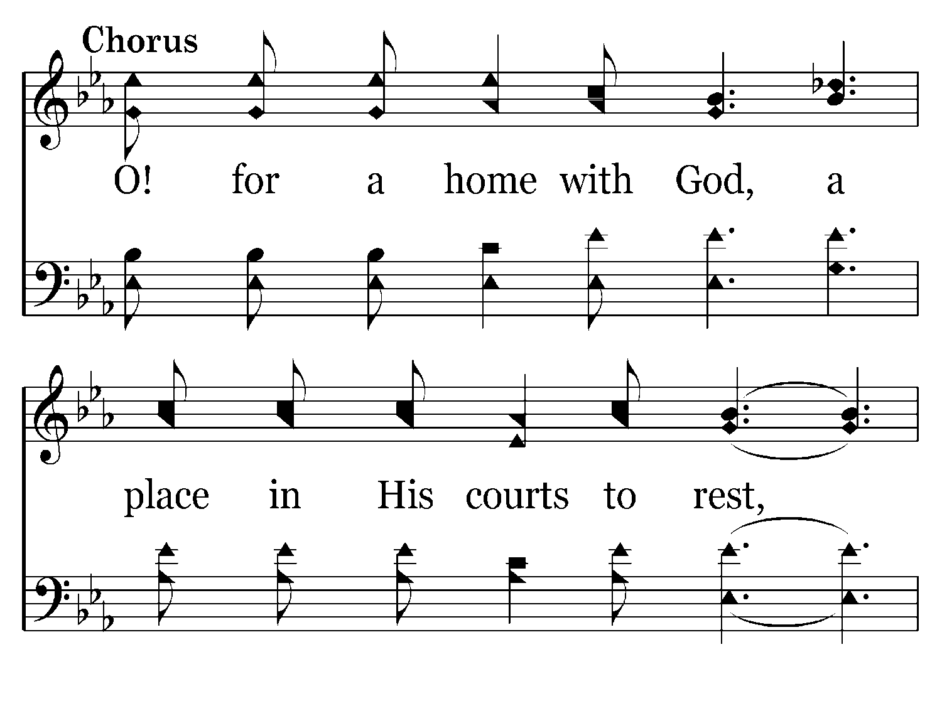
210 - Alone At Eve - C.1

Slide 13
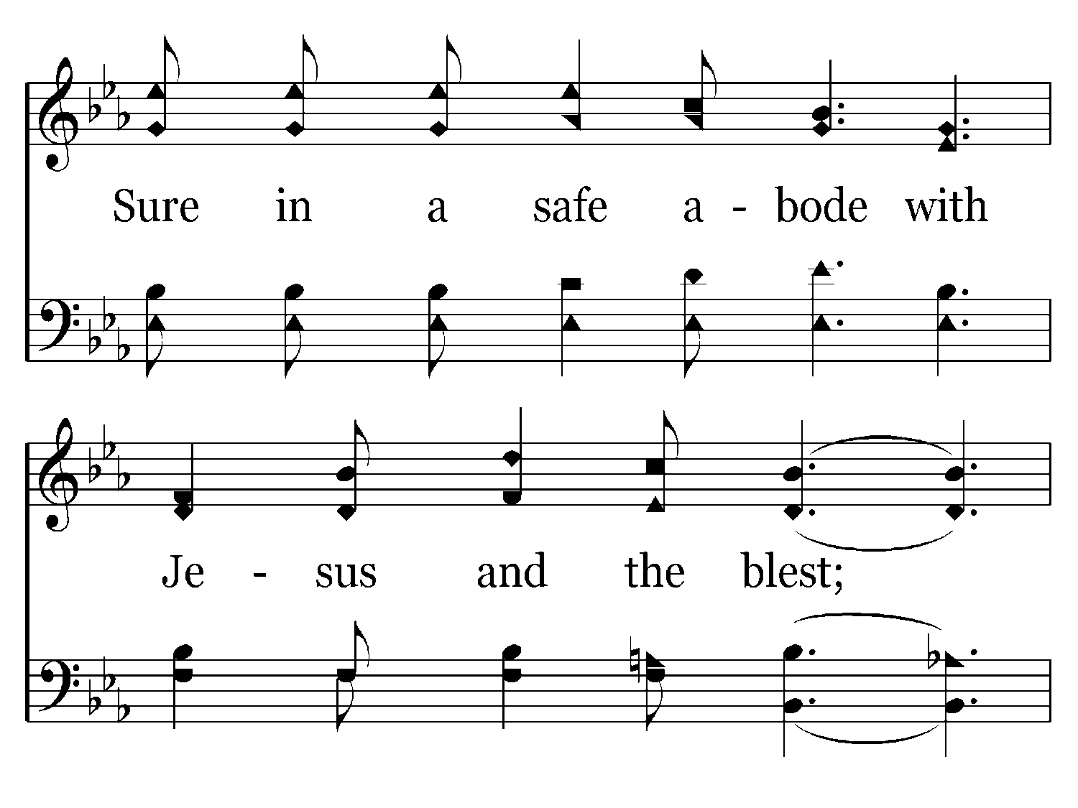
210 - Alone At Eve - C.2

Slide 14
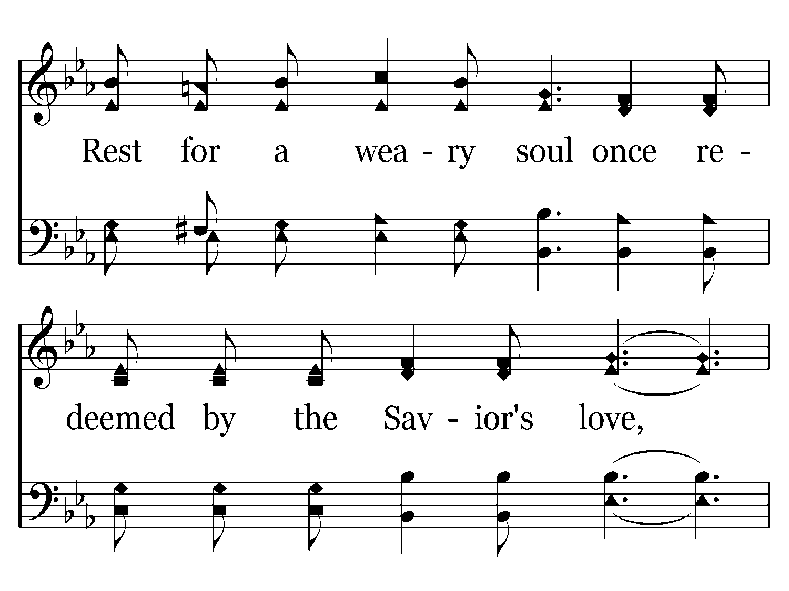
210 - Alone At Eve - C.3

Slide 15
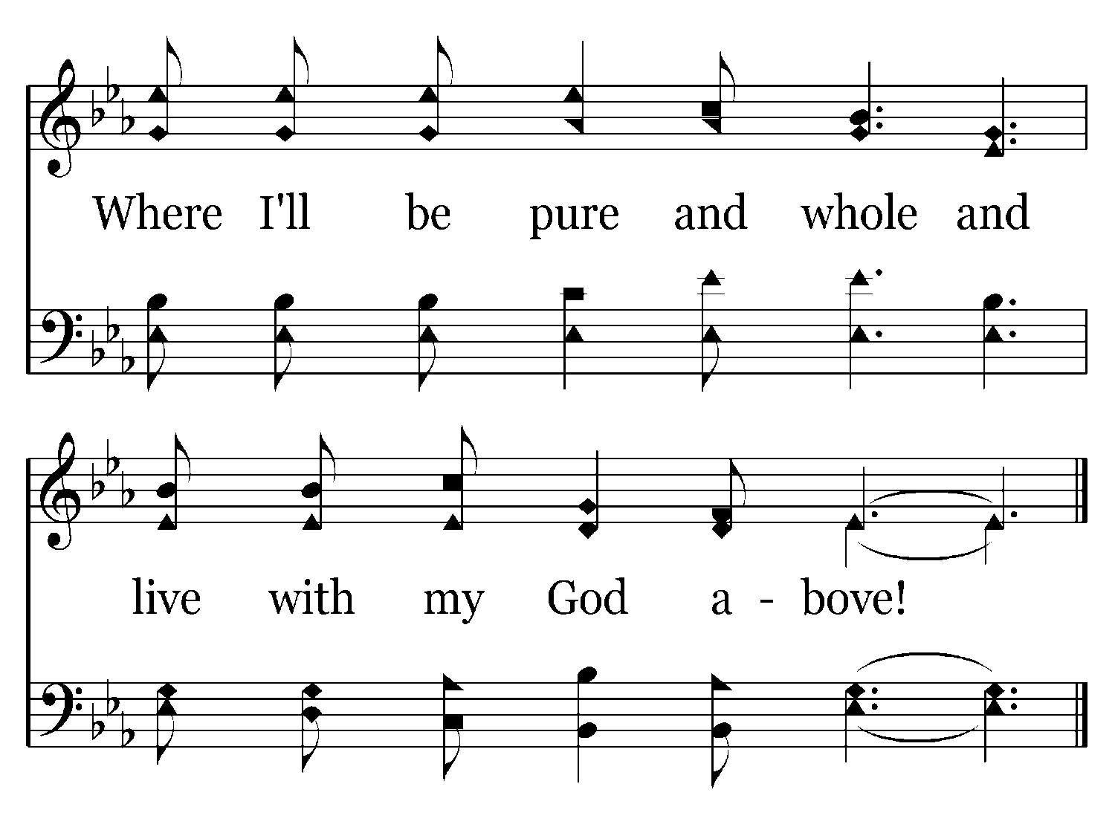
210 - Alone At Eve - C.4
End of Song

Slide 16
“For those who are Christians, earth will be the closest they will ever get to hell; and for those who are not Christians, earth will be the closest they’ll ever get to heaven.”
Something to Think About…

Slide 17
Think About It…
This world is the very best that some will ever experience.
This should light a fire under me to be more zealous in sharing the gospel.
We should also take comfort in the fact that because we are children of God, this world, with all its heartaches and hardships will be the worst we’ll ever experience!

Slide 19
Sources
Outline material from Steve Higginbotham
Outline information from Jim Deason
Commentary on Revelation by Arthur Ogden
Outline information by J.C. Choate
Heaven; O For A Home With God – Steve Klein & Jeff May

