Slide 2
Overview of the letter to the galatians
Paul an apostle--not from men nor through man, but through Jesus Christ and God the Father, who raised him from the dead-- and all the brethren who are with me, To the churches of Galatia: Grace to you and peace from God the Father and our Lord Jesus Christ, who gave himself for our sins to deliver us from the present evil age, according to the will of our God and Father; to whom be the glory for ever and ever. Amen. (Galatians 1:1-5 RSV)
Date: ~A.D.54 – A.D.57

Slide 3
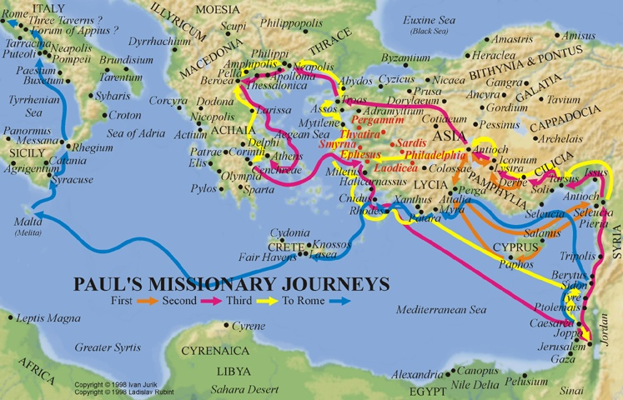
During their first missionary journey (45-47 A.D.), Paul and Barnabas established several churches in the Roman province of Galatia - Ac 13:14-14:23
- On Paul’s second trip (51-54 A.D.), he and Silas visited them again - Ac 16:1-5
- On Paul’s third trip (54-58 A.D.), he visited them yet again - Ac 18:23
- It is quite likely that the churches of Galatia included those established on his first journey
- E.g., Antioch, Lystra, Derbe

Slide 4
OUTLINE
Introduction and Warning against Other Gospels (1:1–10)
Paul Defends His Apostolic Call (1:11–2:21)
Justification by Faith (3:1–4:31)
Freedom in Christ (5:1–12)
Living by the Spirit (5:13–6:18)
Rose Publishing – Bible Overview

Slide 5
Galatians detAILED outline…
The One Gospel – 1:1-10
The Certified Gospel – 1:11-24
Spies of Our Liberty – 2:1-10
Peter’s Hypocrisy – 2:11-21
The Just Shall Live by Faith – 3:1-15
The Tutor – 3:15-25
Baptized into Christ – 3:26 – 4:7
Weak and Beggarly Elements – 4:8-20
Two Mountains, Two Laws – 4:21-31
Stand Fast in the Liberty – 5:1-15
Flesh and Liberty – 5:16-26
The Burdens of Life – 6:1-10
Crucified to the World – 6:11-18
From David Padfield

Slide 6
KEY VERSES
A person is not justified by the works of the law, but by faith in Jesus Christ. So we, too, have put our faith in Christ Jesus that we may be justified by faith in Christ and not by the works of the law, because by the works of the law no one will be justified.—Gal. 2:16
So in Christ Jesus you are all children of God through faith, for all of you who were baptized into Christ have clothed yourselves with Christ. There is neither Jew nor Gentile, neither slave nor free, nor is there male and female, for you are all one in Christ Jesus.—Gal. 3:26–28
But the fruit of the Spirit is love, joy, peace, forbearance, kindness, goodness, faithfulness, gentleness and self-control. Against such things there is no law.—Gal. 5:22–23

Slide 7
Live by the spirit…
And those who belong to Christ Jesus have crucified the flesh with its passions and desires. If we live by the Spirit, let us also walk by the Spirit. Let us have no self-conceit, no provoking of one another, no envy of one another. (Galatians 5:24-26 RSV)

Slide 8
Help One another…
Brethren, if a man is overtaken in any trespass, you who are spiritual should restore him in a spirit of gentleness. Look to yourself, lest you too be tempted. Bear one another's burdens, and so fulfil the law of Christ. For if any one thinks he is something, when he is nothing, he deceives himself. But let each one test his own work, and then his reason to boast will be in himself alone and not in his neighbor. For each man will have to bear his own load. (Galatians 6:1-5 RSV)
Restore the Fallen
Bear Others’ Burdens (trials)
Have a proper view of self
Bear Your Own Burdens (duty)
NOTE: Christians have a responsibility to help others who are temporarily unable to bear their burdens alone. Christians are also to accept their own responsibilities , not expecting others to do their own work for them. (Ref 4)

Slide 9
A Similar Passage…
We who are strong ought to bear with the failings of the weak, and not to please ourselves; let each of us please his neighbor for his good, to edify him. For Christ did not please himself; but, as it is written, "The reproaches of those who reproached thee fell on me." (Romans 15:1-3 RSV)

Slide 10
Do Good to all men…
Let him who is taught the word share all good things with him who teaches. Do not be deceived; God is not mocked, for whatever a man sows, that he will also reap. For he who sows to his own flesh will from the flesh reap corruption; but he who sows to the Spirit will from the Spirit reap eternal life. And let us not grow weary in well-doing, for in due season we shall reap, if we do not lose heart. So then, as we have opportunity, let us do good to all men, and especially to those who are of the household of faith. (Galatians 6:6-10 RSV)
Support Teachers
Understand the principle of sowing and reaping
Do Not Grow Weary
Do Good To All Men

Slide 11
Perseverance in the doing of good… (Galatians 6:1-10)
Restore the Fallen
Bear Others’ Burdens (Trials)
Have a proper view of self
Bear Your Own Burdens (Duty)
Support Teachers
Understand the principle of sowing and reaping
Do Not Grow Weary
Do Good To All Men
Therefore, my beloved brethren, be steadfast, immovable, always abounding in the work of the Lord, knowing that in the Lord your labor is not in vain. (1 Corinthians 15:58 RSV)

Slide 12
sources
Bearing Burdens by Mark A. Copeland
You Who Are Spiritual by Steve Higginbotham
New Life Behavior Course VIII – Lesson 12
Truth Commentary on Galatians by Mike Willis – Page 282
Bible Overview © Copyright 2012 Bristol Works, Inc.All rights reserved. Rose Publishing, Inc.
Material by David Padfield

