Slide 2
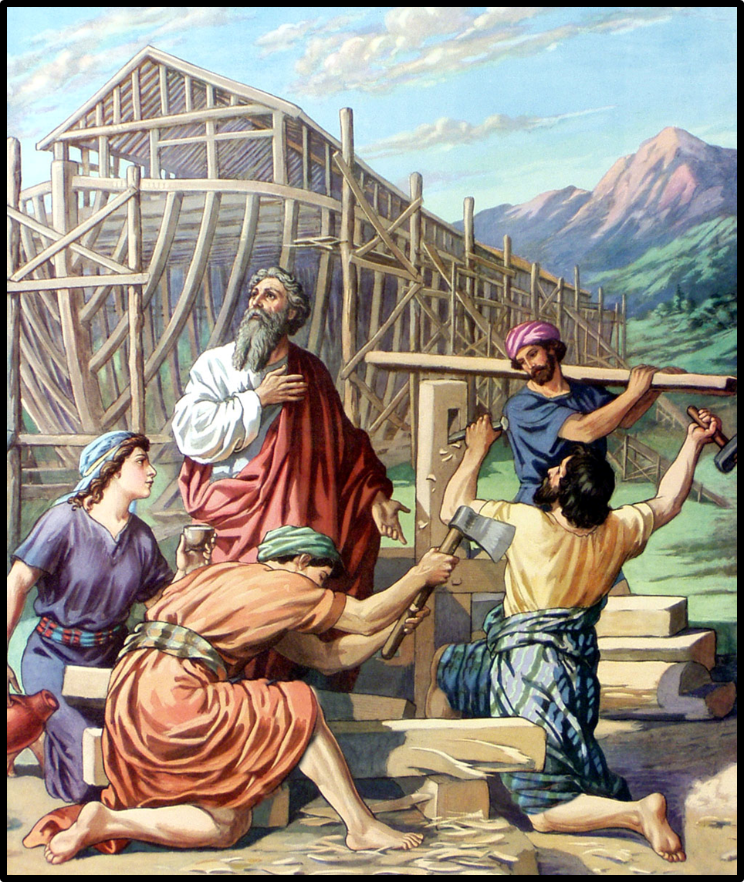
Reminders from a Ship Builder
Church of Christ at Medina
July 15th, 2018
*Pictures from the Visualized Old Testament.

Slide 3
Reminders from a Ship Builder
Yes, sin is that bad! (Genesis 6:7)
Men have a tendency to downplay the ugliness of sin.
Sin is very ugly! It is horrid in God’s sight!
It is like an incurable disease that eats at the soul of man.
Because it is so terrible, Jesus warned that we should do whatever is necessary to avoid it.
The depth of sin’s ugliness is best shown in what it took to erase it.
Isaiah 1:4-6
Matthew 5:29-30
Isaiah 53

Slide 4
Reminders from a Ship Builder
Yes, sin is that bad!
Our thoughts do matter! (Genesis 6:5)
The mind is very difficult to control.
God knows our thoughts, plans and intentions.
Man can sometimes be deceived by his own thoughts, but God is able to righteously judge man on man’s heart and deeds.
Thoughts lead to action.
We must work hard to keep our minds in check by constant evaluation with God’s Word and meditating on the pure things revealed therein.
Isaiah 1:4-6
Matthew 5:29-30
Isaiah 53
1 Chronicles 28:9
1 Kings 11:4
Psalm 94:9-11
1 Corinthians 3:20
Jeremiah 17:9-10
Jeremiah 11:20
Matthew 15:18-20
2 Corinthians 10:5
Hebrews 4:12
Philippians 4:8

Slide 5
Reminders from a Ship Builder
Yes, sin is that bad!
Our thoughts do matter!
When God says something, just do it! (Genesis 6:22)
To say that Noah did all that God commanded was a mouthful!
Why would Noah perform such a task? Simply answered – Because God said so.
This is the kind of faith we need. A faith to do what God says no matter our ability to understand the full picture or not.
We must walk by faith, not by sight.
Isaiah 1:4-6
Matthew 5:29-30
Isaiah 53
1 Chronicles 28:9
1 Kings 11:4
Psalm 94:9-11
1 Corinthians 3:20
Jeremiah 17:9-10
Jeremiah 11:20
Matthew 15:18-20
2 Corinthians 10:5
Hebrews 4:12
Philippians 4:8
Hebrews 11:7
2 Corinthians 5:7

Slide 6
Reminders from a Ship Builder
Yes, sin is that bad!
Our thoughts do matter!
When God says something, just do it!
God does see you – yes, you! (Genesis 6:8-9)
No matter how “big” the world becomes, God will still know each of us.
His ability to know us compares to knowing the number of hairs on our head!
God is always looking around the world to find those who revere Him and are seeking to serve Him!
Isaiah 1:4-6
Matthew 5:29-30
Isaiah 53
1 Chronicles 28:9
1 Kings 11:4
Psalm 94:9-11
1 Corinthians 3:20
Jeremiah 17:9-10
Jeremiah 11:20
Matthew 15:18-20
2 Corinthians 10:5
Hebrews 4:12
Philippians 4:8
Hebrews 11:7
2 Corinthians 5:7
Matthew 10:28-33
Job 1:8
Proverbs 15:3
2 Chronicles 16:9

Slide 7
Reminders from a Ship Builder
Yes, sin is that bad!
Our thoughts do matter!
When God says something, just do it!
God does see you – yes, you!
Isaiah 1:4-6
Matthew 5:29-30
Isaiah 53
1 Chronicles 28:9
1 Kings 11:4
Psalm 94:9-11
1 Corinthians 3:20
Jeremiah 17:9-10
Jeremiah 11:20
Matthew 15:18-20
2 Corinthians 10:5
Hebrews 4:12
Philippians 4:8
Hebrews 11:7
2 Corinthians 5:7
Matthew 10:28-33
Job 1:8
Proverbs 15:3
2 Chronicles 16:9

