Slide 2
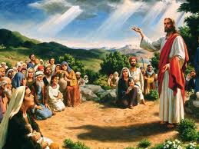
The Unthinkable Command!
Luke 6:20-49

Slide 3
Be-Attitudes (6:20-21) : Christian’s Character
Blessed Are You Poor – Humble (Isa 66:1-3)
Your Is The Kingdom of God (Rights and Privileges)
"Blessed are the poor in spirit, for theirs is the kingdom of heaven. (Matthew 5:3 RSV)
Blessed Are You Who Hunger - (Righteousness)
For You Shall Be Filled (Find Complete Satisfaction)
"Blessed are those who hunger and thirst for righteousness, for they shall be satisfied. (Matthew 5:6 RSV)
Blessed Are You Who Weep Now (For Our Sins)
For You Shall Laugh – (Comforted, Forgiven)
"Blessed are those who mourn, for they shall be comforted. (Matthew 5:4 RSV)
Blessed Are You Who Men Hate (Persecuted)
For The Son of Man’s Sake
"Blessed are you when men revile you and persecute you and utter all kinds of evil against you falsely on my account. Rejoice and be glad, for your reward is great in heaven, for so men persecuted the prophets who were before you. (Matthew 5:11-12 RSV)
Rejoice – And Leap for Joy (When Persecuted)
Your Reward Is Great In Heaven (2 Cor 4:17)

Slide 4
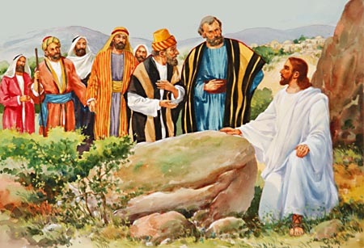
The “Woes” (6:24-26)
Woe To You Who Are Rich (Proud)
You Have Your Reward
Woe To You Who Are Full (Un-Righteous)
For You Shall Hunger
Woe To You Who Laugh (Pleasure)
For You Shall Weep & Mourn
Woe To You When Well Spoken Of
For So Did Their Fathers to the false Prophets
James 4:4 – Friendship with the World

Slide 5
The Unthinkable Command…
"But I say to you that hear, Love your enemies, do good to those who hate you, bless those who curse you, pray for those who abuse you. To him who strikes you on the cheek, offer the other also; and from him who takes away your coat do not withhold even your shirt. Give to every one who begs from you; and of him who takes away your goods do not ask them again. And as you wish that men would do to you, do so to them. (Luke 6:27-31 RSV)
Who is your enemy?
Anyone who curses you
Anyone who hates you
Anyone who spitefully uses you
Anyone who persecutes you
Why Love Your Enemy?
To be like God
To be unlike sinners
To overcome evil
How to Love Your Enemy?
By blessing them
By doing good to them
By praying for them
With active good will

Slide 6
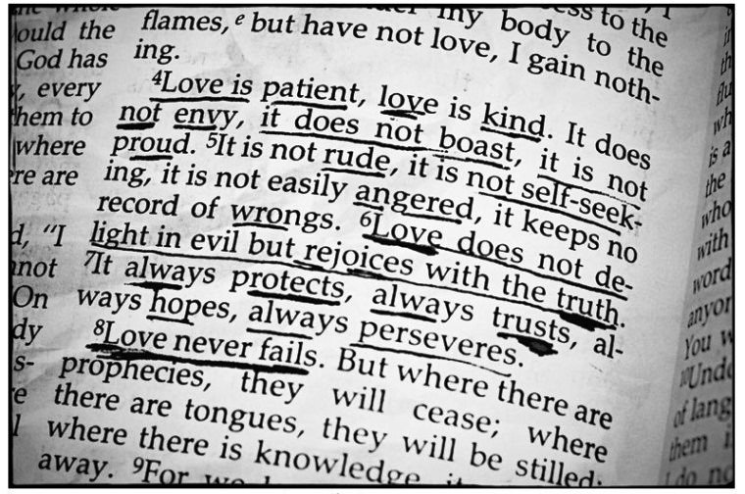
Love Your Enemies?
"If you love those who love you, what credit is that to you? For even sinners love those who love them. And if you do good to those who do good to you, what credit is that to you? For even sinners do the same. And if you lend to those from whom you hope to receive, what credit is that to you? Even sinners lend to sinners, to receive as much again. But love your enemies, and do good, and lend, expecting nothing in return; and your reward will be great, and you will be sons of the Most High; for he is kind to the ungrateful and the selfish. (Luke 6:32-35 RSV)
Imagine Treating Enemies Like This!
No, "if your enemy is hungry, feed him; if he is thirsty, give him drink; for by so doing you will heap burning coals upon his head." Do not be overcome by evil, but overcome evil with good. (Romans 12:20-21 RSV)

Slide 7
Remember The “Golden Rule”
Christ’s sermon cannot be lived by doing nothing.
This rule is a call for love.
Love is the essence of all true religion.
Because love always takes the initiative (1 Jn. 4:10), the golden rule requires us to take the first step.
This truly summarizes the entirety of the OT.
And as you wish that men would do to you, do so to them. (Luke 6:31 RSV)

Slide 8
We Must Make Application!
Most people do not apply because they are selfish and self-centered.
How are men to be released from their basic selfishness?
By looking first at God!
Matthew 22:37-39
What this says is that only God can deliver us from ourselves and enable us to love others selflessly.
Matthew 7:12 - “In everything, therefore, treat people the same way you want them to treat you, for this is the Law and the Prophets.”

Slide 9
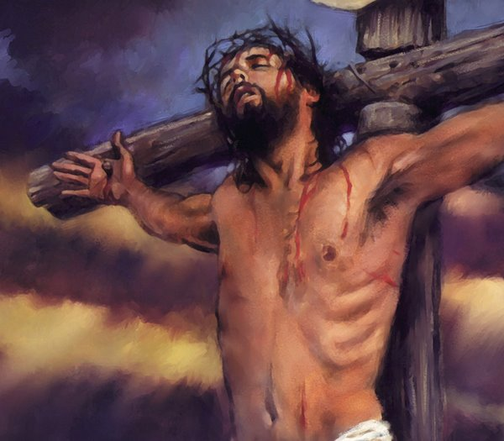
The Ultimate Example of Loving Our Enemies
And Jesus said, "Father, forgive them; for they know not what they do." (Luke 23:34a RSV)

Slide 10
Be A Wise Man…
"Why do you call me 'Lord, Lord,' and not do what I tell you? Every one who comes to me and hears my words and does them, I will show you what he is like: he is like a man building a house, who dug deep, and laid the foundation upon rock; and when a flood arose, the stream broke against that house, and could not shake it, because it had been well built. But he who hears and does not do them is like a man who built a house on the ground without a foundation; against which the stream broke, and immediately it fell, and the ruin of that house was great." (Luke 6:46-49 RSV)

