Slide 1
Expectations have Much To Do With Contentment…

Slide 2
What Kind Of Expectations Do You Have?
Convert everyone?
Always be happy?
No sickness?
Work tirelessly for the Lord?
Have everyone that you know love you?
Cause everyone that you talk to repent?
Forgive all who sin against us?

Slide 3
God Wants His People To Rejoice…
Finally, my brethren, rejoice in the Lord. For me to write the same things to you is not tedious, but for you it is safe. (Philippians 3:1 NKJV)
Rejoice always, pray constantly, (1 Thessalonians 5:16-17 RSV)
Rejoice in the Lord always; again I will say, Rejoice. Let all men know your forbearance. The Lord is at hand. Have no anxiety about anything, but in everything by prayer and supplication with thanksgiving let your requests be made known to God. And the peace of God, which passes all understanding, will keep your hearts and your minds in Christ Jesus. (Philippians 4:4-7 RSV)

Slide 4
God Says We Are Victorious In Jesus!
Romans 8:31-39
Who shall separate us from the love of Christ? Shall tribulation, or distress, or persecution, or famine, or nakedness, or peril, or sword? As it is written, "For thy sake we are being killed all the day long; we are regarded as sheep to be slaughtered." No, in all these things we are more than conquerors through him who loved us. (Romans 8:35-37 RSV)

Slide 5
Do Not Become Discouraged…
Therefore we also, since we are surrounded by so great a cloud of witnesses, let us lay aside every weight, and the sin which so easily ensnares us, and let us run with endurance the race that is set before us, looking unto Jesus, the author and finisher of our faith, who for the joy that was set before Him endured the cross, despising the shame, and has sat down at the right hand of the throne of God. For consider Him who endured such hostility from sinners against Himself, lest you become weary and discouraged in your souls. (Hebrews 12:1-3 NKJV)

Slide 6
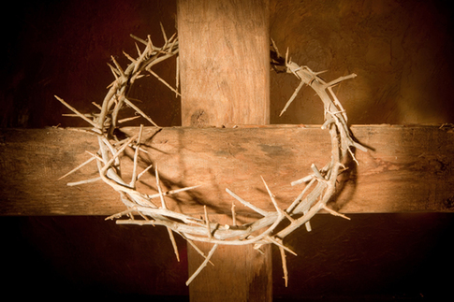
Things That Even Jesus Could Not Do…
Jesus couldn’t avoid sadness and sorrow. (Isa. 53:3-5)
Jesus couldn’t go without rest. (Mk. 6:31)
Jesus couldn’t avoid making enemies. (John 15:18-20)
Jesus couldn’t make his own family believe that He was the Son of God. (John 7:1-6)
Jesus couldn’t cause all men to repent. (Matt. 23:37)
Jesus couldn’t forgive all men their sins though he was willing. (John 8:24; Luke 17:3)
He who says he abides in Him ought himself also to walk just as He walked. (1 John 2:6 NKJV)

Slide 7
Sources
Skeleton Outline from Steve Higginbotham

