Slide 2
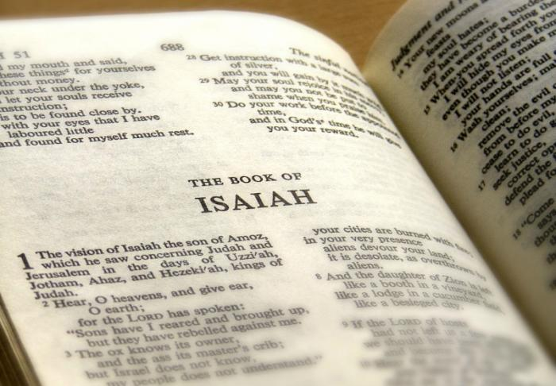
God’s Strength!
Isaiah 40 - Outline
Comfort: Pardon through grace (1-2)
Make preparation (3-5)
The enduring word (6-8)
Declare the tidings! (9-11)
The Incomparable greatness of Jehovah (12-31)
Jehovah and creation (12-14)
Jehovah and the nations (15-17)
Jehovah and the idols (18-21)
Jehovah and the princes of earth (22-25)
Jehovah and the glorious assurance (26-31)

Slide 3
The Incomparable Greatness of God
Get you up to a high mountain, O Zion, herald of good tidings; lift up your voice with strength, O Jerusalem, herald of good tidings, lift it up, fear not; say to the cities of Judah, "Behold your God!" Behold, the Lord GOD comes with might, and his arm rules for him; behold, his reward is with him, and his recompense before him. He will feed his flock like a shepherd, he will gather the lambs in his arms, he will carry them in his bosom, and gently lead those that are with young. Who has measured the waters in the hollow of his hand and marked off the heavens with a span, enclosed the dust of the earth in a measure and weighed the mountains in scales and the hills in a balance? (Isaiah 40:9-12 RSV)

Slide 4
The Mighty Lord…
Behold, the nations are like a drop from a bucket, and are accounted as the dust on the scales; behold, he takes up the isles like fine dust. Lebanon would not suffice for fuel, nor are its beasts enough for a burnt offering. All the nations are as nothing before him, they are accounted by him as less than nothing and emptiness. (Isaiah 40:15-17 RSV)

Slide 5
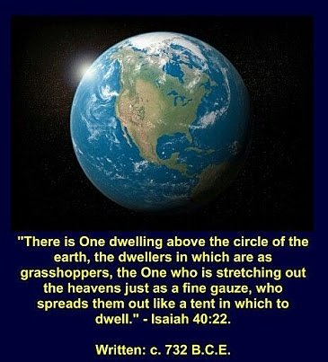
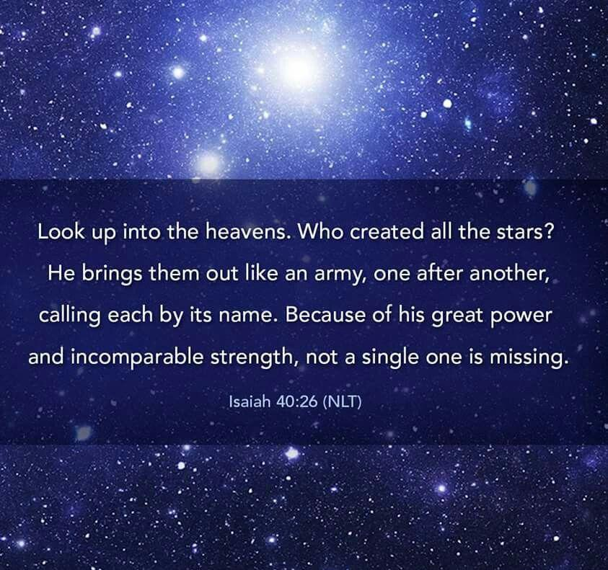
Why do you say, O Jacob, and speak, O Israel, "My way is hid from the LORD, and my right is disregarded by my God"? (Isaiah 40:27 RSV)

Slide 7
God’s Strength!
THREE FUNDAMENTAL THINGS ABOUT God:
God is Aware!
God is Able!
God is Available!
Even youths shall faint and be weary, and young men shall fall exhausted; but they who wait for the LORD shall renew their strength, they shall mount up with wings like eagles, they shall run and not be weary, they shall walk and not faint. (Isaiah 40:30-31 RSV)

Slide 8
Waiting on the Lord…
What does it mean to wait upon the Lord?
SINCERE AND STEADY DEPENDENCE ON HIM, WITH AN OBEDIENT TRUST

Slide 9
Those Who Wait For The Lord…
“Let every day be a time when you look at your own life, consider where you are headed, resolving to make whatever changes the Word of God demands - in spite of the difficulty of repentance!
Let us - if need be - re-order our priorities; fully and completely repent of sin; make the necessary confessions -- and return to the Lord, with fresh zeal and faith ...”

Slide 10
Sources
Material by Warren E. Berkley From Expository Files 1.9; September, 1994
A commentary on Isaiah by Homer Hailey

