Slide 2
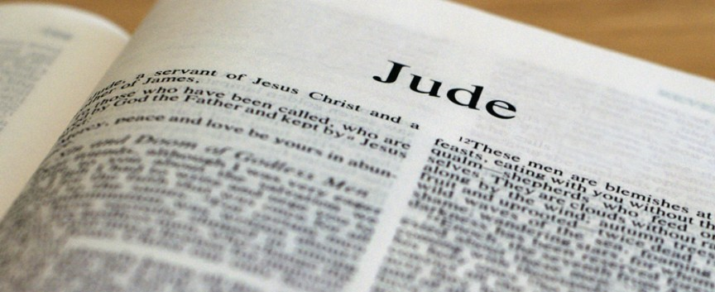
The Book of Jude
Church of Christ at Medina
September 16th, 2018

Slide 3
Background of the Letter
Author
Jude is the brother of James, who is seemingly the James that was the brother of Jesus.
Audience
Called: Invited or summoned by God through the gospel.
Beloved: Loved by God
Kept: Preserved by and for Christ.
Purpose
Original: To write about their common salvation.
Actual: To contend for the faith
Key Verses
Matthew 13:55, 2 Thessalonians 2:14, Romans 5:8, 1 Peter 1:5, 2 Timothy 4:1-4, Romans 6:17, Acts 6:7, Galatians 1:23, Romans 1:16-17, James 1:25, 1 Corinthians 13:8-10

Slide 4
Know the Danger
Jude recognized that there was a danger of false teaching even among the saints.
These teachers had crept in unnoticed or unaware.
The character of these men was such that they were ungodly, which is the reason why they would hide their intentions.
The false teachers pervert the grace of God.
The perversions include a falling into ‘sensuality’.
They reject authority and blaspheme – speak evil of – those in authority.
Although they come in unnoticed, they are not unexpected. Jude says that the apostles warned that they would come and they would bring divisions.
Key Verses
1 John 2:4, Romans 6:1ff,

Slide 5
Know the Danger
Jude states that the destiny for these false teachers is sure – they will receive the punishment from God.
As a means of showing God’s consistent dealings with evil or wickedness, Jude provides three examples.
Children of Israel
God proclaimed to Pharaoh that the Israelites were His people.
Yet, despite delivering them from the bondage of Egypt, providing them a holy law, and showing them His great power, He also destroyed that generation because “He was not pleased with them.”
Why? Because of their sin and wickedness.
Angels
Angels – spiritual beings that serve as ministers of God – are not exempt from God’s justice. They serve as an example for the punishment reserved for those who reject God’s authority.
Sodom and Gomorrah
These cities represent those who totally reject God’s law and live according to their own lusts. They received God’s wrath.
Key Verses
1 Corinthians 10:1-11, Exodus 5, Genesis 18-20, 2 Peter 2:6, 2 Thessalonians 1:5-10

Slide 6
Look After Your Own Faith
Praying in the Holy Spirit
It is a benefit of being a child of God and is a means of communicating and feeling close to God.
Keep Yourselves in the Love of God
We are loved by God, but we have the responsibility to stay or keep ourselves in God’s love.
This can only be accomplished by keeping ourselves in the light of God and abiding in Him.
Waiting for the Mercy of Our Lord Jesus Christ
His mercy is seen on earth through the forgiveness of sins. Yet, the ultimate fulfillment of His mercy will be experienced on the day of judgment.
Key Verses
Ephesians 6:18, 1 Thessalonians 5:17, 1 John 2:3-6, John 15:9-10, 2 Peter 3:10-12

Slide 7
Save Those You Can
We are to look out for the dangers and keep a watch for our own faith, but we are to look out for others as well.
Have mercy on those who doubt…
These seem to be those who are wavering – confused or unsure – with regard to the false teachers.
To these we need to be very tender and patient.
Save others by snatching them out of the fire…
These seem to be further away and need to be approached with the immediate urgency as those in danger of fire.
Others show mercy with fear, hating even the garment stained by the flesh…
This last group needs to be approached with caution, taking special care that we are not defiled.
Key Verses
Jude 22-23

Slide 8
Conclusion
Know the Danger
Look After Your Own Faith
Save Those You Can
References
Preaching on the Books of the New Testament by Dwight Stevenson
Commentary on Jude by Guy N. Woods
The New Testament Book by Book by Roy E. Cogdill
Halley’s Bible Handbook by Henry Halley

