Slide 2
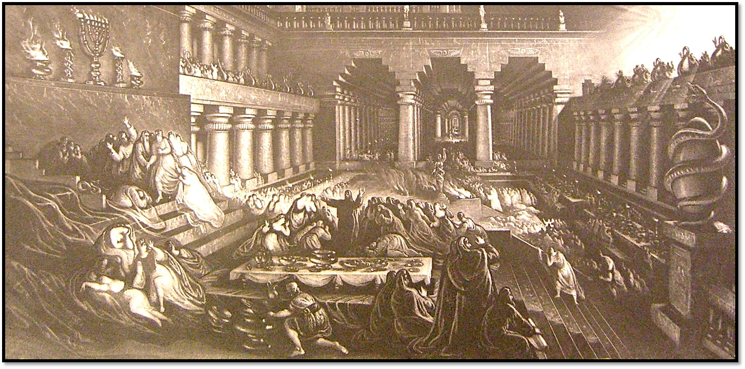
The Writing on the Wall
King Belshazzar made a great feast for a thousand of his lords and drank wine in front of the thousand. ²Belshazzar, when he tasted the wine, commanded that the vessels of gold and of silver that Nebuchadnezzar his father had taken out of the temple in Jerusalem be brought, that the king and his lords, his wives, and his concubines might drink from them. ³ Then they brought in the golden vessels that had been taken out of the temple, the house of God in Jerusalem, and the king and his lords, his wives, and his concubines drank from them. ⁴ They drank wine and praised the gods of gold and silver, bronze, iron, wood, and stone.
Daniel 1:1-4, ESV

Slide 3
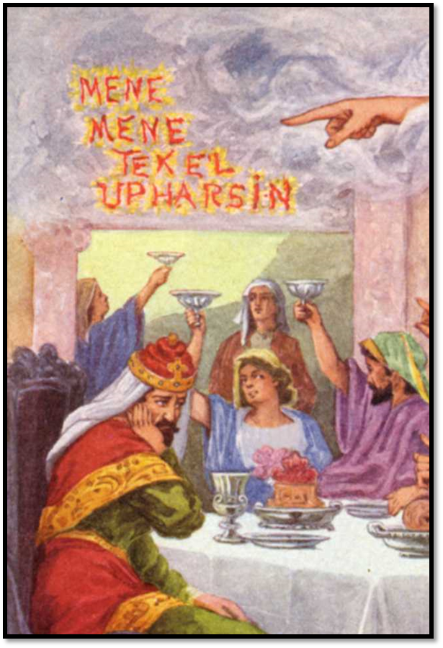
The Writing on the Wall
⁵Immediately the fingers of a human hand appeared and wrote on the plaster of the wall of the king's palace, opposite the lampstand. And the king saw the hand as it wrote. ⁶Then the king's color changed, and his thoughts alarmed him; his limbs gave way, and his knees knocked together.
Daniel 1:5-6, ESV

Slide 4
The Writing on the Wall
⁷ The king called loudly to bring in the enchanters, the Chaldeans, and the astrologers. The king declared to the wise men of Babylon, “Whoever reads this writing, and shows me its interpretation, shall be clothed with purple and have a chain of gold around his neck and shall be the third ruler in the kingdom.” ⁸ Then all the king's wise men came in, but they could not read the writing or make known to the king the interpretation. ⁹ Then King Belshazzar was greatly alarmed, and his color changed, and his lords were perplexed.
Daniel 1:7-9, ESV

Slide 5
The Writing on the Wall
¹⁰ The queen,³ because of the words of the king and his lords, came into the banqueting hall, and the queen declared, “O king, live forever! Let not your thoughts alarm you or your color change. ¹¹ There is a man in your kingdom in whom is the spirit of the holy gods.⁴ In the days of your father, light and understanding and wisdom like the wisdom of the gods were found in him, and King Nebuchadnezzar, your father—your father the king—made him chief of the magicians, enchanters, Chaldeans, and astrologers, ¹² because an excellent spirit, knowledge, and understanding to interpret dreams, explain riddles, and solve problems were found in this Daniel, whom the king named Belteshazzar. Now let Daniel be called, and he will show the interpretation.”
Daniel 1:10-12, ESV

Slide 6
The Writing on the Wall
¹⁷ Then Daniel answered and said before the king, “Let your gifts be for yourself, and give your rewards to another. Nevertheless, I will read the writing to the king and make known to him the interpretation.
Daniel 1:17, ESV

Slide 7
The Writing on the Wall
²⁰ But when his heart was lifted up and his spirit was hardened so that he dealt proudly, he was brought down from his kingly throne, and his glory was taken from him. ²¹ He was driven from among the children of mankind, and his mind was made like that of a beast, and his dwelling was with the wild donkeys. He was fed grass like an ox, and his body was wet with the dew of heaven, until he knew that the Most High God rules the kingdom of mankind and sets over it whom he will. ²² And you his son,⁶ Belshazzar, have not humbled your heart, though you knew all this, ²³ but you have lifted up yourself against the Lord of heaven. And the vessels of his house have been brought in before you, and you and your lords, your wives, and your concubines have drunk wine from them. And you have praised the gods of silver and gold, of bronze, iron, wood, and stone, which do not see or hear or know, but the God in whose hand is your breath, and whose are all your ways, you have not honored.
Daniel 1:20-23, ESV

Slide 8
The Writing on the Wall
Mene
“God has numbered the days of your kingdom and brought it to an end.”
Tekel
“…you have been weighed in the balances and found wanting.”
Peres
“…your kingdom is divided and given to the Medes and Persians.”
Daniel 1:24-28, ESV

Slide 9
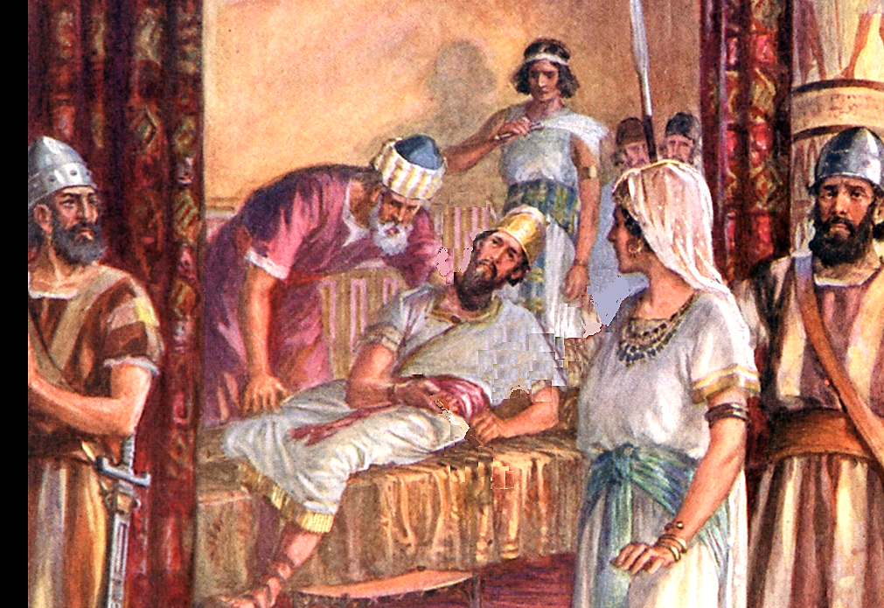
The Writing on the Wall
²⁹ Then Belshazzar gave the command, and Daniel was clothed with purple, a chain of gold was put around his neck, and a proclamation was made about him, that he should be the third ruler in the kingdom.
³⁰ That very night Belshazzar the Chaldean king was killed. ³¹ And Darius the Mede received the kingdom, being about sixty-two years old.
Daniel 1:29-31, ESV

Slide 10
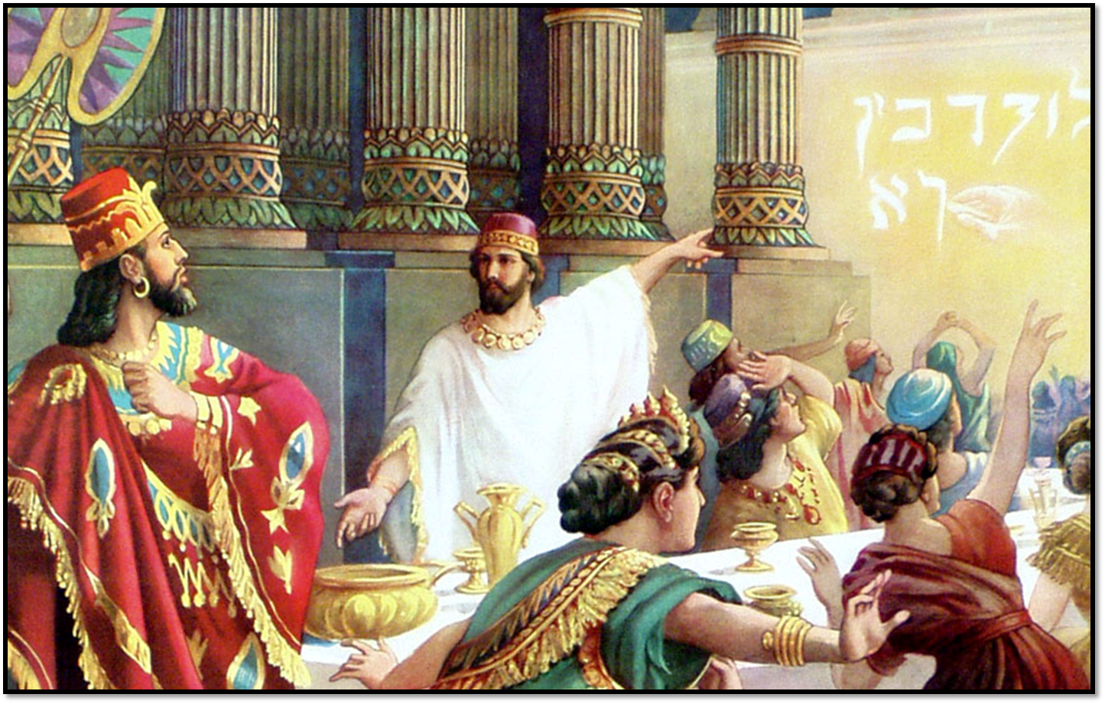
The Writing on the Wall
Church of Christ at Medina
October 21st, 2018

Slide 11
Lesson 1: Our days are numbered.
To number is to count but also to fix the limit of.
Our earthly life is limited and brief compared to eternity.
Job, David and Moses all were reminded of the frailty of man.
James describes the folly of man to make plans without God in mind because of the brevity of life.
It is not, however, the amount of days that determine its worth. Rather, it is the amount of glory we give to God that determines their value!
It is not the one who runs the fastest or longest that receives the crown. It is for the one who finishes!
Key Verses
Job 14:1, 1 Chronicles 29:15, James 4:13-16, Psalm 90:1-17, 2 Timothy 4:6-8, Ecclesiastes 12:1, Ephesians 5:15-17, Colossians 4:5

Slide 12
Lesson 2: We will be weighed.
The actions of Belshazzar came before God and He determined their ‘weight’. He found them wanting.
No one ever prospered by mocking God.
Many today still mock God by…
…fail to receive God’s Word.
…fail to believe that God is both loving and just.
…think that Christ’s church is not that important.
…fail to think that worshipping God is demanded by His children.
In the end, all of us will be judged.
Key Verses
Job 14:1, 1 Chronicles 29:15, James 4:13-16, Psalm 90:1-17, 2 Timothy 4:6-8, Ecclesiastes 12:1, Ephesians 5:15-17, Colossians 4:5

Slide 13
Conclusion
Our days are numbered, so take advantage of all our opportunities.
All our deeds will be weighed in the final judgment.
References
A Commentary on Daniel by Homer Hailey
Images from the Visual Bible, Old Testament

