Slide 2
The Captivity & Exile
Year | Ruler | Books of Bible | Event
605 | Nebuchadnezzar | Daniel | First Captives taken
597 | Nebuchadnezzar | Daniel | 2nd Captives taken
586 | Nebuchadnezzar | Daniel | Jerusalem Destroyed
539 | Cyrus | Daniel | Persia defeats Babylon
538 | Cyrus | Ezra | Zerubbabel leads a return of exiles
538 | Cyrus | Ezra | Altar built, sacrifices
521 – 486 | Darius the Great | Ezra
516 | Darius the Great | Ezra, Haggai, Zechariah | Temple is finished
486-465 | Xerxes | Esther | Also known as Ahaseurus
≈ 479 | Xerxes | Esther | Esther becomes Queen
≈ 473 | Xerxes | Esther | Jews delivered from Haman
465 – 425 | Artaxerxes | Ezra, Nehemiah
458 | Artaxerxes | Ezra | Ezra leads back 2nd group
445 | Artaxerxes | Nehemiah | Nehemiah returns to rebuild wall

Slide 3
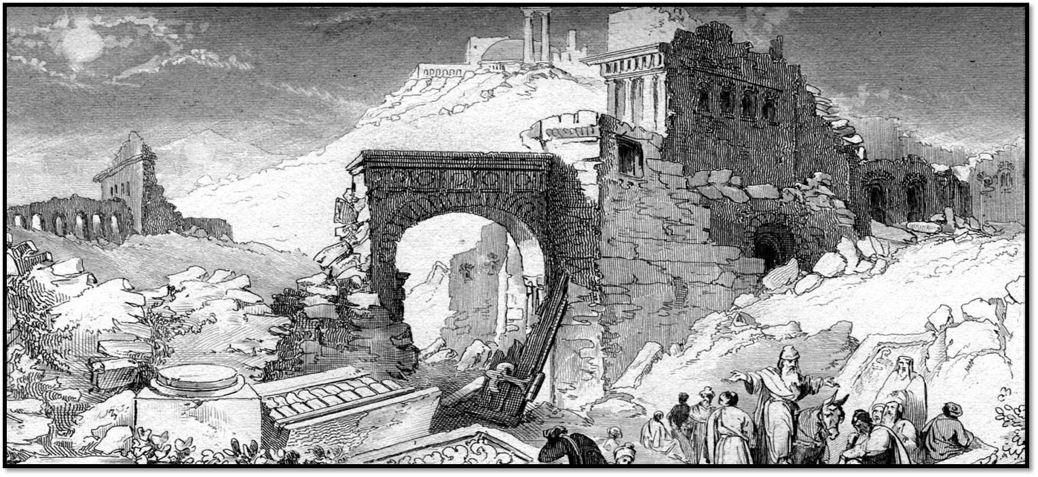
Lessons from the Captivity and Return of Israel
Church of Christ at Medina
December 23rd, 2018

Slide 4
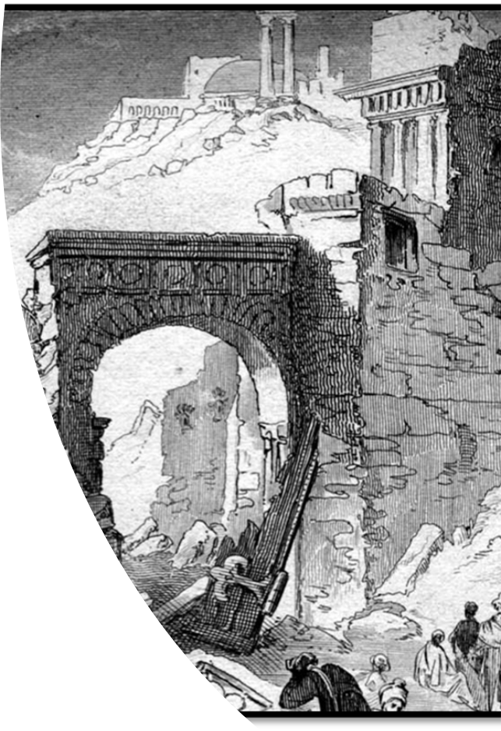
Serving God in Difficult Circumstances
They were willing servants.
The people who returned under the leadership of Zerubbabel were volunteers.
Nehemiah was not forced to go by the King, but made a request that was a risk to his position.
Esther made a willing choice to go before the King even when facing death.
They were prepared servants.
Ezra prepared himself to teach Israel by studying God’s law.
Nehemiah prepared by asking for God’s help.
Esther and Mordecai prepared by fasting.
How do we prepare to serve God?
Key Passages
Ezra 1:3-5, 7:10, 8:21-23, 3:2-3, 9-10
Nehemiah 2:5, 1:11, 2:4, 2:15-16, 4:6, 9:1-3, 8:13-18
Esther 4:6, 4:16
Colossians 3:17

Slide 5
Serving God in Difficult Circumstances
They were willing servants.
They were prepared servants.
They were willing to work!
Once they returned to the work from the encouragement of Haggai and Zechariah, the people built the temple and “prospered.”
Nehemiah and the people had “a mind to work” in building the walls of Jerusalem. It was a work of both individuals and a group.
They were willing to worship Him as He directs!
Key Passages
Ezra 1:3-5, 7:10, 8:21-23, 3:2-3, 9-10
Nehemiah 2:5, 1:11, 2:4, 2:15-16, 4:6, 9:1-3, 8:13-18
Esther 4:6, 4:16
Colossians 3:17

