Slide 2
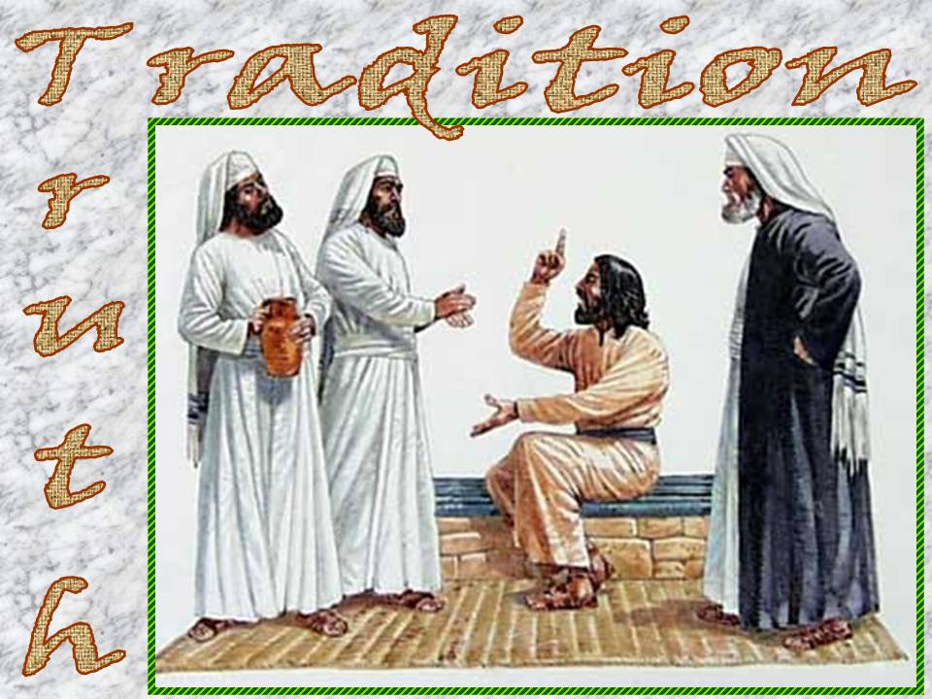
Lessons From The Teaching of Jesus
Matthew 15:1-20

Slide 3
The Danger of Traditions of Men Matthew 15:1-9
Human authority does not equal God’s authority.
They can make void the Word of God (3-6).
They can lead to vain worship (9).
They can lead to hypocritical worship (7-8).
It is God’s Word that will decide the issue of defilement.

Slide 4
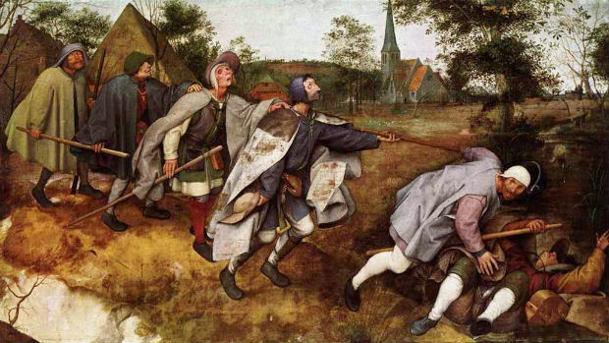
Blind Leaders of the Blind Matthew 5:12-14
Characteristics of a blind leader.
God will deal ruthlessly with those who contravene His Law (13).
How not to be misled by blind leaders.
Listen to them carefully.
Search the Scriptures daily (Acts 17:11).
"Let them alone. They are blind leaders of the blind. And if the blind leads the blind, both will fall into a ditch." (Matthew 15:14 NKJV)

Slide 5
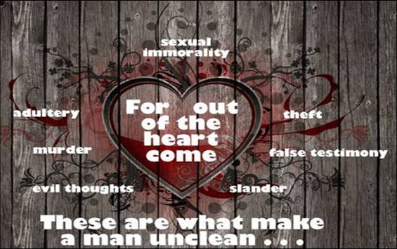
That Which Defiles… Matthew 15:15-20
Food only affects us physically.
The heart is the source of a man’s true character!

Slide 6
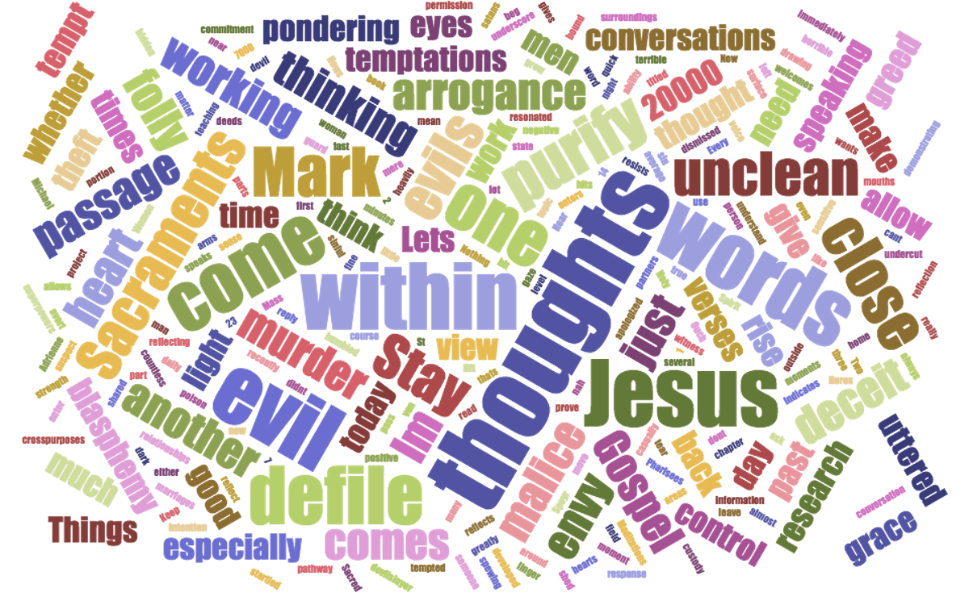
The standard is not simply to avoid immoral thoughts or actions.
We are commanded to pursue and think holy/pure things.

Slide 7
‘Faith
‘Righteousness’
‘Love’
‘Peace’
A Christian's
Goal
‘True, noble, just’
‘Pure’
‘Virtuous… Praiseworthy’
‘Of good report’
‘Lovely’
Philippians 4:8; Galatians 5:22,23; Colossians 3:12-14

Slide 8
Sources
Outlines in Matthew by Mark Copeland
The Gospel of Matthew by Kenneth L. Chumbley

