Slide 2
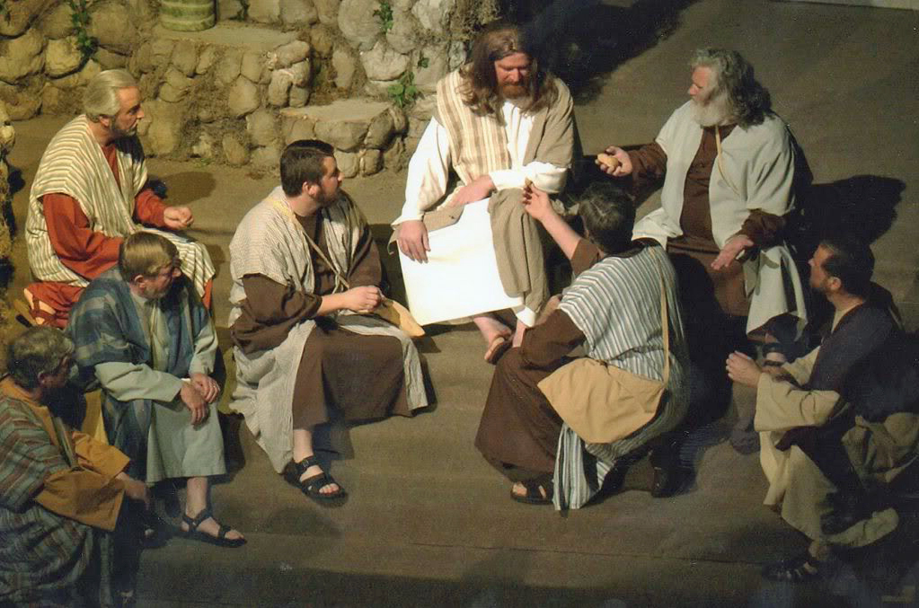
To Whom Shall We Go?
John 6:60-69

Slide 3
Context: After The Feeding of the 5000 Men
Jesus answered them, "Truly, truly, I say to you, you seek me, not because you saw signs, but because you ate your fill of the loaves. Do not labor for the food which perishes, but for the food which endures to eternal life, which the Son of man will give to you; for on him has God the Father set his seal." (John 6:26-27 RSV)

Slide 4

Where Some Go:
Majority
Human Wisdom
Preachers
Conscience
Feelings
Bible Verses:
Matthew 7:13-14
Isaiah 55:8,9
1 Corinthians 1:18-29
2 Corinthians 11:13-15
Matthew 15:12-14
Acts 23:1; 26:9-11
Do not labor for the food which perishes, but for the food which endures to eternal life, which the Son of man will give to you; for on him has God the Father set his seal." (John 6:27 RSV)

Slide 5
We Must Go To The Food Which Endures:
It Is Jesus, The Word Of God
  In the beginning was the Word, and the Word was with God, and the Word was God. (John 1:1 RSV)
  And the Word became flesh and dwelt among us, full of grace and truth; we have beheld his glory, glory as of the only Son from the Father. (John 1:14 RSV)
  But he answered, "It is written, 'Man shall not live by bread alone, but by every word that proceeds from the mouth of God.'" (Matthew 4:4 RSV)
  John 6:31-35; 47-51

Slide 6
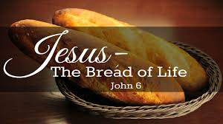
Where We Must Go!
Jesus Christ, Son of the Living God
He Provides the food which endures (John 6:27,35,40)
He is the Way! (John 14:6)
We must turn to the Apostles of Christ (John 16:7-13; 13:20)
We must view their words as the commandments of the Lord (1 Cor. 14:37).
⁶⁷So Jesus said to the twelve, "You do not want to go away also, do you?“ ⁶⁸Simon Peter answered Him, "Lord, to whom shall we go? You have words of eternal life. ⁶⁹"We have believed and have come to know that You are the Holy One of God."

Slide 7
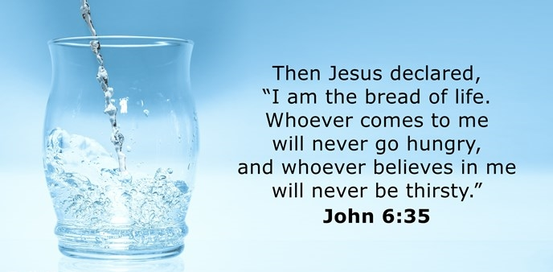
And there is salvation in no one else, for there is no other name under heaven given among men by which we must be saved." (Acts 4:12 RSV)

