Slide 2
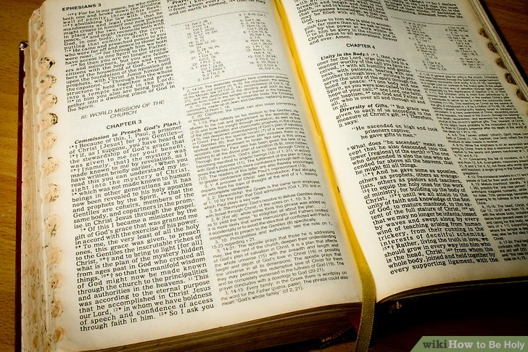
Issues Around Bible Fellowship
Text: 1 John 1:1 – 2:2
God is faithful, by whom you were called into the fellowship of His Son, Jesus Christ our Lord. (1 Corinthians 1:9 NKJV)

Slide 3
Biblical Fellowship
Notice the Circle of this Fellowship (1:3-6; 5:1)
With God and Christ
With The Apostles
With One Another
Why Do We Need This Fellowship?
Where and How is this Fellowship Attained?
It is “in the light” (vs. 5-7)
The Privileges of Having this Fellowship (1:7 – 2:2)
Advocate with the Father
Avenue of Prayer
Forgiveness
Continual Cleansing
Heaven
Defining Biblical Fellowship
Greek word means: Communion, fellowship, sharing in common. (WE Vines)
“fellowship, a close mutual relationship.” (Concise Greek-English Dictionary of NT)
It refers to the close relationship and intimacy that Christians have with the Father.

Slide 4
The Vine Brings Us In Connection With The Branches
"I am the true vine, and My Father is the vinedresser. "Every branch in Me that does not bear fruit He takes away; and every branch that bears fruit He prunes, that it may bear more fruit. "You are already clean because of the word which I have spoken to you. "Abide in Me, and I in you. As the branch cannot bear fruit of itself, unless it abides in the vine, neither can you, unless you abide in Me. "I am the vine, you are the branches. He who abides in Me, and I in him, bears much fruit; for without Me you can do nothing. "If anyone does not abide in Me, he is cast out as a branch and is withered; and they gather them and throw them into the fire, and they are burned. (John 15:1-6 NKJV)

Slide 5
Possible Errors Concerning Congregational Fellowship
Excluding from our fellowship those who are in fellowship with God - 3 Jn. 9,10. Cf. Ac. 9:26-28.
Including in our fellowship those who are not in fellowship with God - 1 Cor. 5:1-13. Cf. Rev. 2:14-16.
And when Saul had come to Jerusalem, he tried to join the disciples; but they were all afraid of him, and did not believe that he was a disciple. But Barnabas took him and brought him to the apostles. And he declared to them how he had seen the Lord on the road, and that He had spoken to him, and how he had preached boldly at Damascus in the name of Jesus. So he was with them at Jerusalem, coming in and going out. (Acts 9:26-28 NKJV)

Slide 6
Congregational Fellowship
God Commands Congregational Action:
But we command you, brethren, in the name of our Lord Jesus Christ, that you withdraw from every brother who walks disorderly and not according to the tradition which he received from us. (2 Thessalonians 3:6 NKJV)
And if anyone does not obey our word in this epistle, note that person and do not keep company with him, that he may be ashamed. Yet do not count him as an enemy, but admonish him as a brother. (2 Thessalonians 3:14-15 NKJV)
Now I urge you, brethren, note those who cause divisions and offenses, contrary to the doctrine which you learned, and avoid them. (Romans 16:17 NKJV)

Slide 7
Remember…
Each of us must give account of himself individually to God - Rom. 14:12. Cf. Rom. 2:5-11; 2 Cor. 5:10; 1 Pt. 4:5.
We are not saved or lost on the “group plan.” Cf. Rev. 3:4.
Congregations can, and often do, make mistakes in the matter of fellowship — but God does not! Cf. 2 Tim. 2:19.
As an individual, I should understand:
I will not be lost just because the congregation rejected me.
Nor will I be saved just because the congregation received me.
I will be lost or saved depending on my obedience to God’s truth and Walking in the Light! Cf. 2 Thess. 1:8; 1 John 1:5-7

Slide 8
Sources
Fellowship with God – by Alex Ogden
Article by Doy Moyer – March 1996, revised March 2001
Two Fellowships – by Gary Henry – Brass Tacks
Adapted from an Article by Robert Turner

