Slide 2
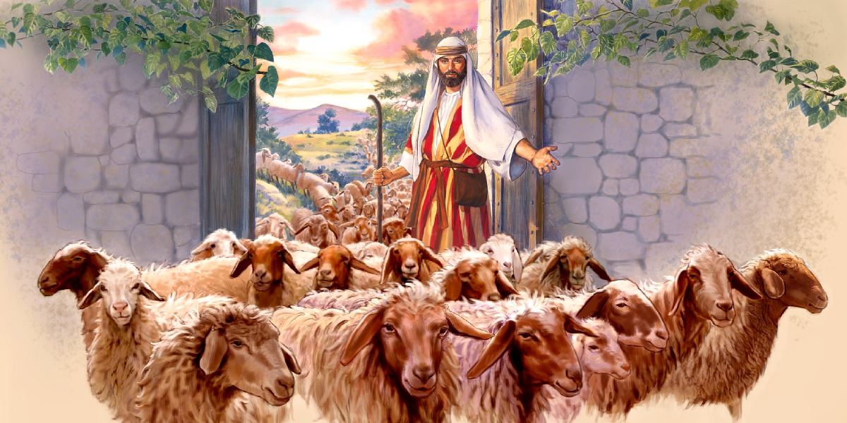
Jesus is The Door
John 10:1-10

Slide 3
The Door of the Sheepfold
Shepherds often left home with sheep to find grass.
Often they had to sleep outside at night.
The Shepherds found a cave, or built a sheep pin.

Slide 4
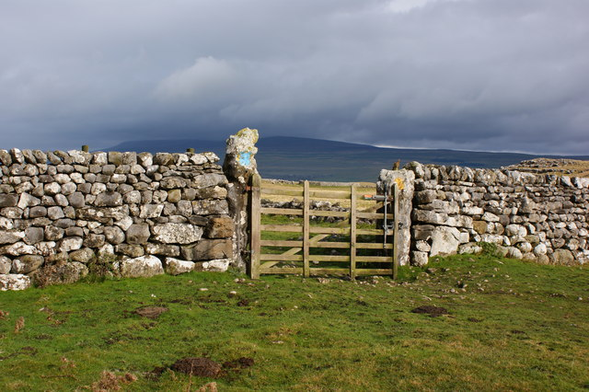
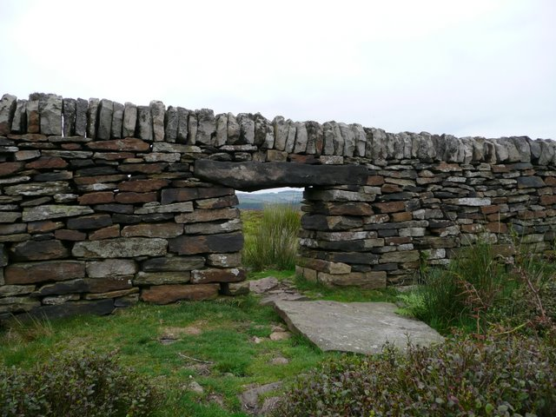
Sheepfolds of Palestine

Slide 5
“I Am The Door Of The Sheep”
Jesus is the Door:
To the love of God.
To the family of God.
To the provisions of God.
To the presence of God.
To salvation.
1 Jn. 4:8-10; Jn. 3:16; Rom. 5:8; 1 Jn. 5:1; Gal. 3:26,27; Matt. 5:45; Eph. 1:3; Eph. 1:7
Matthew 6:9; 7:7,8; Matt. 19:29; Phil. 4:7; 1 John 1:7; Heb. 9:11; 10:10; Jn. 14:6; 10:1

Slide 7
Sources
Truth Commentary on John
The Gospel of John: That You Might Believe – Steve Higginbotham

