Slide 2
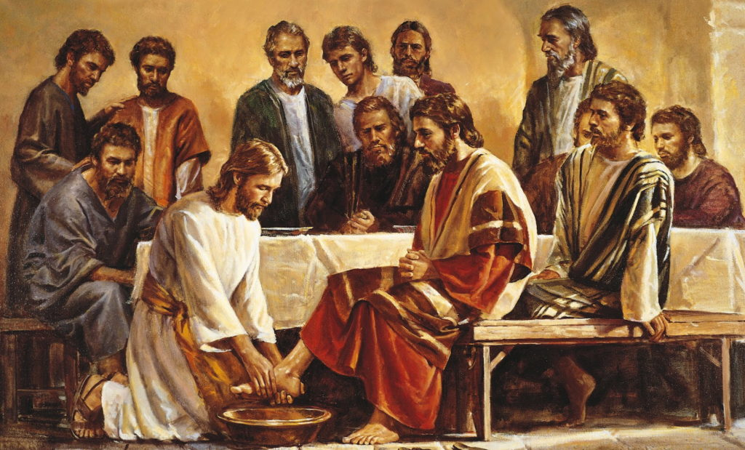
The Ministry of Love
John 13:1-17

Slide 3
Who is the Greatest?
(Luke 22:24-27) Now there was also a dispute among them, as to which of them should be considered the greatest. And He said to them, "The kings of the Gentiles exercise lordship over them, and those who exercise authority over them are called 'benefactors.' "But not so among you; on the contrary, he who is greatest among you, let him be as the younger, and he who governs as he who serves. "For who is greater, he who sits at the table, or he who serves? Is it not he who sits at the table? Yet I am among you as the One who serves. (NKJV)

Slide 4
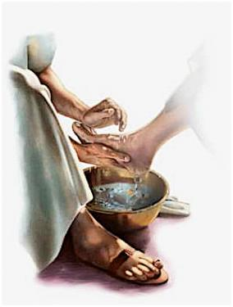
“None of us is worthy of His service for us. But no one of us can be saved without His service.” (Daniel H. King)

Slide 5
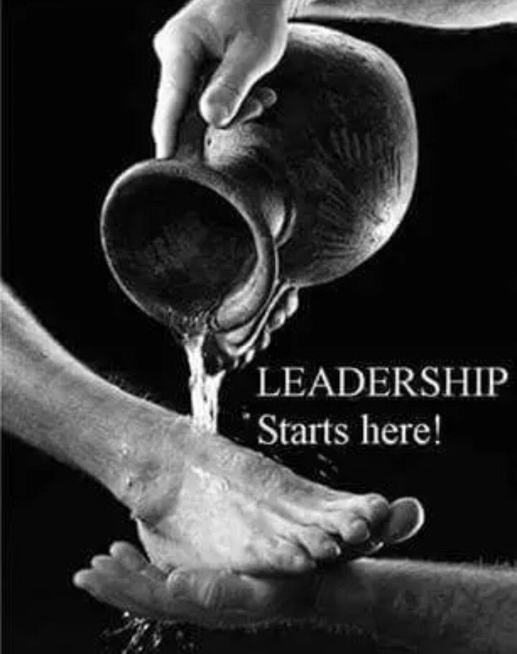
Washing the Disciples’ Feet
So when He had washed their feet, taken His garments, and sat down again, He said to them, "Do you know what I have done to you? "You call me Teacher and Lord, and you say well, for so I am. "If I then, your Lord and Teacher, have washed your feet, you also ought to wash one another's feet. "For I have given you an example, that you should do as I have done to you. "Most assuredly, I say to you, a servant is not greater than his master; nor is he who is sent greater than he who sent him. "If you know these things, blessed are you if you do them. (John 13:12-17 NKJV)
Actions Speak Louder Than Words!

Slide 6
Life Lessons
Serve others...
Humble yourself in the sight of your brethren.
Prefer one another in honor.
Lean not on your own understanding.
Quit competing.
Love unconditionally

Slide 7
Will You Accept Jesus' Challenge To Serve?
""If you know these things, blessed are you if you do them. (John 13:17 NKJV)

Slide 8
Sources
Truth Commentary on John by Daniel H. King.
Lessons from a Foot Washing - Material by Jim Deason

