Slide 2
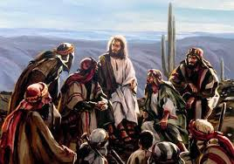
For the Son of man came to seek and to save the lost." (Luke 19:10 RSV)

Slide 3
What Motivated Jesus To Save The Lost?
His strong sense of purpose (to do His Father’s will) - Jn 6:38
The Father’s love (which He wanted to share) - Jn 15:9; 17:26
The potential condemnation of those He sought to save (of which He warned) - Mt 10:28
The joy set before Him (helping Him to endure the cross) - He 12:2
His Compassion (Matthew 9:36)

Slide 4
Compassion For The Lost
Matthew 9:35-38

Slide 5
Compassion…
And Jesus went about all the cities and villages, teaching in their synagogues and preaching the gospel of the kingdom, and healing every disease and every infirmity. When he saw the crowds, he had compassion for them, because they were harassed and helpless, like sheep without a shepherd. Then he said to his disciples, "The harvest is plentiful, but the laborers are few; pray therefore the Lord of the harvest to send out laborers into his harvest." (Matthew 9:35-38 RSV)
JESUS HAD COMPASSION FOR THE LOST...
HIS COMPASSION MOVED HIM TO ACTION...
DO WE HAVE COMPASSION FOR THE LOST?
HOW CAN WE DEVELOP COMPASSION?
HOW SHOULD COMPASSION MOVE US?

Slide 6
With Compassion…
If I say, "I will not mention him, or speak any more in his name," there is in my heart as it were a burning fire shut up in my bones, and I am weary with holding it in, and I cannot. (Jeremiah 20:9 RSV)

Slide 7
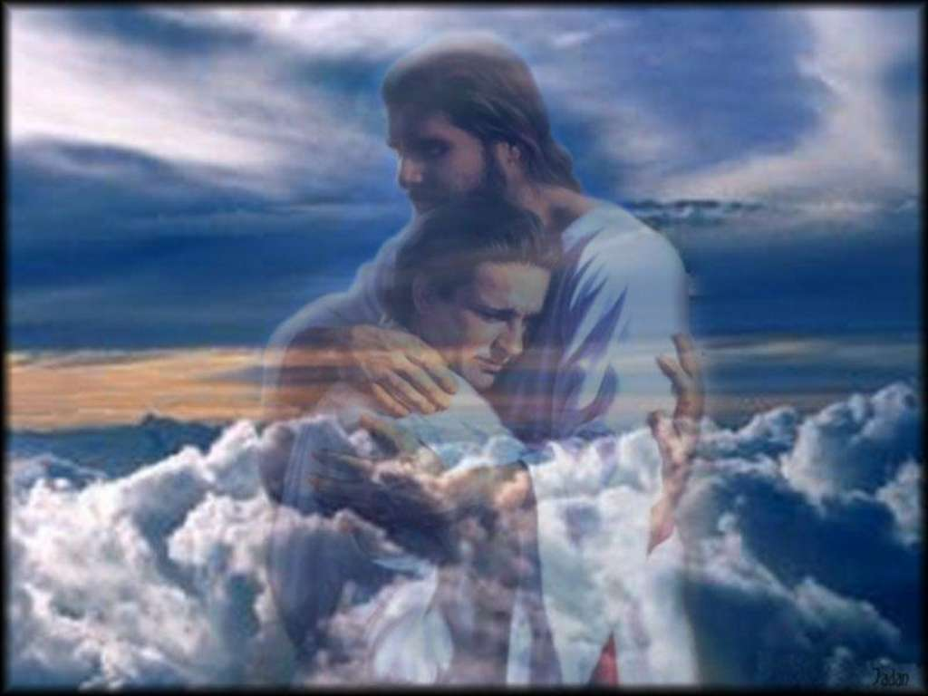
We All Need The Great Physician!
“Those who are well have no need of a physician, but those who are sick. But go and learn what this means: ‘I desire mercy and not sacrifice.’ For I did not come to call the righteous, but sinners, to repentance.” (Mt 9:12-13)

Slide 8
Sources
Material by Mark Copeland
Commentary on Matthew by Kenneth Chumbley
Commentary on Matthew by George Dehoff

