Slide 2
Jesus is or was…
…the Son of God.
…the Son of Man.
…the Lamb of God.
…the Savior of the world.
…the Light of the world.
…the door to God.

Slide 3
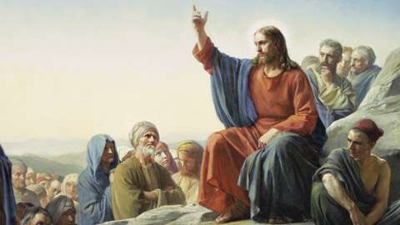
The Master Teacher
Jesus was unique, and those who heard Him knew it.
What made His teaching different?
The teacher was different – His background, His character, His “experience”.
The message was different.
They were one and the same – the Truth!
Jesus also had confirmation like no other teacher.
He received commendation from God the Father.
He confirmed the message with great power!
Matthew 7:29, John 7:46, John 14:6, John 1:14, John 14:9-10, John 17:17, John 8:26, Matthew 17:5, John 3:2

Slide 4
The Master Teacher
Despite these powerful confirmations, Jesus did not force His hearers to believe. Instead, He taught in various ways to help men to understand.
One of the most frequently used teaching methods – and one that we associate with Jesus specifically – was the parable.
Matthew 7:29, John 7:46, John 14:6, John 1:14, John 14:9-10, Matthew 17:5, John 3:2

Slide 5
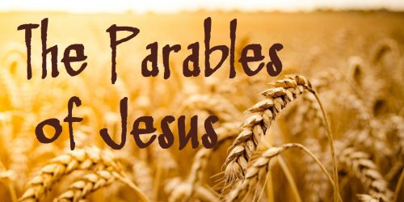
Church of Christ at Medina July 21st, 2019
A Study from Matthew 13

Slide 6
Matthew 13:3 Matthew 13:34
Parables
Greek word, parabole, meaning to “cast alongside”
To use what is known in comparison to something unfamiliar for the purpose of instruction
“Earthly story with a heavenly meaning”
Jesus seemingly made a stark transition to using more parables in Matthew 13.
“…all these things Jesus said to the crowds in parables; indeed, He said nothing to them without a parable.”

Slide 7
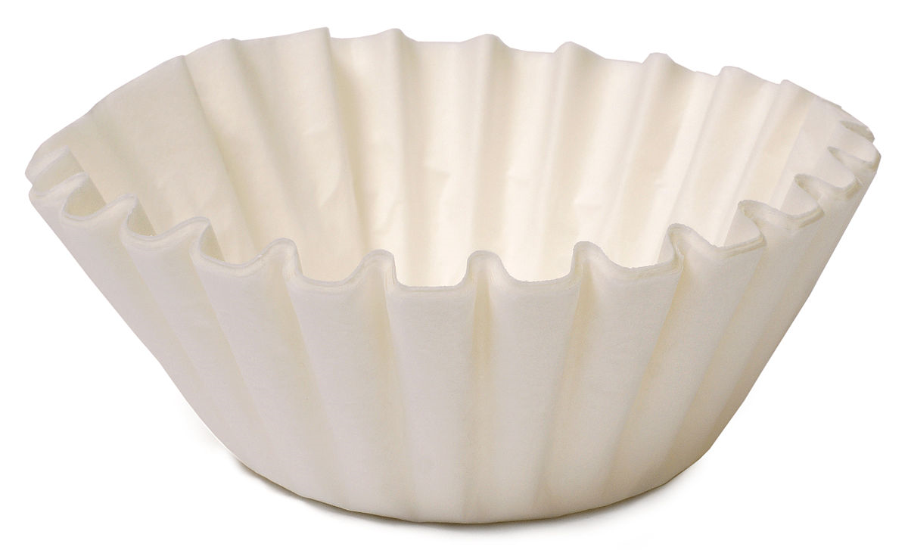
Matthew 13:10-17 Matthew 13:36
Why would Jesus use parables?
The disciples wondered why Jesus would use parables in order to teach the people.
In short, the parables were used as filters to determine who really wanted to know the truths of the kingdom.

Slide 8
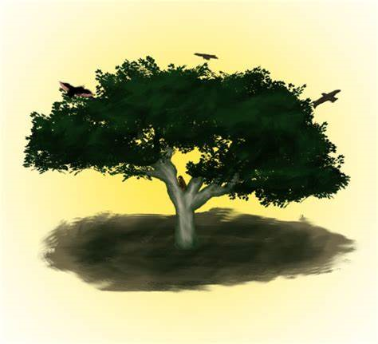
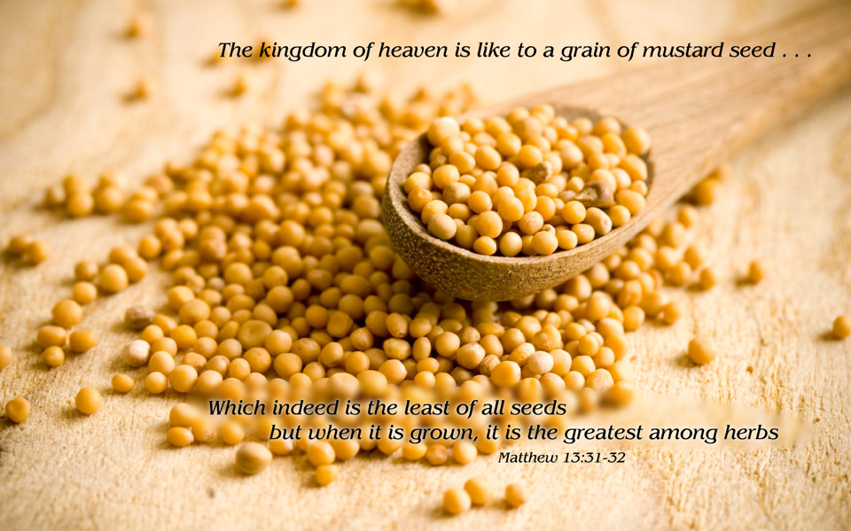
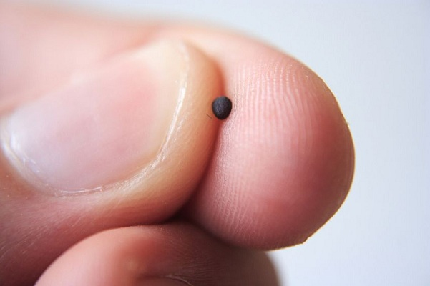
Matthew 13:31-32
The Parable of the Mustard Seed
Intended to show that even from “humble beginnings”, the kingdom of heaven would wield a large influence over time.
It might start small, but it would grow tremendously as compared to its beginning.

Slide 9
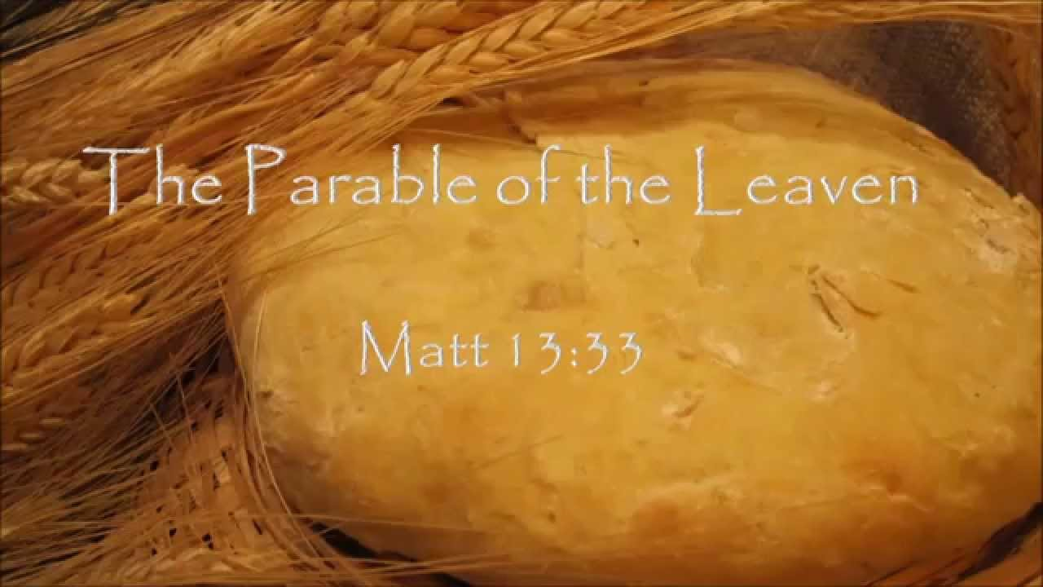
Matthew 13:33
The Parable of the Leaven
Only a small amount of leaven – yeast – is required to affect a large amount of dough.
It is a quiet and penetrating work just like the effect of the kingdom citizens on the world around them.

Slide 10
Ephesians 2:8-10 Ephesians 3:14-21 Proverbs 4:23 Deut. 6:4
The Parable of the Leaven
Transformation begins without
Transformation must come from within
Transformation must be complete

