Slide 2
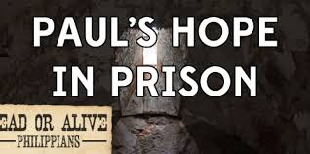
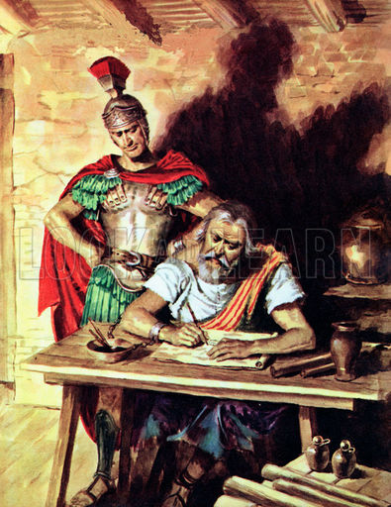
Rejoice in the Lord always; again I will say, Rejoice. Let all men know your forbearance. The Lord is at hand. Have no anxiety about anything, but in everything by prayer and supplication with thanksgiving let your requests be made known to God. And the peace of God, which passes all understanding, will keep your hearts and your minds in Christ Jesus. (Philippians 4:4-7 RSV)

Slide 3
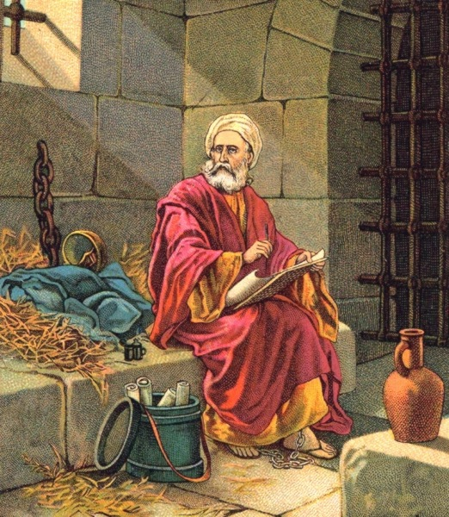
What kept Paul going during this time of great distress and turmoil in his life?
Why did Paul keep preaching about faith in Jesus even in chains?
How did Paul keep his faith in God?
What kept Paul from giving up?
What was Paul’s secret?
But the Lord said to him, "Go, for he is a chosen instrument of mine to carry my name before the Gentiles and kings and the sons of Israel; for I will show him how much he must suffer for the sake of my name." (Acts 9:15-16 RSV)

Slide 4
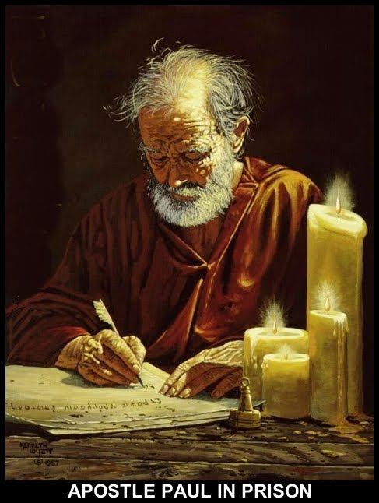
The Secret of Paul’s Success. . .
Paul had a Sense of Personal Unworthiness
Paul had Singleness of Purpose
Paul was Able to Forget:
A noble ancestry (Phil. 3:5)
A respectable religion in which he profited (Gal. 1:14)
His miserable mistakes (Acts 8)
Paul had a Spirit of Pressing On

