Slide 2
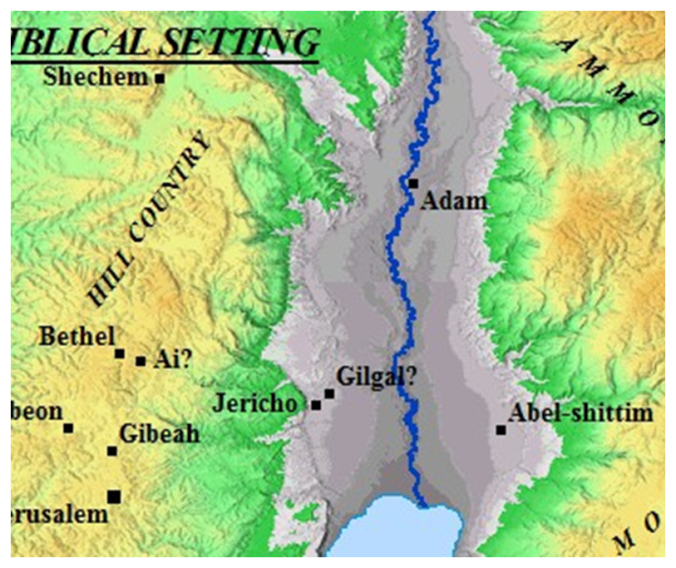
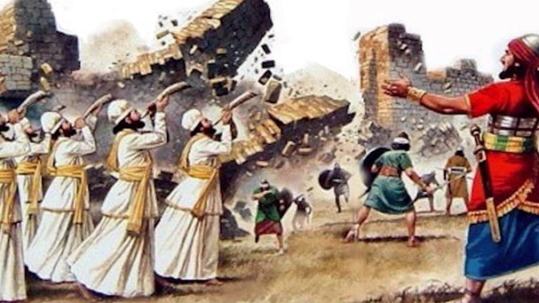
Photo credit: Ytimg.com

Slide 3
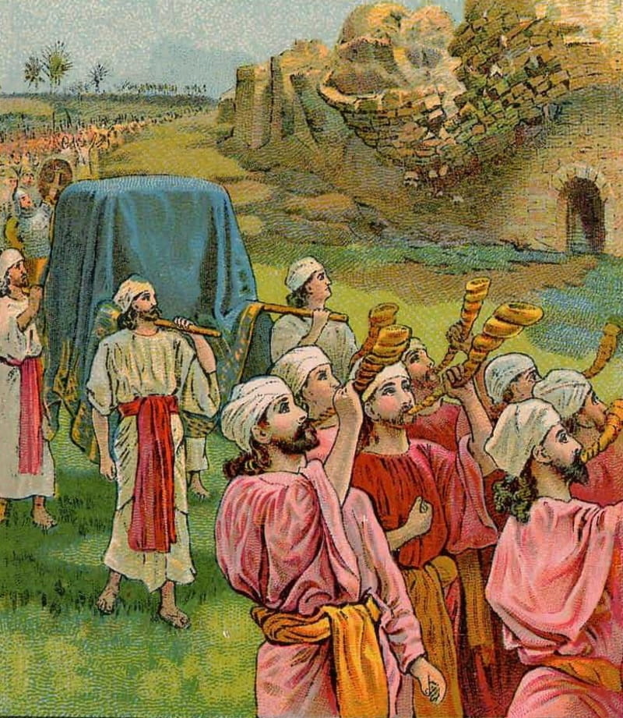
Breaking Down Walls Joshua 6
Church of christ
at medina
November 17th, 2019

Slide 4
The Walls of Jericho: A Lesson on the Grace of God
Grace is the unmerited favor of God.
The victory at Jericho was not a result of the power of the children of Israel.
God assured victory in Canaan – before the children of Israel even crossed the Jordan.
The victory at Jericho showed…
…the dependence of the Israelites on God.
…God’s faithfulness.
Exodus 3:6-8
Genesis 15:13-16
Deuteronomy 7:1-2
Deuteronomy 7:6-8
Joshua 1:2
Joshua 6:2

Slide 5
The Walls of Jericho: A Lesson on the Faith of Man
Although God had already assured victory, it wasn’t provided until after the Israelites obeyed.
God was very specific in His instructions.
The failure to act – unbelief – on the part of the people of Jericho condemned them.
The people of Jericho believed in God.
The people of Jericho feared God.
The people of Jericho did not have faith.
Consider Rahab.
Hebrews 11:30
Joshua 6:2-5
Joshua 2:9-11
Hebrews 11:6
Ecclesiastes 12:7
Joshua 4:20-24
James 2:25-26
Hebrews 11:31
Romans 10:17
Acts 10:34-35

Slide 6
Grace and Faith still act together today!
God’s grace provided the greatest gift of all – Jesus Christ, the Son of God!
At the same time, we stand in God’s grace through the working of our faith.
Ephesians 2:8-9
1 Corinthians 1:18-23
Isaiah 55:8-11
Romans 5:1-2
Romans 6:17-18
1 John 5:3

Slide 7
References / Acknowledgements
Joe Price: “Lessons at Jericho”
Jim Deason: “The Battle of Jericho”
Multiple other commentaries and references

