Slide 2
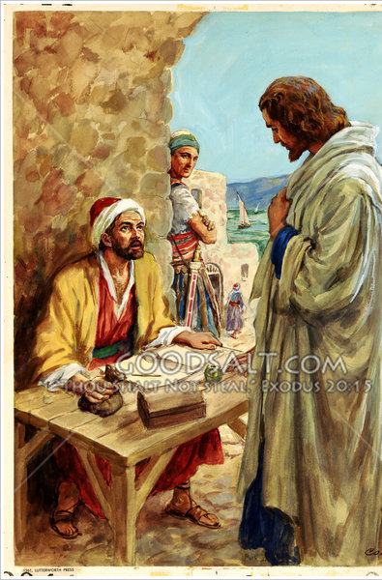
Following Jesus
Trusting the Leader
Desiring the Destination
Passable Path
Key Verses
2 Corinthians 5:21
Acts 13:38-39
Romans 3:20
Galatians 3:21
Ephesians 2:1-10
Acts 16:30-33
Acts 2:38
Acts 3:19
Acts 8:36-37
Acts 22:16

Slide 3
Follow Jesus
Church of Christ at Medina
December 1st, 2019

Slide 4
Following Jesus
…is a personal affair.
Man’s very beginning included a personal relationship with God.
The relationship was desired by God, but not mandated. It’s man’s choice.
^{“11}For I know the plans I have for you, declares the Lord, plans for welfare and not for evil, to give you a future and a hope. ¹² Then you will call upon me and come and pray to me, and I will hear you. ¹³ You will seek me and find me, when you seek me with all your heart.” (Jeremiah 29:11-13)
Key Verses
Genesis 1:26-27
Genesis 3:1-24
Isaiah 59:1-2
Jeremiah 29:11-13
Matthew 11:38-30
1 Peter 3:15
Matthew 16:24
Revelation 3:4
2 Corinthians 5:10

Slide 5
Following Jesus
…is a personal affair.
Man’s very beginning included a personal relationship with God.
The relationship was desired by God, but not mandated. It’s man’s choice.
“Come to me, all who labor and are heavy laden, and I will give you rest. Take my yoke upon you, and learn from me, for I am gentle and lowly in heart, and you will find rest for your souls. For my yoke is easy and my burden is light.” (Matthew 11:28-30)
Key Verses
Genesis 1:26-27
Genesis 3:1-24
Isaiah 59:1-2
Jeremiah 29:11-13
Matthew 11:38-30
1 Peter 3:15
Matthew 16:24
Revelation 3:4
2 Corinthians 5:10

Slide 6
Following Jesus
…is a personal affair.
Man’s very beginning included a personal relationship with God.
The relationship was desired by God, but not mandated. It’s man’s choice.
Salvation, and judgment, is an individual matter, not a collective.
“…but in your hearts honor Christ the Lord as holy, always being prepared to make a defense to anyone who asks you for a reason for the hope that is in you; yet do it with gentleness and respect.”
(1 Peter 3:15, ESV)
Key Verses
Genesis 1:26-27
Genesis 3:1-24
Isaiah 59:1-2
Jeremiah 29:11-13
Matthew 11:38-30
1 Peter 3:15
Matthew 16:24
Revelation 3:4
2 Corinthians 5:10

Slide 7
Following Jesus
…is a personal affair.
Man’s very beginning included a personal relationship with God.
The relationship was desired by God, but not mandated. It’s man’s choice.
Salvation, and judgment, is an individual matter, not a collective.
“Then Jesus told His disciples, ‘If anyone would come after Me, let him deny himself and take up his cross and follow Me.’”
(Matthew 16:24, ESV)
Key Verses
Genesis 1:26-27
Genesis 3:1-24
Isaiah 59:1-2
Jeremiah 29:11-13
Matthew 11:38-30
1 Peter 3:15
Matthew 16:24
Revelation 3:4
2 Corinthians 5:10

Slide 8
Following Jesus
…is a personal affair.
Man’s very beginning included a personal relationship with God.
The relationship was desired by God, but not mandated. It’s man’s choice.
Salvation, and judgment, is an individual matter, not a collective.
“For we must all appear before the judgment seat of Christ, so that each one may receive what is due for what he has done in the body, whether good or evil.”
(2 Corinthians 5:10, ESV)
Key Verses
Genesis 1:26-27
Genesis 3:1-24
Isaiah 59:1-2
Jeremiah 29:11-13
Matthew 11:38-30
1 Peter 3:15
Matthew 16:24
Revelation 3:4
2 Corinthians 5:10

Slide 9
Being a Good Follower
Know the leader (Don’t get out in front).
In order to be a good follower, we must actually follow.
We need to understand that our leader in all things spiritual must be Christ.
“Everyone who goes on ahead and does not abide in the teaching of Christ, does not have God.” (2 John 9a)
“We ask you, brothers, to respect those who labor among you and are over you in the Lord and admonish you, and to esteem them very highly in love because of their work.”
(1 Thessalonians 5:12-13, ESV)
Key Verses
1 Thess. 5:12-13
John 8:12
John 10:27
John 12:26
2 John 9

Slide 10
Being a Good Follower
Know the leader (Don’t get out in front).
Don’t follow from a distance.
It’s a sign that we are fearful.
It makes it easier to deny Christ, to follow sin and error and to be a spectator.
“Be sober, be vigilant; because your adversary the devil walks about like a roaring lion, seeking whom he may devour.”
(1 Peter 5:8, ESV)
Key Verses
Matthew 26:57ff
Matthew 10:27-31
John 12:37-43
1 Thess. 5:21
2 Timothy 1:13
1 Samuel 15:2
Deut. 25:17-18
1 Peter 5:8
James 4:4-8
1 John 2:15-17
2 Cor. 6:17-7:1
Ephesians 6:13-16

Slide 11
Being a Good Follower
Know the leader (Don’t get out in front).
Don’t follow from a distance.
Follow from close behind.
We should be close enough to receive His instruction, admonitions and discipline.
When we follow this closely, we have great blessings.
“Let us then with confidence draw near to the throne of grace, that we may receive mercy and find grace to help in time of need.”
(Hebrews 4:16, ESV)
Key Verses
Hebrews 4:16
Hebrews 10:19-22
James 4:8
1 John 1:7

