Slide 2
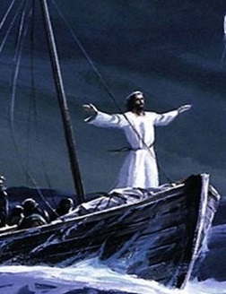
Mark 4:35-41
Who Is This Jesus?
Jesus shows His Power Over Nature!
All Nature Obeys God!

Slide 3
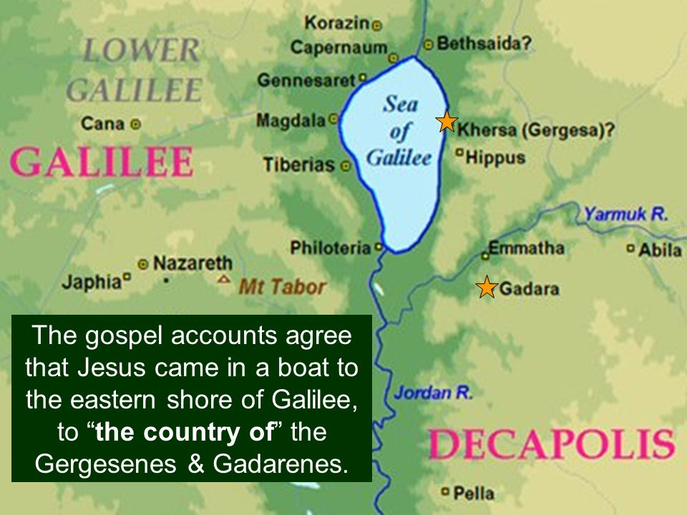

Slide 5
Who Was Afraid of Jesus? (Mark 5:1-20)
The Demons who were Legion. (1-7)
The People of the Region. (14-17)
The Demoniac who was Healed. (18-20)

Slide 6
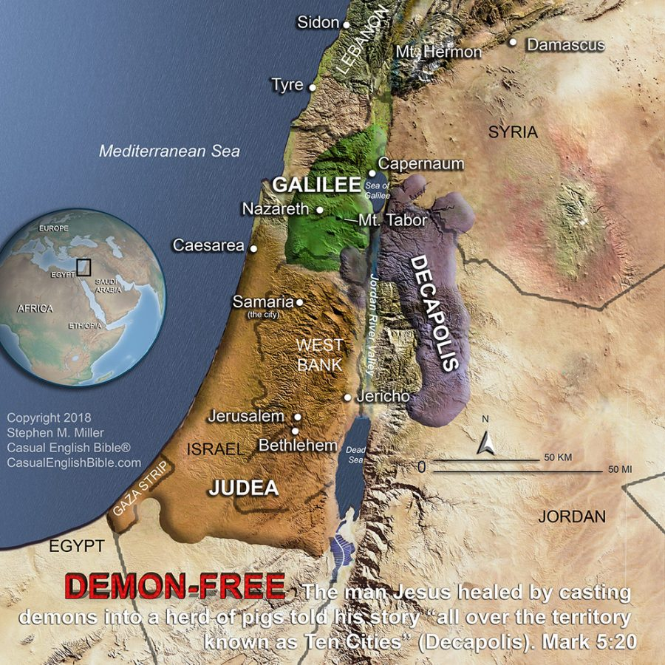

Slide 7
Summary
Who was afraid of Jesus...?
Those unwilling to repent of their sins
Those unwilling to learn about Jesus
Who was not afraid of Jesus...?
The one who appreciated what Jesus had done for him
The one who was willing to tell others what Jesus had done
Who are we more like in this story...?
The demons who were legion?
The people of the region?
The demoniac who was healed?

Slide 8
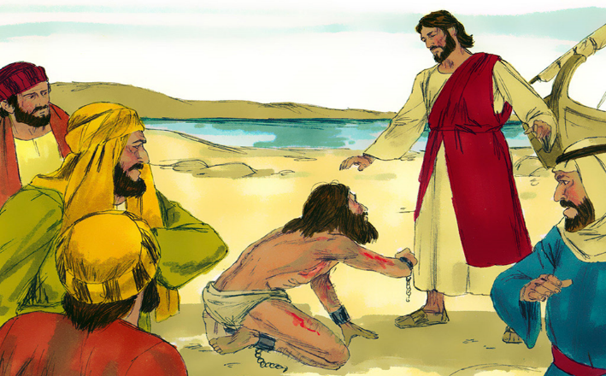
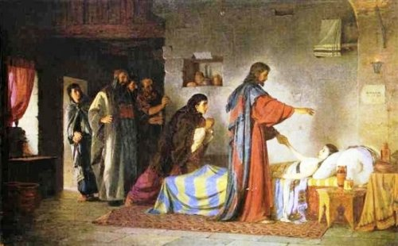
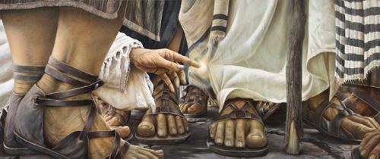
Will You Submit To Jesus?
Jesus Has Power Over:
Nature
Demons
Disease
Death
Jesus Has The Power To Save You!

