Slide 2
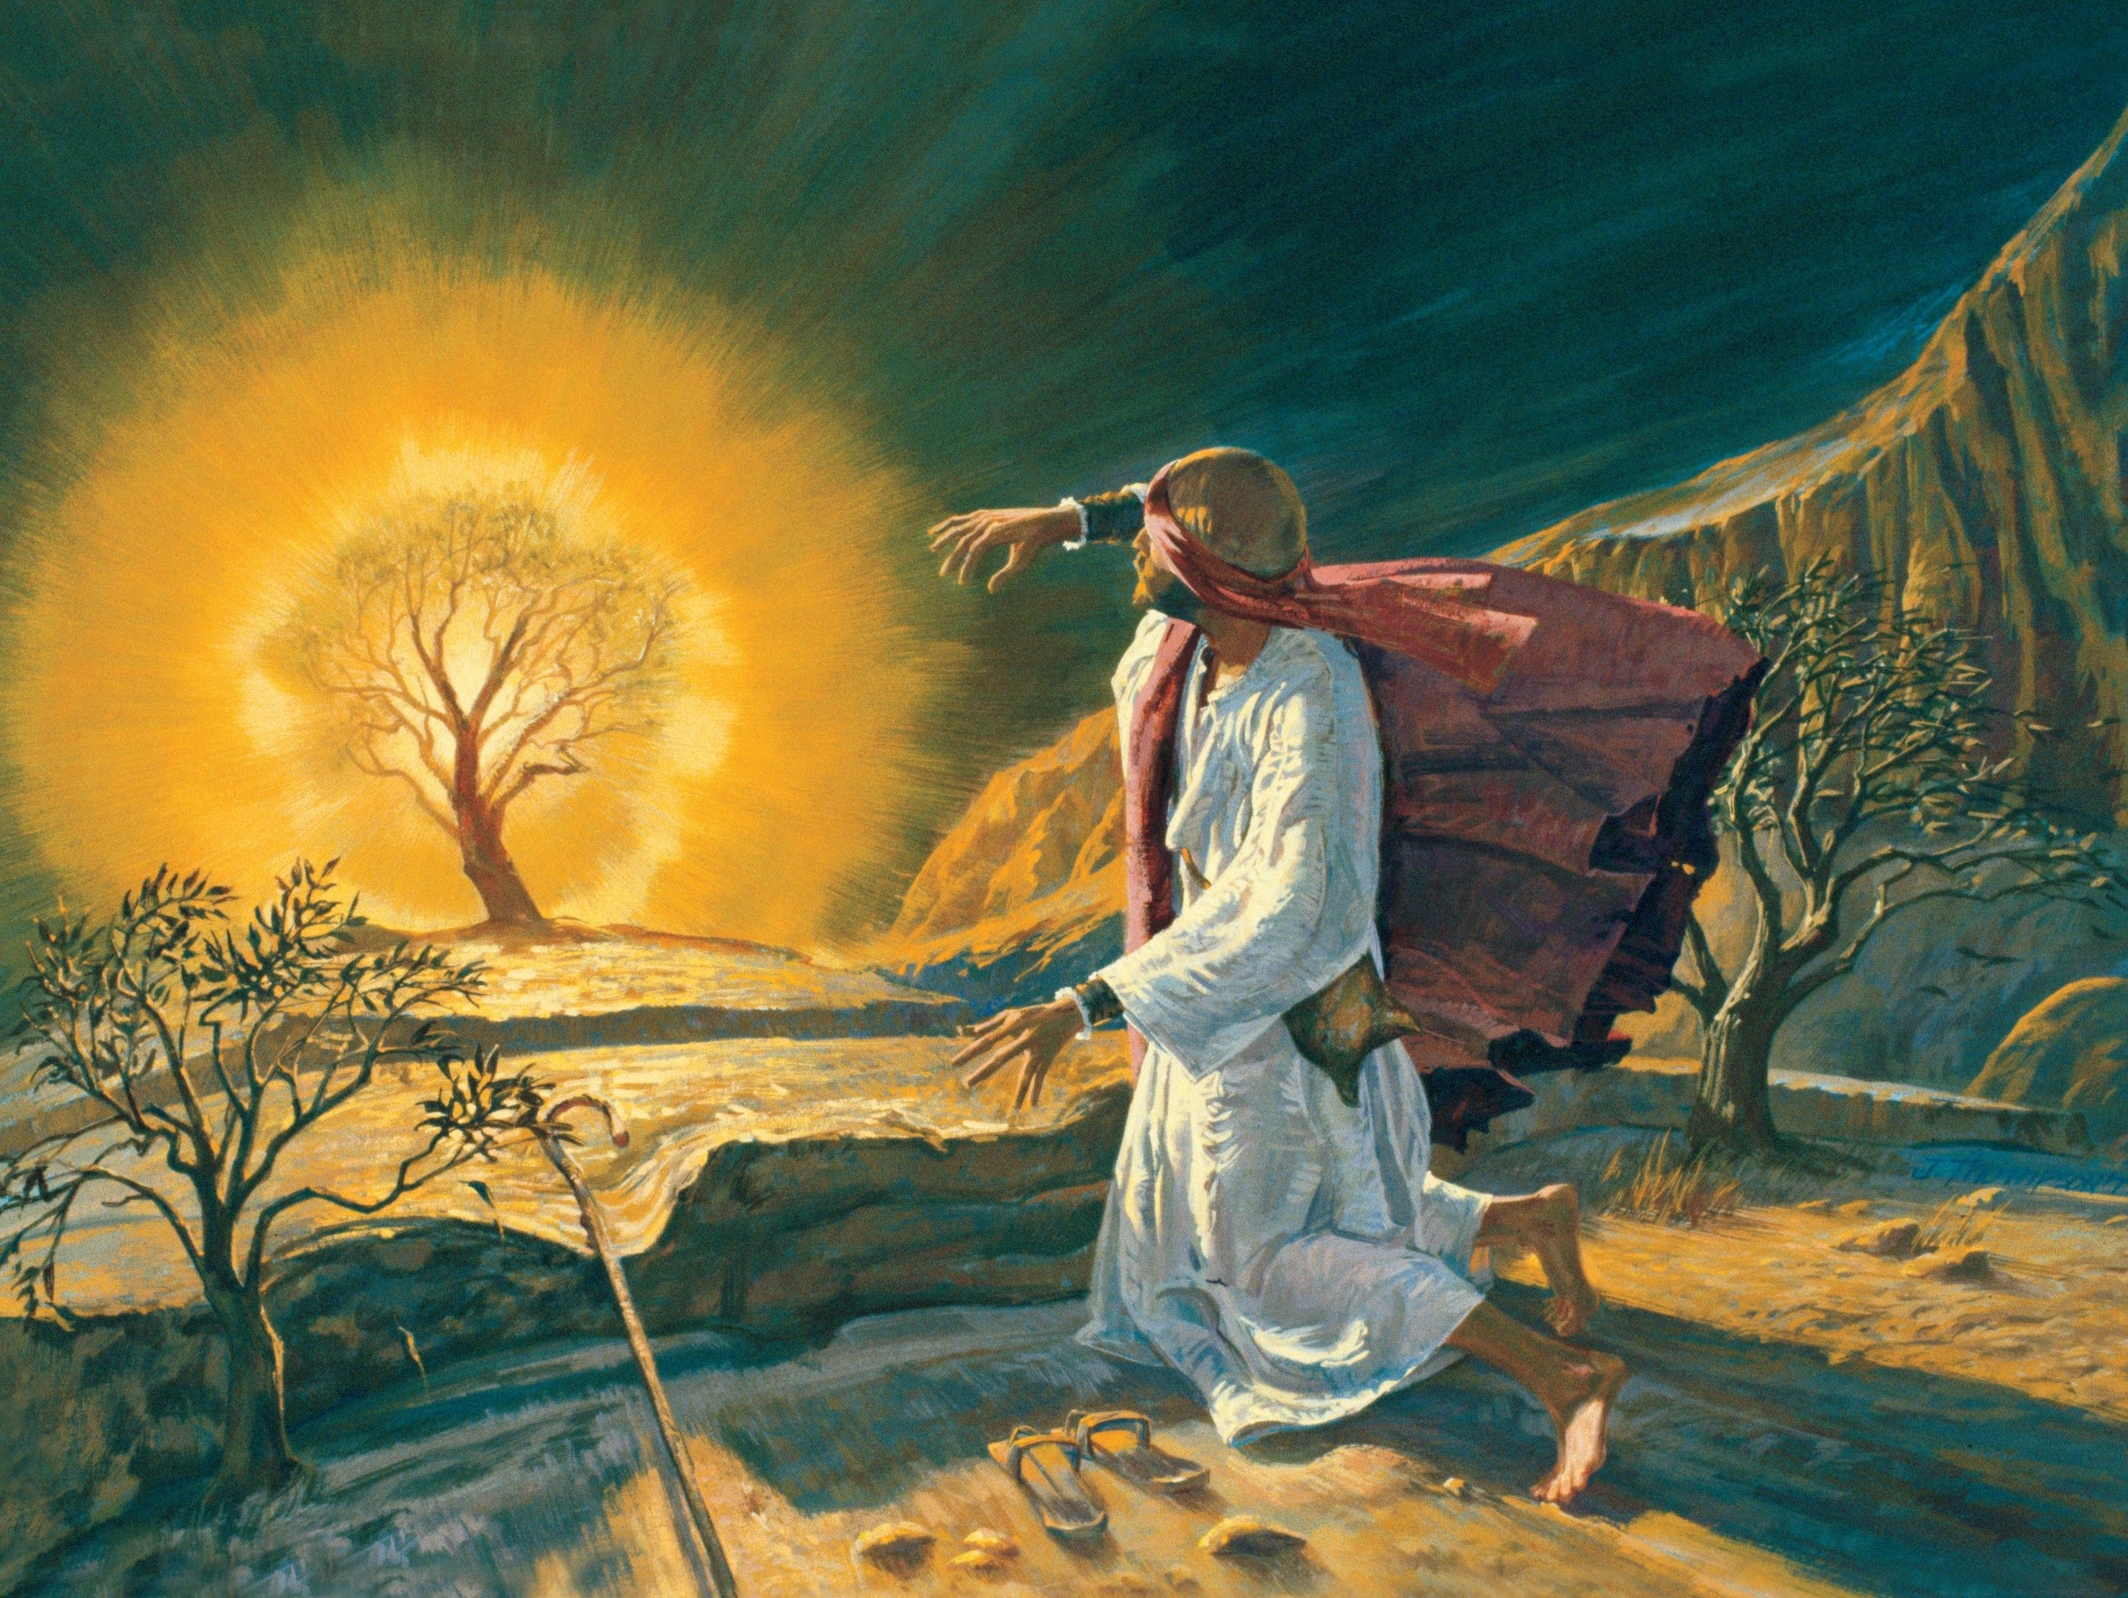
The Call of Moses..and Us!
Church of Christ at Medina
February 7th, 20

Slide 3
Moses had a big task…and so do we!
God’s people were in great affliction, and God had decided it was time to deliver them. He chose Moses as the leader!
Our task is not to lead a nation, but it is a big task! Our task is to…
…teach our children. (Ephesians 6:4, Psalm 78:1-7)
“Fathers, do not provoke your children to anger, but bring them up in the discipline and instruction of the Lord.”
Ephesians 6:4, ESV
References
Acts 7:23-28, 7:35, Exodus 5:1

Slide 4
Moses had a big task…and so do we!
God’s people were in great affliction, and God had decided it was time to deliver them. He chose Moses as the leader!
Our task is not to lead a nation, but it is a big task! Our task is to…
…teach our children. (Ephesians 6:4, Psalm 78:1-7)
…stand up for what is right. (Isaiah 5:20, Proverbs 28:4, Mark 11:15-18)
“Woe to those who call evil good and good evil, who put darkness for light and light for darkness, who put bitter for sweet and sweet for bitter!”
Isaiah 5:20, ESV
References
Acts 7:23-28, 7:35, Exodus 5:1
“Those who forsake the law praise the wicked, but those who keep the law strive against them.”
Proverbs 28:4, ESV

Slide 5
Moses had a big task…and so do we!
God’s people were in great affliction, and God had decided it was time to deliver them. He chose Moses as the leader!
Our task is not to lead a nation, but it is a big task! Our task is to…
…teach our children. (Ephesians 6:4, Psalm 78:1-7)
…stand up for what is right. (Isaiah 5:20, Proverbs 28:4, Mark 11:15-18)
…teach the gospel. (Matthew 9:35-38)
References
Acts 7:23-28, 7:35, Exodus 5:1
“Then he said to his disciples, ‘The harvest is plentiful, but the laborers are few; therefore pray earnestly to the Lord of the harvest to send out laborers into his harvest.”
Matthew 9:37-38, ESV

Slide 6
Moses had a big task…and so do we!
God’s people were in great affliction, and God had decided it was time to deliver them. He chose Moses as the leader!
Our task is not to lead a nation, but it is a big task! Our task is to…
…teach our children. (Ephesians 6:4, Psalm 78:1-7)
…stand up for what is right. (Isaiah 5:20, Proverbs 28:4, Mark 11:15-18)
…teach the gospel. (Matthew 9:35-38)
…encourage the weak. (1 Thessalonians 5:14)
References
Acts 7:23-28, 7:35, Exodus 5:1
“And we urge you, brothers, admonish the idle, encourage the fainthearted, help the weak, be patient with them all.”
1 Thessalonians 5:14, ESV

Slide 7
God saw the affliction of Israel, and He sees our afflictions too.
God has always seen the sufferings of His people.
Consider the 1st Century Christians…
Church in Ephesus: “I know you are enduring patiently and bearing up for my name’s sake, and you have not grown weary.” (2:3)
Church in Smyrna: “I know your tribulation and your poverty (but you are rich) and the slander of those who say that they are Jews and are not, but are a synagogue of Satan.” (2:9)
References
Revelation 2:3, 2:9, 2:13, 2:19, 3:10-11, 1 Peter 3:10-17,
1 Peter 5:7

Slide 8
God saw the affliction of Israel, and He sees our afflictions too.
God has always seen the sufferings of His people.
Consider the 1st Century Christians…
Church in Pergamum: “I know where you dwell, where Satan’s throne is. Yet you hold fast my name, and you did not deny my faith even in the days of Antipas my faithful witness, who was killed among you, where Satan dwells.” (2:13)
Church in Thyatira: “I know your works, your love and faith and service and patient endurance, and that your latter works exceed the first.” (2:19)
Church in Philadelphia: “Because you have kept my word about patient endurance, I will keep you from the hour of trial that is coming on the whole world, to try those who dwell on the earth. I am coming soon. Hold fast what you have, so that no one may seize your crown.” (3:10-11)
References
Revelation 2:3, 2:9, 2:13, 2:19, 3:10-11, 1 Peter 3:10-17,
1 Peter 5:7

Slide 9
Excuses: Unacceptable then and now.
Moses tried everything…
“I’m a nobody.”
“What if they ask who sent me?”
“They won’t believe me.”
“I am not a good speaker.”
“Can’t someone else do it?”
God will not accept any of our excuses today…
“I don’t have enough time.”
“I’m not smart enough.”
“I cannot speak very well.”
“Someone else is better at that.”
References
Matthew 25:24-30

Slide 10
“What is that in your hand?”
God was able to use what Moses had to do his work.
God can use whatever we have as well.
“Having gifts that differ according to the grace given to us, let us use them: if prophecy, in proportion to our faith; if service, in our serving; the one who teaches, in his teaching; the one who exhorts, in his exhortation; the one who contributes, in generosity; the one who leads, with zeal; the one who does acts of mercy, with cheerfulness.”
Romans 12:6-8, ESV
References
Matthew 25:24-30

