Slide 1
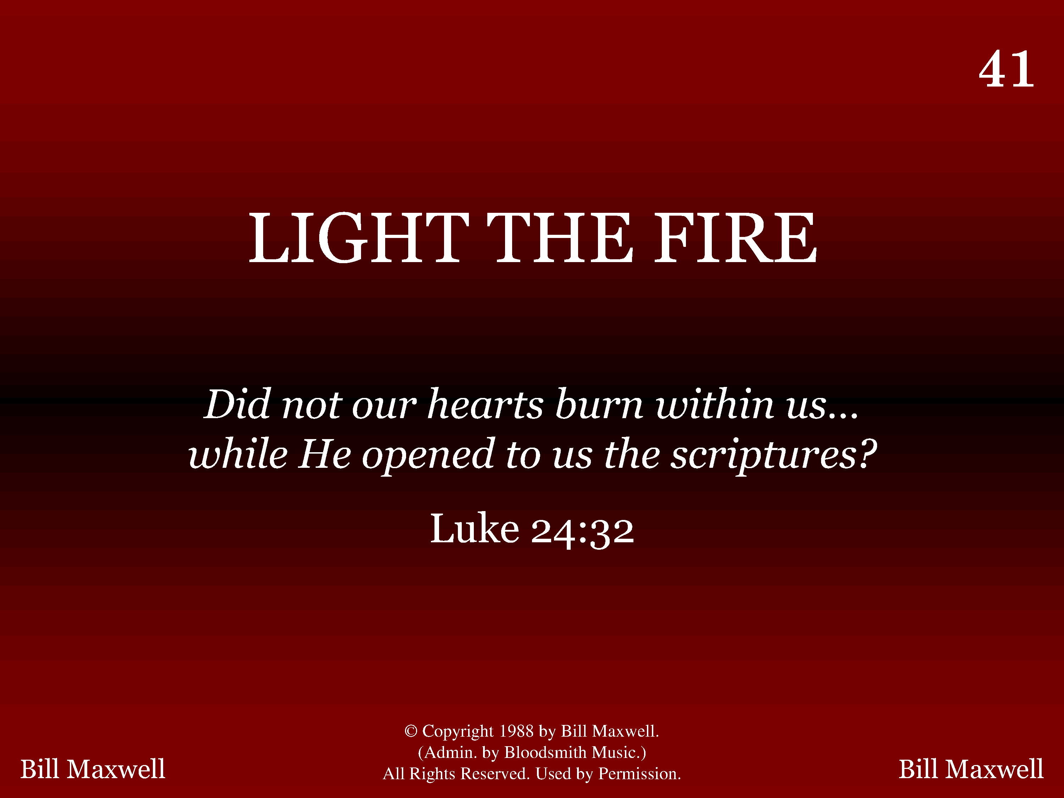
1041 - Light The Fire - Title

Slide 2
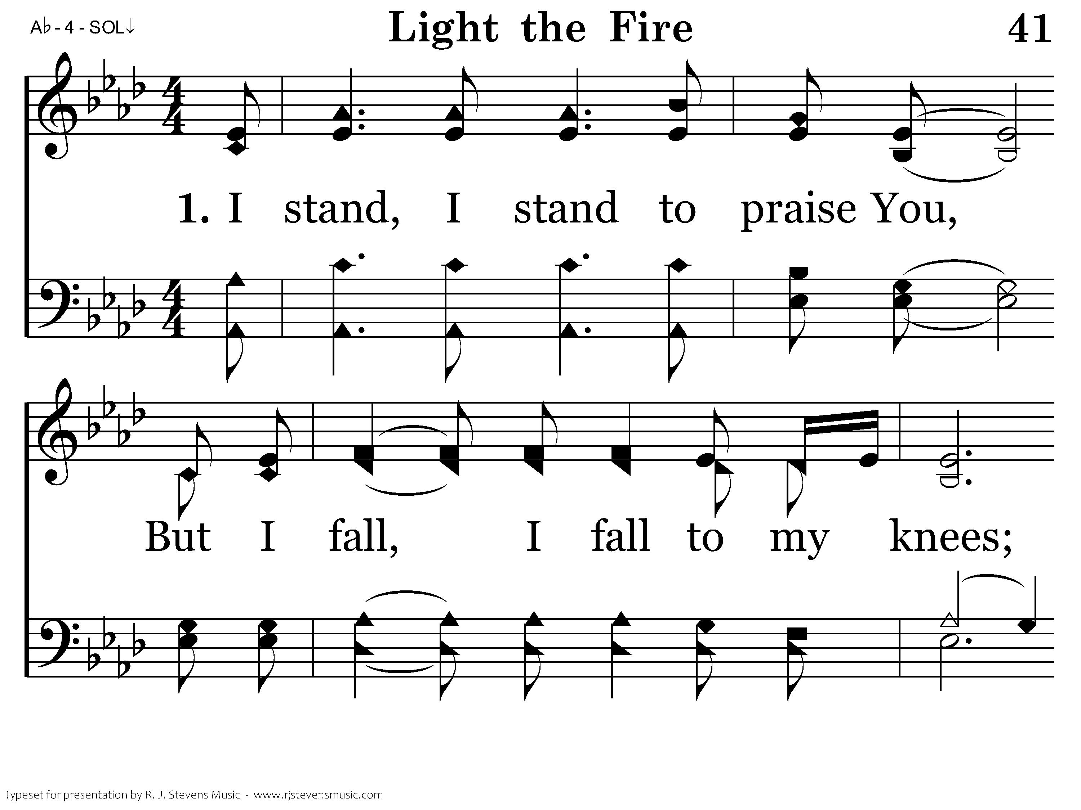
1041 - Light The Fire - 1.1

Slide 3
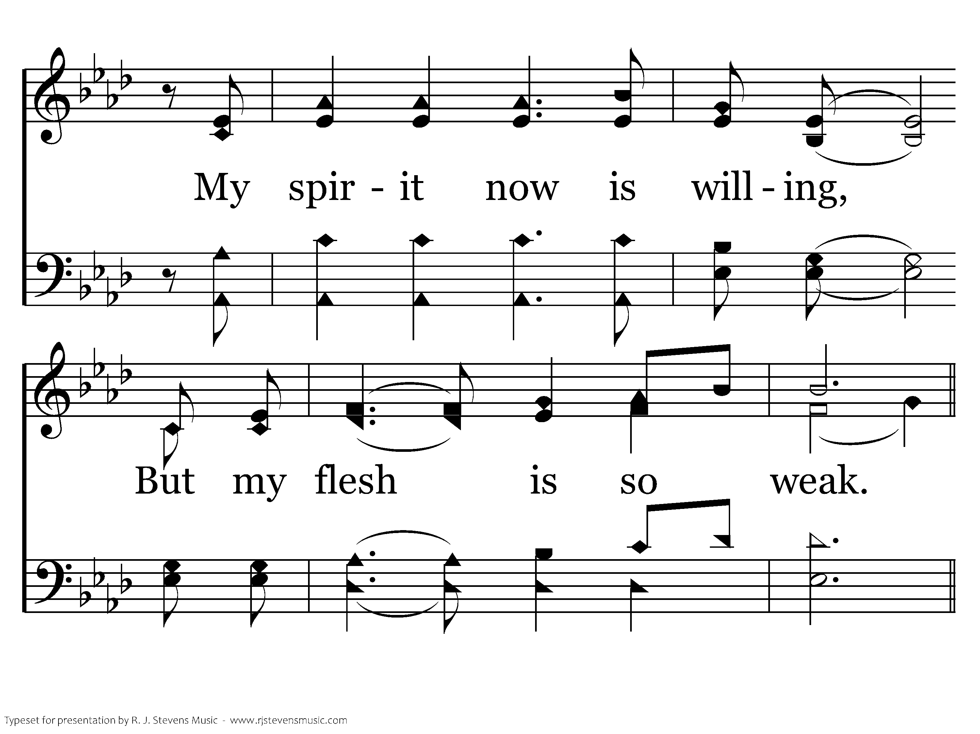
1041 - Light The Fire - 1.2

Slide 4
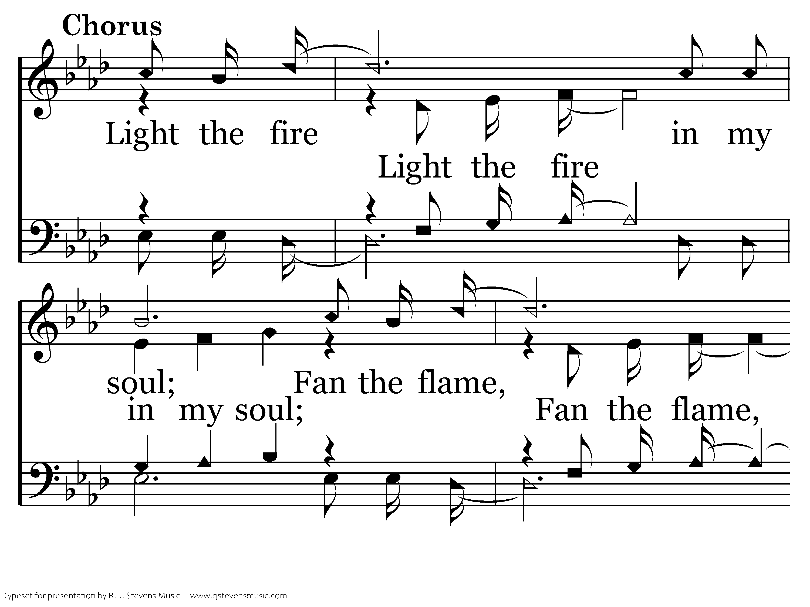
1041 - Light The Fire - C.1

Slide 5
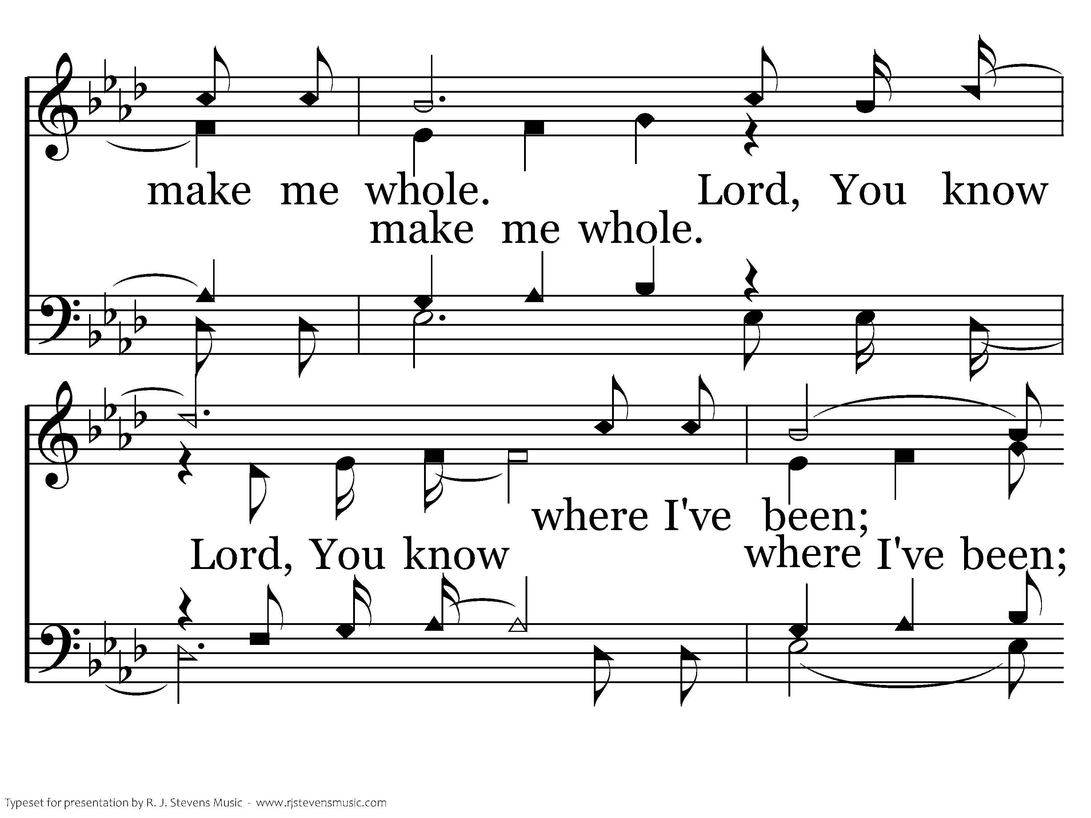
1041 - Light The Fire - C.2

Slide 6
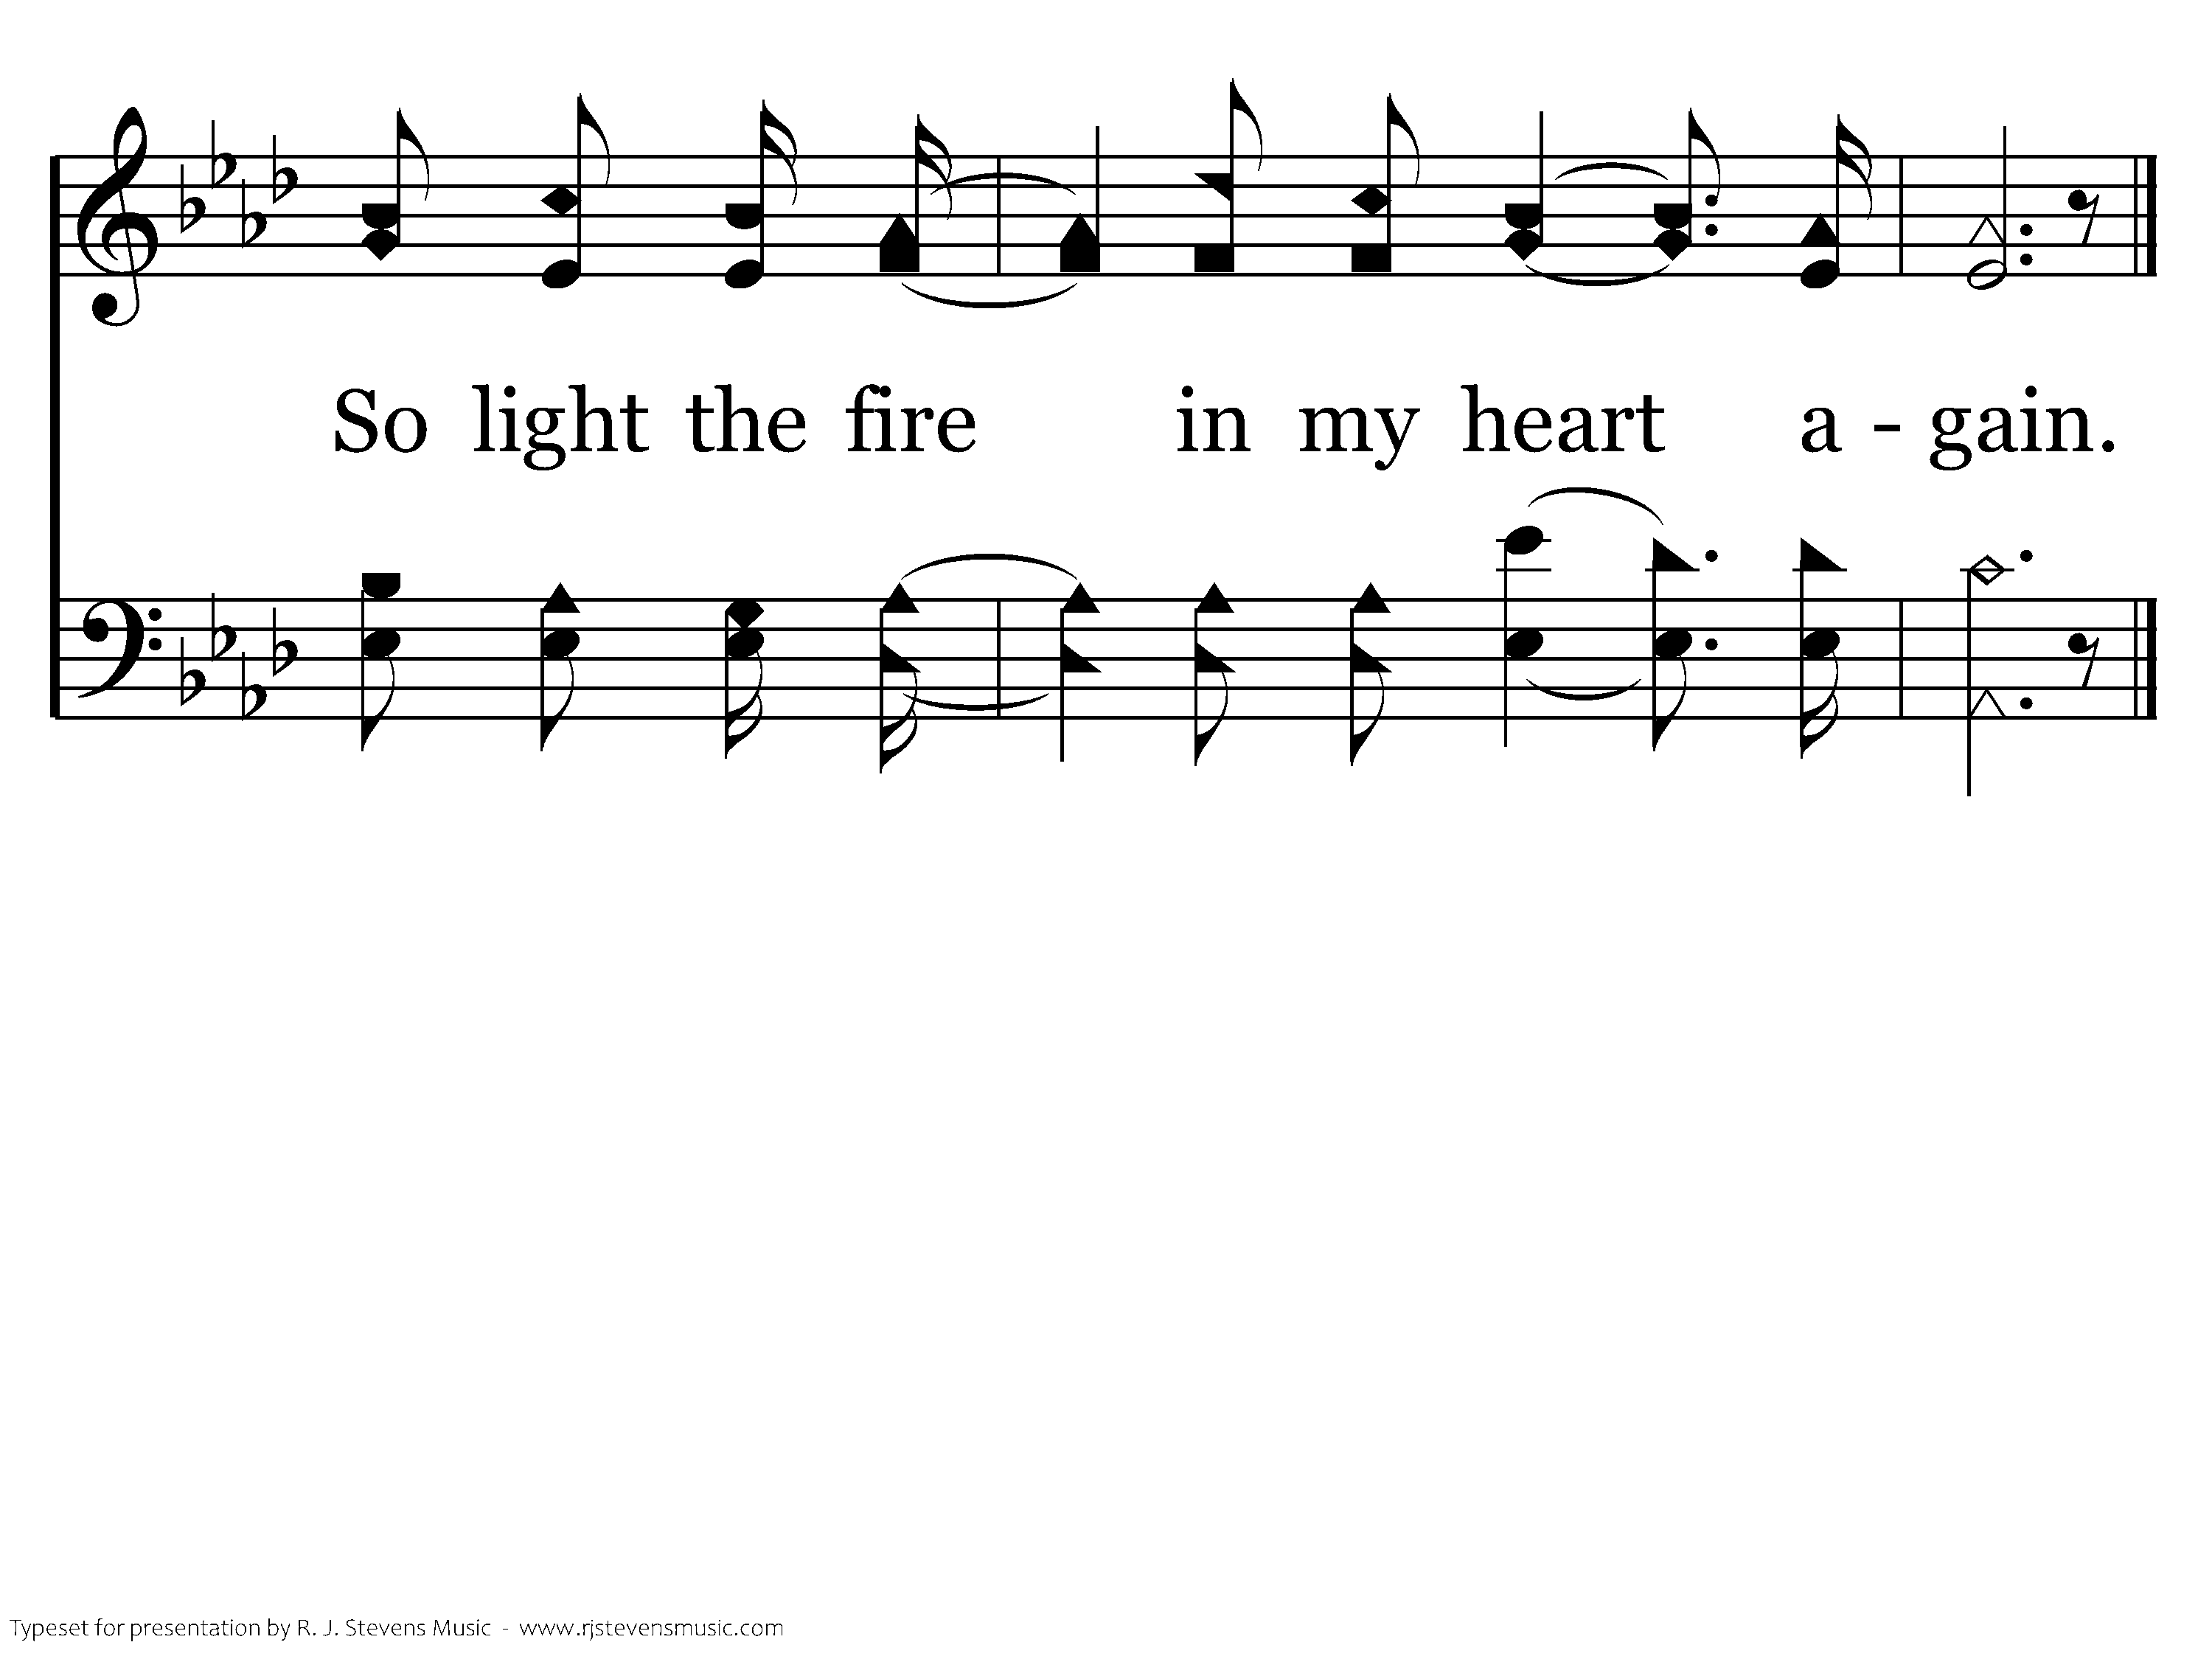
1041 - Light The Fire - C.3
End of Verse 1

Slide 7
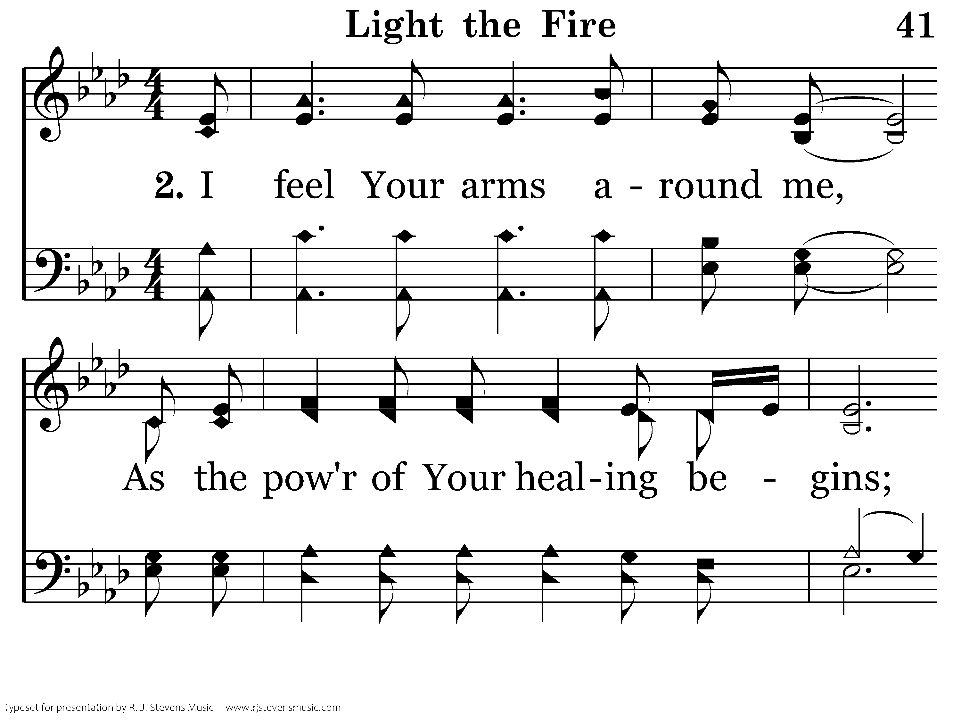
1041 - Light The Fire - 2.1

Slide 8
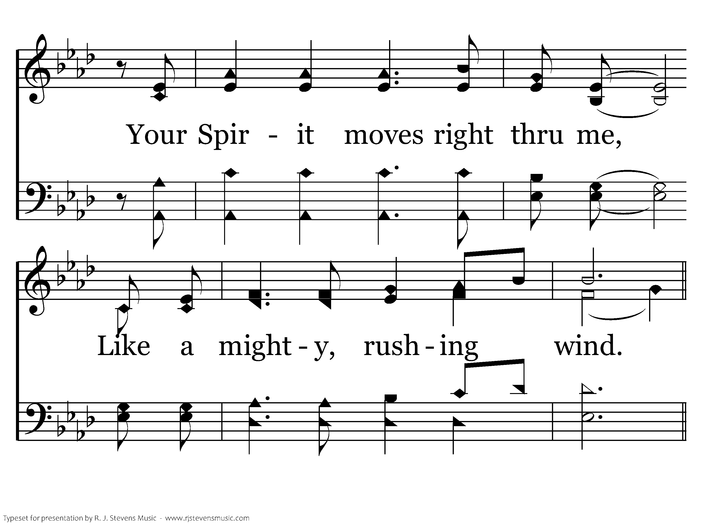
1041 - Light The Fire - 2.2

Slide 9
1041 - Light The Fire - C.1

Slide 10
1041 - Light The Fire - C.2

Slide 11
1041 - Light The Fire - C.3
End of Song

Slide 12
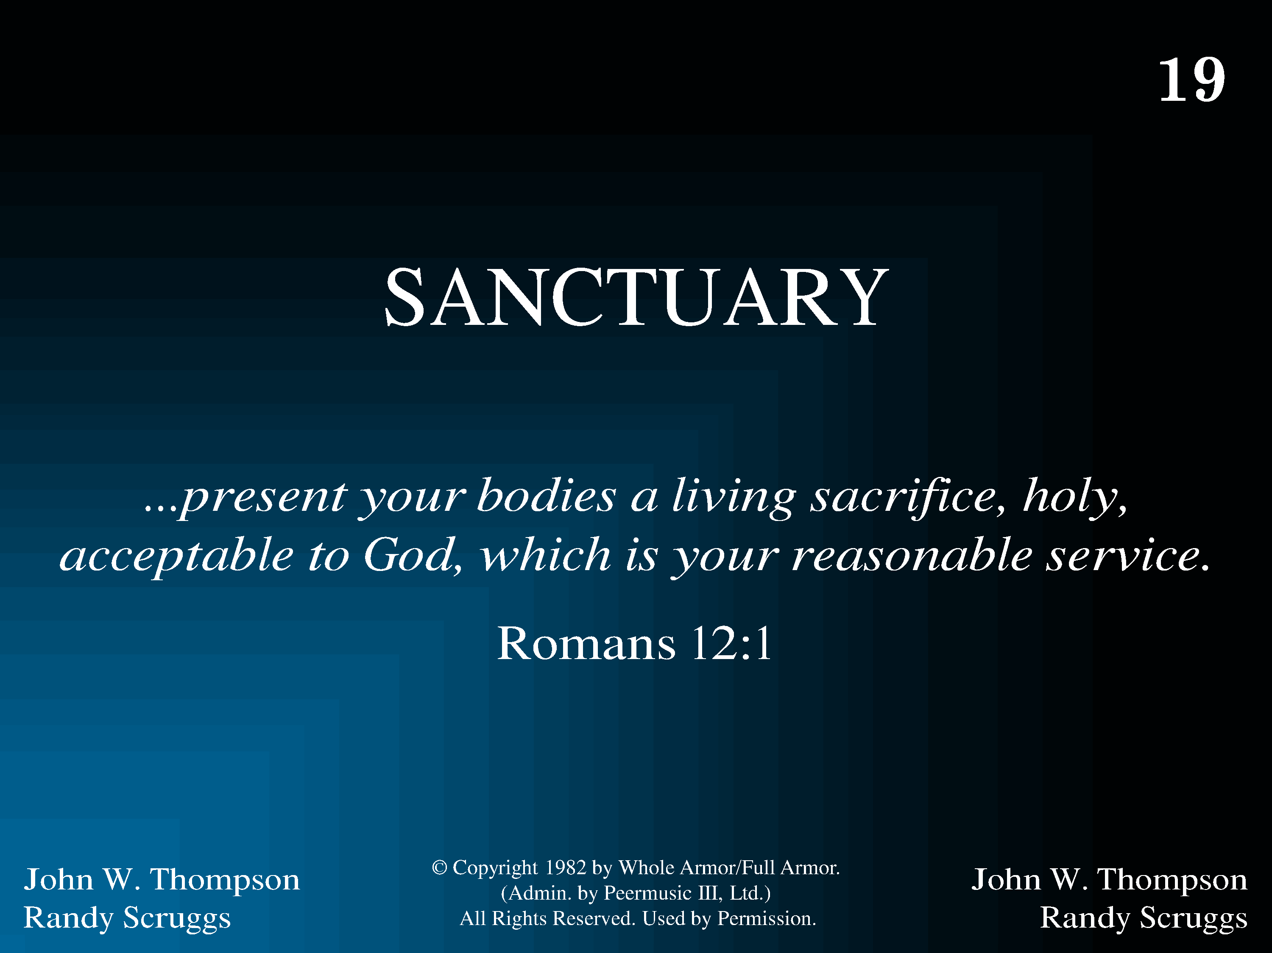
1019 - Sanctuary - Title

Slide 13
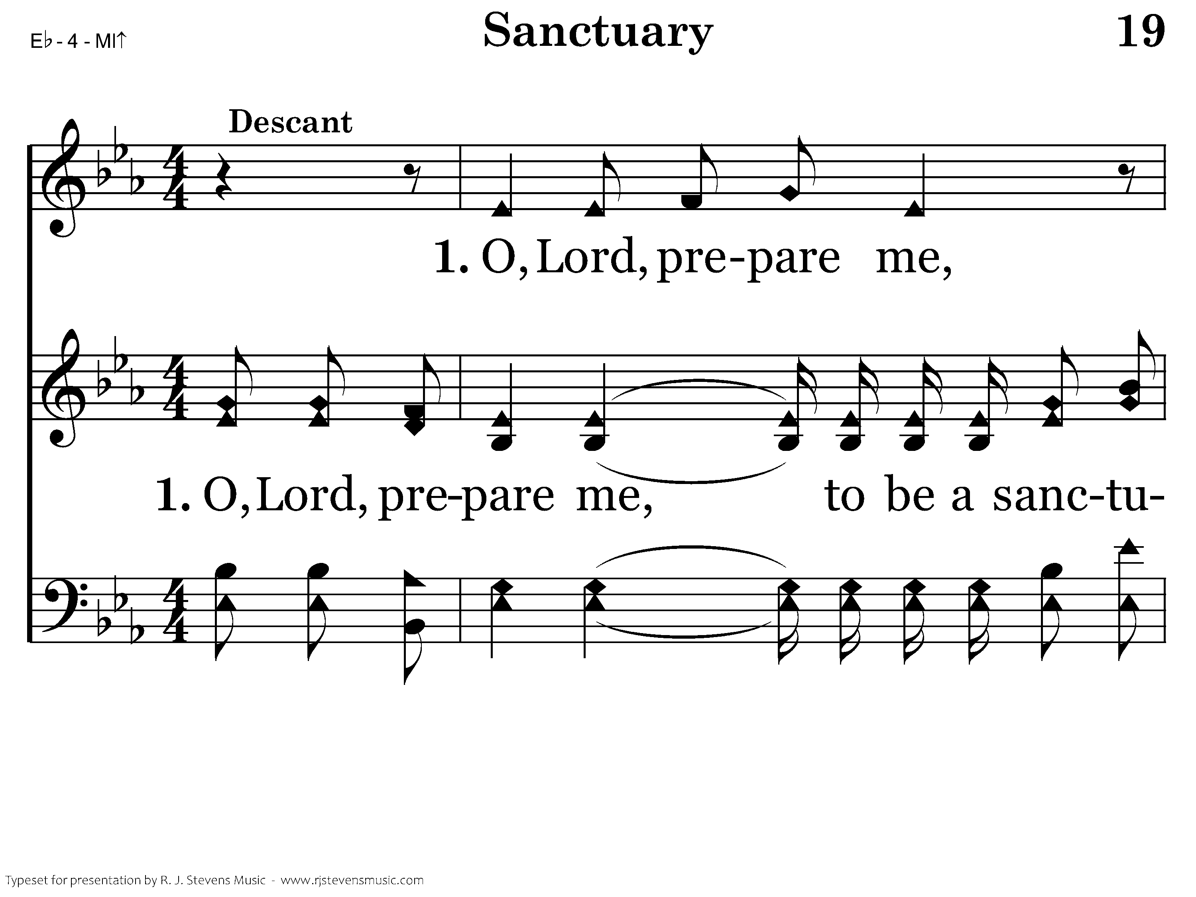
1019 - Sanctuary - 1.1

Slide 14
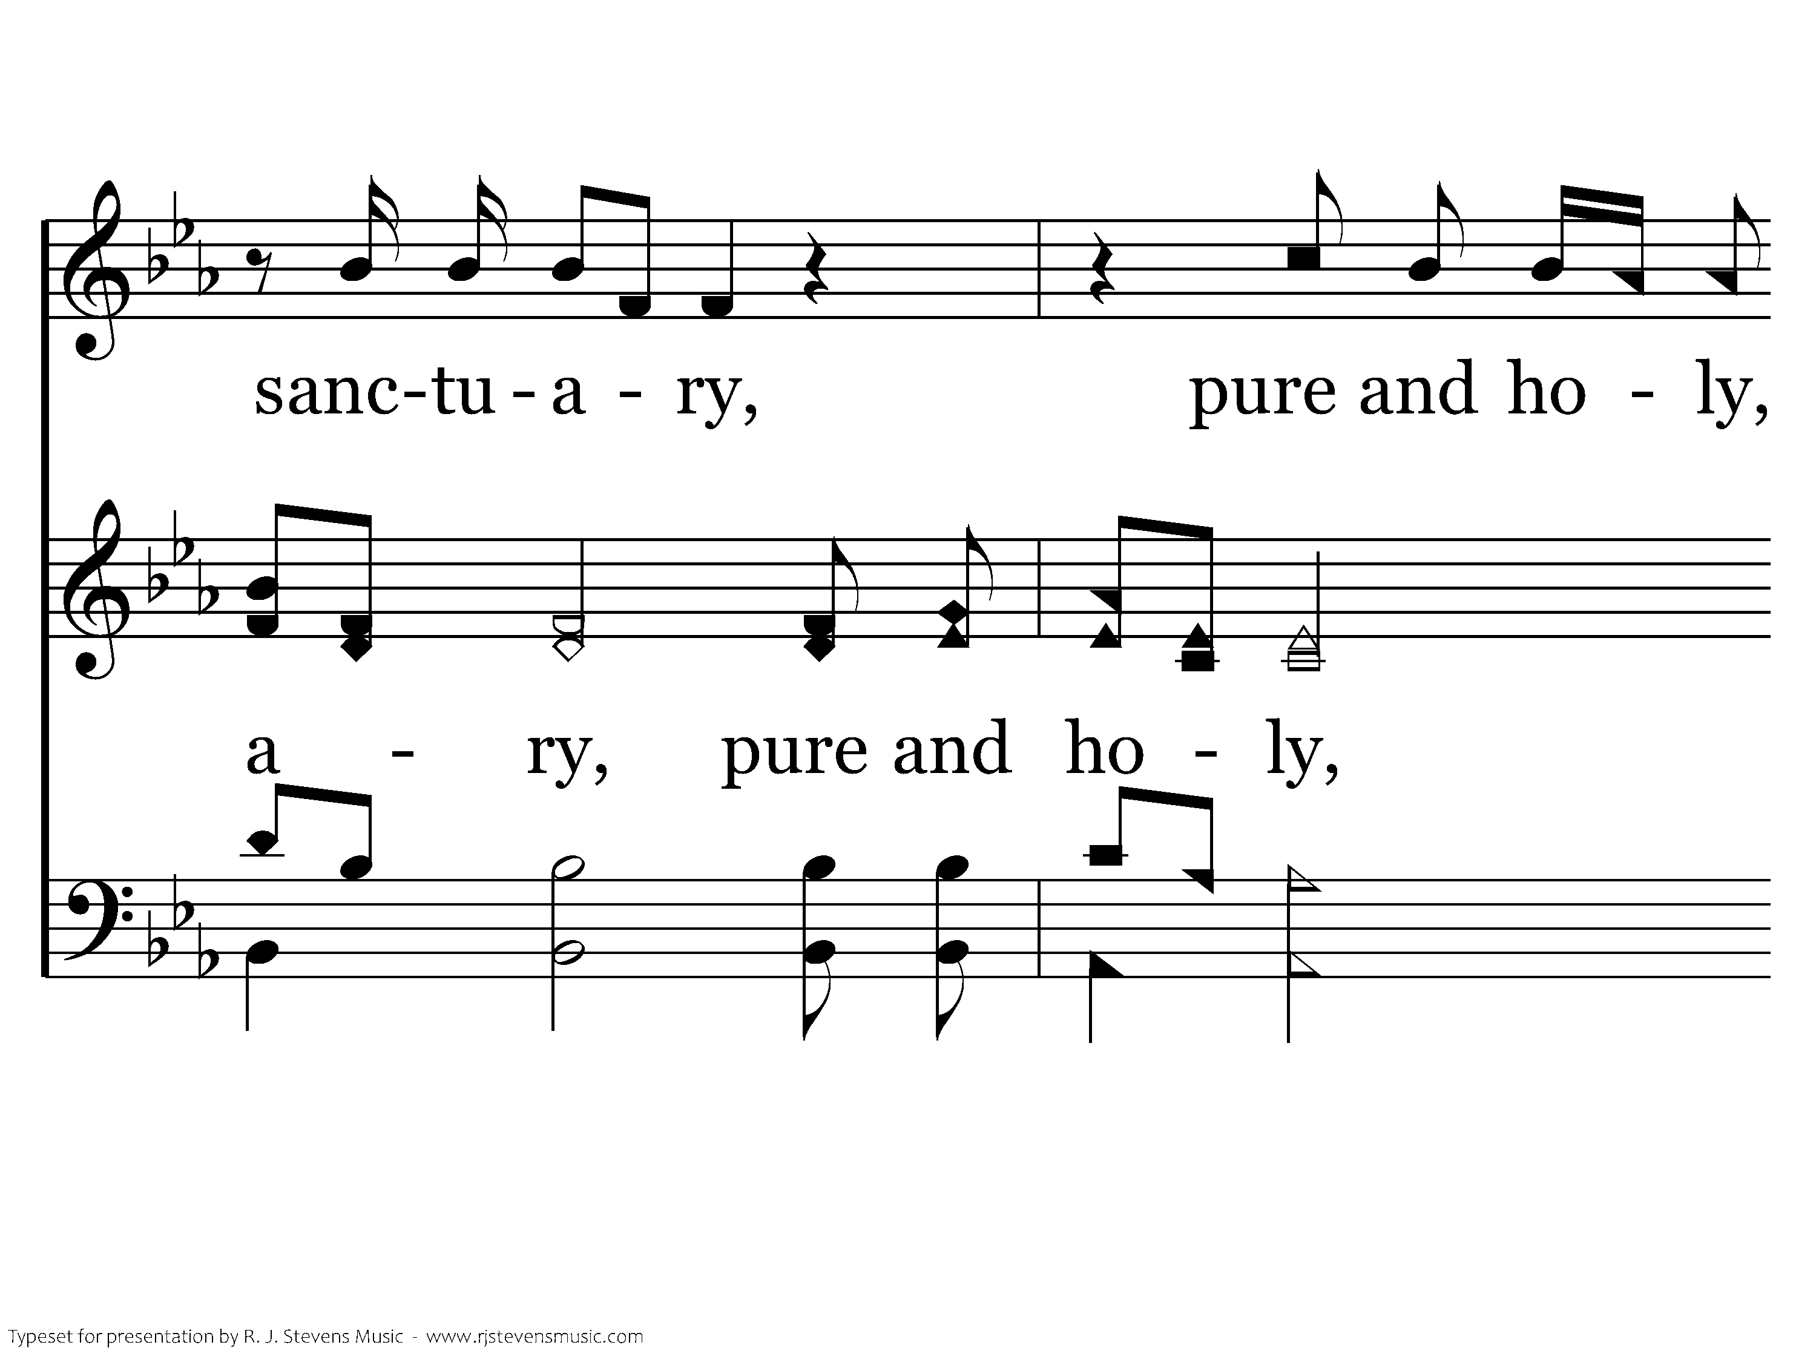
1019 - Sanctuary - 1.2

Slide 15
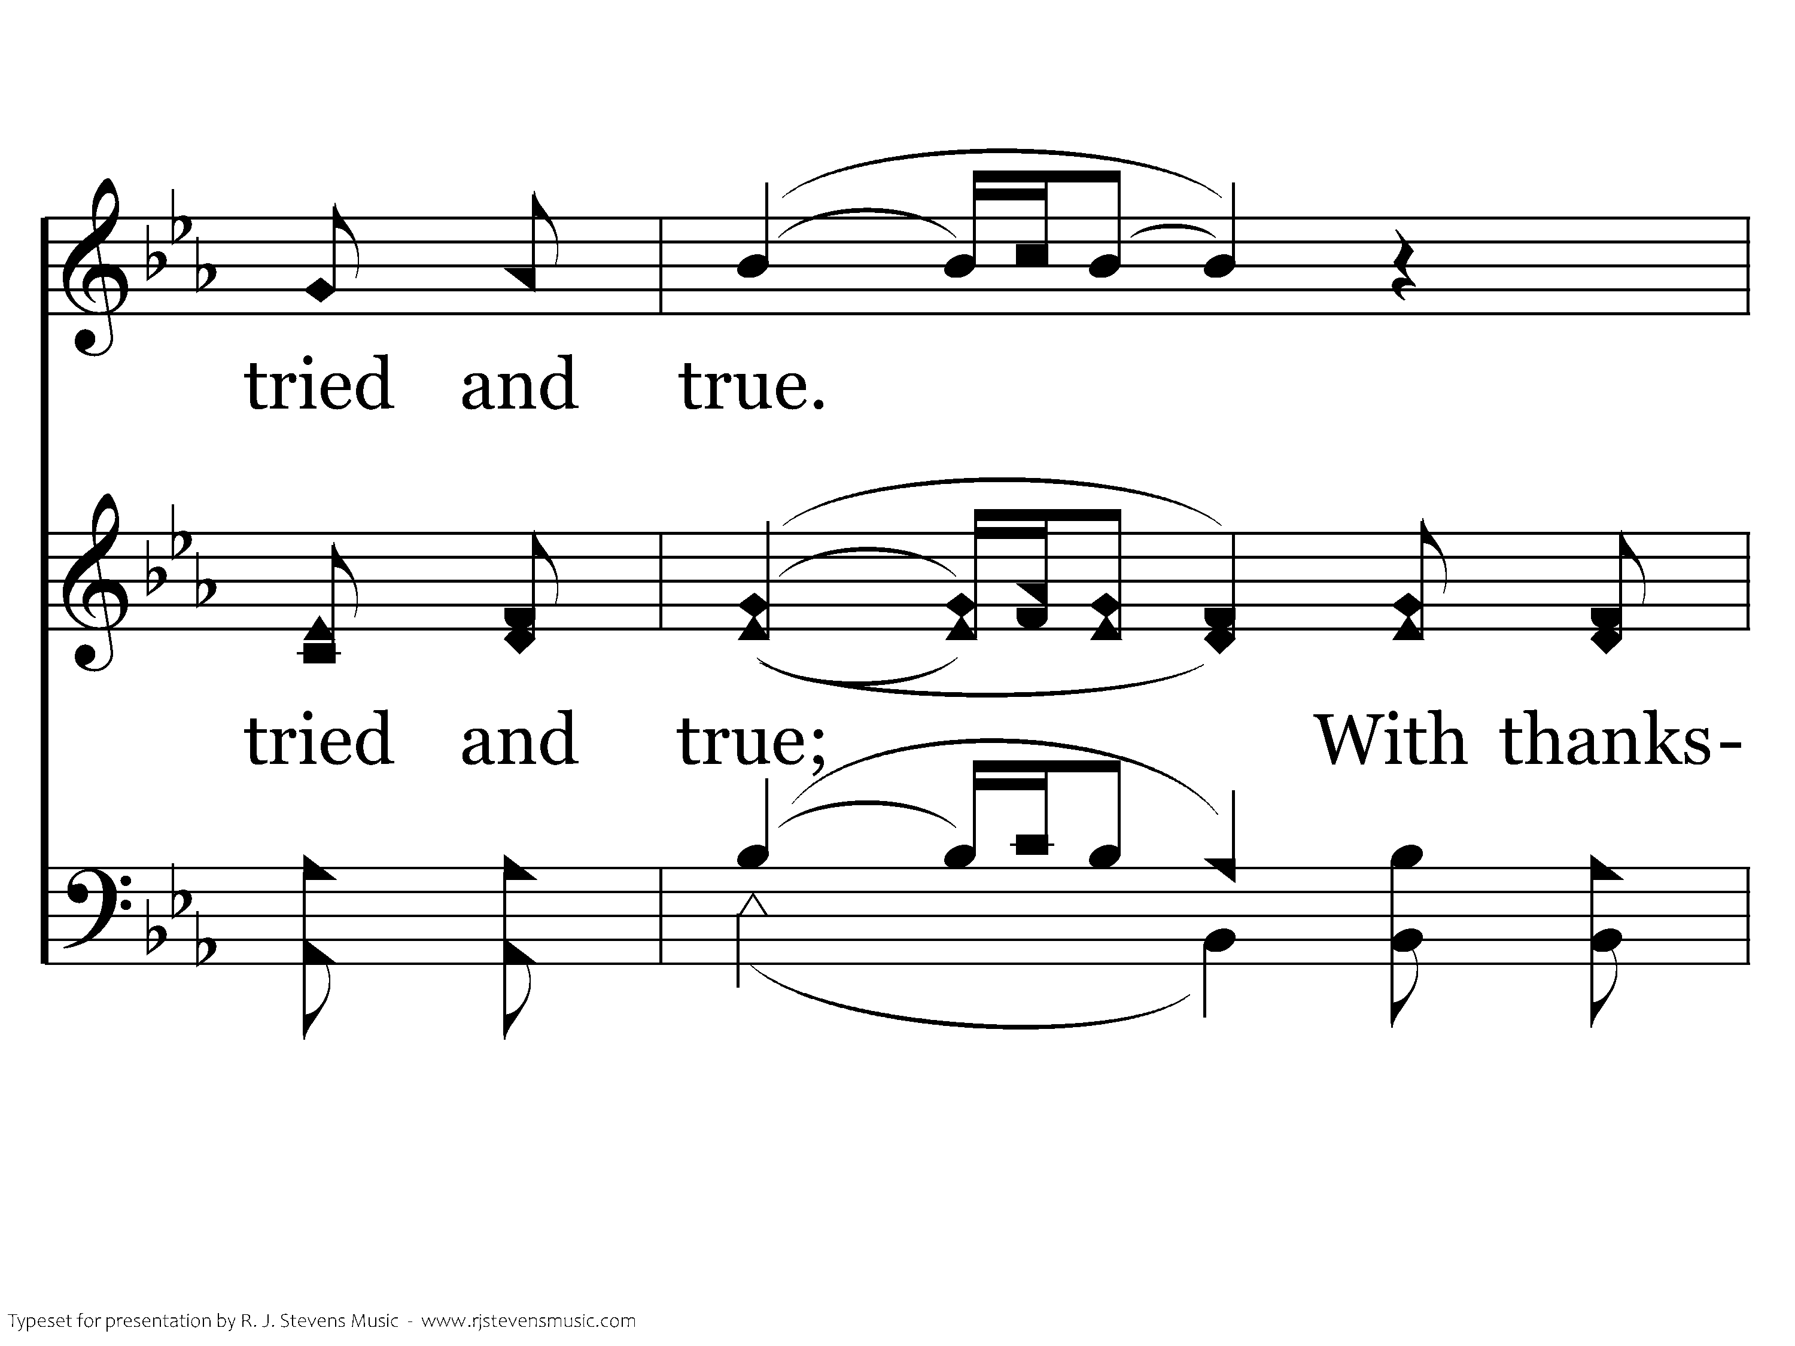
1019 - Sanctuary - 1.3

Slide 16
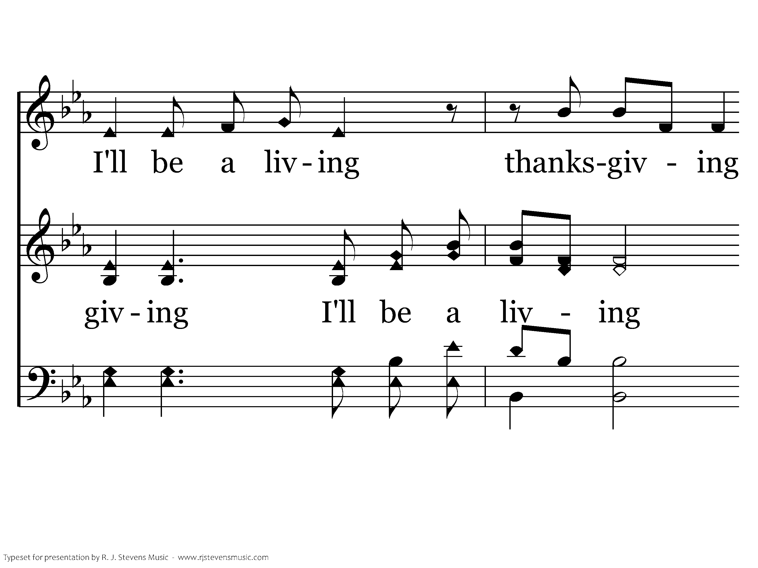
1019 - Sanctuary - 1.4

Slide 17
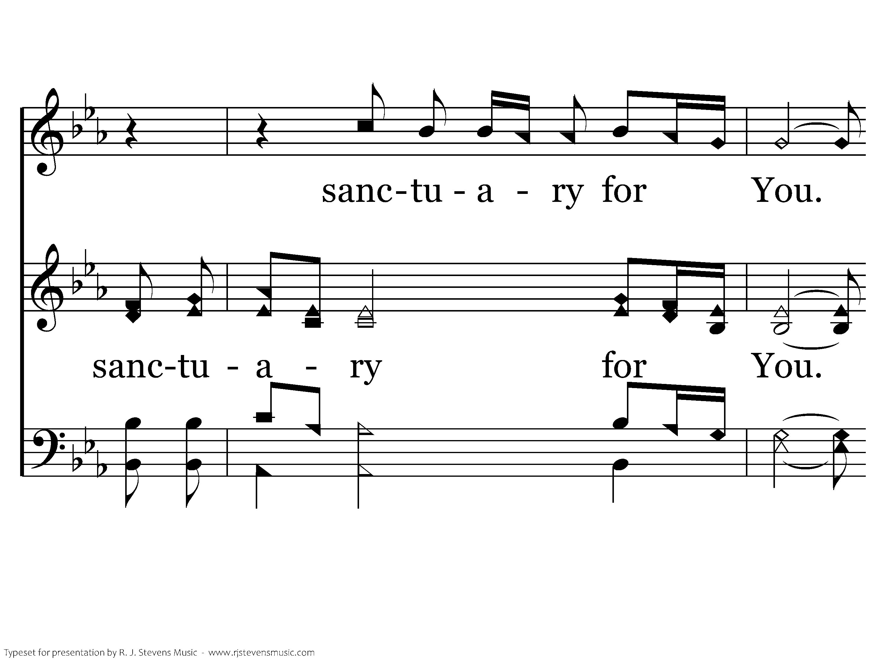
1019 - Sanctuary - 1.5

Slide 18
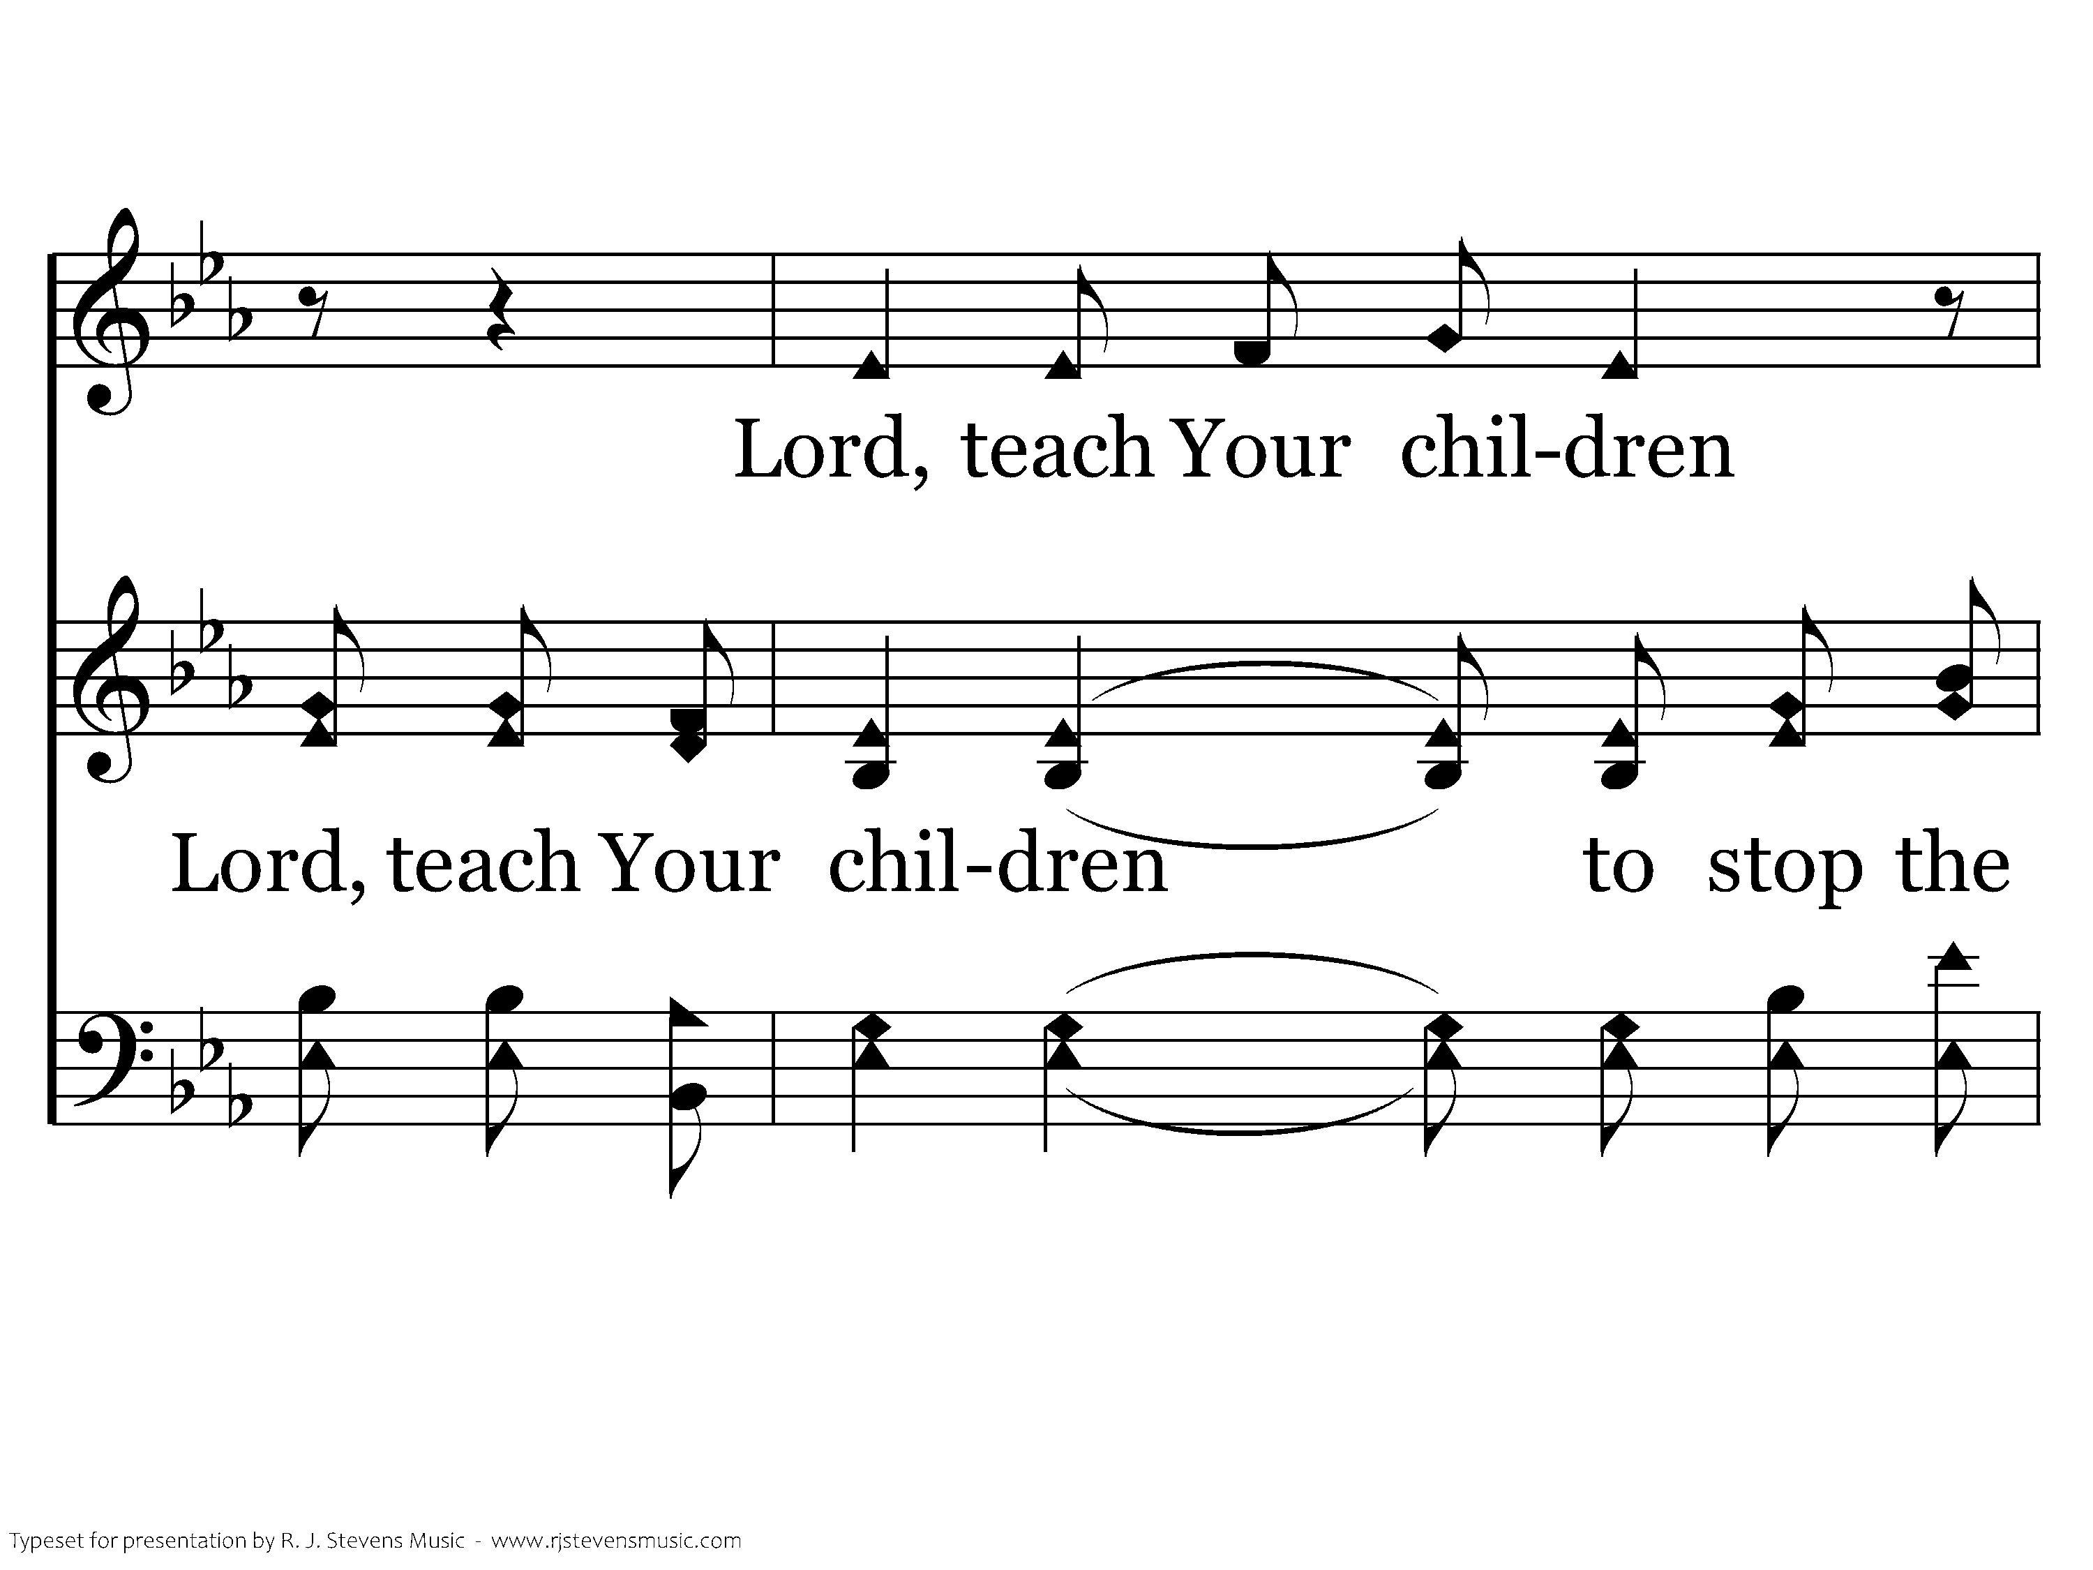
1019 - Sanctuary - 1.6

Slide 19
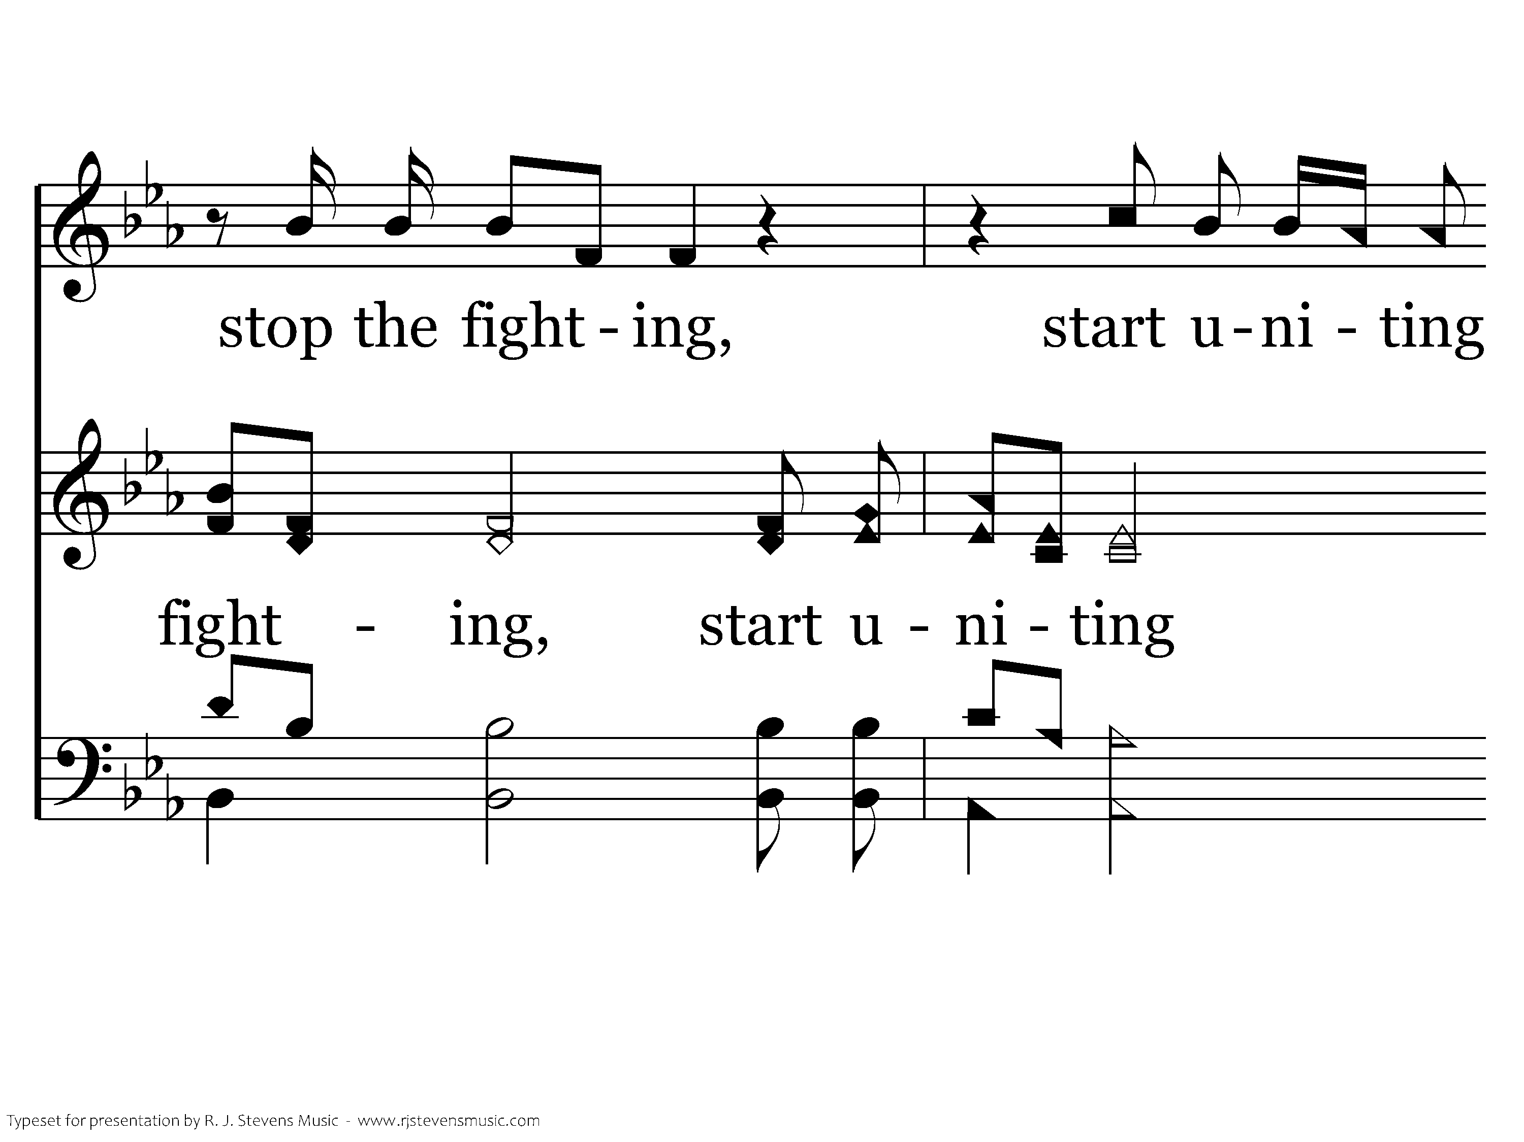
1019 - Sanctuary - 1.7

Slide 20
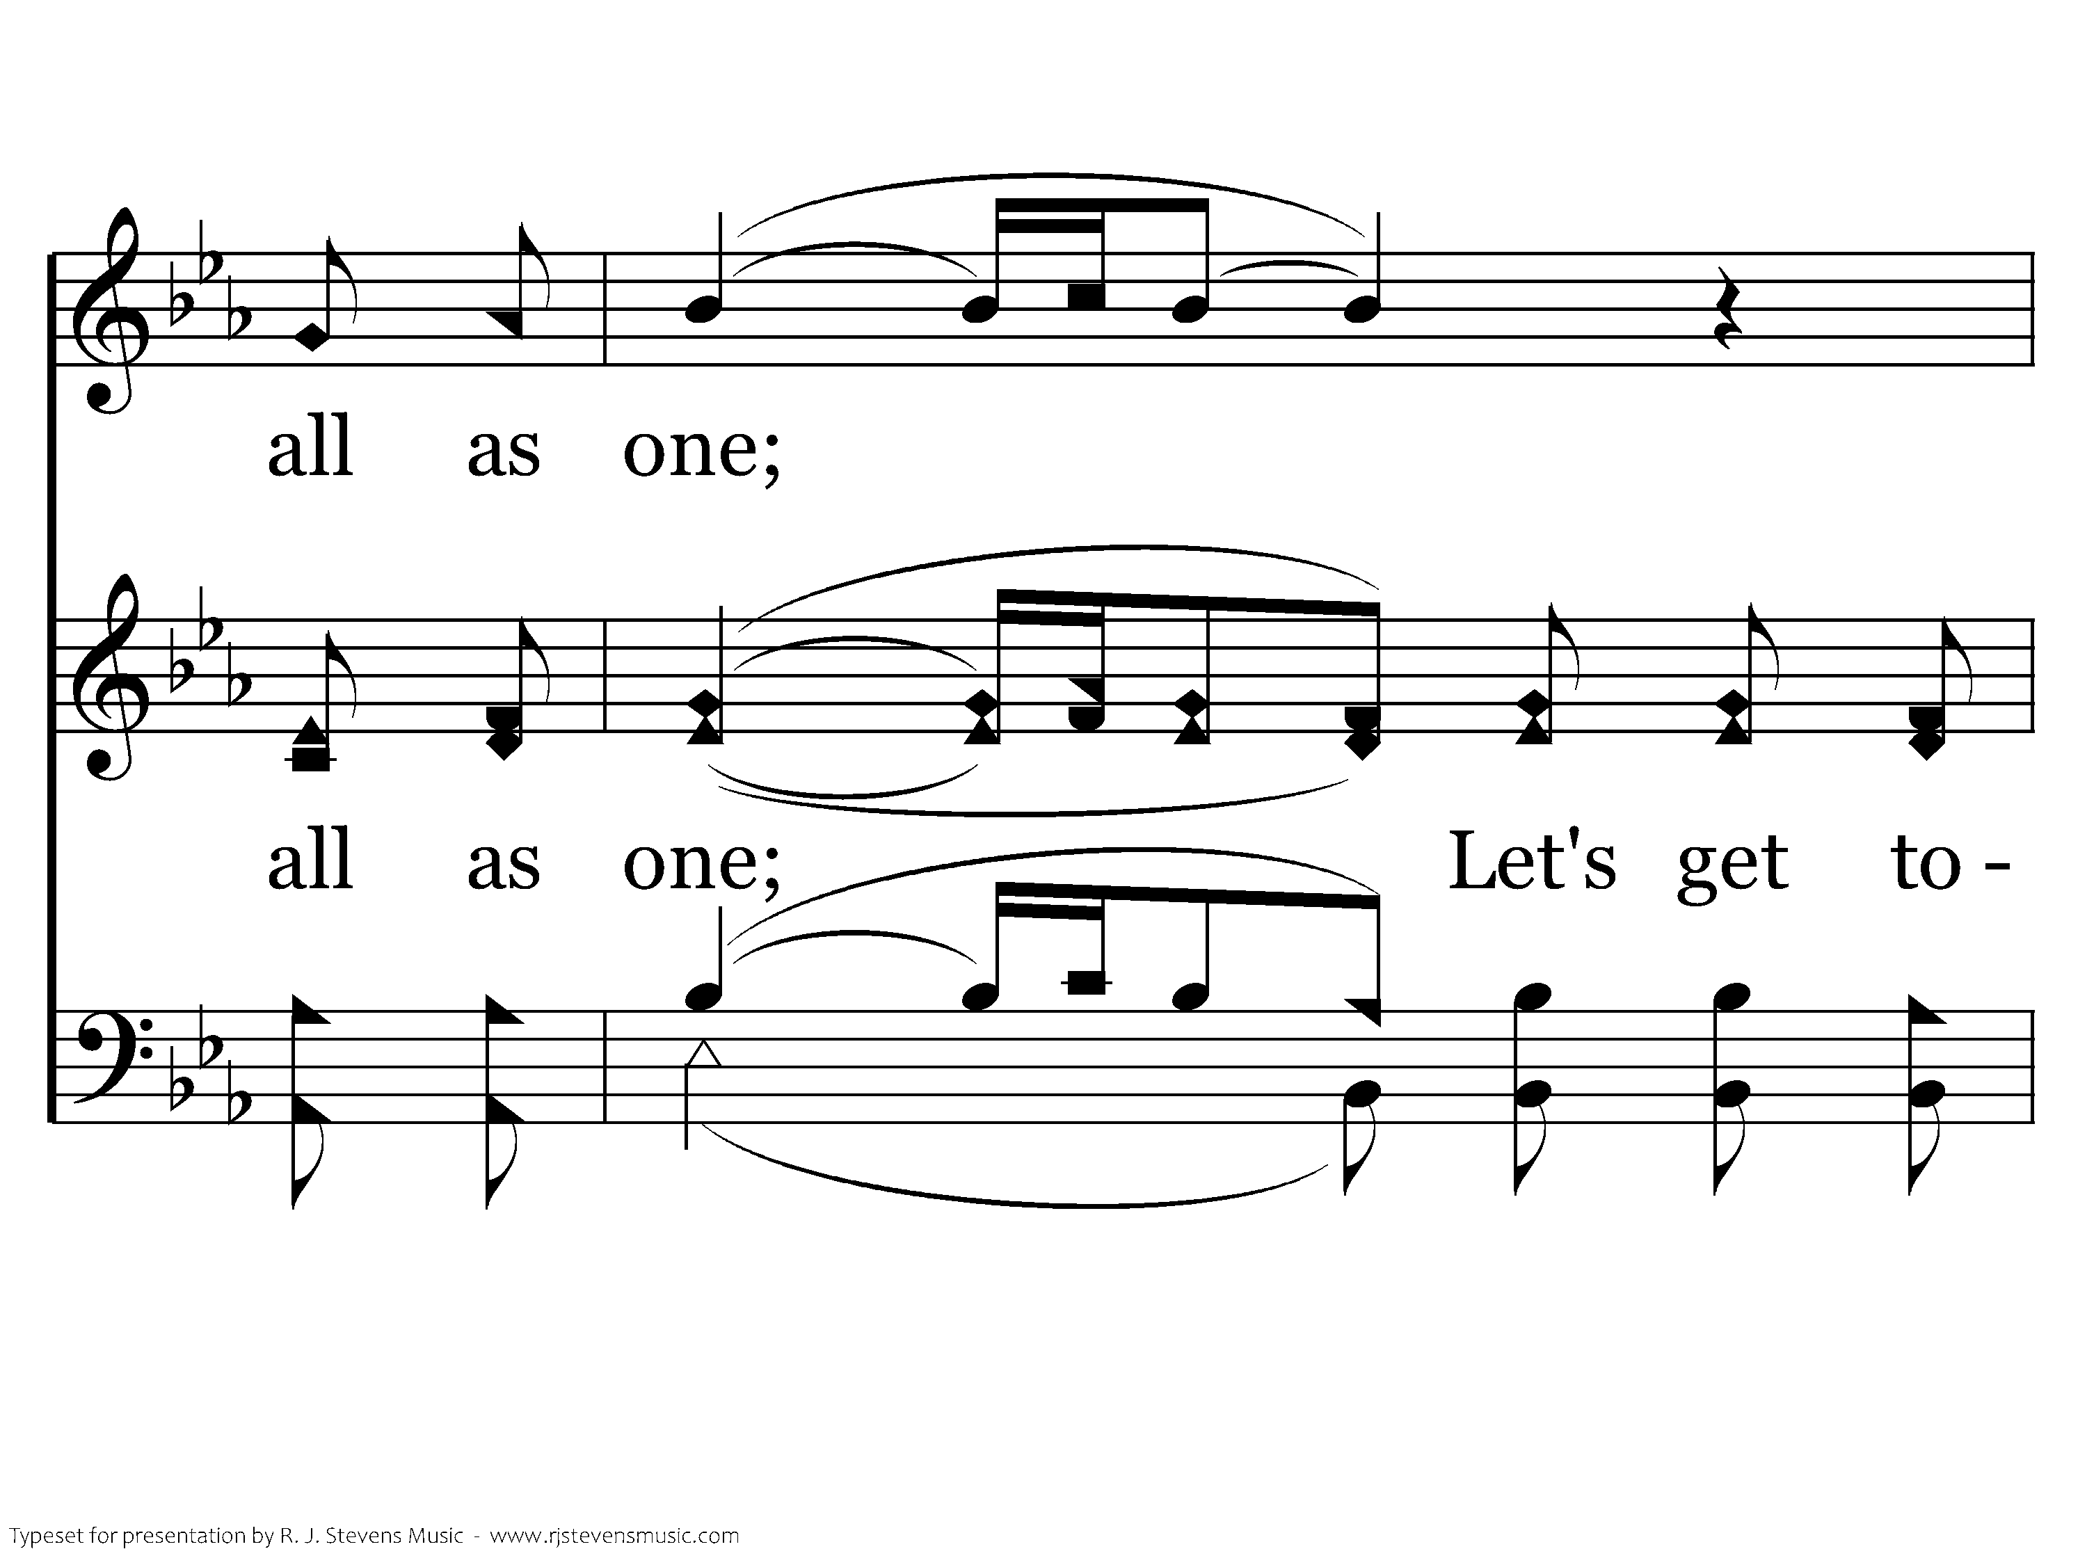
1019 - Sanctuary - 1.8

Slide 21
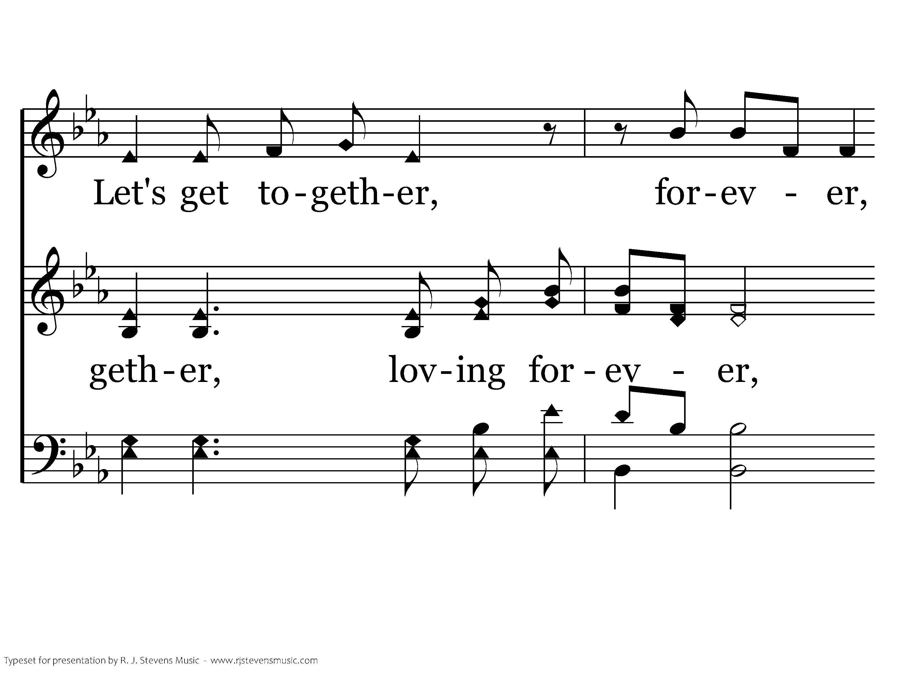
1019 - Sanctuary - 1.9

Slide 22
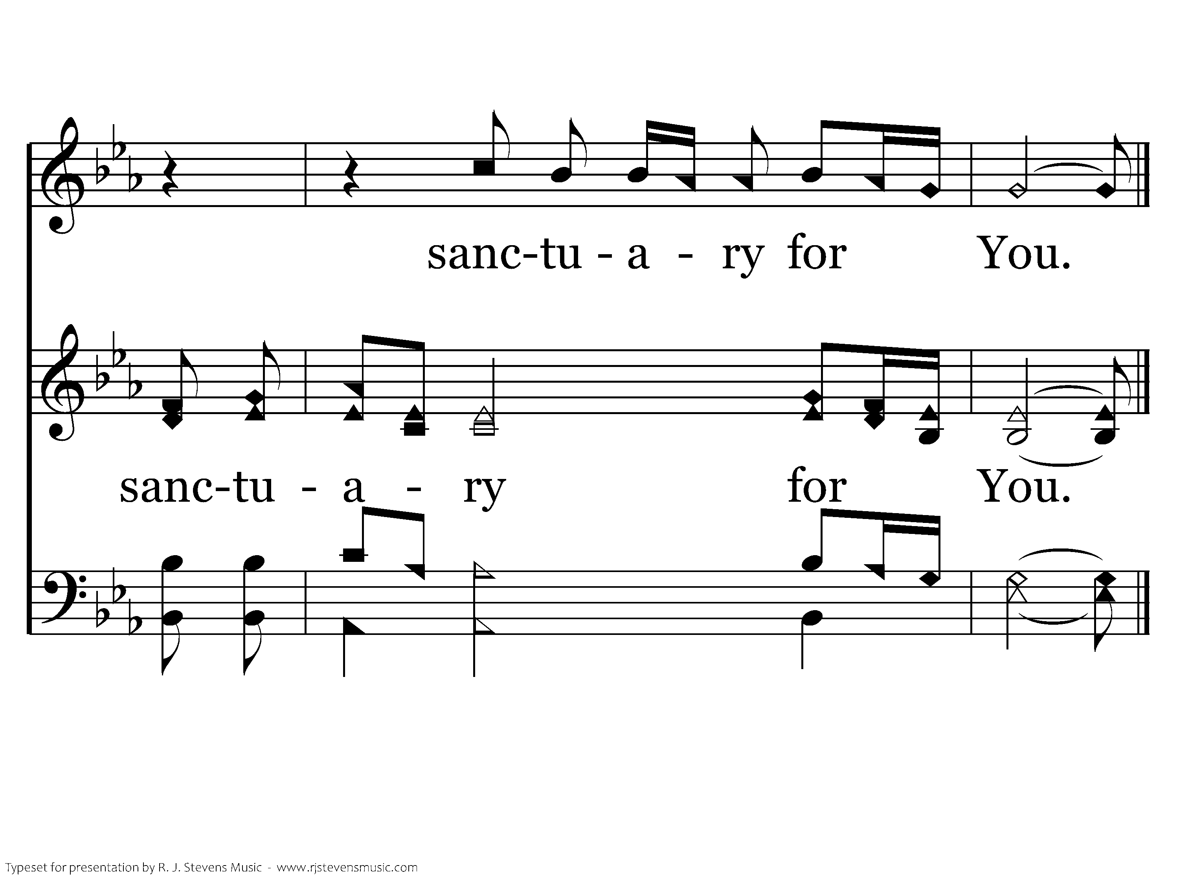
1019 - Sanctuary - 1.10
End of Verse 1

Slide 23
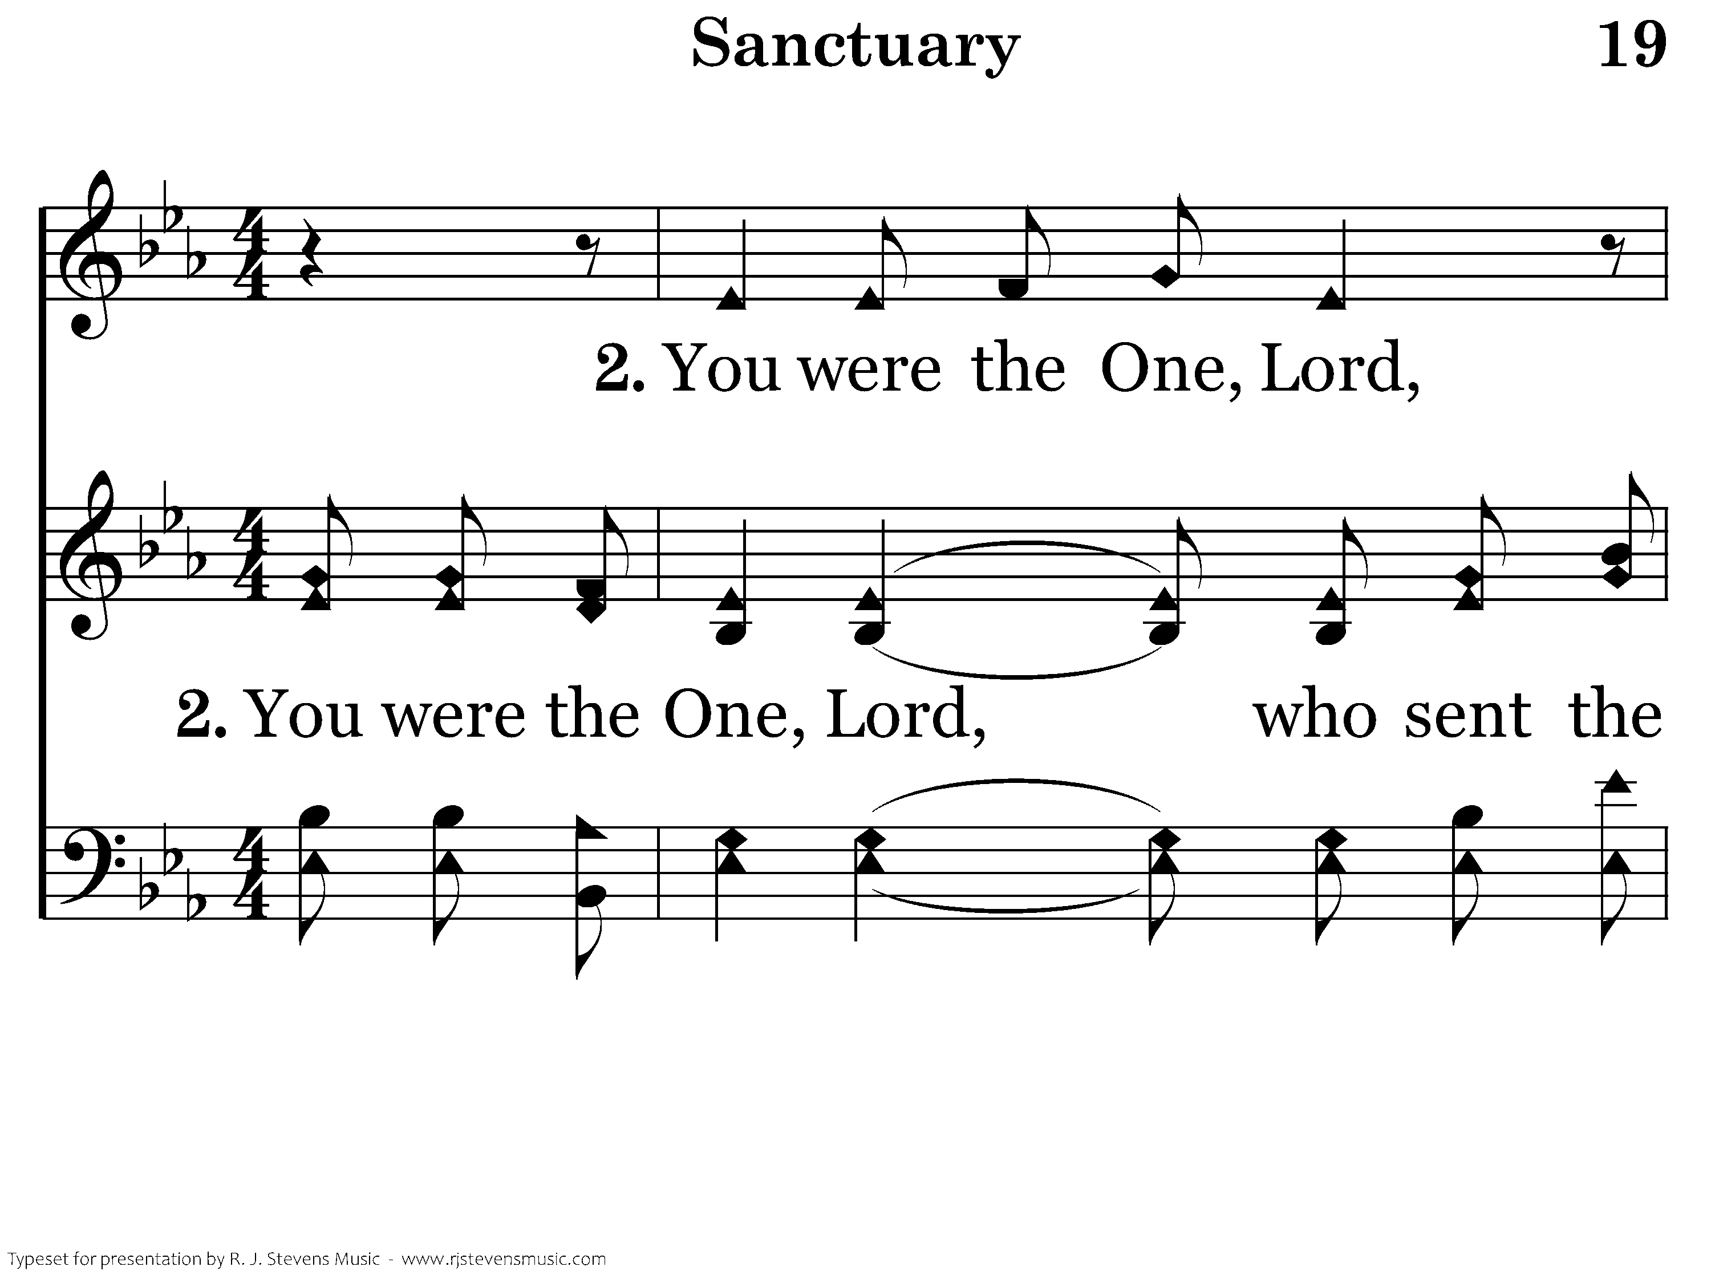
1019 - Sanctuary - 2.1

Slide 24
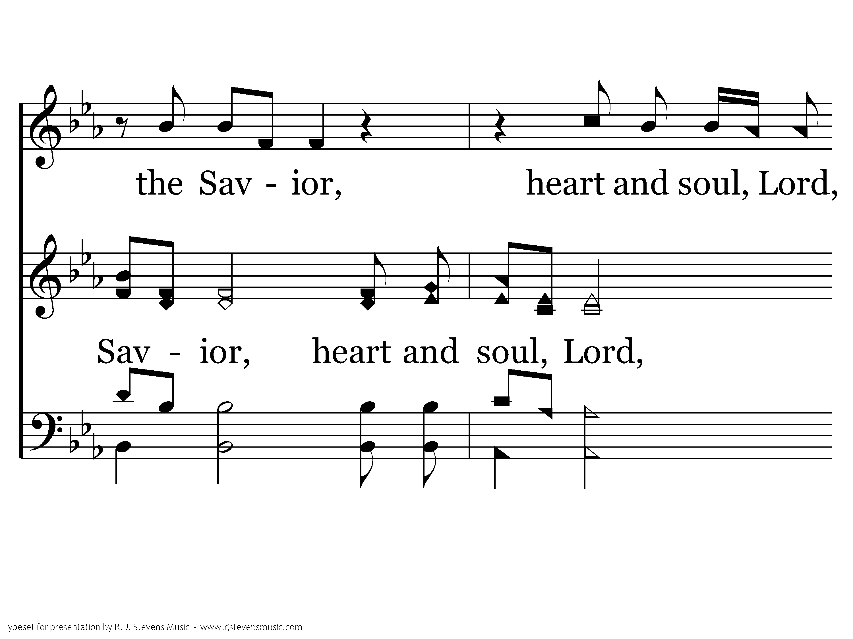
1019 - Sanctuary - 2.2

Slide 25
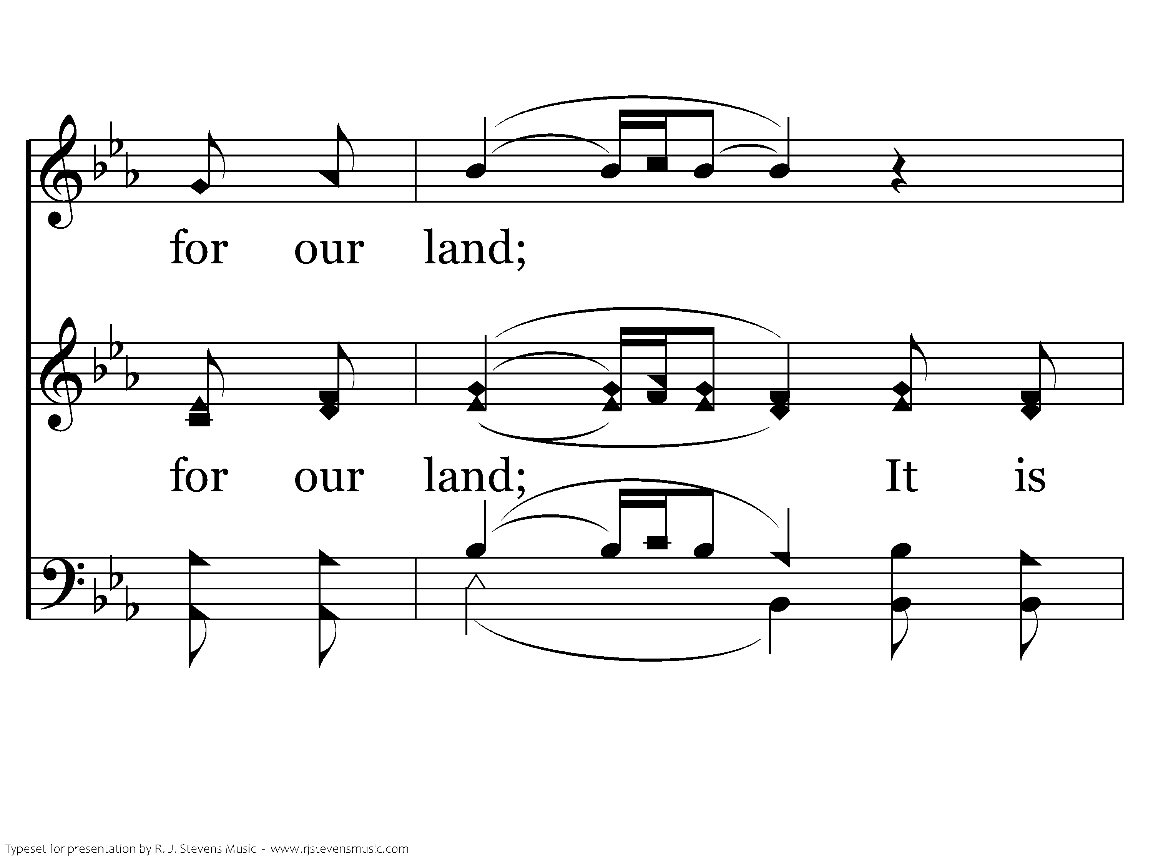
1019 - Sanctuary - 2.3

Slide 26
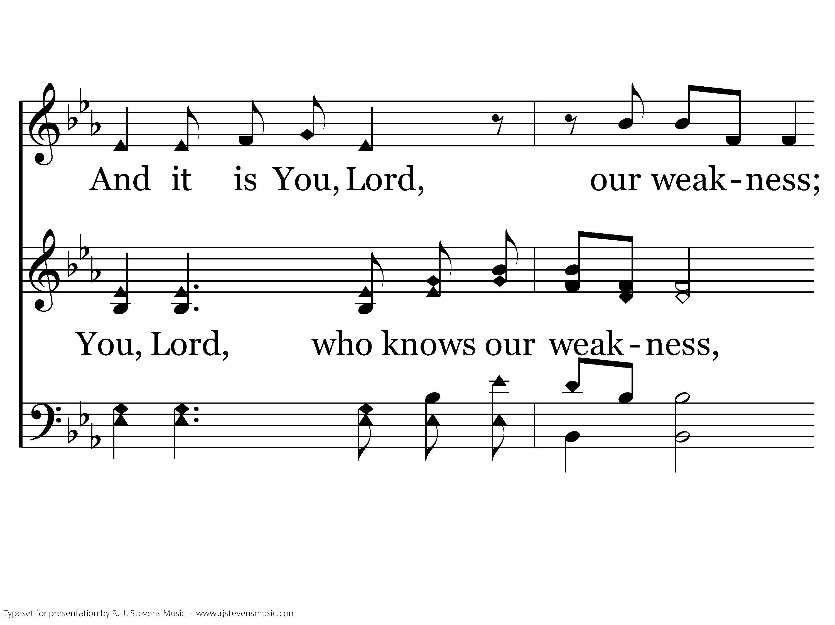
1019 - Sanctuary - 2.4

Slide 27
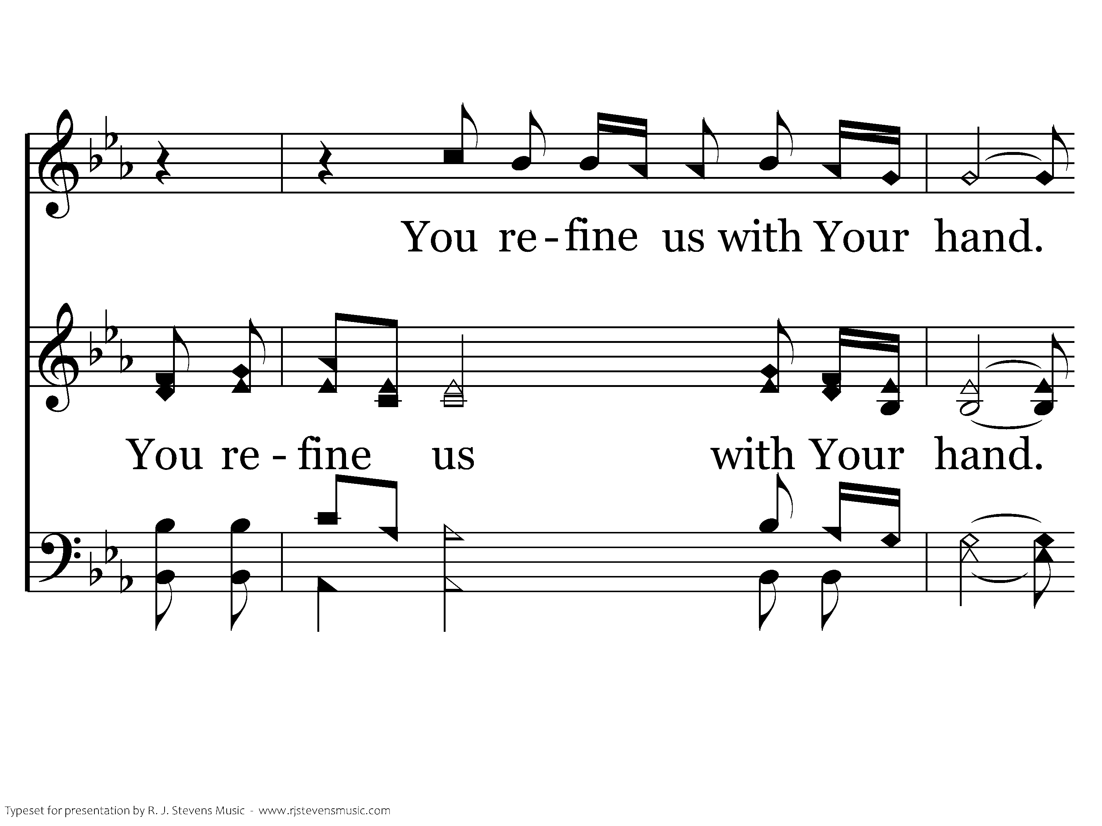
1019 - Sanctuary - 2.5

Slide 28
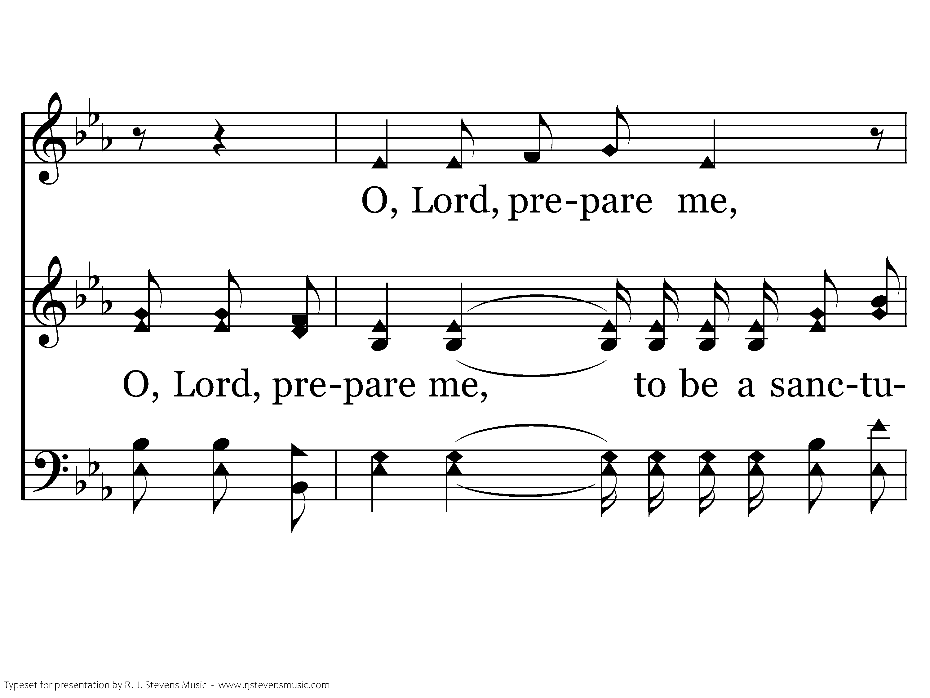
1019 - Sanctuary - 2.6

Slide 29
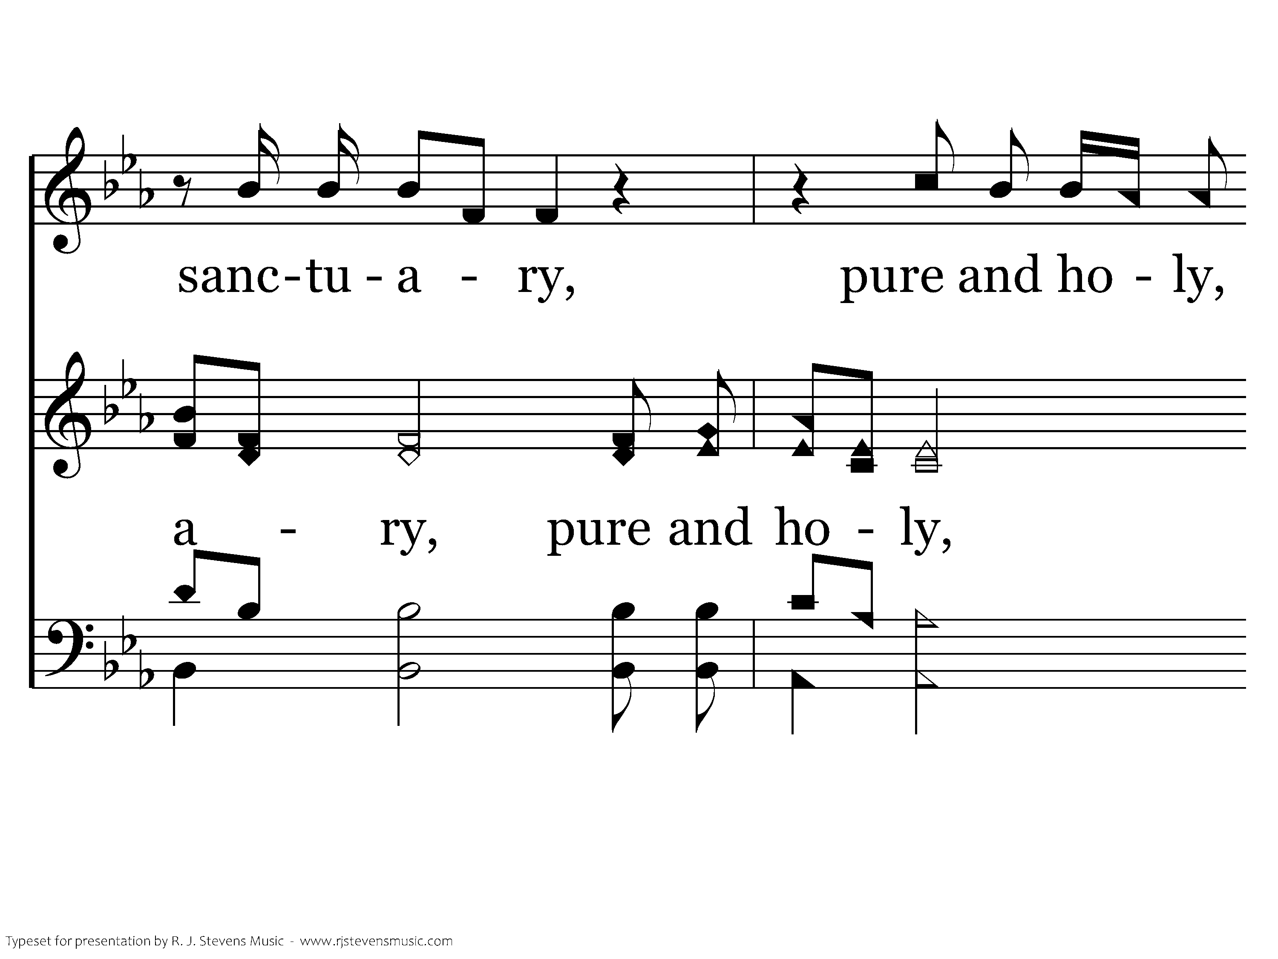
1019 - Sanctuary - 2.7

Slide 30
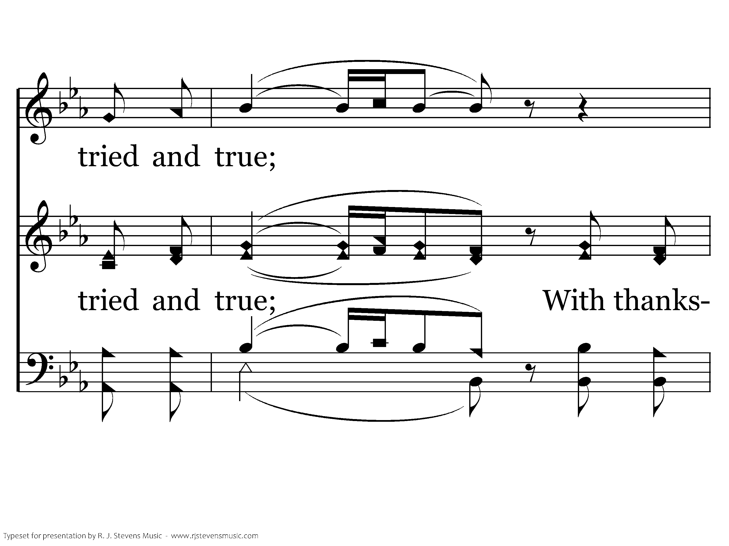
1019 - Sanctuary - 2.8

Slide 31
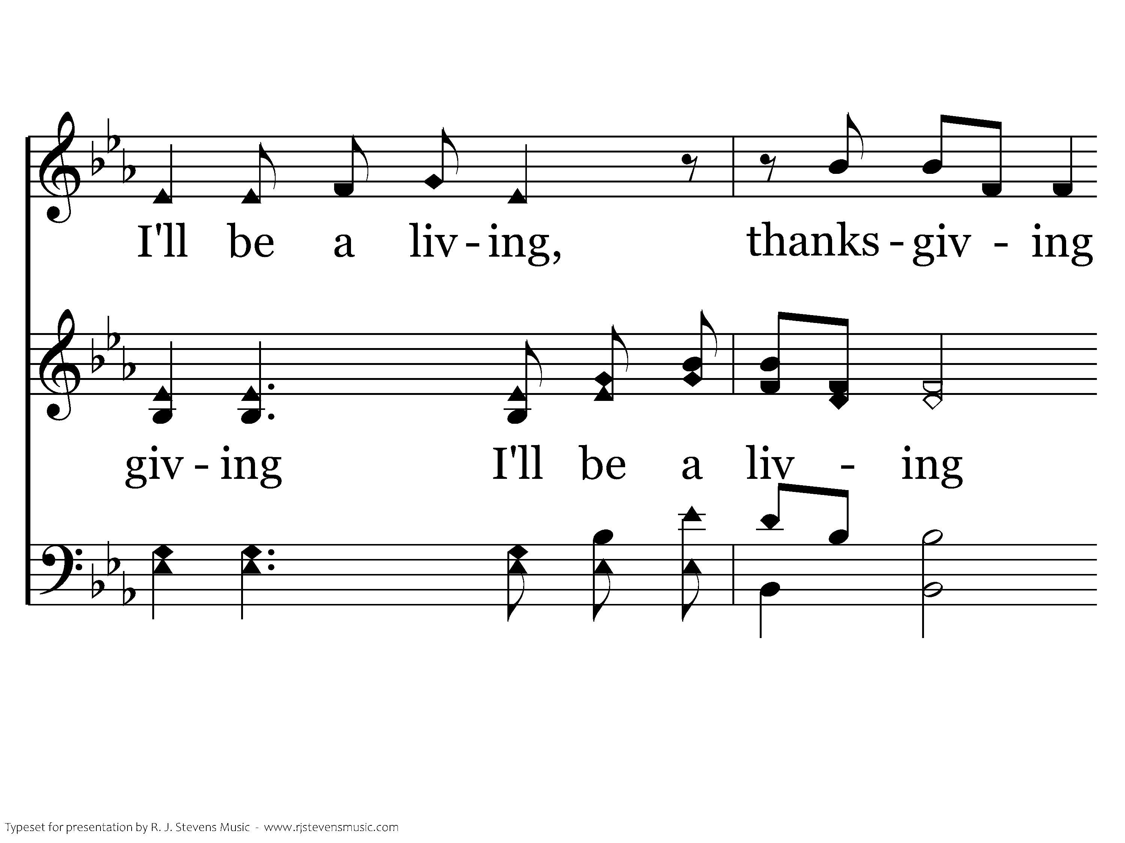
1019 - Sanctuary - 2.9

Slide 32

1019 - Sanctuary - 2.10
End of Song

Slide 33
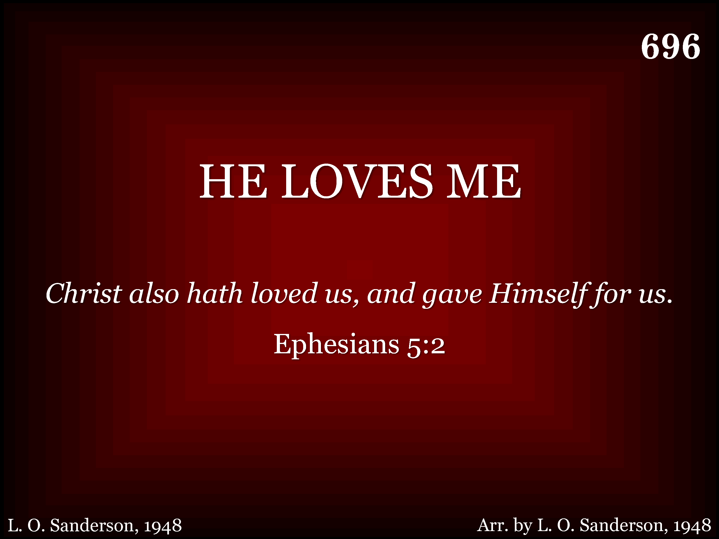
696 - He Loves Me - Title

Slide 34
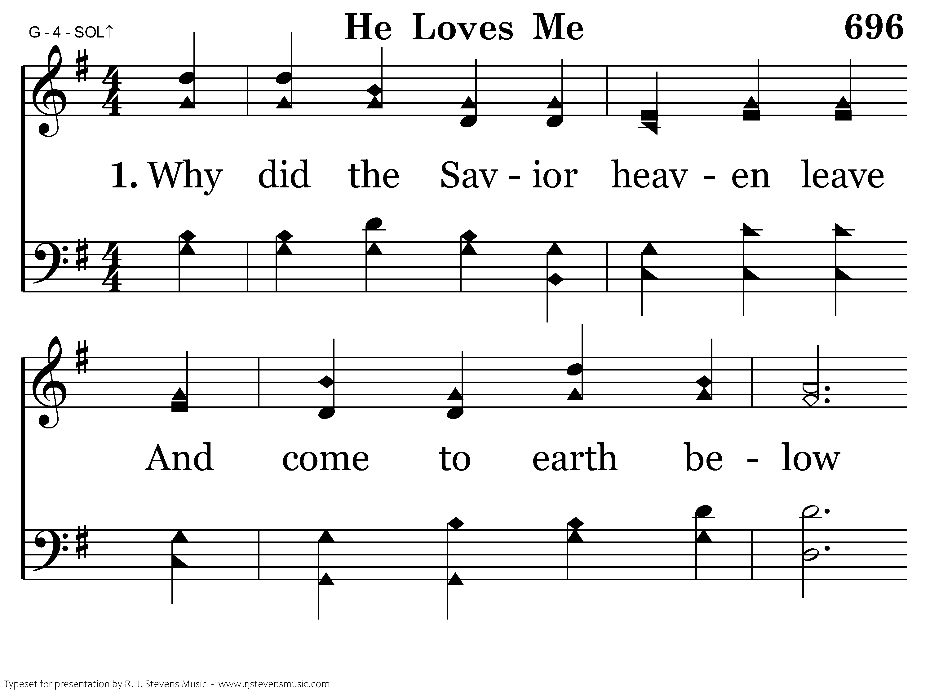
696 - He Loves Me - 1.1

Slide 35
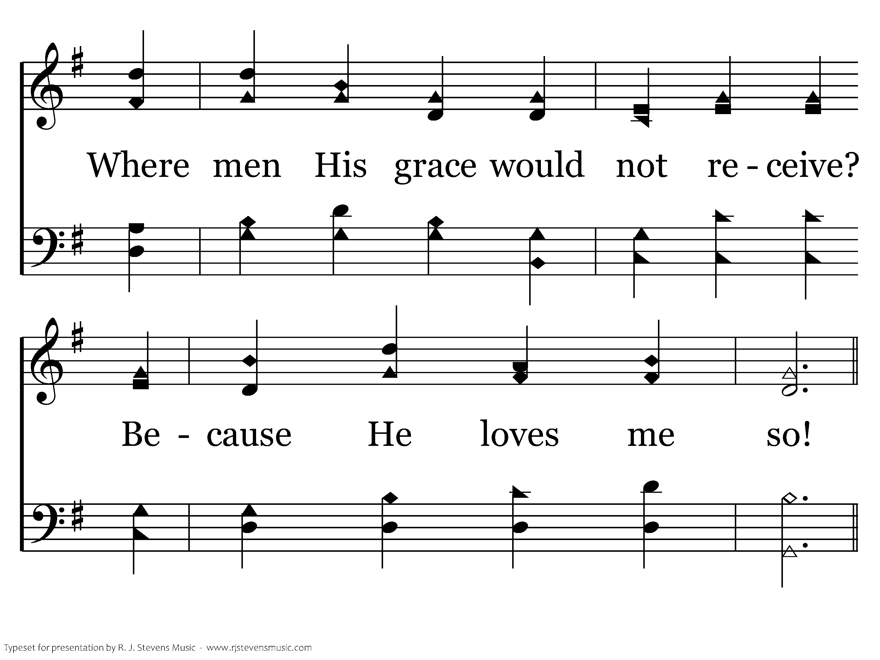
696 - He Loves Me - 1.2

Slide 36
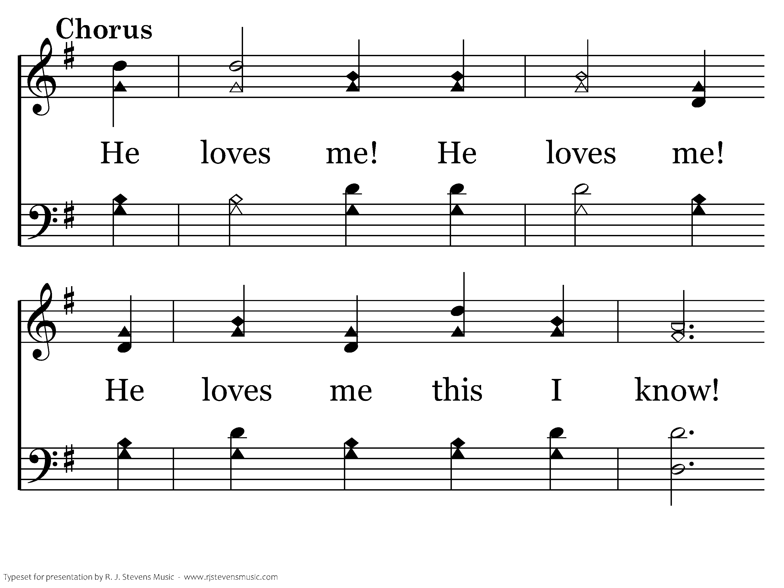
696 - He Loves Me - C.1

Slide 37
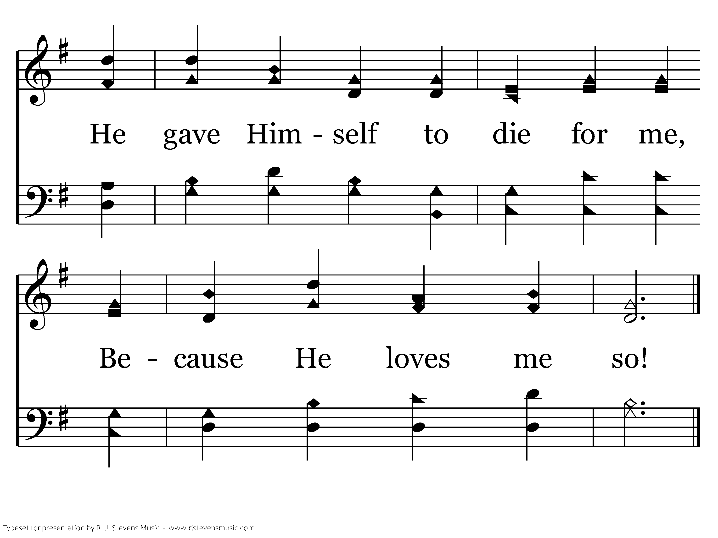
696 - He Loves Me - C.2
End of Verse 1

Slide 38
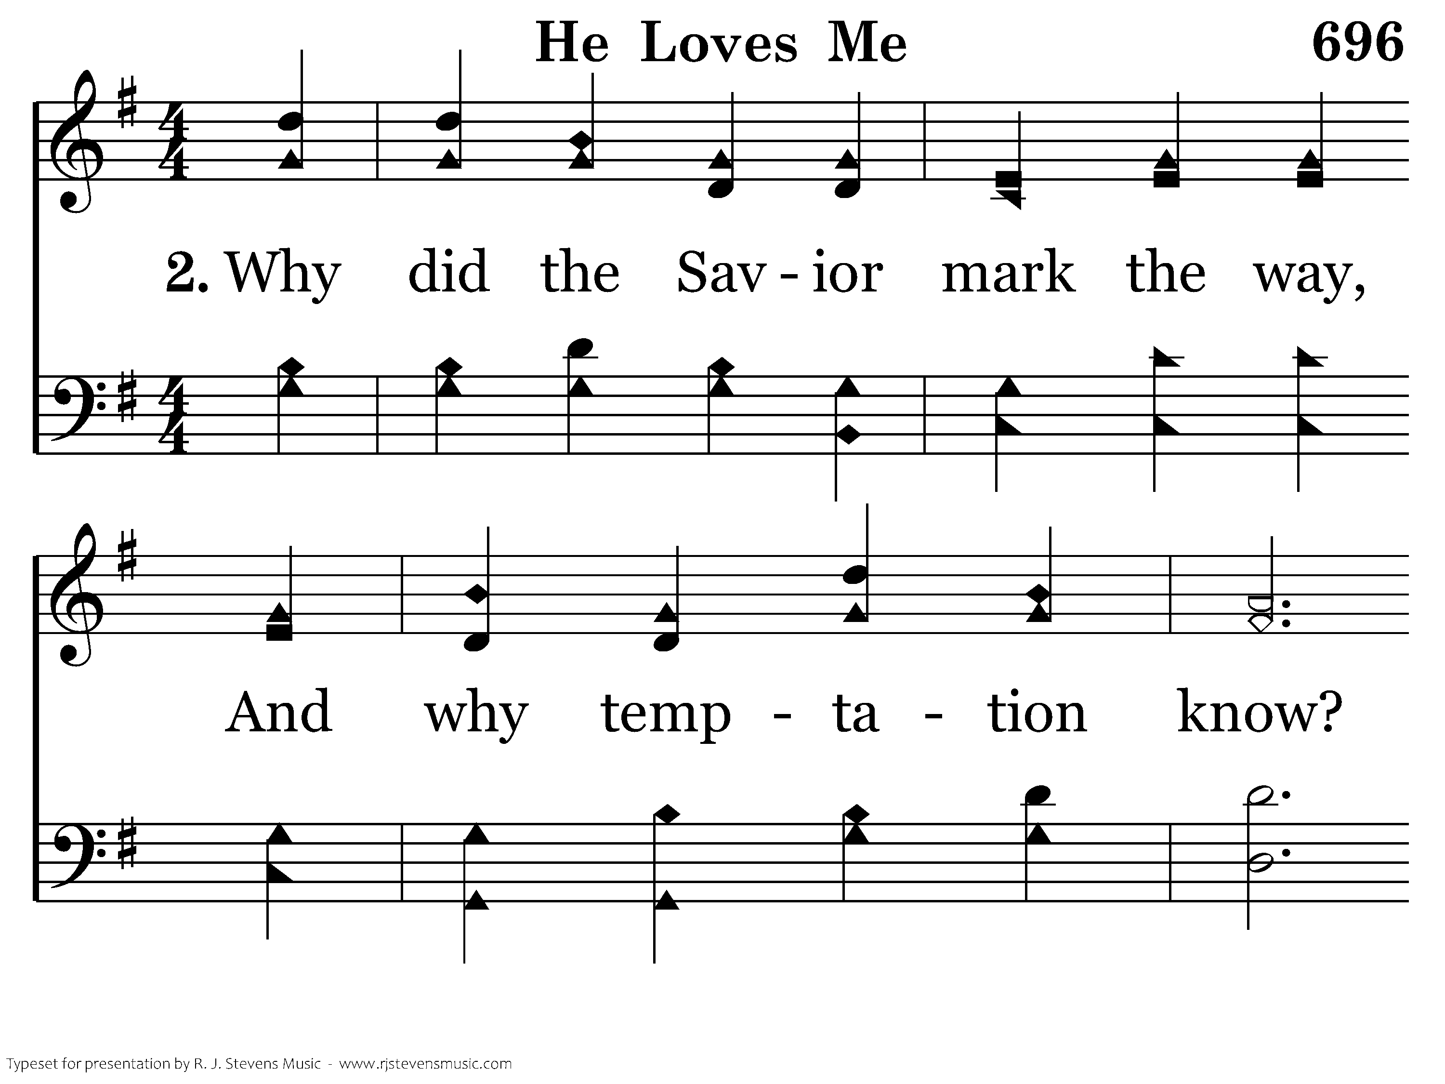
696 - He Loves Me - 2.1

Slide 39
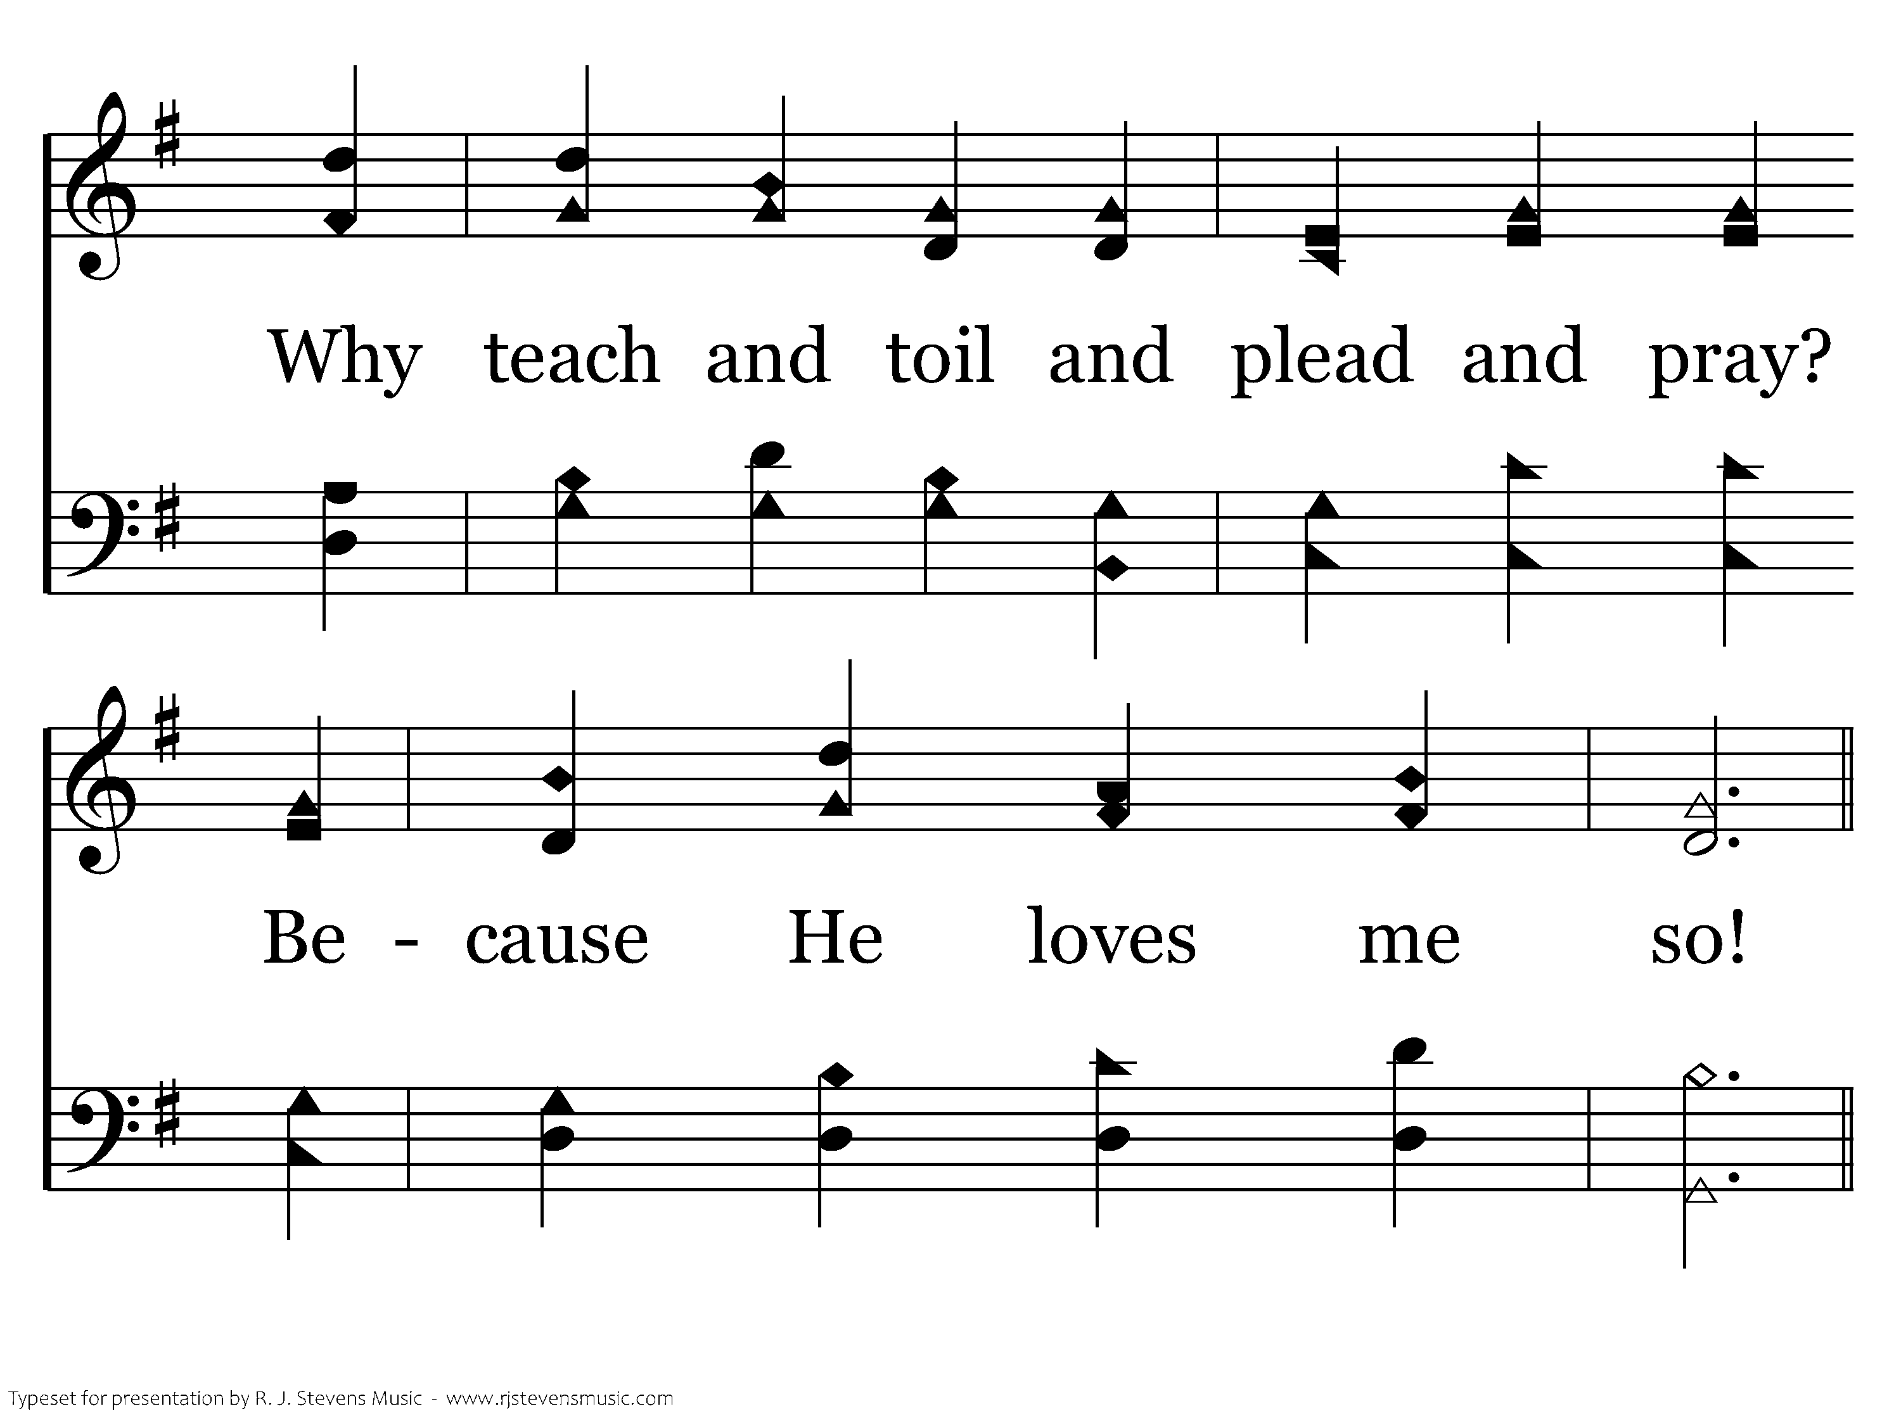
696 - He Loves Me - 2.2

Slide 40
696 - He Loves Me - C.1

Slide 41
696 - He Loves Me - C.2
End of Verse 2

Slide 42
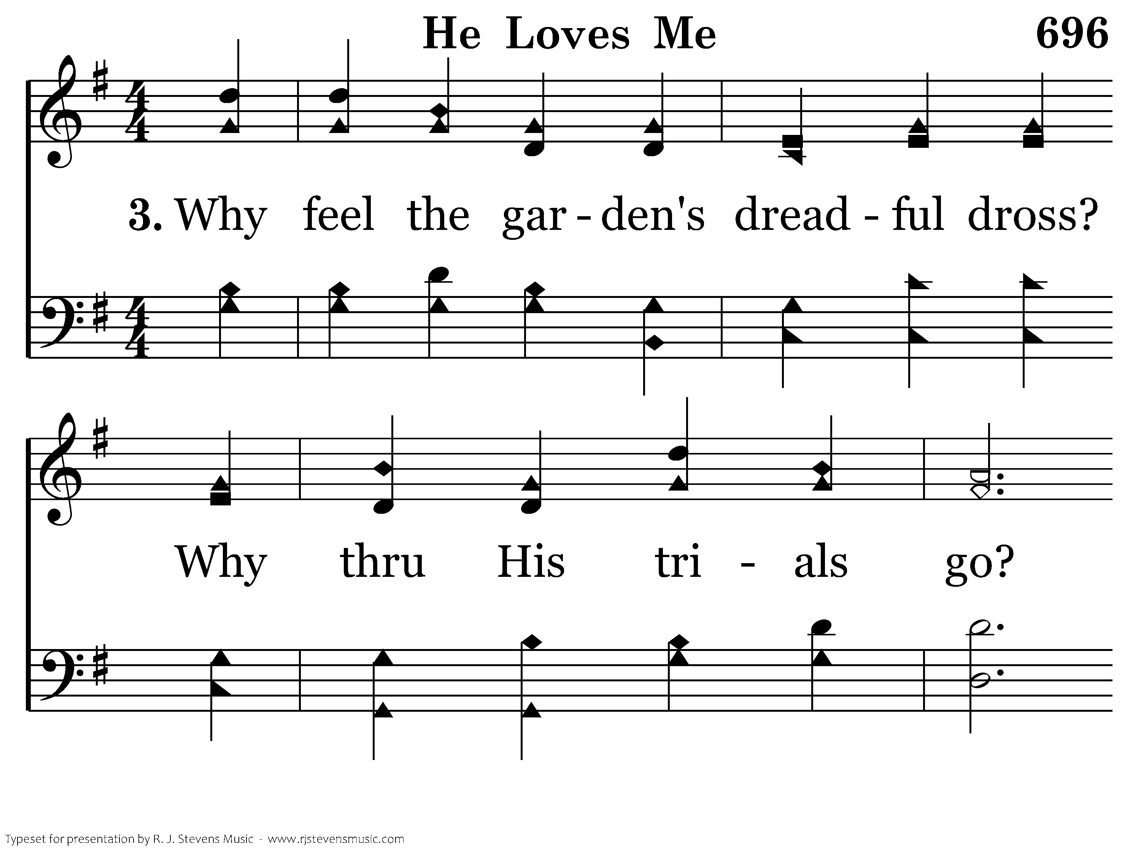
696 - He Loves Me - 3.1

Slide 43
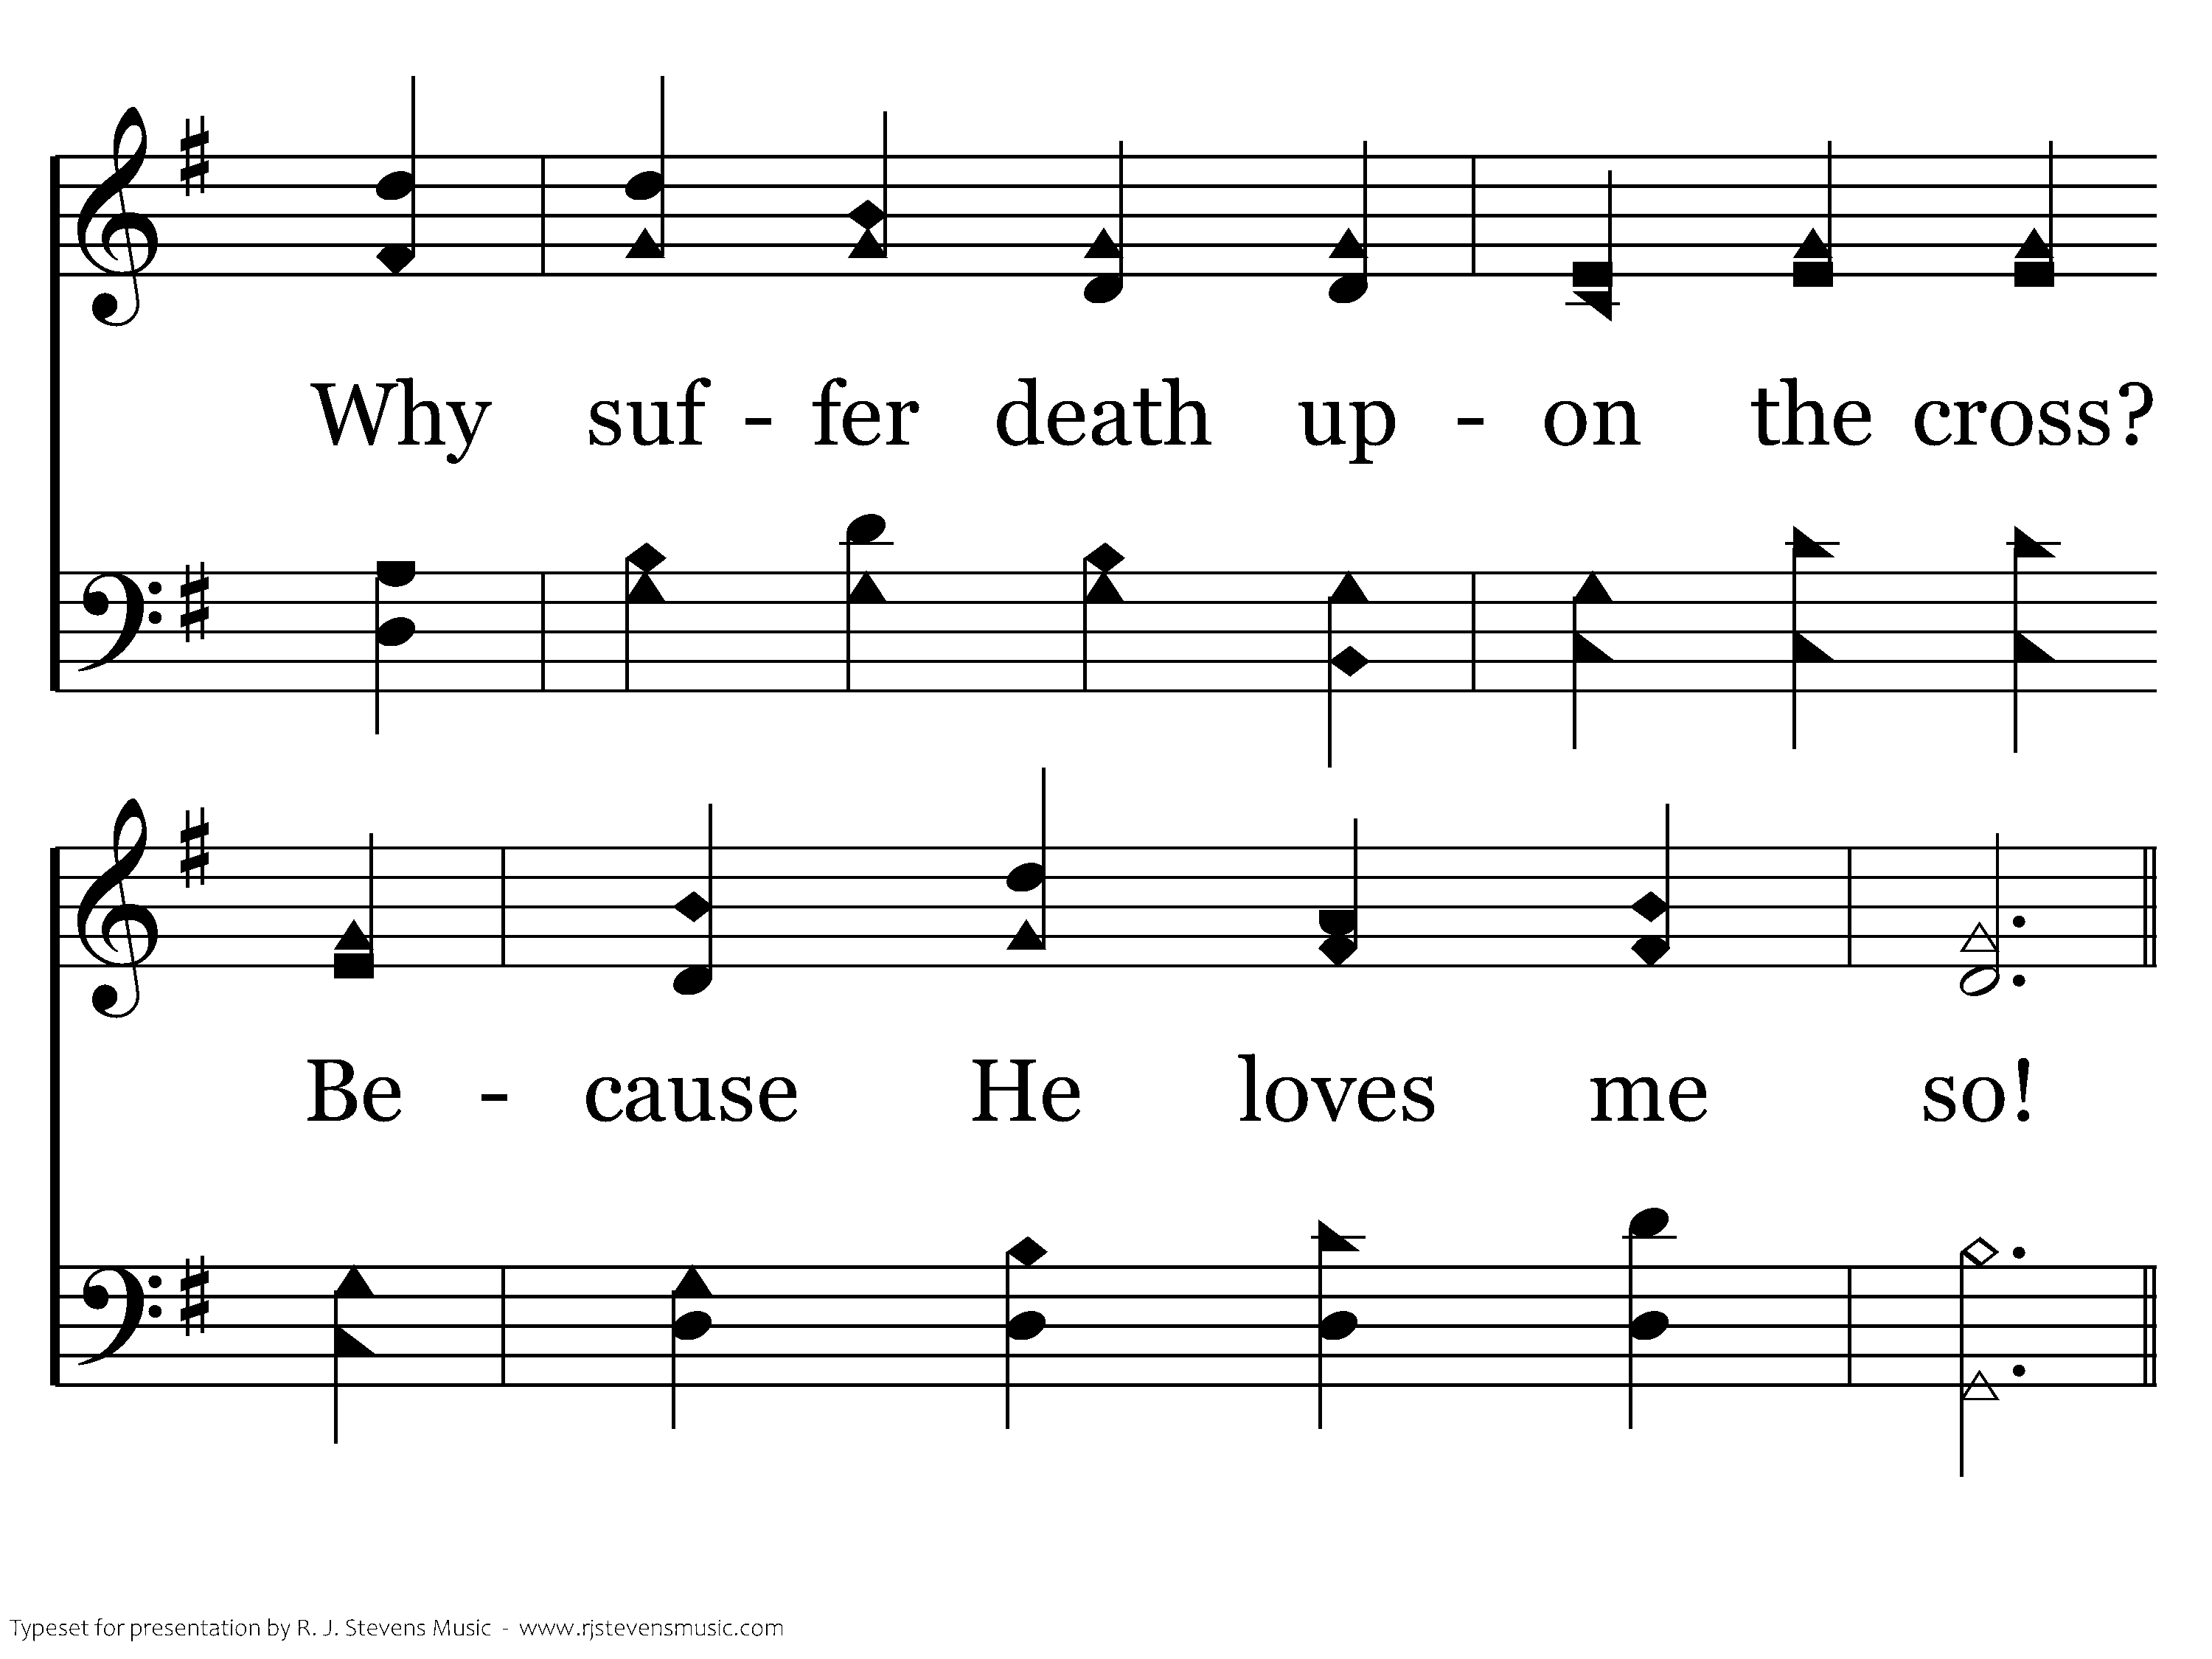
696 - He Loves Me - 3.2

Slide 44
696 - He Loves Me - C.1

Slide 45
696 - He Loves Me - C.2
End of Song

Slide 47
Lessons in Leadership
Studying King Hezekiah
Church of Christ at Medina
November 6th, 2022

Slide 48
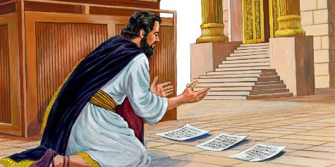
Lessons in Leadership
Leaders first decide to follow the Lord themselves.
  Leaders don’t ask others to do what they are unwilling to do.
  Leaders don’t procrastinate.
  Leaders don’t allow tradition or the pressure of society to determine right and wrong.
References
2 Chronicles 31:20, 29:2-3, 6
“Now it is in my heart to make a covenant with the Lord, the God of Israel, in order that his fierce anger may turn away from us.”
2 Chronicles 31:20, ESV

Slide 49
Lessons in Leadership
Leaders decide to follow the Lord themselves.
Leaders get others involved in the service of the Lord.
  Provide direction or commands.
  Provide encouragement.
References
2 Chronicles 29:15, 30:5-6, 30:22, 29:4-5, 29:11, 32:6-8
“²² And Hezekiah spoke encouragingly to all the Levites who showed good skill in the service of the Lord. So they ate the food of the festival for seven days, sacrificing peace offerings and giving thanks to the Lord, the God of their fathers.”
2 Chronicles 30:22, ESV

Slide 50
Lessons in Leadership
Leaders decide to follow the Lord themselves.
Leaders get others involved in the service of the Lord.
Leaders show themselves in times of crises.
  Good leaders trust in God.
  Good leaders make wise decisions.
  Even good leaders fail at times.
References
Daniel 4:30, 2 Chronicles 32:2-8, 2 Kings 19:10, 20:1, 2 Chronicles 32:25-26
⁸With him is an arm of flesh, but with us is the LORD our God, to help us and to fight our battles." And the people took confidence from the words of Hezekiah king of Judah.
2 Chronicles 32:8, ESV

Slide 51
Applications in Leadership
Leaders – elders and fathers - decide first to follow the Lord.
  Why do we lose our young people? Is it because they didn’t have the example of fathers putting God first?
Leaders – elders and fathers - get others involved in the service of the Lord.
  This includes giving instruction, reproof and encouragement.
Leaders – elders and fathers - show themselves in times of crises.
  Trust in the Lord.
  Make good decisions, and act.
  We will fail at times. Don’t give up!!
References
1 Peter 5:3-5, Titus 1:9, Hebrews 13:17, Eph. 6:10-18, Luke 5:15-16, Jer. 17:5-8
“¹⁷ Obey your leaders and submit to them, for they are keeping watch over your souls, as those who will have to give an account. Let them do this with joy and not with groaning, for that would be of no advantage to you.”
Hebrews 13:17, ESV

Slide 52
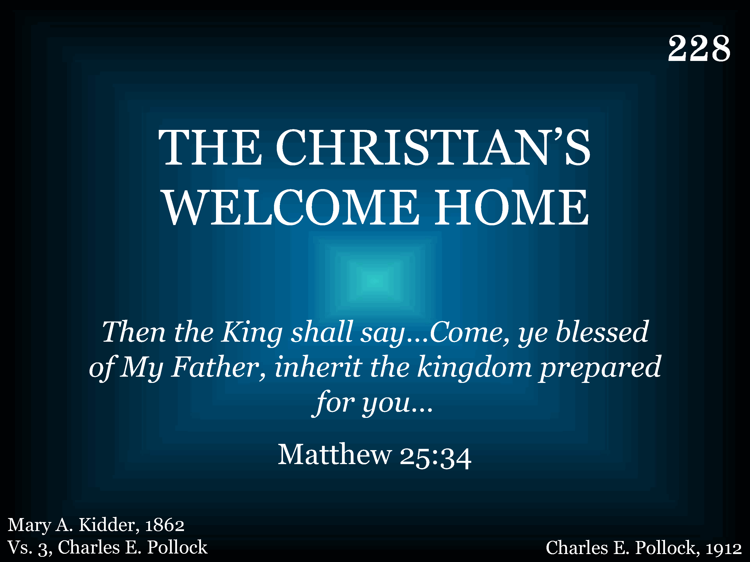
228 - The Christian's Welcome Home - Title

Slide 53
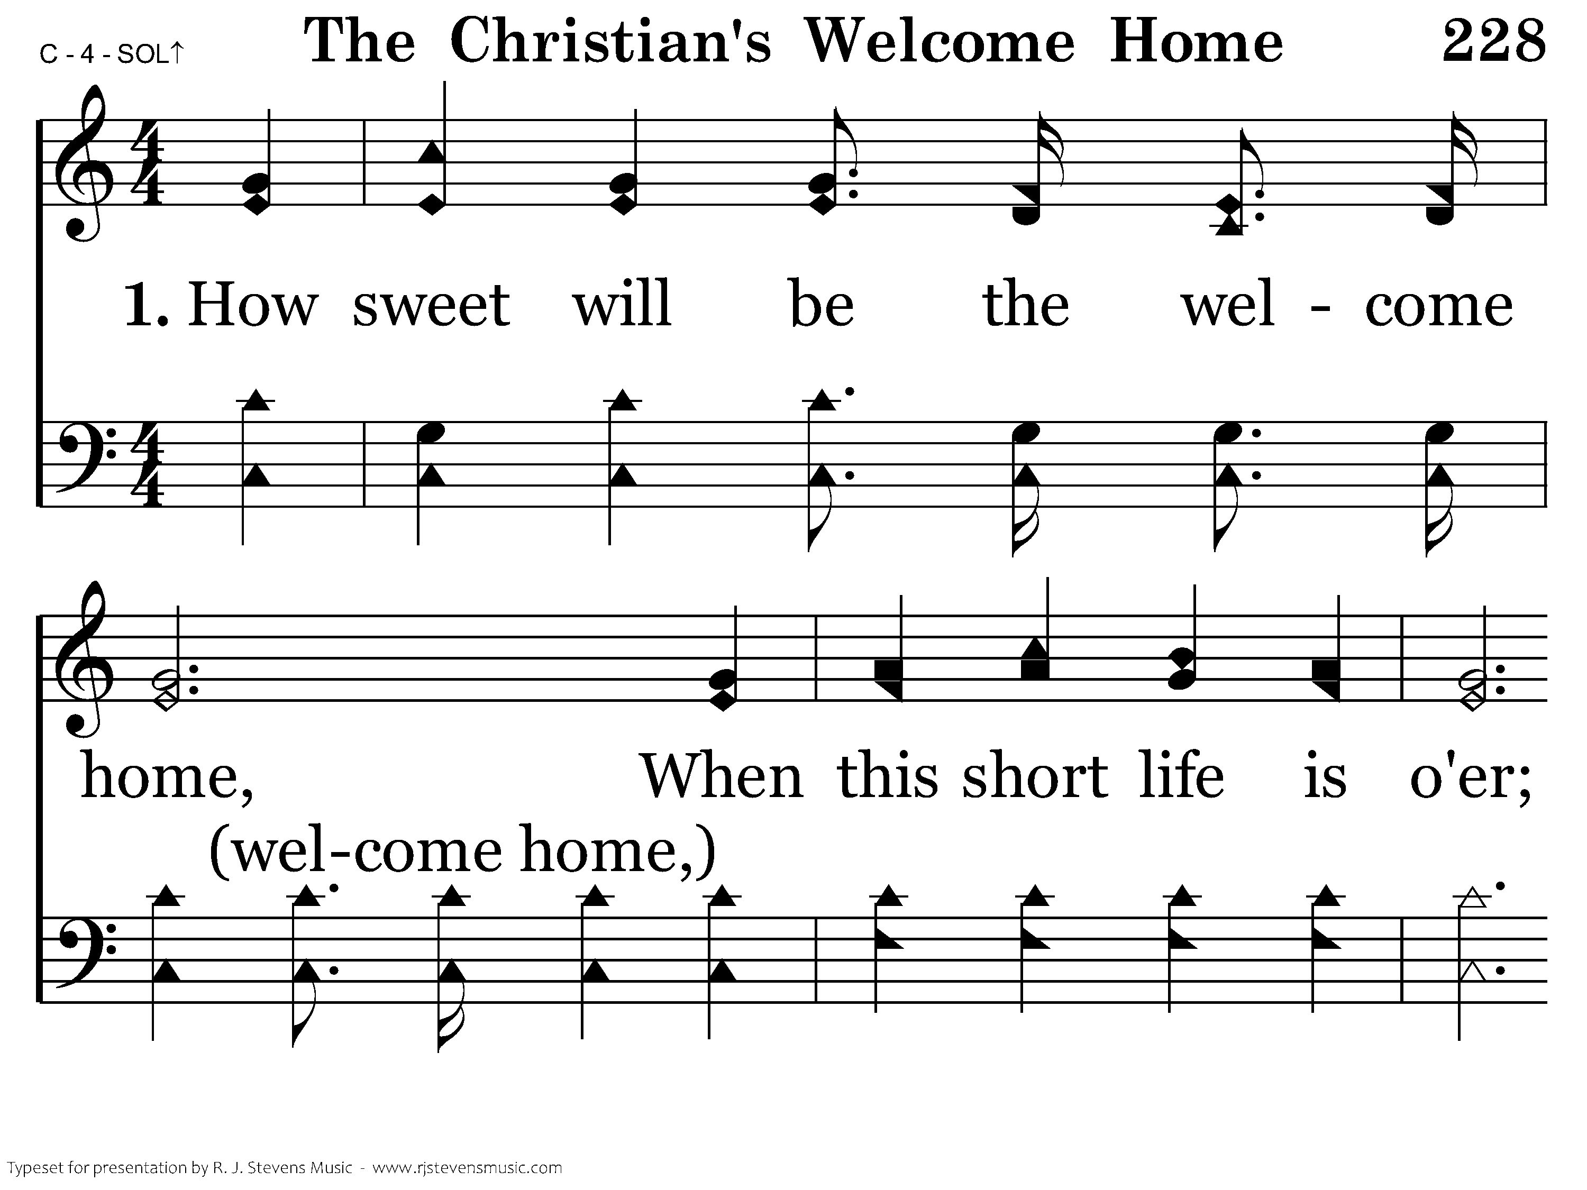
228 - The Christian's Welcome Home - 1.1

Slide 54
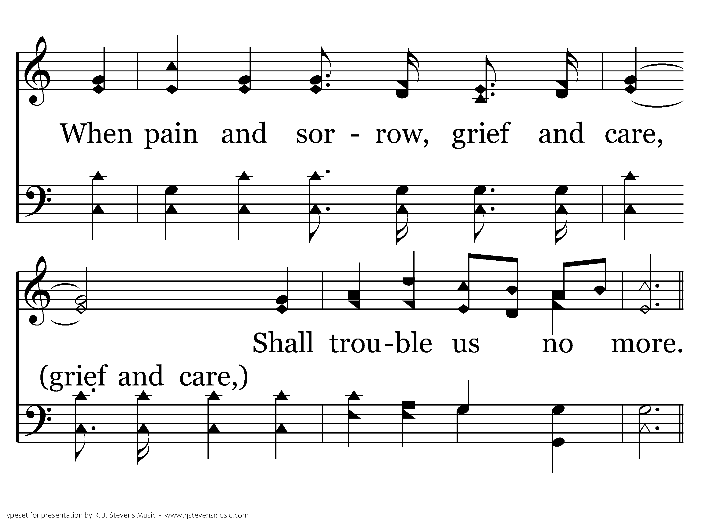
228 - The Christian's Welcome Home - 1.2

Slide 55
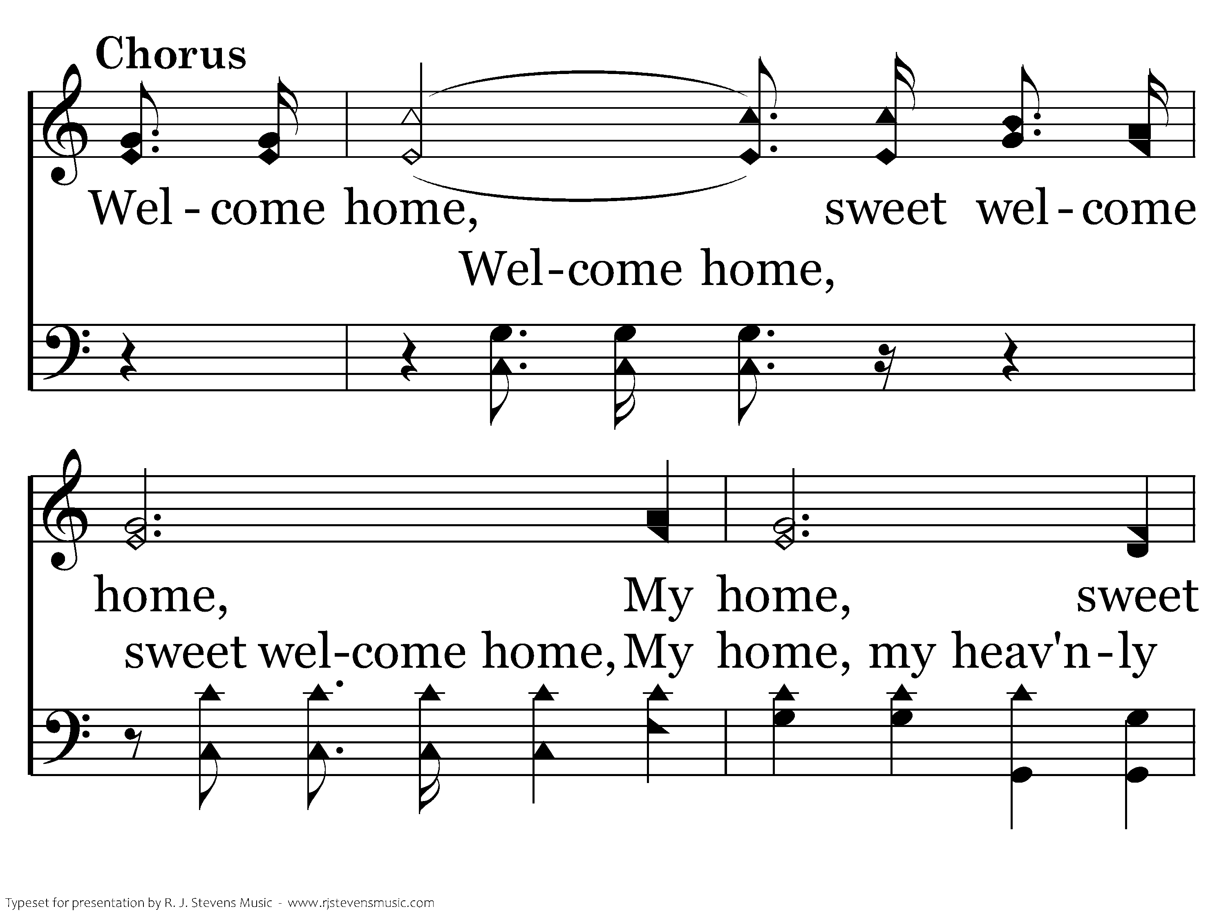
228 - The Christian's Welcome Home - C.1

Slide 56
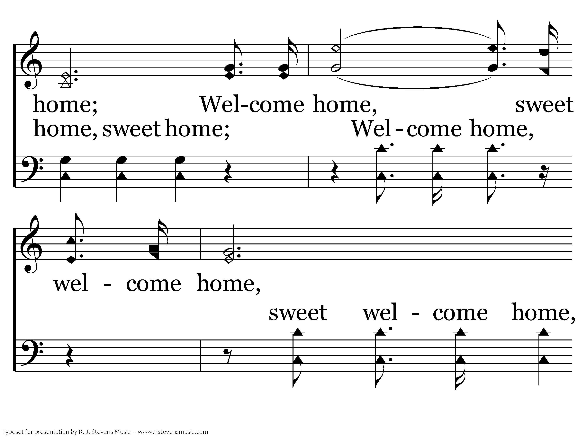
228 - The Christian's Welcome Home - C.2

Slide 57
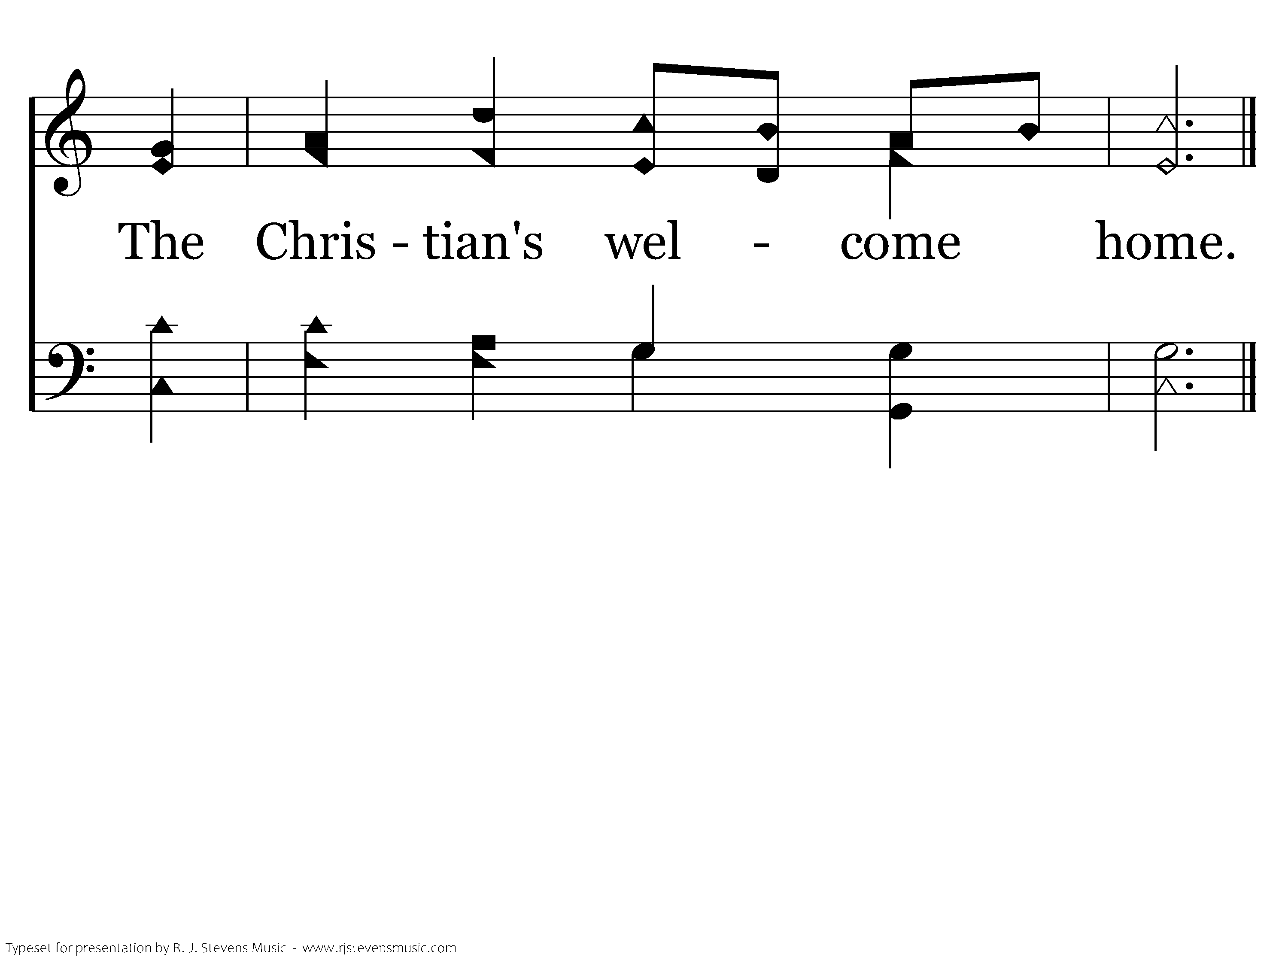
228 - The Christian's Welcome Home - C.3
End of Verse 1

Slide 58
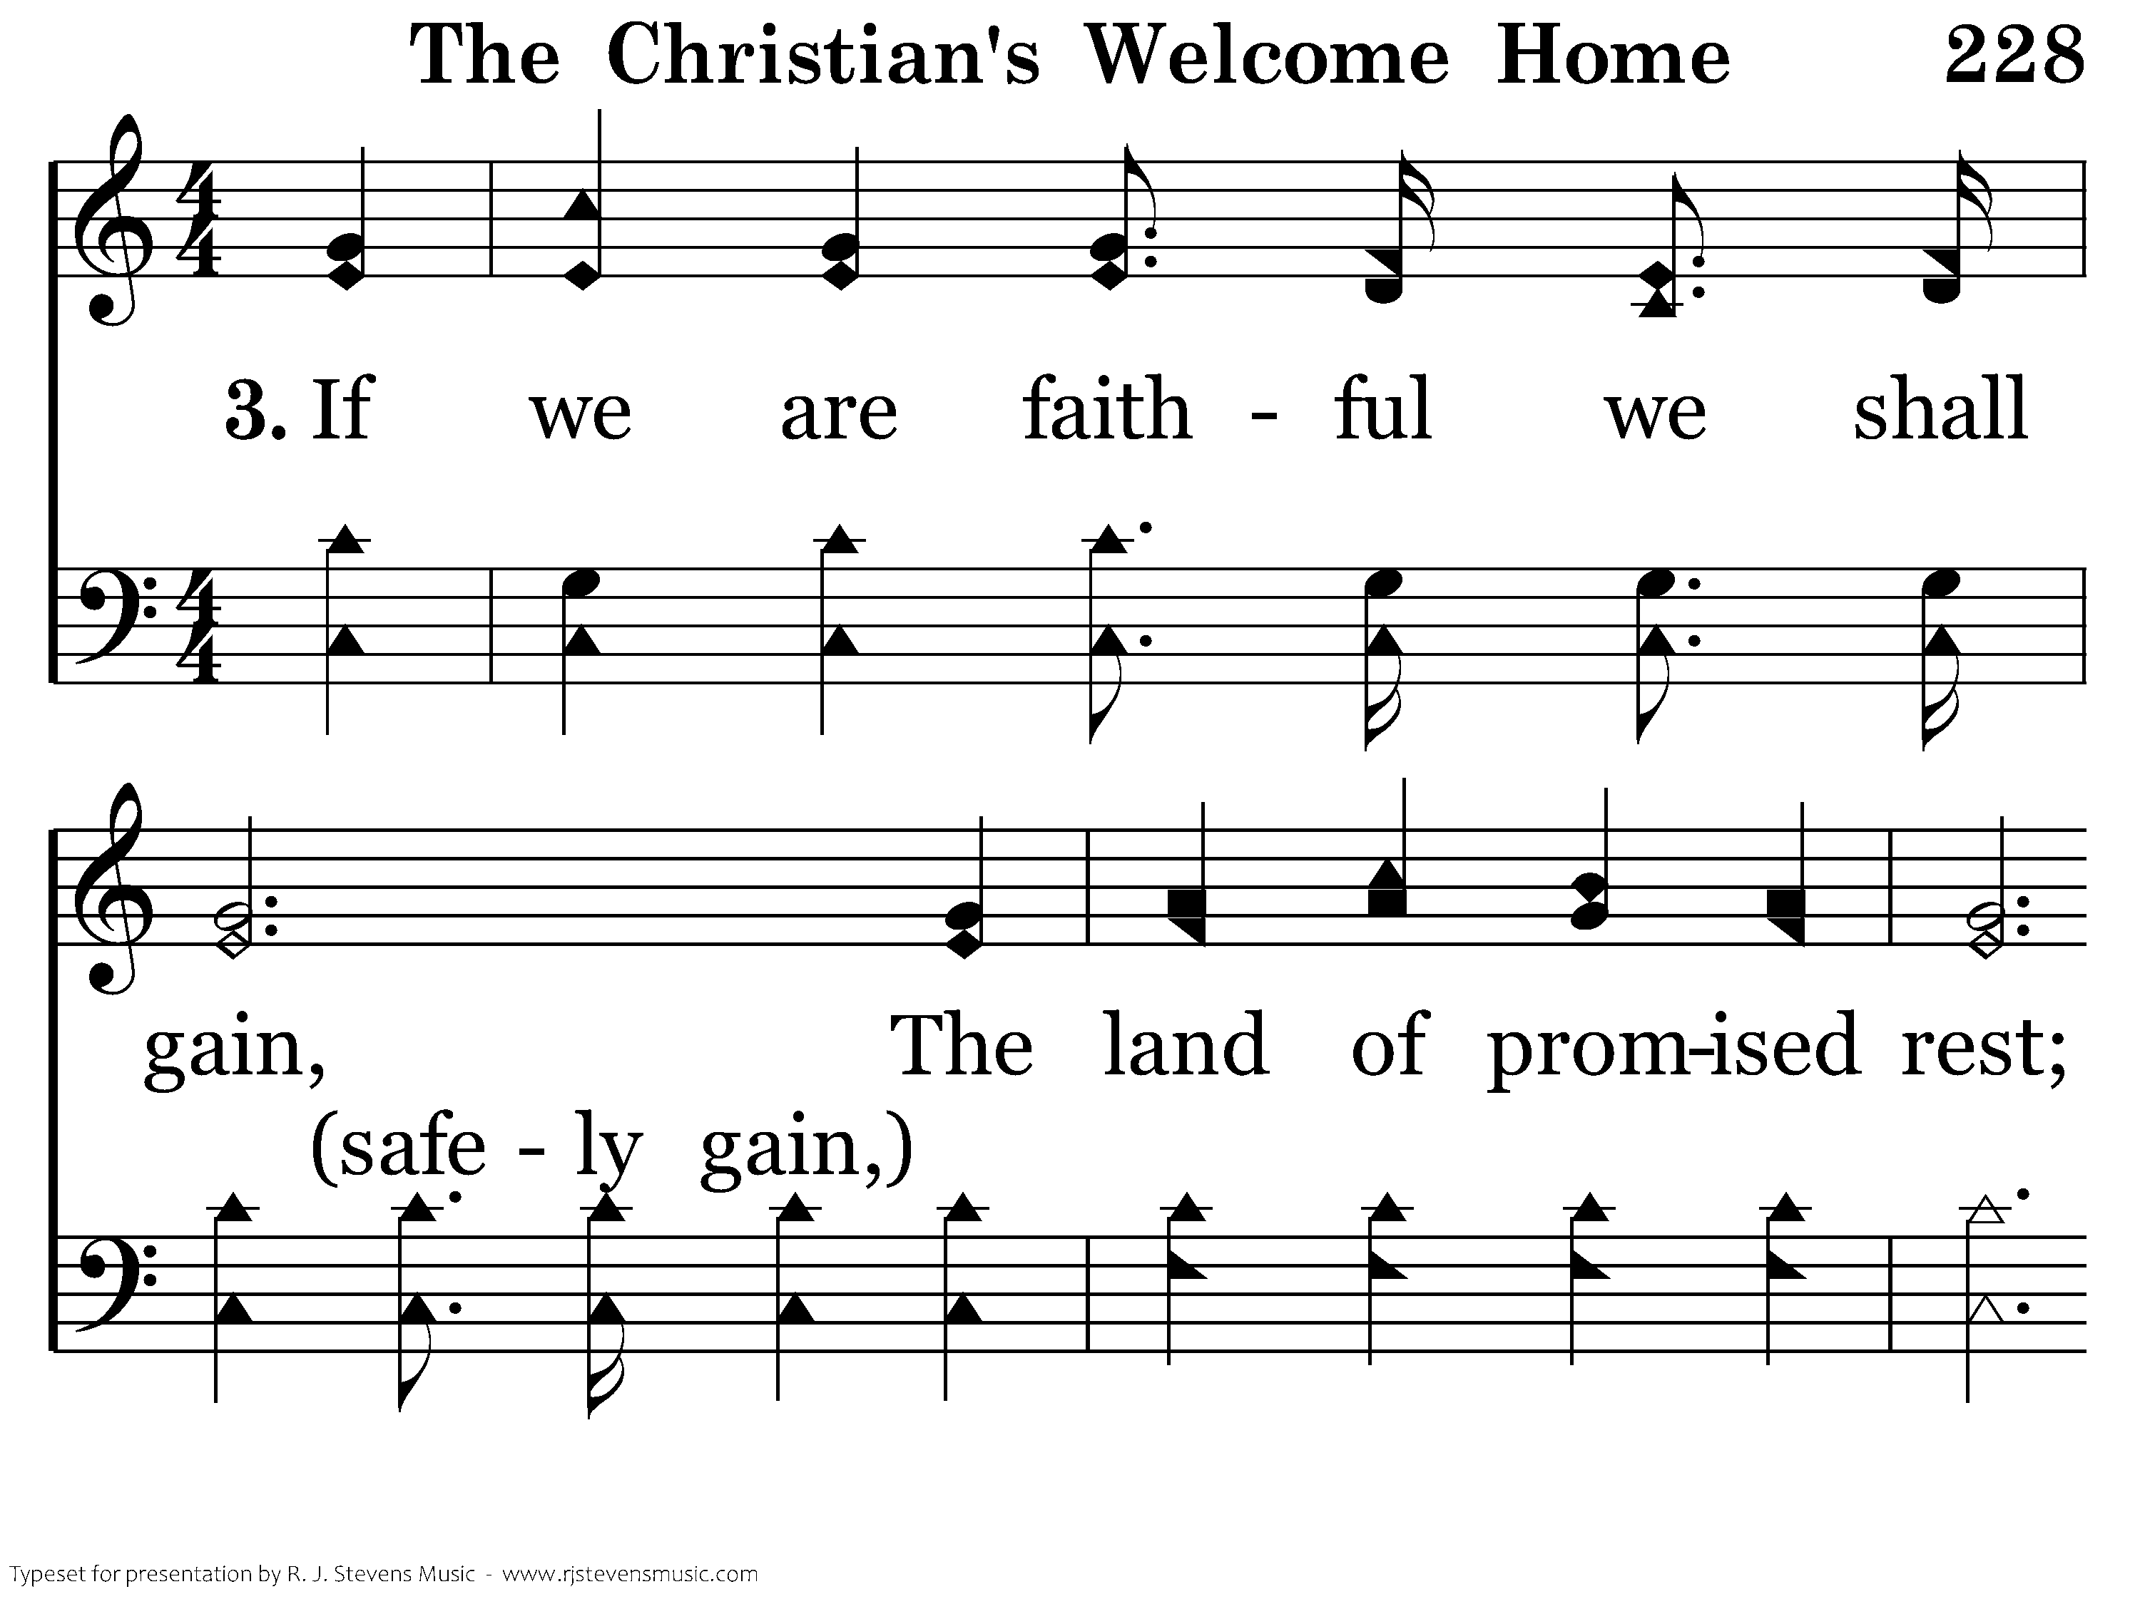
228 - The Christian's Welcome Home - 3.1

Slide 59
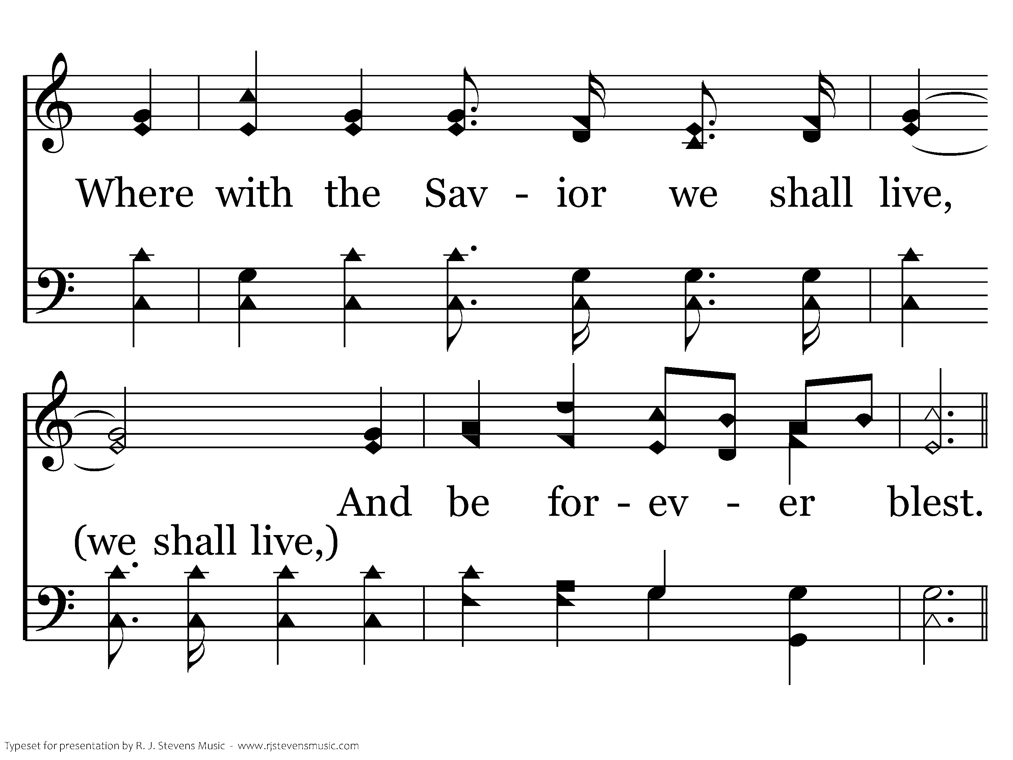
228 - The Christian's Welcome Home - 3.2

Slide 60
228 - The Christian's Welcome Home - C.1

Slide 61
228 - The Christian's Welcome Home - C.2

Slide 62
228 - The Christian's Welcome Home - C.3
End of Song

