Slide 2
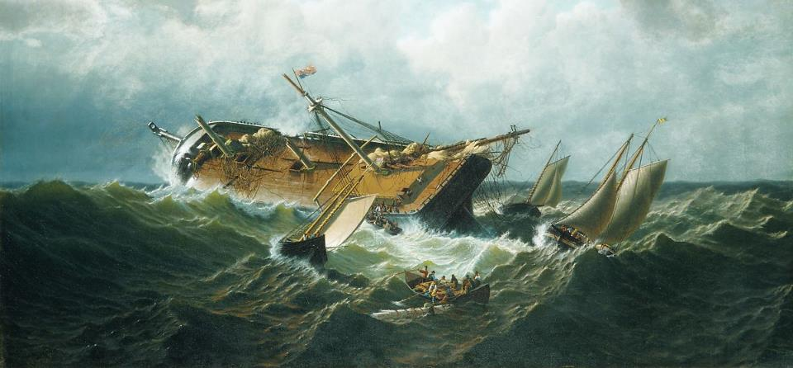
Making Shipwreck of My Faith
Church of Christ at Medina October 30th, 2022

Slide 3
Making Shipwreck of My Faith
Paul’s charge to Timothy included…
Wage the good warfare
Hold Faith
Hold a Good Conscience
Some men – Hymenaeus and Alexander to be specific – thrust aside these things which led to a shipwreck of faith!
References
1 Timothy 1:18-20, 1 Cor. 4:1-2, 2 Tim. 1:13, Rom. 1:18ff

Slide 4
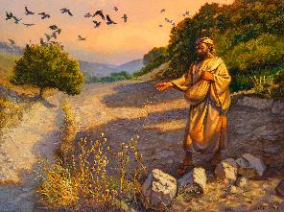
Choking the Seed
¹That same day Jesus went out of the house and sat beside the sea. ²And great crowds gathered about him, so that he got into a boat and sat down. And the whole crowd stood on the beach. ³And he told them many things in parables, saying: "A sower went out to sow. ⁴And as he sowed, some seeds fell along the path, and the birds came and devoured them. ⁵Other seeds fell on rocky ground, where they did not have much soil, and immediately they sprang up, since they had no depth of soil, ⁶but when the sun rose they were scorched. And since they had no root, they withered away. ⁷Other seeds fell among thorns, and the thorns grew up and choked them. ⁸Other seeds fell on good soil and produced grain, some a hundredfold, some sixty, some thirty. ⁹He who has ears, let him hear.“
²²As for what was sown among thorns, this is the one who hears the word, but the cares of the world and the deceitfulness of riches choke the word, and it proves unfruitful.
References
Matthew 13:1-9, 18-23

Slide 5
Choking the Seed
The principle character in the parable is the sower, but Jesus made application for the various types of soil which the seed falls on.
Seed among the thorns
Seed started to grow, but it grew among thorns. These thorns represented…
…the cares of this world.
…the deceitfulness of riches.
What happened to the seed? It was choked out by the thorns and proved unfruitful.
References
Matthew 13:1-9, 18-23

Slide 6
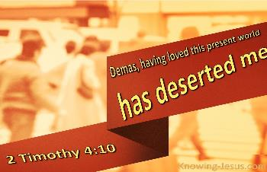
In Love With This Present World
“Epaphras, my fellow prisoner in Christ Jesus, sends greetings to you, and so do Mark, Aristarchus, Demas, and Luke, my fellow workers.” (Philemon 1:23-24)
These fellow workers would have been engaged with Paul in the tasks associated with spreading the gospel to both Jews and Gentiles.
Unfortunately, Demas did not stay the course.
He deserted, forsook or abandoned the work.
Why? He was in love with the present world. It had become the object of his efforts and affections.
References
Philemon 24, Colossians 4:14, 2 Timothy 4:10

Slide 7
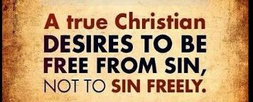
Entangled!
Peter warns against false teachers who would…
…bring in destructive heresies.
…cause the truth to be blasphemed.
…exploit others.
…become enslaved by their own lusts.
…entice others through sensual passions.
Although these false teachers promise freedom, they become entangled again in the defilements of the world and are defeated by them.
References
2 Peter 1:20-22, John 8:34, Titus 3:3, Romans 6:12-14, Hebrews 6:4-8

Slide 8
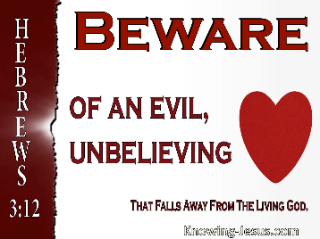
Evil, Unbelieving Hearts
The Hebrew writer uses the example of the Israelites to exhort these Christians to remain firm and committed to Christ.
Waters of Meribah
Refusal to enter Canaan
What is the lesson? Evil, unbelieving hearts prevent us from receiving the promised rest of God.
References
Hebrews 3:12-18, Exodus 17:1-7, Numbers 13-14, Hebrews 13:12-13

Slide 9
Avoiding Shipwrecks
Don’t neglect our faith!
Don’t be overcome with the worries and cares of this world!
Don’t fall in love with the present world!
Avoid becoming entangled in the defilements of this world!
Be warned – evil, unbelieving hearts are a danger to us all!
References
Romans 10:17, Psalm 119:97, Matthew 6:25-30, 1 John 3:15-17, Ephesians 4:20-24

