Slide 1
Questions Asked By God!
Then the LORD answered Job out of the whirlwind, and said: "Who is this who darkens counsel By words without knowledge? Now prepare yourself like a man; I will question you, and you shall answer Me. (Job 38:1-3 NKJV)

Slide 2
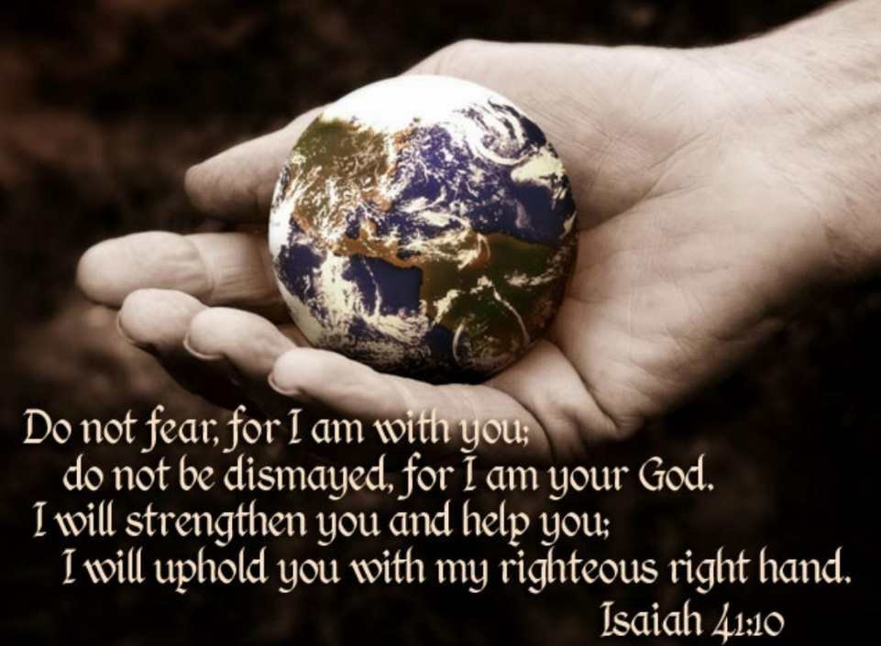
Question #1
What Are You Doing Here?
And there he went into a cave, and spent the night in that place; and behold, the word of the LORD came to him, and He said to him, "What are you doing here, Elijah?" (1 Kings 19:9 NKJV)
1 Kings 9:13
Never put a question mark where God has put a period!

Slide 3
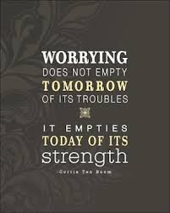
Question #2
Why Are You Anxious?
"Consider the ravens, for they neither sow nor reap, which have neither storehouse nor barn; and God feeds them. Of how much more value are you than the birds? "And which of you by worrying can add one cubit to his stature? "If you then are not able to do the least, why are you anxious for the rest? (Luke 12:24-26 NKJV)

Slide 4
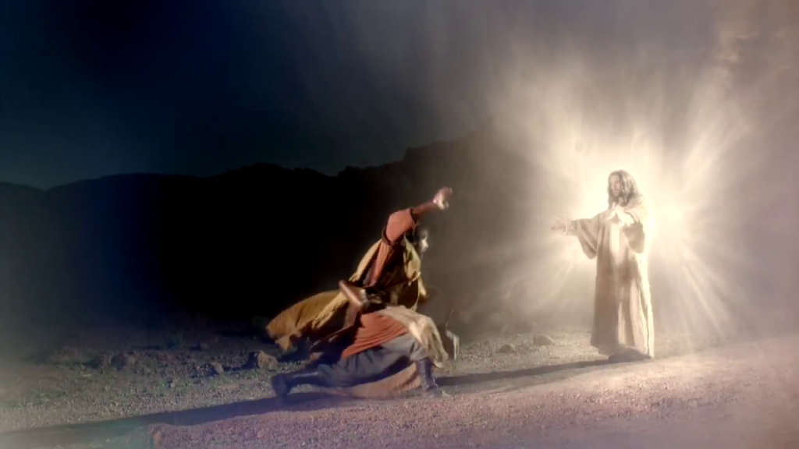
Question #3
Why Are You Persecuting Me?
Then Saul, still breathing threats and murder against the disciples of the Lord, went to the high priest and asked letters from him to the synagogues of Damascus, so that if he found any who were of the Way, whether men or women, he might bring them bound to Jerusalem. As he journeyed he came near Damascus, and suddenly a light shone around him from heaven. Then he fell to the ground, and heard a voice saying to him, "Saul, Saul, why are you persecuting Me?" (Acts 9:1-4 NKJV)

Slide 5
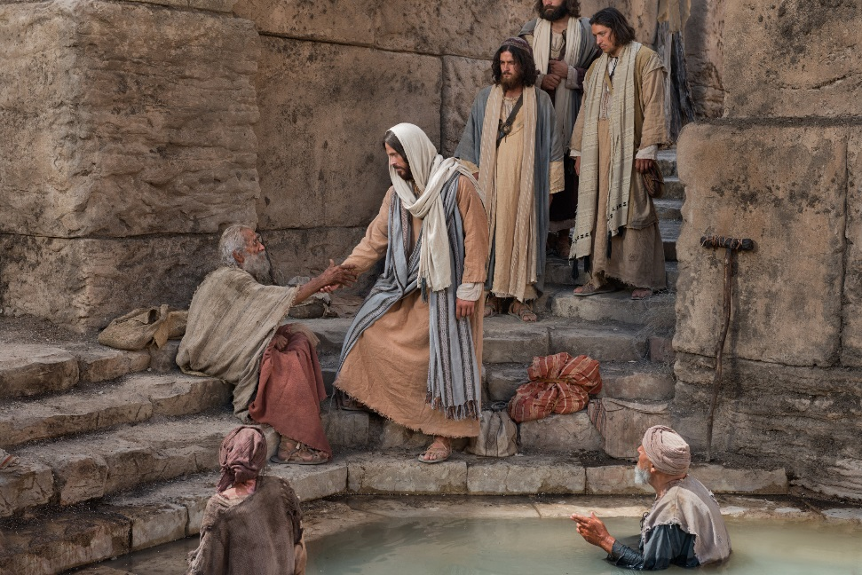
Question #4
Do You Want To Be Made Well?
Now a certain man was there who had an infirmity thirty-eight years. When Jesus saw him lying there, and knew that he already had been in that condition a long time, He said to him, "Do you want to be made well?" (John 5:5-6 NKJV)

Slide 6
One Last Question…
Therefore we must give the more earnest heed to the things we have heard, lest we drift away. For if the word spoken through angels proved steadfast, and every transgression and disobedience received a just reward, how shall we escape if we neglect so great a salvation, which at the first began to be spoken by the Lord, and was confirmed to us by those who heard Him, (Hebrews 2:1-3 NKJV)

Slide 7
Sources
Outline by Steve Higginbotham

