Slide 1
The Three D’s of a Christian
Medina church of Christ
October 30th, 2016

Slide 2
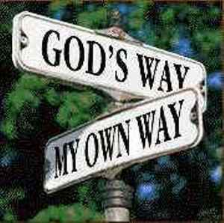
The Three D’s of a Christian…
Dedicated – Luke 9:24; Romans 12:1,2
Determined – Luke 9:62; Acts 11:23; 20:24
Dependable – Phil. 3:13,14; Matt. 25:21

Slide 3
Dedicated-Determined-Dependable
Therefore we also, since we are surrounded by so great a cloud of witnesses, let us lay aside every weight, and the sin which so easily ensnares us, and let us run with endurance the race that is set before us, looking unto Jesus, the author and finisher of our faith, who for the joy that was set before Him endured the cross, despising the shame, and has sat down at the right hand of the throne of God. (Hebrews 12:1-2 NKJV)

