Slide 2
A Conversation in Caesarea Philippi
Now when Jesus came into the district of Caesarea Philippi, he asked his disciples, “Who do people say that the Son of Man is?” And they said, “Some say John the Baptist, others say Elijah, and others Jeremiah or one of the prophets.” He said to them, “But who do you say that I am?” Simon Peter replied, “You are the Christ, the Son of the living God.” And Jesus answered him, “Blessed are you, Simon Bar-Jonah! For flesh and blood has not revealed this to you, but my Father who is in heaven. And I tell you, you are Peter, and on this rock I will build my church, and the gates of hell shall not prevail against it. I will give you the keys of the kingdom of heaven, and whatever you bind on earth shall be bound in heaven, and whatever you loose on earth shall be loosed in heaven.” Then he strictly charged the disciples to tell no one that he was the Christ.
- Matthew 16:13-20, ESV

Slide 3
“But Who Do You Say That I Am?
Church of Christ at Medina
February 26th, 2017

Slide 4
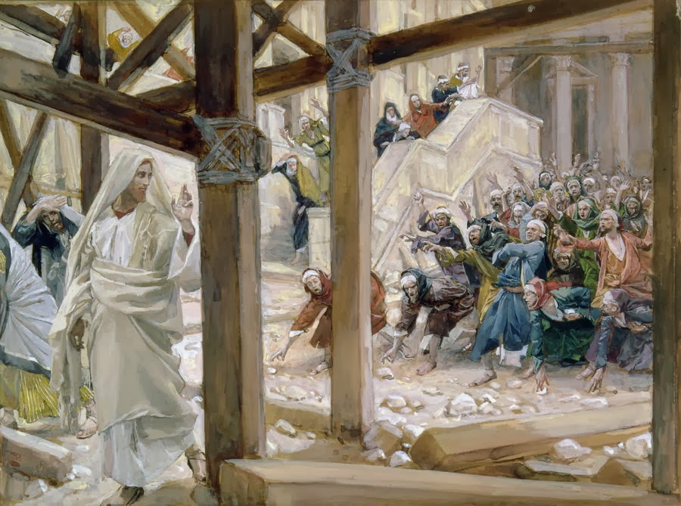
The Claims of Jesus: Equality with the Father
The Healing of a Lame Man (John 5)
’My Father is working until now, and I am working.’ This was why the Jews were seeking all the more to kill Him, because not only was He breaking the Sabbath, but He was even calling God His own Father, making Himself equal with God.” (5:17-18)
Jesus, the I AM (John 8)
“Jesus said to them, ‘Truly, truly, I say to you, before Abraham was, I am.’” (8:58)
One with the Father (John 10)
“My Father, who has given them to me, is greater than all, and no one is able to snatch them out of the Father’s hand. I and the Father are one.” (10:29-30)
“So they picked up stones to throw at Him, but Jesus hid Himself and went out of the temple.” (John 8:59)

Slide 5
The Claims of Jesus: Equality with the Father
Confession before Caiaphas (Mark 14)
“Again the high priest asked Him, ‘Are you the Christ, the Son of the Blessed?’ And Jesus said, ‘I am, and you will see the Son of Man seated at the right hand of Power, and coming with the clouds of heaven.’” (14:61a-62)
“So they picked up stones to throw at Him, but Jesus hid Himself and went out of the temple.” (John 8:59)

Slide 6
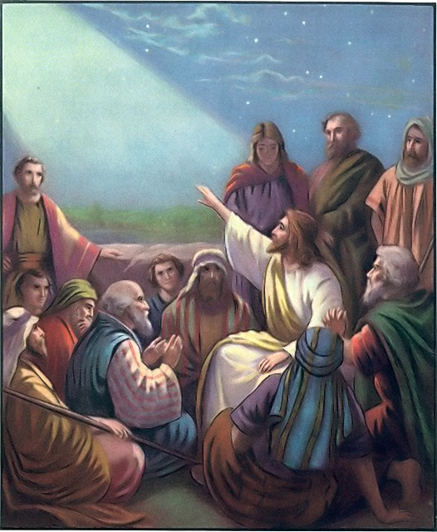
The Claims of Jesus: Only Son of God
Jesus visits the temple. (Luke 2:49)
“Why were you looking for Me? Did you not know that I must be in My Father’s house?”
The mission of Jesus (John 5:39)
In this one statement – “I have come in my Father’s name – we have the authority, mission and relationship of Jesus stated with respect to the Father.
One with the Father (John 14:8-13)
“Whoever has seen Me has seen the Father…Believe Me that I am in the Father and the Father is in Me.”

Slide 7
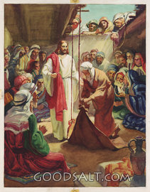
The Claims of Jesus: Power to Forgive
Jesus heals a paralytic. (Mark 2)
“And when Jesus saw their faith, He said to the paralytic, ‘Son, your sins are forgiven.’” (2:5)
And scribes…”Why does this man speak like that? He is blaspheming! Who can forgive sins but God alone?” (2:7)
“Which is easier, to say to the paralytic, ‘Your sins are forgiven’, or to say, ‘Rise, take up your bed and walk?’ (2:9)
“But that you may know that the Son of Man has authority on earth to forgive sins – He said to the paralytic – ‘I say to you, rise, pick up your bed, and go home.’” (2:10-11)

Slide 8
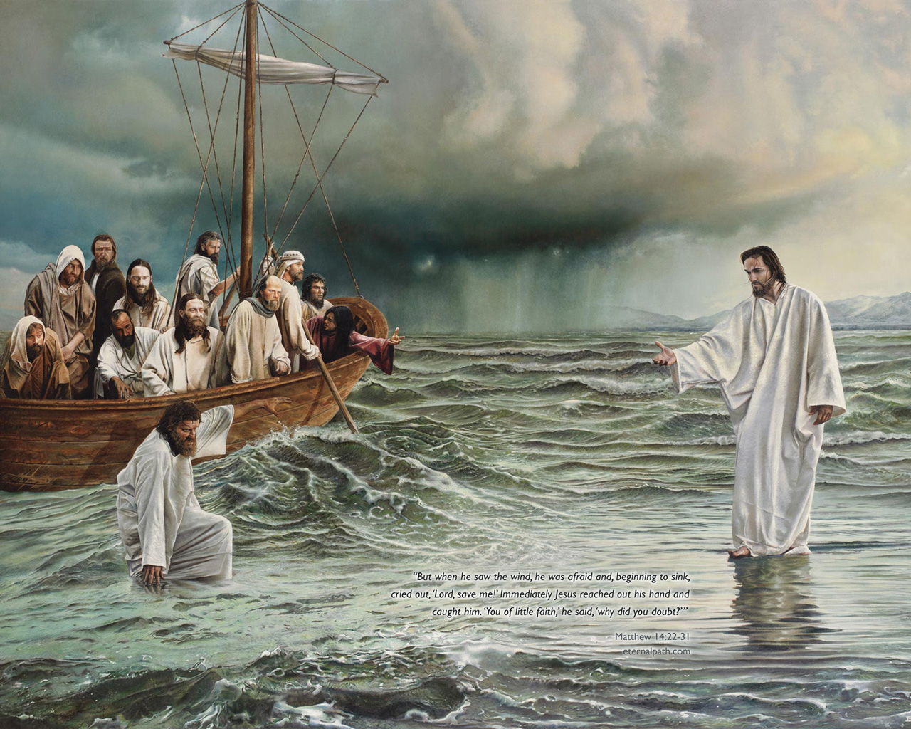
The Claims of Jesus: Accepted Worship
Jesus walks on water. (Matthew 14)
After the feeding of the 5,000 and the walking on water, the disciples “worshipped Him, saying, ‘Truly You are the Son of God.’” (14:33)
Worship is an action that is only acceptable to God.
Peter refused it from Cornelius. (Acts 10:25-26)
Paul & Barnabas refused it in Lystra. (Acts 14:11-18)
An angel prevented it from John. (Revelation 19:10)
The blind man who was healed worshipped Jesus. (John 9:38)
Jesus did not prevent worship of Him, which shows He proclaimed to be God.
The women who saw the resurrected Jesus worshipped Him. (Mt. 28:9)

Slide 9
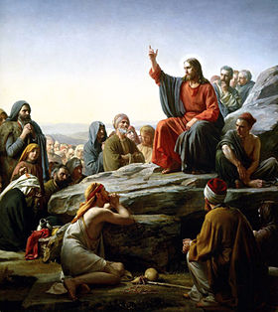
The Claims of Jesus: Authoritative Words
No one else spoke like Him. (Matt. 5)
The Sermon on the Mount was further explanation of the Law of Moses and a baseline for the character of the citizen of the Heavenly Kingdom.
In His explanation, Jesus did not rely on other interpretations or teachers. Rather, He told them – “But I say to you…”
By the end of the sermon, Jesus pronounced blessings and cursings based upon their willingness to listen to Him.
The crowd recognized the difference – “for He was teaching them as one who had authority.”
Matthew 24:35 – “Heaven and earth will pass away, but my words will not pass away.”
“…for He was teaching them as one who had authority, and not as their scribes.” (Matthew 7:29)

Slide 10
The Claims of Jesus
He was equal with the Father.
He is the only Son of God – a special relationship.
He is able to forgive sins, which is reserved for God alone.
He was worshipped, which is only accepted when given to God.
He spoke with the authority of God, because He is God.

