Slide 1
Where are the Nine?
Luke 17:12-19

Slide 2
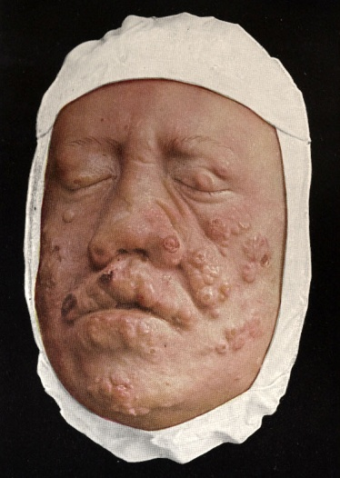
Leprosy In Jesus’ Day…
Leprosy was a horrible disease during Bible days. Members would fall off at the joints:
These people were isolated from the world:
Imagine:
Your body just rotting away.
Not being able to touch anyone; friends, family.
Loss of life as you know it.
Forced to live in a colony with others who will suffer the same fate.
Suffering for 10-20 years.
Notes:
“Stood afar off” because of leprosy – loathsome, destructive, infectious, often in curable, almost always fatal (cf. Lev. 13:46), and therefore type of sin.

Slide 3
The Ten Lepers and Gratitude
Observations:
Vs. 12, 13: Lepers were isolated (Lev. 13: 46). The ten lepers appeared to have known of Jesus (cp. Matt. 4: 23, 8: 2, 3).
Vs. 14: Jesus tested their faith.
Vs. 15, 16: Healed on the way. The Samaritan returned (others probably Jews).
Vs. 17, 18: Ten per cent gave thanks.
Vs. 19: Faith made whole (Gal. 5: 6).
Notes:
Slide two allows you to briefly comment on each of the verses. Regarding verse 14, accent the matter of saving faith and contrast it with denominational teaching relative to faith (Jas. 2: 14-26). Pertaining to verses 15, 16, address the matter of one being a Samaritan and point out Jesus’ lack of intimidation to involve himself in the prejudicial social issues of his day (cp. John 4: 7-26, 27; Luke 10: 25-37). Regarding verses 17, 18, show how you do not normally observe large percentages in terms of spiritual accomplishments (cp. Matt. 13: 3-9).

Slide 4
The Ten Lepers and Gratitude
Ten left and were healed on the way.
Notes:
Activate each leper (graphic) until all have left.
God gives people marriage & people throw it away… He gives people children & they don’t care about
them... He gives salvation, & people fail to love being in Christ… He gives people life and they want to
take it… He gives people the church, and they want to turn it to a corporation & entertainment center…
Beloved, God commands thanks for the blessings, favors, & gifts He has given us… There is no option…
And the reason a person will be thankful is because of his faith in God (Col 2:7)….

Slide 5
The Ten Lepers and Gratitude
Only one healed leper returned to give thanks!
Jesus wanted to know why the nine did not return to give God glory and praise!
What about you?
Worship?
Singing ?
Giving? – (We give to what we believe in)
Bible Study?
Notes:
Talk more about the disposition to be thankful in the matter of the ten lepers. Notice the rationalization that, “The nine were Jews; therefore, in compliance to the Law of Moses, they could not return to give thanks when the Samaritan did. Also notice the denominational teaching that, “The nine were healed, which is symbolic of salvation; therefore, there are degrees of grace, the Samaritan who was healed, returned, and had the ultimate degree of grace.” They thus reason this way regarding salvation (degrees of salvation). The scriptures know nothing of such a concept of “degrees of grace.” Some even teach that one can even “fall from grace” and remain saved, due to their warped understanding of the “degrees of grace” (cp. Gal. 5: 4).

Slide 6
The Samaritan took advantage of potentially His only opportunity to show his thankfulness.
We find ourselves in similar situations with people who do good to us. Do not let those situations pass without thanking them! (Gal. 6:10; 1 Thess. 5:18)

Slide 7
"Where Are The Nine?"
Rejoice evermore. Pray without ceasing. In every thing give thanks: for this is the will of God in Christ Jesus concerning you. (1 Thessalonians 5:16-18 KJV)
Notes:
Gratitude is a commandment!

Slide 8
“Where Are The Nine?”
Reasons to be thankful:
Physical blessings (Matt. 6:33)
Remission of sins (Acts 2:38).
Jesus’ death & resurrection. (Rom. 5: 6-10).
The church (Matt. 11: 11, Eph. 1: 3).
Prayer (Phil. 4: 6).
The promise of heaven (I Pet. 1: 4).
Difficulties in life (Jas. 1: 2-4).
God’s faithfulness (Heb. 13: 5, 6).
The person who is not thankful, especially the Christian, just has not separated himself from his selfishness long enough to realize all he has for which to be thankful!
Notes:
The person who is not thankful, especially the Christian, just has not separated himself from his selfishness long enough to realize all he has for which to be thankful!

Slide 9
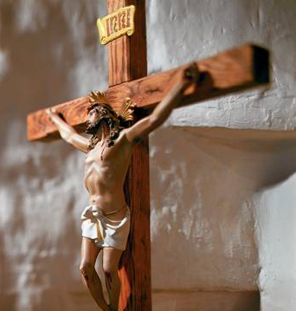
Are You Thankful?
Those who live by the sea can’t hear the music of the ocean, those
who live in the snow covered mountains of the Rockies cannot see the grandeur… Those who become so
familiar with the cross are sometimes unaffected by its surpassing grace….

Slide 10
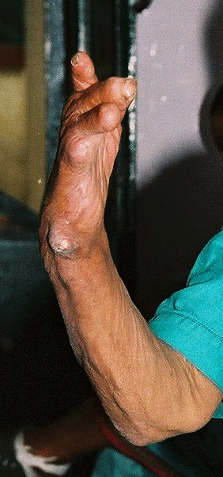
Leprosy And Sin…
The physical disease is like the spiritual malady.
Loss of sensitivity (1 Tim. 4:2)
Uncleanness (Eph. 5:1-7)
Contagious danger to others (1 Cor. 15:33)
Separation (Isa. 59:1,2)
Decay (James 1:14-16)
Death (Rom. 6:23; Eph. 2:1-3)

Slide 11
Sources
Truth Commentary on Luke by C.G. Caldwell
A life of gratitude by Shawn Bain
Where are the nine – Presentation clip art graphics by unknown source

