Slide 2
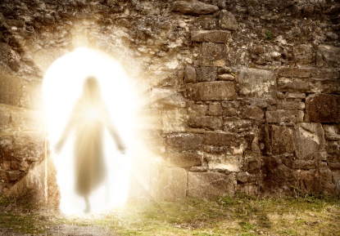
The Resurrection Of Jesus Was More Than A Historical Event…
concerning His Son Jesus Christ our Lord, who was born of the seed of David according to the flesh, and declared to be the Son of God with power according to the Spirit of holiness, by the resurrection from the dead. (Romans 1:3-4 NKJV)

Slide 3
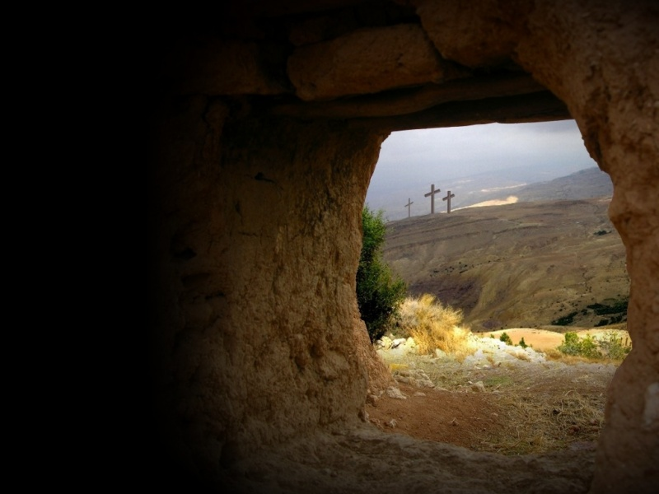
Responding To The Resurrection…
We respond by being crucified with Jesus. (Romans 6:6; Col. 2:13,14; Gal. 2:20)
We respond by considering ourselves dead to sin. (Romans 6:11; 1 Pet. 4:3; Col. 3:1-8)
We respond by presenting our members to righteousness. (Romans 6:13, 23; Col. 3:9-17; Eph. 4:20 – 5:5

Slide 4
The Victory Over Sin Is A Growth Process…
But also for this very reason, giving all diligence, add to your faith virtue, to virtue knowledge, to knowledge self-control, to self-control perseverance, to perseverance godliness, to godliness brotherly kindness, and to brotherly kindness love. For if these things are yours and abound, you will be neither barren nor unfruitful in the knowledge of our Lord Jesus Christ. (2 Peter 1:5-8 NKJV)

Slide 5
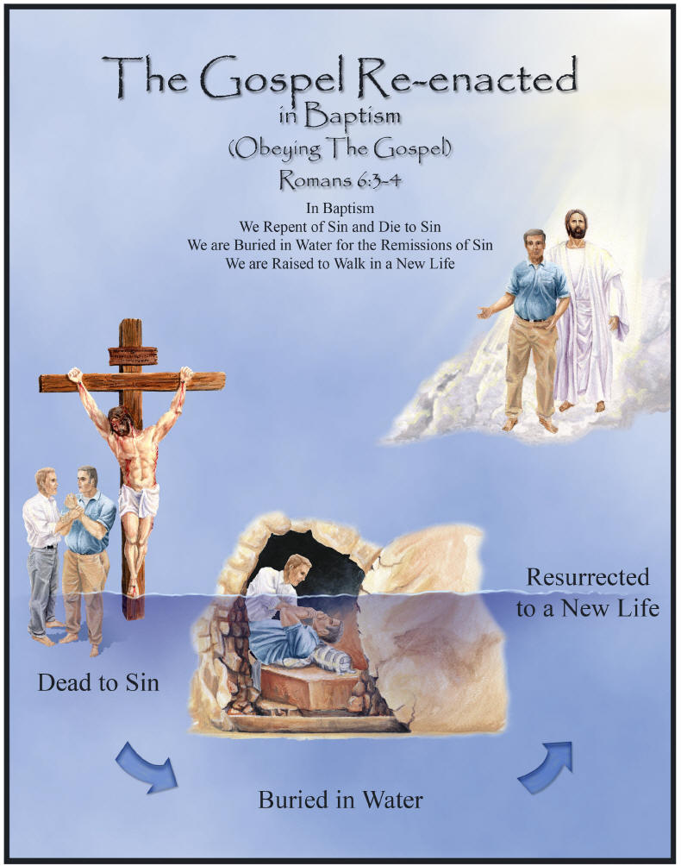
When Do We Start Being Crucified With Christ And Die To Sin?
What shall we say then? Shall we continue in sin that grace may abound? Certainly not! How shall we who died to sin live any longer in it? Or do you not know that as many of us as were baptized into Christ Jesus were baptized into His death? Therefore we were buried with Him through baptism into death, that just as Christ was raised from the dead by the glory of the Father, even so we also should walk in newness of life. For if we have been united together in the likeness of His death, certainly we also shall be in the likeness of His resurrection, (Romans 6:1-5 NKJV)

Slide 6
Sources
Outline by Edwin Crozier – Franklin Church of Christ – 4/16/06

