Slide 2
Table Of Contents
Song of Solomon
Isaiah
Jeremiah
Lamentations
Ezekiel
Daniel
Hosea
Joel
Amos
Obadiah
Jonah
Micah
Nahum
Habakkuk
Zephaniah
Haggai
Zechariah
Malachi
Genesis
Exodus
Leviticus
Numbers
Deuteronomy
Joshua
Judges
Ruth
1 & 2 Samuel
1 & 2 Kings
1 & 2 Chronicles
Ezra
Nehemiah
Esther
Job
Psalms
Proverbs
Ecclesiastes
The book of Esther is listed among the 12 books of history.
It has 10 chapters.

Slide 3
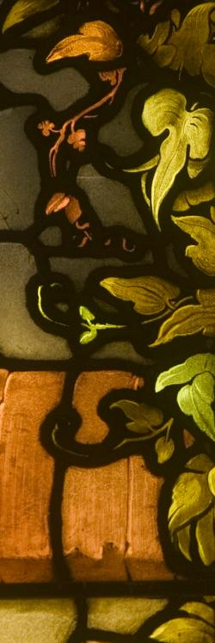
HISTORICAL BACKGROUND

Slide 4
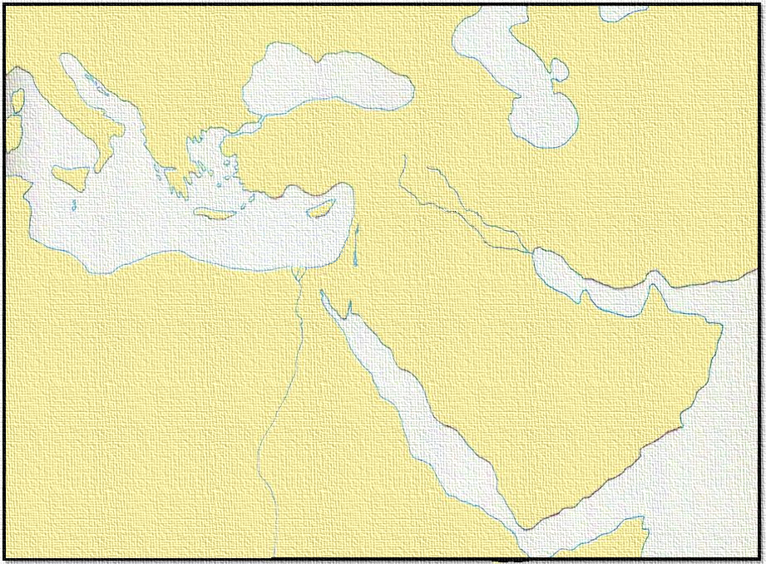
Because of the sins of the people the Northern Kingdom of Israel was taken into captivity by Assyria . . .
Assyrian Empire

Slide 5
Babylon Empire
Then Babylon conquered Assyria and took the Southern Kingdom of Judah into captivity.

Slide 6
Persian Empire
ASIA MINOR
MESOPOTAMIA
CANAAN
At the end
of 70 years
Babylon was captured by Persia. The first Persian King was Cyrus.
EGYPT
ARABIA

Slide 7
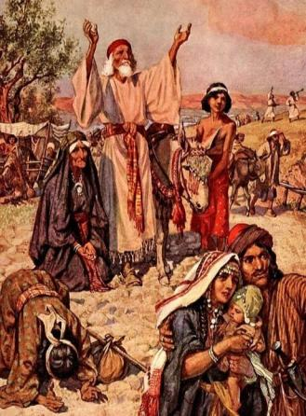
After 70 Years Of Exile
They Returned To Canaan
Three Returns From Captivity
The 1st lead by
Zerubbabel with: 42,360 Jews, 7,337 servants, 200 singers, 736 horses, 245 mules, 435 camels, 6,720 asses, 5,400 gold and silver vessels.
The 2nd lead by
Ezra with: 1,754 men, 100 talents, 750 talents of silver.
The 3rd lead by
Nehemiah: Army escorts supplied by Artaxerxes I. Nehemiah rebuilt and fortified Jerusalem.
The Jews began a journey of more than 700 miles across the desert from Babylon to Jerusalem.
Not just people from the tribe of Judah but from other tribes as well. The term “all Israel” is used of those who returned.

Slide 8
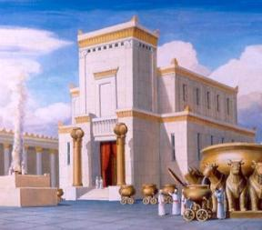
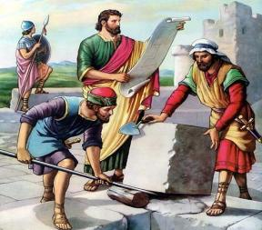
Two Periods After
The Return
1st period:
Zerubbabel—Governor
Joshua—Priest
The temple was rebuilt (Ezra 3-6)
Haggai and Zechariah—Prophets
Lasted about 20 years
Esther
2nd Period:
Nehemiah—Governor
Ezra—Priest
Rebuilt the wall; Jerusalem restored
Malachi—Prophet
Lasted about 25 years
Ezra
gives an account of both periods.
Nehemiah
tells of the 2nd period.
Esther
comes in between the two periods.
Esther appeared on the scene about 40 years after the temple was rebuilt and about 30 years before the wall of Jerusalem was rebuilt.

Slide 9
Persian Empire
ASIA MINOR
MESOPOTAMIA
Shushan
CANAAN
EGYPT
ARABIA
Esther lived in Mesopotamia near Shushan, the Palace of the Persian Kings. At this time, the Persian Empire covered more than half the known world.

Slide 10
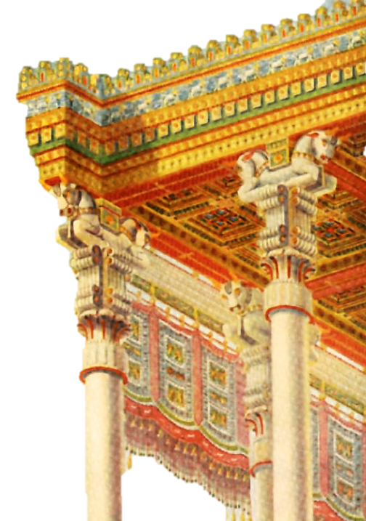
THE BOOK OF ESTHER

Slide 11
GREECE
Persian Empire
ASIA MINOR
MESOPOTAMIA
Shushan
CANAAN
EGYPT
ARABIA
King Ahasuerus wanted to enlarge his kingdom by conquering Greece.

Slide 12
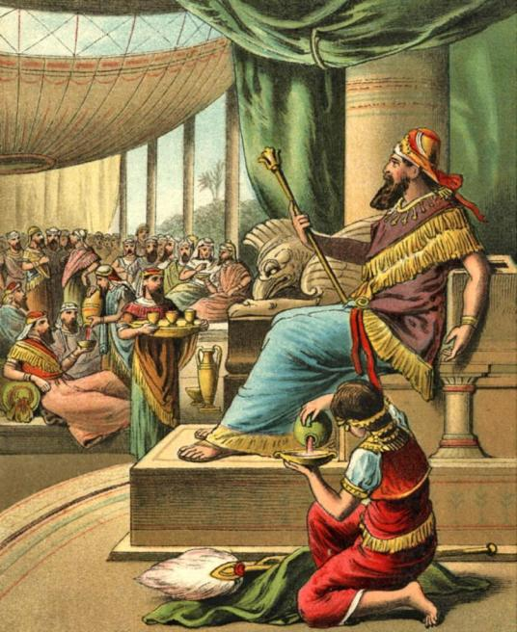
CHAPTER 1
He made a great feast for his princes and servants to show his power before his attempt on Greece. In the midst of their drunken revelry he called for his queen, Vashti, to come in so he could show off her beauty.

Slide 13
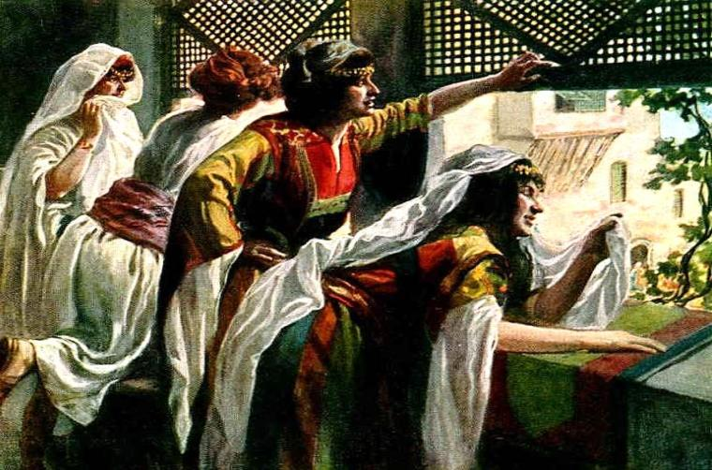
Drunkenness caused the king to violate one of the most sacred rules of Oriental etiquette, the seclusion of the harem.

Slide 14
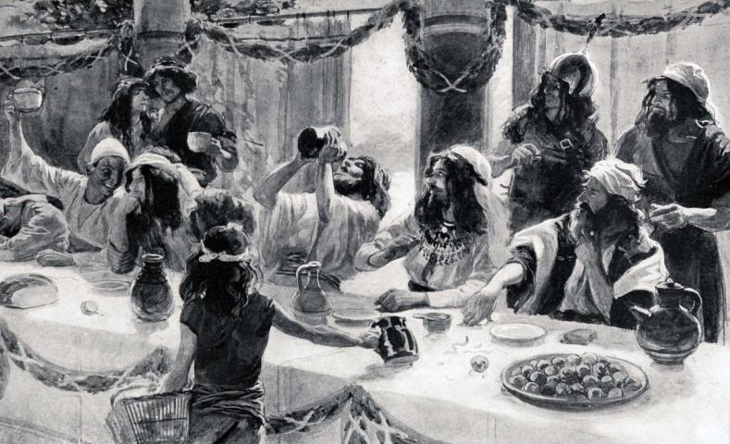
It was an outrage for the queen to be used for the amusement of a group of drunken revelers.
Vashti refused.

Slide 15
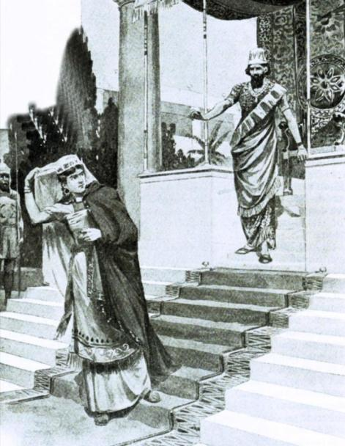
This made the king a laughing stock. To defend himself he removed her as the queen.

Slide 16
GREECE
Persian Empire
ASIA MINOR
MESOPOTAMIA
Shushan
CANAAN
EGYPT
ARABIA
Between chapters 1 and 2, Ahasuerus made his historic attack on Greece and suffered a terrible defeat. He returned home.

Slide 17
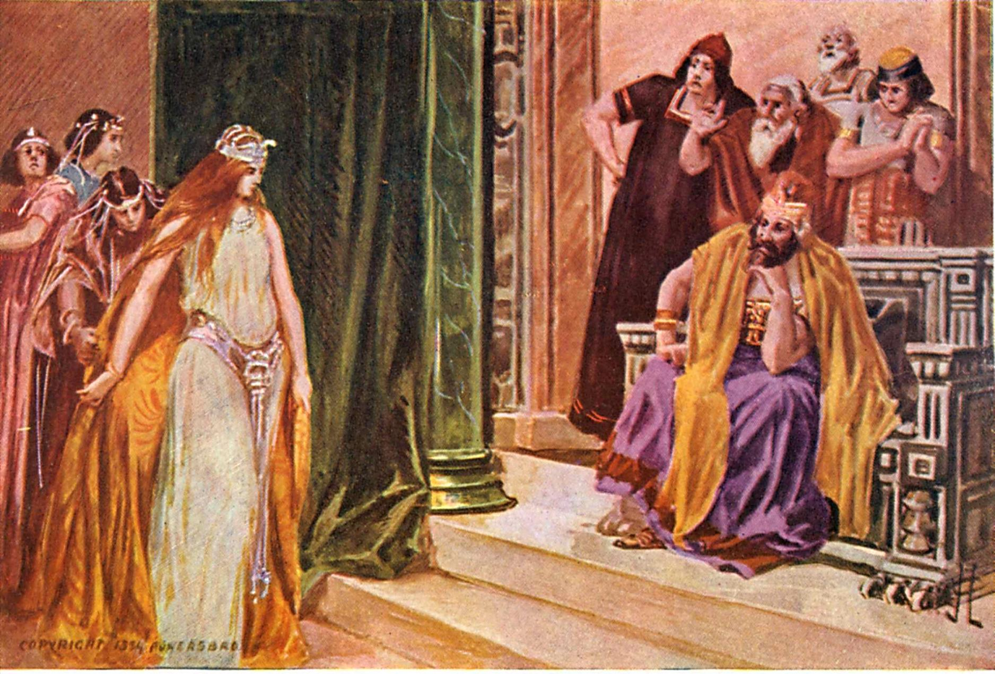
After his return he sent forth a decree to search for another wife to replace Vashti. Young women were brought to the palace for the king to choose from.

Slide 18
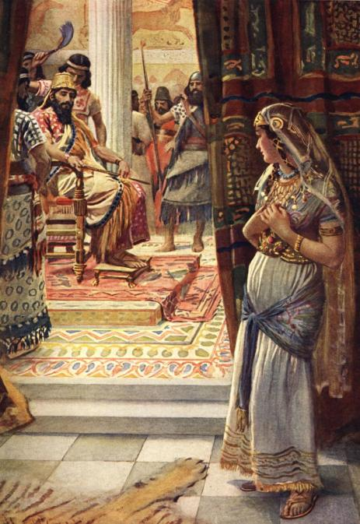
CHAPTER 2
As soon as he saw Esther, he made her his queen.

Slide 19
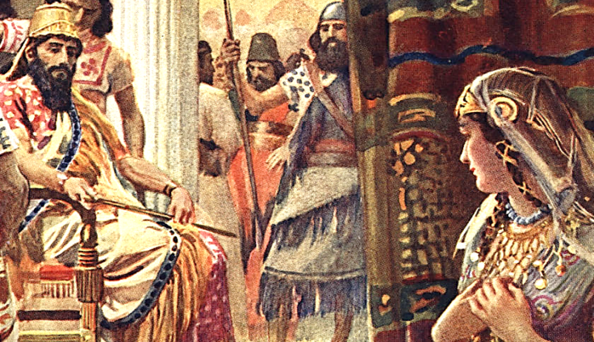
Esther 2:17
“And the king loved Esther above all the women, and she obtained grace and favor in his sight more than all the virgins; so that he set the royal crown upon her head, and made her queen instead of Vashti”

Slide 20
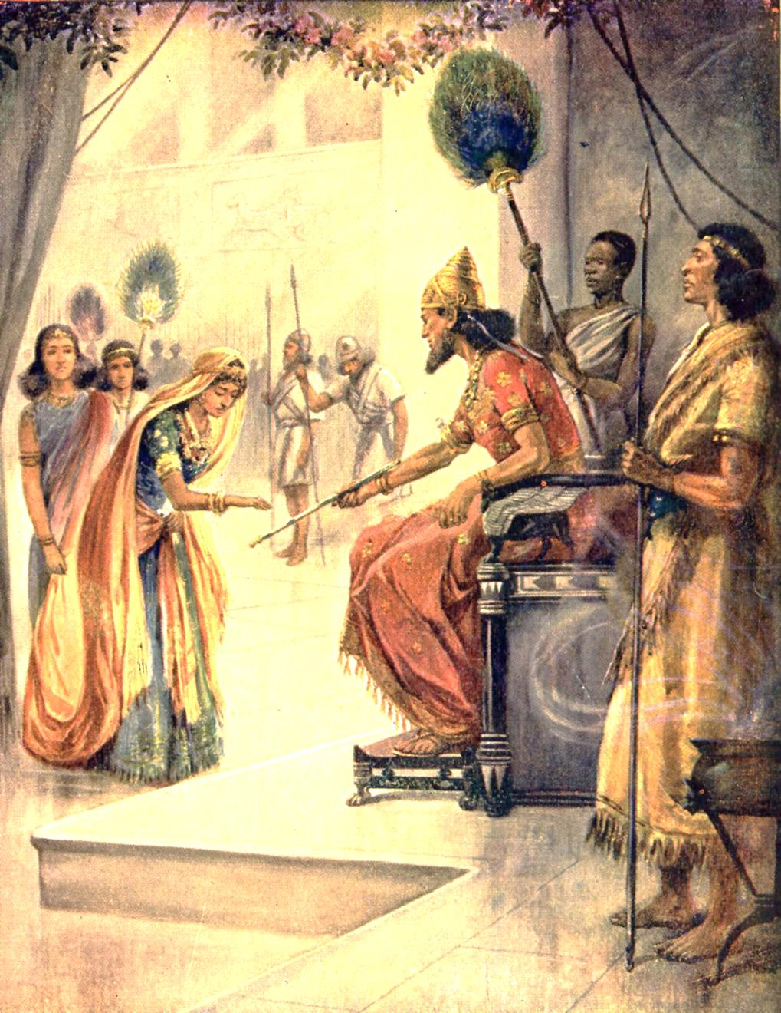
The little Jewish orphan girl, brought up by her cousin, Mordecai, was lifted to the Persian throne.

Slide 21
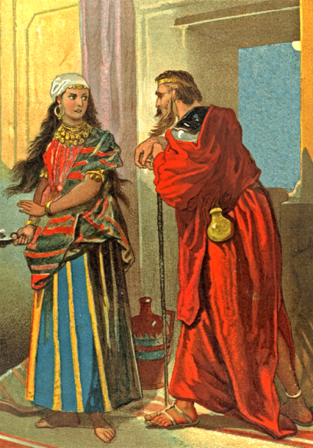
Mordecai, Esther’s cousin, was a leader of the people of Judah that were in Shushan, the Persian capital.
Mordecai told Esther to keep it a secret that she was a Jew.

Slide 22
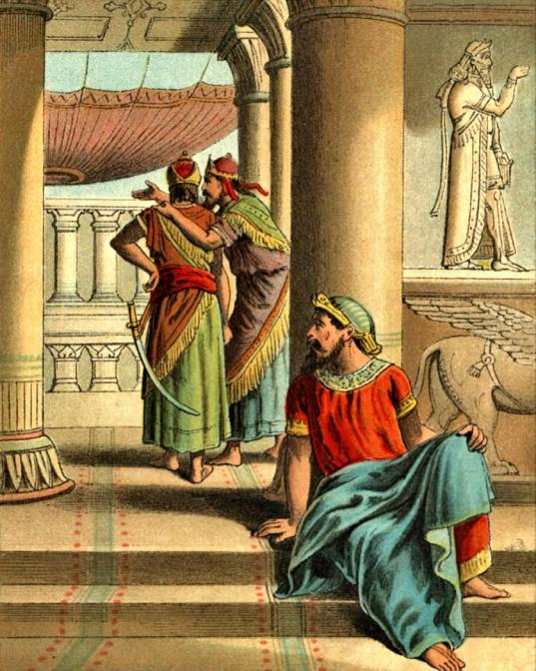
Esther 2
“²¹In those days, while Mordecai sat in the king’s gate, two of the king’s chamberlains, Bigthan and Teresh, of those which kept the door, were wroth, and sought to lay hand on the king Ahasuerus.”

Slide 23
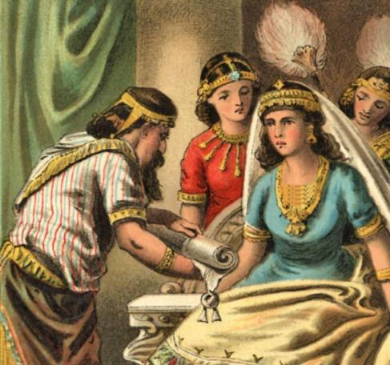
Esther 2
“²²And the thing was known to Mordecai, who told it unto Esther the queen; and Esther certified the king thereof in Mordecai’s name. ²³And when inquisition was made of the matter, it was found out; therefore they were both hanged on a tree: and it was written in the book of the chronicles before the king.”

Slide 24
THE PLOT OF HAMAN

Slide 25
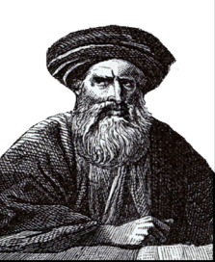
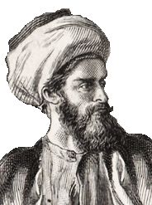
Esther 3:2
“And all the king’s servants, that were in the king’s gate, bowed, and reverenced Haman: for the king had so commanded concerning him. But Mordecai bowed not, nor did him reverence.”
Mordecai
Esther’s Cousin
Wicked Haman

Slide 26
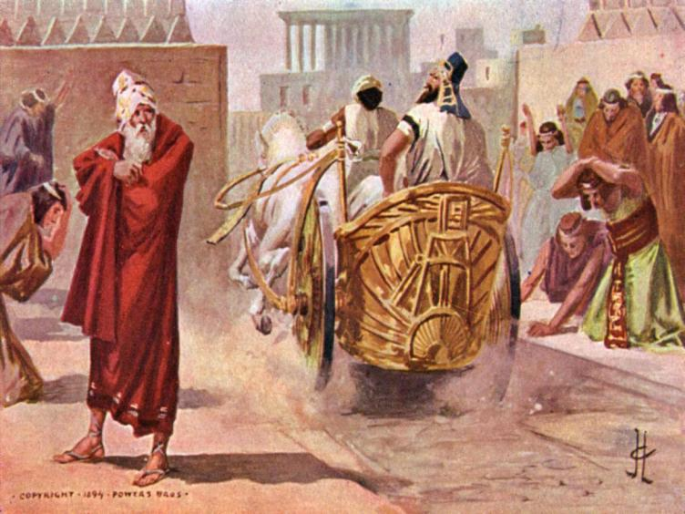
Esther 3:5
“And when Haman saw that Mordecai bowed not, nor did him reverence, then was Haman full of wrath.”

Slide 27
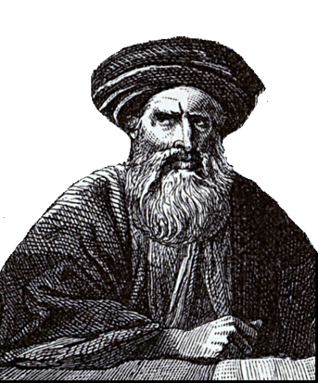
Haman wanted to punish Mordecai, but how could he do anything to the man that had saved the life of the king?
The answer came to him when he found out that Mordecai was a Jew.
Wicked Haman

Slide 28
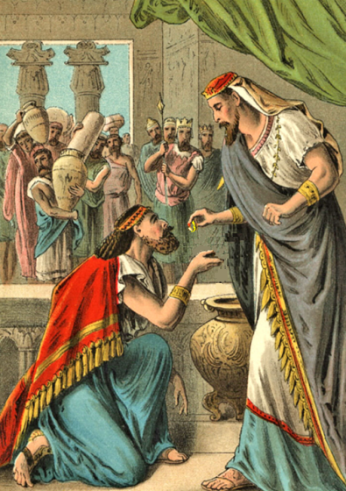
Esther 3
“⁸And Haman said unto king Ahasuerus, There is a certain people scattered abroad and dispersed among the people in all the provinces of thy kingdom; and their laws are diverse from all people; neither keep they the king’s laws: therefore it is not for the king’s profit to suffer them.”
Haman made a false and malicious representation of the Jews. He described them as if they were fugitives, vagabonds and lawless. He made the king believe that the Jews were dangerous.

Slide 29
The king took his ring from his hand and gave it unto Haman the Jews' enemy.
Haman was to use the kings ring to seal the document that Haman would deliver through out the land.
The document said that all the Jews in the land were to be massacred.
Haman even offered to pay the king ten thousand talents of silver to replace the revenue of losing so many citizens.
Esther 3
“⁹If it please the king, let it be written that they may be destroyed: and I will pay ten thousand talents of silver to the hands of those that have the charge of the business, to bring it into the king’s treasuries.”

Slide 30
From the Palace at Shushan—
On the 13th day of the 12th month all Jews are to be killed.
Signed, King Ahasuerus

Slide 31
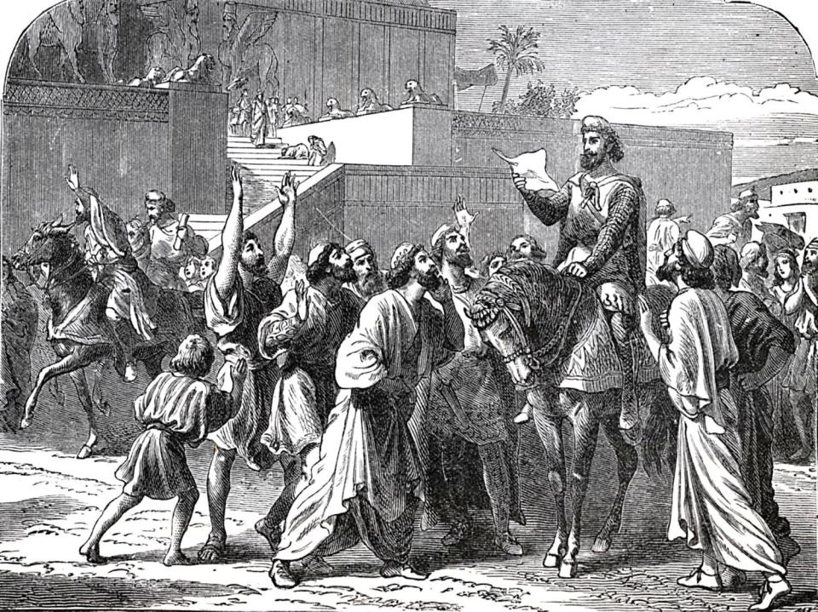
In every province where the king’s decree came the Jews rent their clothes, cried and fasted, and lay in sackcloth and ashes.

Slide 32
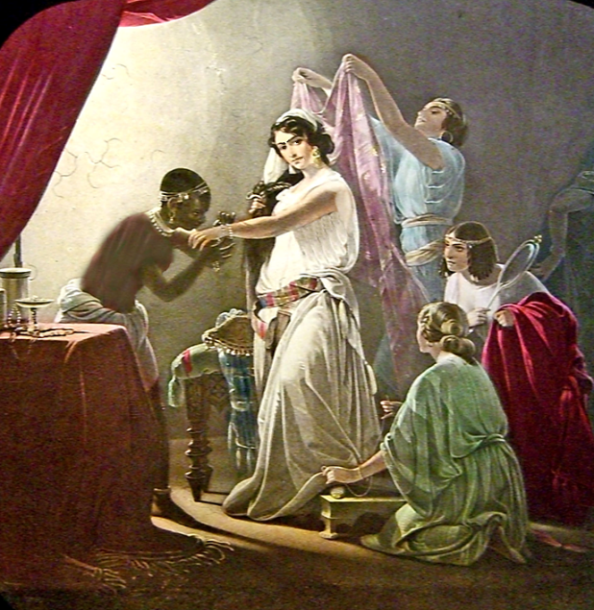
Esther 4
“⁴So Esther’s maids and her chamberlains came and told it her. Then was the queen exceedingly grieved; and she sent raiment to clothe Mordecai, and to take away his sackcloth from him: but he received it not.”

Slide 33
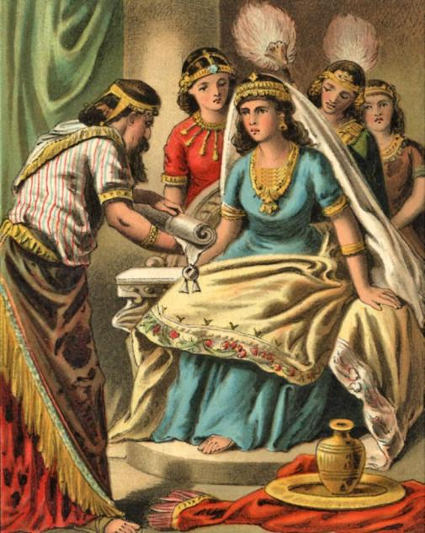
Esther 4
“⁶So Hatach went forth to Mordecai unto the street of the city, which was before the king’s gate.
⁷And Mordecai told him of all that had happened unto him, and of the sum of the money that Haman had promised to pay to the king’s treasuries for the Jews, to destroy them.”
Esther 4
“⁵Then called Esther for Hatach, one of the king’s chamberlains, whom he had appointed to attend upon her, and gave him a commandment to Mordecai, to know what it was, and why it was.”

Slide 34
Mordecai gave Esther’s servant a copy of the decree and told him to take it to the queen, and ask her to go to the king and plead with him to spare the Jews.

Slide 35
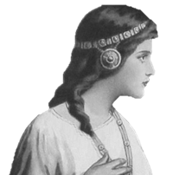
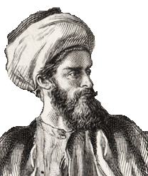
Esther
Queen of Persia
Mordecai
Esther’s Cousin
Esther had been queen for about 5 years, yet she still had to request permission to appear before the king. She had her servant go tell her cousin Mordecai that she could be put to death if she went into the king’s court.

Slide 36
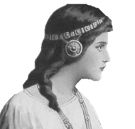
“All the king’s servants, and the people of the king’s provinces, do know, that whosoever, whether man or woman, shall
come unto the king into the inner court, who is not called, there is one law of his to put him to death, except such to whom the king shall hold out the golden sceptre, that he may live: but I have not been called to come in unto the king these thirty days” (Esther 4:11).

Slide 37
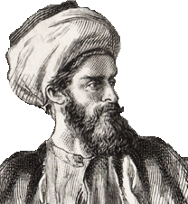
“For if thou altogether holdest thy peace at this time, then shall there enlargement and deliverance arise to the Jews
from another place; but thou and thy father’s house shall be destroyed: and who knoweth whether thou art come to the kingdom for such a time as this?” (Esther 4:14).
This Is The Key Verse In The Whole book!

Slide 38
“Go, gather together all the Jews that are present in Shushan, and fast ye for me, and neither eat nor drink three
days, night or day: I also and my maidens will fast likewise; and so will I go in unto the king, which is not according to the law: and if I perish, I perish” (Esther 4:16).
She did not say this in despair but in a holy resolution to do her duty with faith and trust in God.

Slide 39
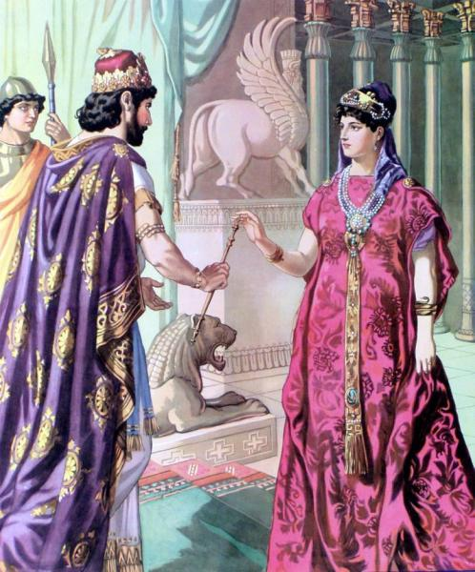
Esther 5
“²And it was so, when the king saw Esther the queen standing in the court, that she obtained favour in his sight: and the king held out to Esther the golden sceptre that was in his hand. So Esther drew near, and touched the top of the sceptre.”
Esther told the king she had prepared a feast and wanted both him and Haman to come.
The king agreed.

Slide 40
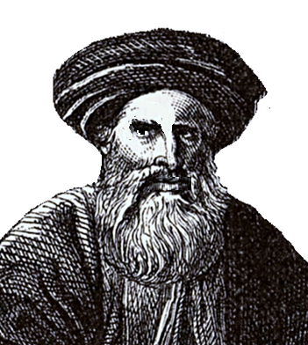
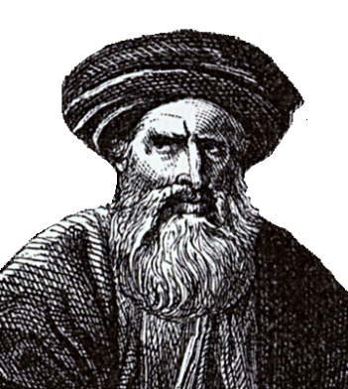
Esther 5
“¹⁴Then said Zeresh his wife and all his friends unto him,
Let a gallows be made of fifty cubits high, and to morrow speak thou unto the king that Mordecai may be hanged thereon: then go thou in merrily with the king unto the banquet. And the thing pleased Haman; and he caused the gallows to be made.”
But, when he passed by Mordecai at the gate and Mordecai did not bow to him he was furious.
Then Haman’s wife and friends gave him advice—
Haman was thrilled to be invited to a banquet that the queen had prepared.
Wicked Haman

Slide 41
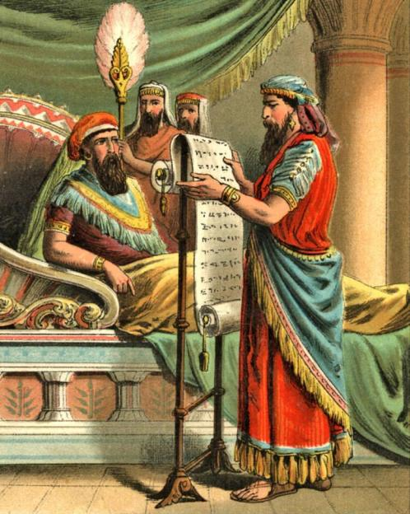
That night the king had trouble sleeping and had his servant read his book of records to him.
It reminded him of the good deed Mordecai had done when he warned him of a threat on his life. He decided to reward Mordecai.

Slide 42
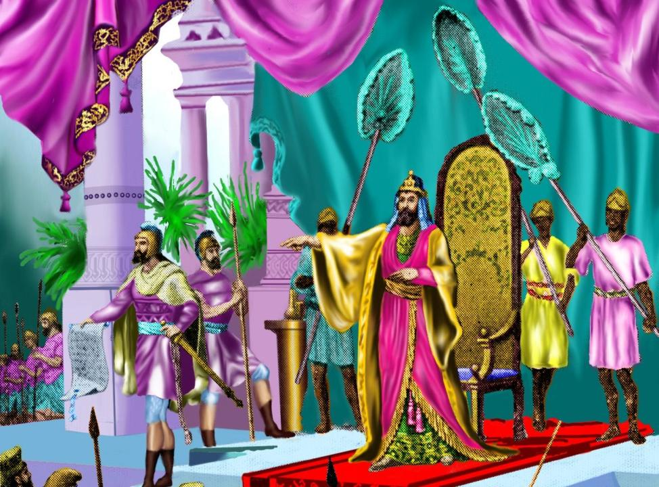
The next day Haman was admitted to the king with the plan to ask to hang Mordecai but, before he could speak the king asked him—
“What shall be done unto the man whom the king delighteth to honour?” (Esther 6:6).

Slide 43
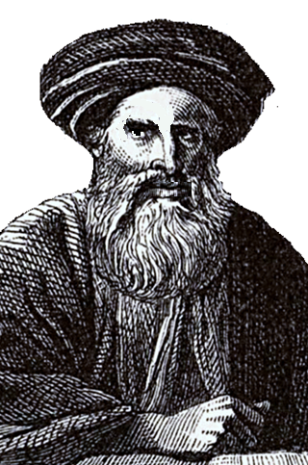
Haman was so vain that he assumed the king spoke of him so, he suggested —
Give him royal apparel
The kings horse
A royal crown
Bring him on horseback through the street of the city, and proclaim before him—
“Thus shall it be done to the man whom the king delighteth to honour. “
Wicked Haman

Slide 44
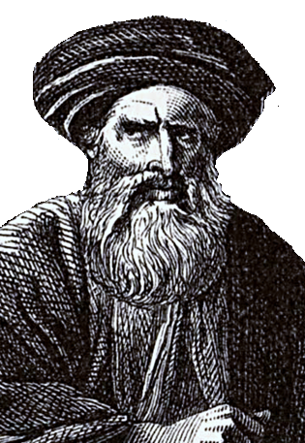
You can imagine how shocked and angry Haman felt when the king told him to do all those things for Mordecai the Jew!
Wicked Haman

Slide 45
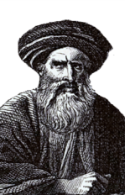
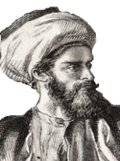
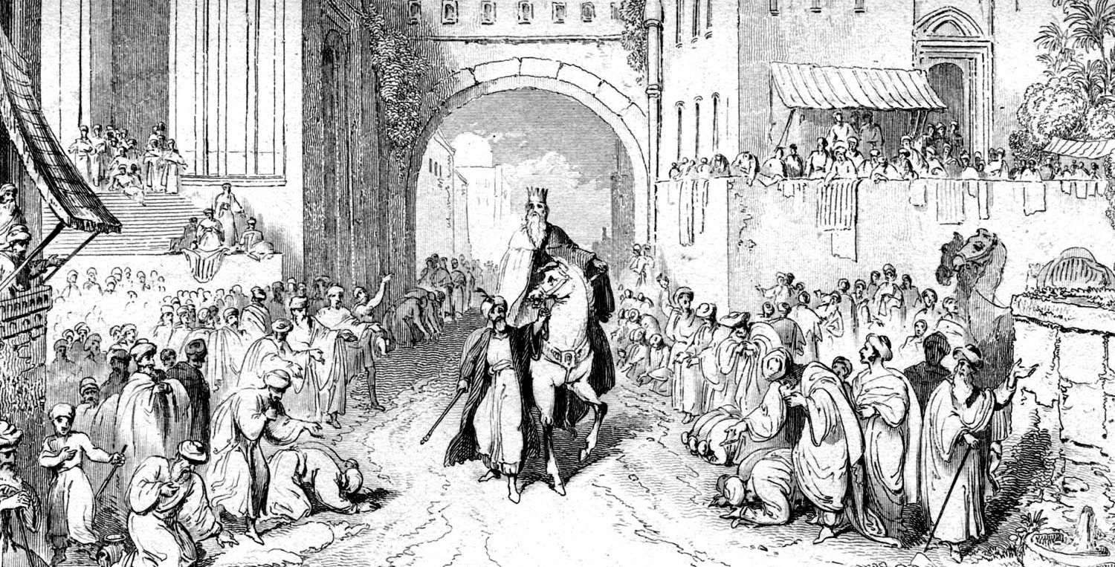
Mordecai was not puffed up with his advancement. He simply went back to his place and duty at the king’s gate and minded his business.
Haman took the gifts to Mordecai and lead his horse through the city saying that the king was honoring Mordecai.
Wicked Haman
Mordecai
Esther’s Cousin

Slide 46
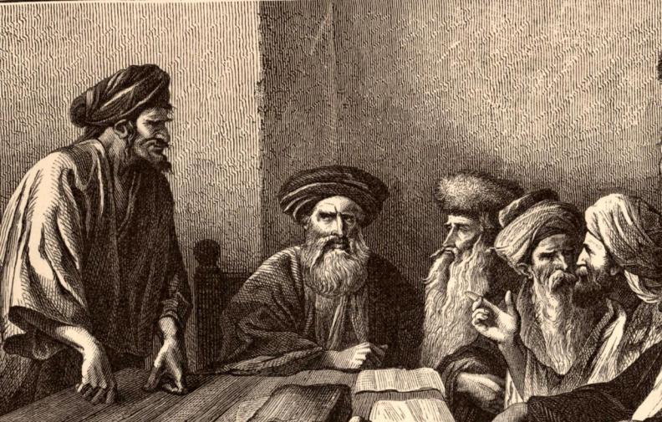
Haman was cast down with disappointment and humiliation. His pride was wounded by the very man that he had intended to hang.
His doom was pointed out to him by his wife and friends when they told him that his actions against the Jews would cause him to fall and to lose his position and influence.
While he was talking to his wife and friends in came the king’s chamberlain to take him to Queen Esther’s banquet!

Slide 47
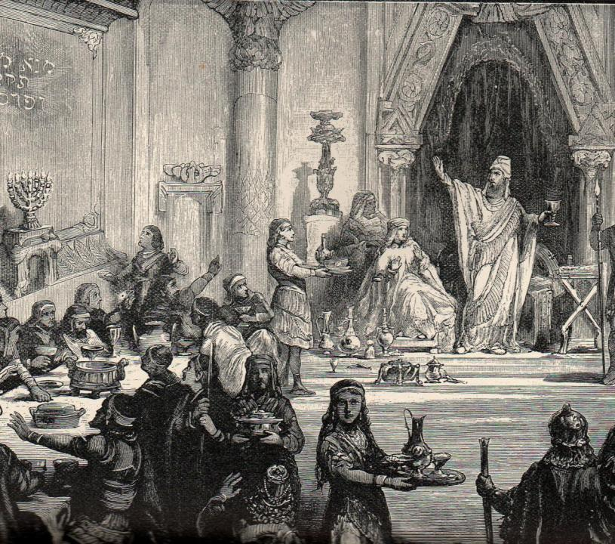
Esther 7:2
“And the king said again unto Esther on the second day at the banquet of wine,
What is thy petition, queen Esther? and it shall be granted thee: and what is thy request? and it shall be performed, even to the half of the kingdom.”

Slide 48
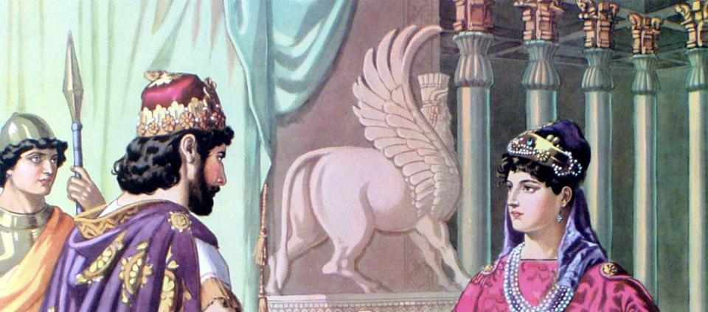
Esther 7
^{“3}Then Esther the queen answered and said, If I have found favour in thy sight, O king, and if it please the king, let my life be given me at my petition, and my people at my request: ⁴For we are sold, I and my people, to be destroyed, to be slain, and to perish.”
Esther 7
“⁵Then the king Ahasuerus answered and said unto Esther the queen, Who is he, and where is he, that durst presume in his heart to do so?”

Slide 49
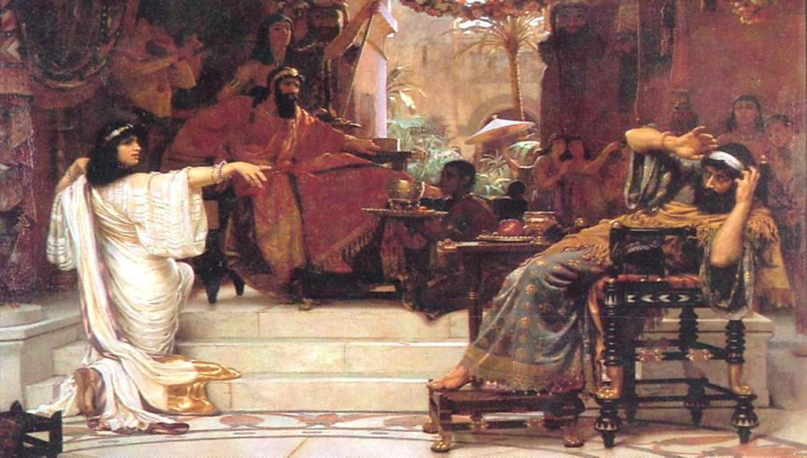
Esther 6:7
“And Esther said, The adversary and enemy is this wicked Haman.”
King Ahasuerus was so angry that he left the room and went into the palace garden. While he was gone Haman went over to the queen where she lay to plead to her for his life and . . .

Slide 50
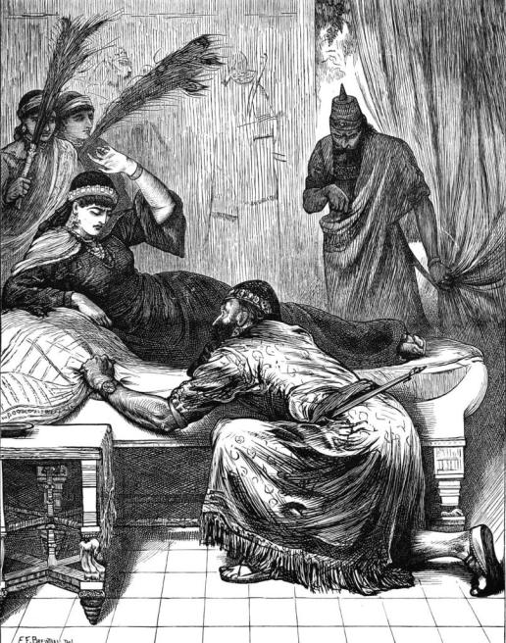
Haman had fell across the queen’s bed pleading with her when the king came back in the room!

Slide 51
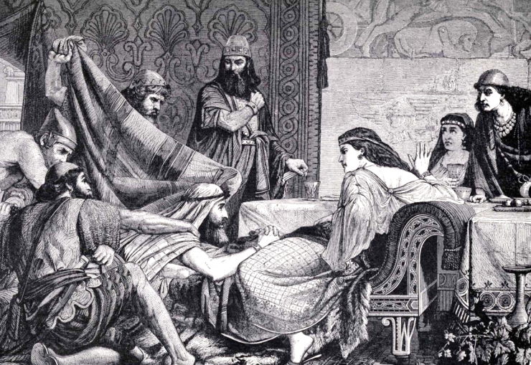
When they saw the anger of the king the servants covered the face of Haman and suggested he be hung from his own gallows which he had built to hang Mordecai.

Slide 52
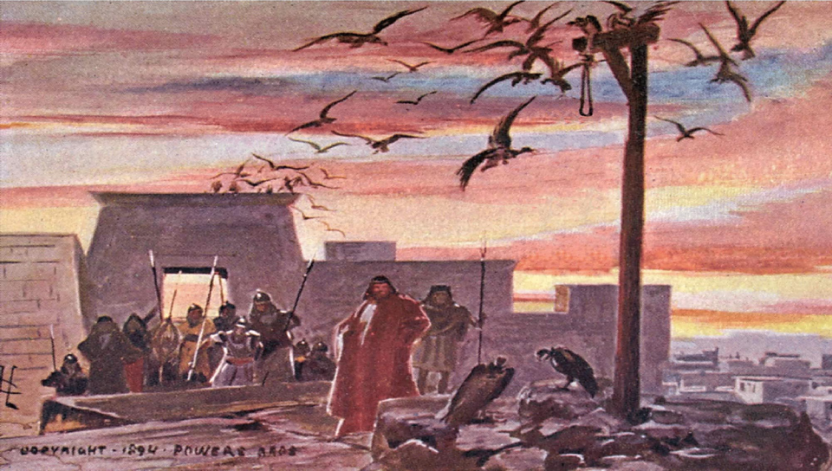
Esther 7:10
“So they hanged Haman on the gallows that he had prepared for Mordecai. Then was the king’s wrath pacified.”

Slide 53
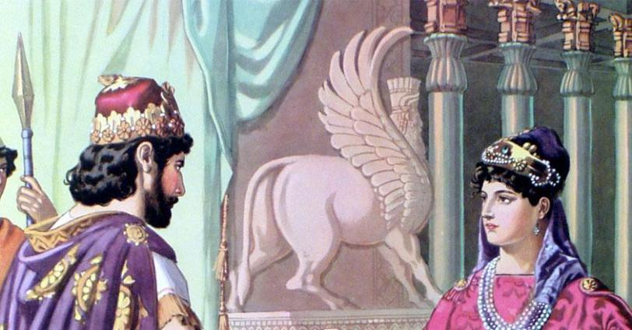
The king gave Esther the house of Haman and she put her cousin, Mordecai over the house. When Esther told King Ahasuerus that Mordecai was her cousin he took the ring that he had given Haman and gave it to Mordecai.

Slide 54
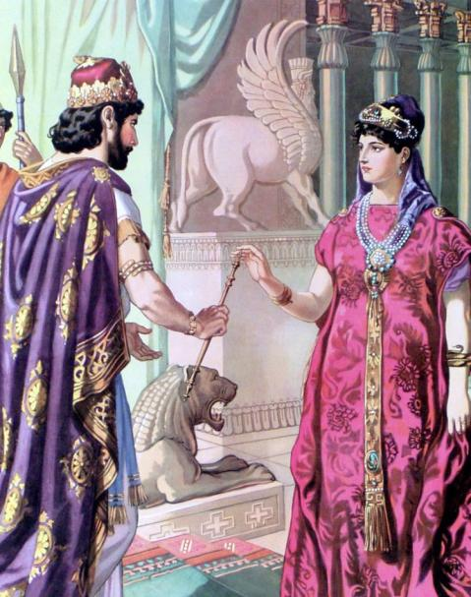
Esther bravely came a second time uncalled into the king’s presence and was allowed to present her petition by the king’s holding out the golden sceptre to her.

Slide 55
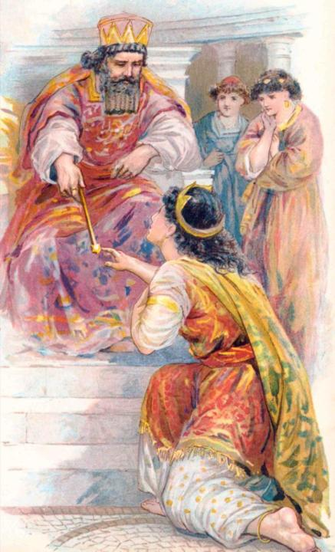
Esther fell down at the feet of the king and in tears pleaded that he change the decree Haman had made against the Jews.
From the Palace at Shushan—
On the 13th day of the 12th month all Jews are to be killed.
Signed, King Ahasuerus

Slide 56
But there was a law of the Medes and the Persians that when the king made a law it was never to be changed.
The king could not reverse the law, but he could defeat it! He wrote another law that gave the Jews the right to defend themselves.

Slide 57
From the Palace at Shushan—
On the13th day of the 12th month
The king grants the Jews permission to gather themselves together, and to stand for their life, to destroy, to slay, and to cause to perish, anyone that would assault them, and to take the spoil of them for a prey.
Signed, King Ahasuerus

Slide 58
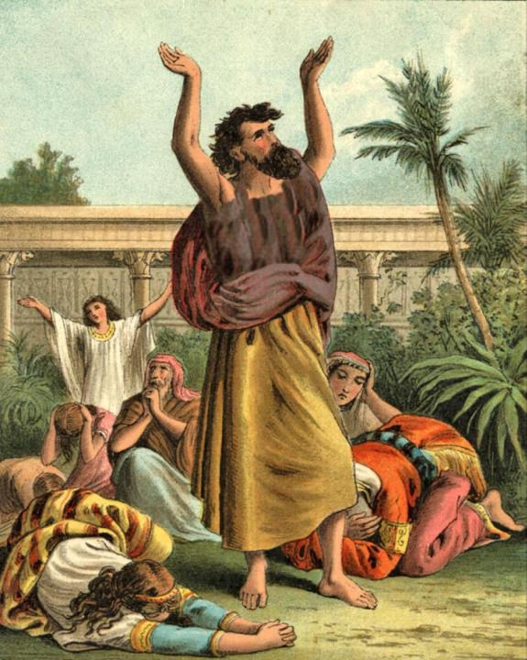
Esther 8:17
“And in every province, and in every city, whithersoever the king’s commandment and his decree came, the Jews had joy and gladness, a feast and a good day. And many of the people of the land became Jews; for the fear of the Jews fell upon them.”

Slide 59
On the 13th day of the 12th month the Jews were ready, and everyone was afraid of them. The rulers and officers of the king helped the Jews, because Mordecai was a powerful man and had influence with the king—
Esther 9
“⁵Thus the Jews smote all their enemies with the stroke of the sword, and slaughter, and destruction, and did what they would unto those that hated them. ⁶And in Shushan the palace the Jews slew and destroyed five hundred men.”

Slide 60
Esther 9
“¹⁵For the Jews that were in Shushan gathered themselves together on the fourteenth day also of the month Adar, and slew three hundred men at Shushan; but on the prey they laid not their hand. ¹⁶But the other Jews that were in the king’s provinces gathered themselves together, and stood for their lives, and had rest from their enemies, and slew of their foes seventy and five thousand, but they laid not their hands on the prey.”

Slide 61
Esther 9:28
“. . . these days should be remembered and kept throughout every generation, every family, every province, and every city; and that these days of Purim should not fail from among the Jews, nor the memorial of them perish from their seed.”
Esther 9
“¹⁸But the Jews that were at Shushan assembled together on the thirteenth day thereof; and on the fourteenth thereof; and on the fifteenth day of the same they rested, and made it a day of feasting and gladness,”
Purim—
From Pur, a Persian word which signifies a lot, because Haman had by lot determined this to be the time of the Jews’ destruction, but the Lord, at whose disposal the lot is, had determined it to be the time of their triumph.

Slide 62
Esther was queen for 13 years. It is thought that she lived far into the reign of her stepson, Artaxerxes.

Slide 63
Esther & Mordecai Servants of God
God does work behind the scenes to provide for His people.
Matthew 6:25-34, 28:18-20
1 Peter 5:6-7
Psalm 34:15
Although there may always be someone else to pick-up and do it, we are expected to do our part.
Esther 4:13-14
Ephesians 4:15-16

Slide 64
THE BIBLE VISUALIZED
Produced By Ethical Media
Executive Producer
Gary McDade
Graphics
Sheila McDade
Research
Jason McDade
SOURCES
ULTIMATE PICTURE COLLECTION
DEHOFF’S BIBLE HANDBOOK
MATTHEW HENRY’S COMMENTARY
THE NEW COMPACT BIBLE DICTIONARY
Copyright 2013
Slides taken from The Visualized Bible.

