Slide 2
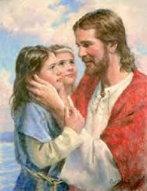
Jesus Loves The Little Children
Mark 10:13-16
Matthew 19:13-15
Luke 18:15-17

Slide 3
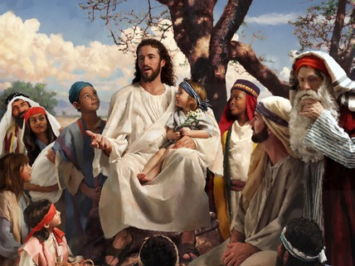
Jesus Loves The Little Children…
Someone Brought These Children To Jesus – Vs. 13
The Failure Of The Disciples – Vs. 13
Jesus Rebukes His Disciples – Vs. 14
Jesus’ Explanation – Vs. 15
Jesus’ Love For Children – Vs. 16
But when Jesus saw it he was indignant, and said to them, "Let the children come to me, do not hinder them; for to such belongs the kingdom of God. (Mark 10:14 RSV)

Slide 4
Earlier Teaching From Jesus…
At that time the disciples came to Jesus, saying, "Who is the greatest in the kingdom of heaven?" And calling to him a child, he put him in the midst of them, and said, "Truly, I say to you, unless you turn and become like children, you will never enter the kingdom of heaven. Whoever humbles himself like this child, he is the greatest in the kingdom of heaven. "Whoever receives one such child in my name receives me; but whoever causes one of these little ones who believe in me to sin, it would be better for him to have a great millstone fastened round his neck and to be drowned in the depth of the sea. (Matthew 18:1-6 RSV)

Slide 5
Jesus Loves The Little Children…
Children are important to God!
Parents have an obligation and privilege to bring their children to the Savior!
We must not discourage the children but learn from them!
Qualities of Children:
Simple
Loving
Humble
Teachable
Trustful
Obedient
God’s kingdom is composed of childlike natures. The proud, self-sufficient, and self-confident are out of harmony with those who recognize a Divine Head and is governed by Divine laws.

Slide 6
Sources
Outline by Steve Higginbotham
The Pulpit Commentary on Mark – Spence and Exell –
Sermons from the Gospel of Mark by Mark A. Copeland

