Slide 2
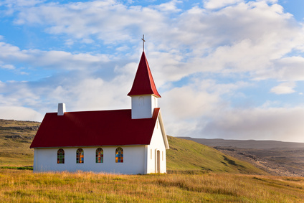
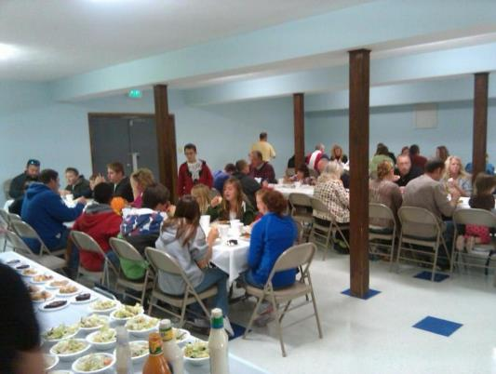
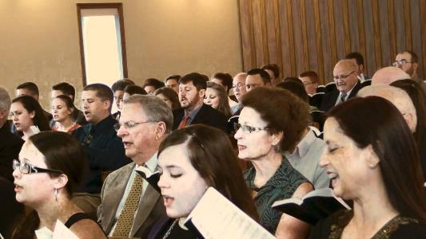
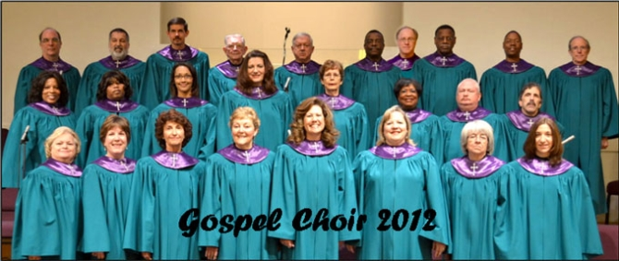
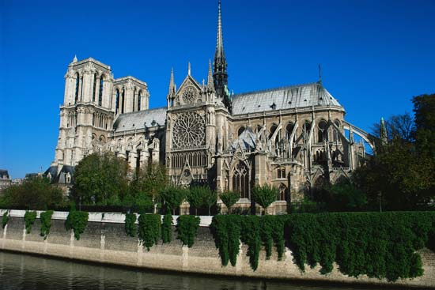
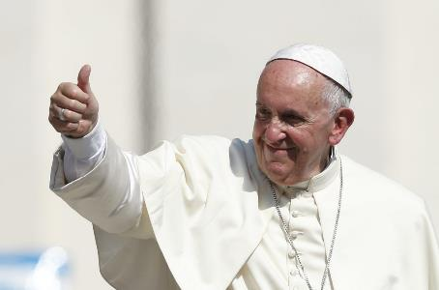
What do you think of when we use the term “church”?
Most people probably think of the building or physical structure.
Others have moved past this to think of the people who assemble together.

Slide 3
What should be our concept of the church?
What should our minds be drawn to when we think of the church?
Who’s to say what is right or wrong?
Why can’t we have different viewpoints and visions?
The simple answer is that the Bible only speaks of one church.
“⁴There is one body and one Spirit—just as you were called to the one hope that belongs to your call— ⁵one Lord, one faith, one baptism, ⁶one God and Father of all, who is over all and through all and in all.”
- Ephesians 4:4-6, ESV

Slide 4
What should be our concept of the church?
What should our minds be drawn to when we think of the church?
Who’s to say what is right or wrong?
Why can’t we have different viewpoints and visions?
The simple answer is that the Bible only speaks of one church.
It is the one that was built by Jesus.
“And I tell you, you are Peter, and on this rock I will build my church, and the gates of hell shall not prevail against it.”
- Matthew 16:18, ESV

Slide 5
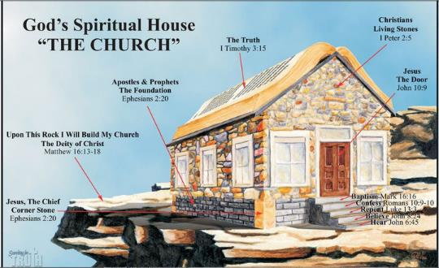
Why the church? What should we think about the church?
Church of Christ at Medina
July 2nd, 2017

Slide 6
The church: The eternal plan of God
The church has always been in the plan of God.
“Of this gospel I was made a minister according to the gift of God's grace, which was given me by the working of his power. ⁸ To me, though I am the very least of all the saints, this grace was given, to preach to the Gentiles the unsearchable riches of Christ, ⁹ and to bring to light for everyone what is the plan of the mystery hidden for ages in God who created all things, ¹⁰ so that through the church the manifold wisdom of God might now be made known to the rulers and authorities in the heavenly places. ¹¹ This was according to the eternal purpose that he has realized in Christ Jesus our Lord, ¹² in whom we have boldness and access with confidence through our faith in him. ¹³ So I ask you not to lose heart over what I am suffering for you, which is your glory.”
- Ephesians 3:7-13, ESV
This indicates the importance of the church – God planned it in eternity!

Slide 7
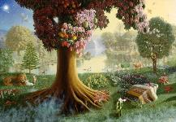
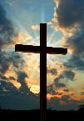
The church: The eternal plan of God
Mt. Sinai
The Church
The Cross
Garden of Eden
“Blessed be the God and Father of our Lord Jesus Christ, who has blessed us in Christ with every spiritual blessing in the heavenly places, ⁴ even as he chose us in him before the foundation of the world, that we should be holy and blameless before him. In love ⁵ he predestined us for adoption through Jesus Christ, according to the purpose of his will, ⁶ to the praise of his glorious grace, with which he has blessed us in the Beloved.” (Ephesians 1:3-6, ESV)

Slide 8
The church: The eternal plan of God
Mt. Sinai
The Church
The Cross
Garden of Eden
“…to preach to the Gentiles the unsearchable riches of Christ, ⁹ and to bring to light for everyone what is the plan of the mystery hidden for ages in God who created all things, ¹⁰ so that through the church the manifold wisdom of God might now be made known to the rulers and authorities in the heavenly places. ¹¹ This was according to the eternal purpose that he has realized in Christ Jesus our Lord…” (Ephesians 3:8a-11, ESV)

Slide 9
What is the church?
Simply put, the church is the called-out group of the saved.
The church is the body of Christ, and Christ is the Savior of the body. (Ephesians 5:23)
It is God’s Spiritual House!
Being a spiritual house, we have a spiritual purpose and mission!
“For the husband is the head of the wife even as Christ is the head of the church, his body, and is himself its Savior.”
- Ephesians 5:23, ESV
“As you come to him, a living stone rejected by men but in the sight of God chosen and precious, ⁵you yourselves like living stones are being built up as a spiritual house, to be a holy priesthood, to offer spiritual sacrifices acceptable to God through Jesus Christ.”
- 1 Peter 2:4-5, ESV

Slide 10
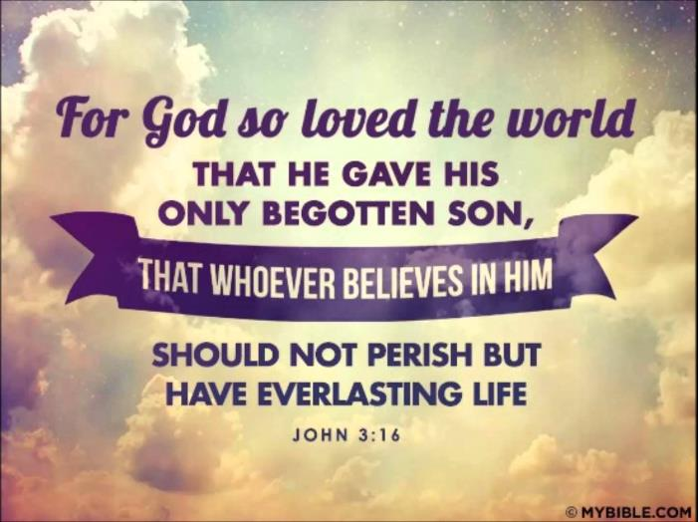
What is the Mission of the Church?
Glorify God
Worship
Worship is only given to one who is worthy or deserving of praise and service.

Slide 11
What is the Mission of the Church?
Glorify God
Worship
Worship is only given to one who is worthy or deserving of praise and service.
God desires our worship! (John 4:23)
His desire for worship is seen in the early actions of the church.
Acts 2:42 – “And they devoted themselves to the apostles teaching and the fellowship, to the breaking of bread and prayers.” (See also 2:46-47)
Acts 20:7, 1 Corinthians 16:2, Hebrews 10:24-25

Slide 12
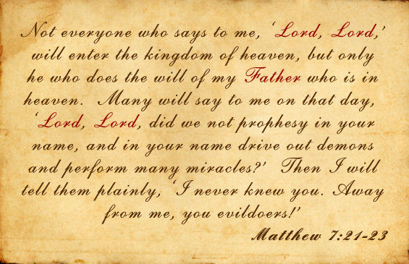
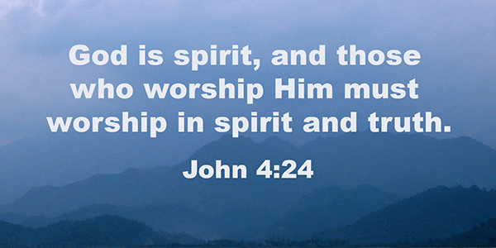
What is the Mission of the Church?
Glorify God
Worship
Worship is only given to one who is worthy or deserving of praise and service.
God desires our worship! (John 4:23)
What governs our worship? How is it to be done?

Slide 13
What is the Mission of the Church?
Glorify God
Worship
 | Authorized? |  |  | Authorized?
√ | Pray | Acts 2:42 |  | Instrumental Music? | No!
√ | Preach | Acts 20:7 |  | Concerts? | No!
√ | Give | 1 Cor. 16:1-2 |  | Plays? | No!
√ | Lord’s Supper | Acts 20:7 |  | Puppet Acts? | No!
√ | Sing | Col. 3:16 |  | Movies? | No!

Slide 14
What is the Mission of the Church?
“But God, being rich in mercy, because of the great love with which he loved us, ⁵even when we were dead in our trespasses, made us alive together with Christ — by grace you have been saved— ⁶and raised us up with him and seated us with him in the heavenly places in Christ Jesus, ⁷so that in the coming ages he might show the immeasurable riches of his grace in kindness toward us in Christ Jesus. ⁸For by grace you have been saved through faith. And this is not your own doing; it is the gift of God, ⁹not a result of works, so that no one may boast.”
- Ephesians 2:4-8, ESV
Glorify God
Worship
Evangelize
To Evangelize is to teach the good news of the gospel.
Mark 16:15-16
We glorify God when we tell others of His…
Love
Mercy
Grace
Sacrifice

Slide 15
What is the Mission of the Church?
Glorify God
Worship
Evangelize
Benevolent
This is being kind-hearted and well-meaning. It is caring for the needs of others.
It glorifies God because we are following the command of God. (Matthew 22:34-40)
Examples of Benevolence in the N.T. Church
Early Church in Jerusalem (Acts 2:44-45, 6:1-6)
Churches in Antioch, Macedonia and Achaia (Acts 11:27-30, Romans 15:24-26, 1 Corinthians 8-9)
What governs our benevolent activities? The same word of God that governs our worship and the gospel we preach.

Slide 16
What is the Mission of the Church?
Glorify God
Edify One Another
Edification is providing for the proper spiritual growth and maturity of each other.
God designed the church so that we could help one another.
“…for building up of the body of Christ…from whom the whole body, joined and held together by every joint with which it is equipped, when each part is working properly, makes the body grow so that it builds itself up in love.” (Ephesians 4:11-16, ESV)
How do we edify each other? Fellowship!

Slide 17
What is the Mission of the Church?
Glorify God
Edify One Another
“That which was from the beginning, which we have heard, which we have seen with our eyes, which we looked upon and have touched with our hands, concerning the word of life — ²the life was made manifest, and we have seen it, and testify to it and proclaim to you the eternal life, which was with the Father and was made manifest to us — ³that which we have seen and heard we proclaim also to you, so that you too may have fellowship with us; and indeed our fellowship is with the Father and with his Son Jesus Christ. ⁴And we are writing these things so that our joy may be complete.” (1 John 1:1-4)
Fellowship is a spiritual sharing. It is not a focus on the physical needs, but rather on the spiritual needs and growth of each other. God provides for edification through…

Slide 18
What is the Mission of the Church?
X
Recreation
???
Glorify God
Edify One Another
Comfort
1 Thessalonians 4:18
Worship
Hebrews 10:24-25
Encouragement
1 Thessalonians 5:14
Correction
1 Corinthians 5
X
Entertainment
???

Slide 19
Why the church?
It is the means by which God planned from eternity that men should be able to honor and glorify God, and help each other!

