Slide 1
Fundamentals & Fallacies of ISLAM
1 Thessalonians 5:211 John 4:1  1 Corinthians 9:22

Slide 2
Origin of Islam
Founded by Muhammad (570-632 AD)
Born in Mecca in 570 A.D.
Married Kadijah at the age of 25
Began visiting Mt. Hira at age 40
Claims to have received revelations from Gabriel, which he then shared orally.
NOTE: After his death, his disciples wrote down what Muhammad said to form the Quran.
Rejected in Mecca, Muhammad and his followers fled to Medina in 622 A.D.
NOTE: This event, known as the Hijra marks the beginning of the Muslim Era.

Slide 3
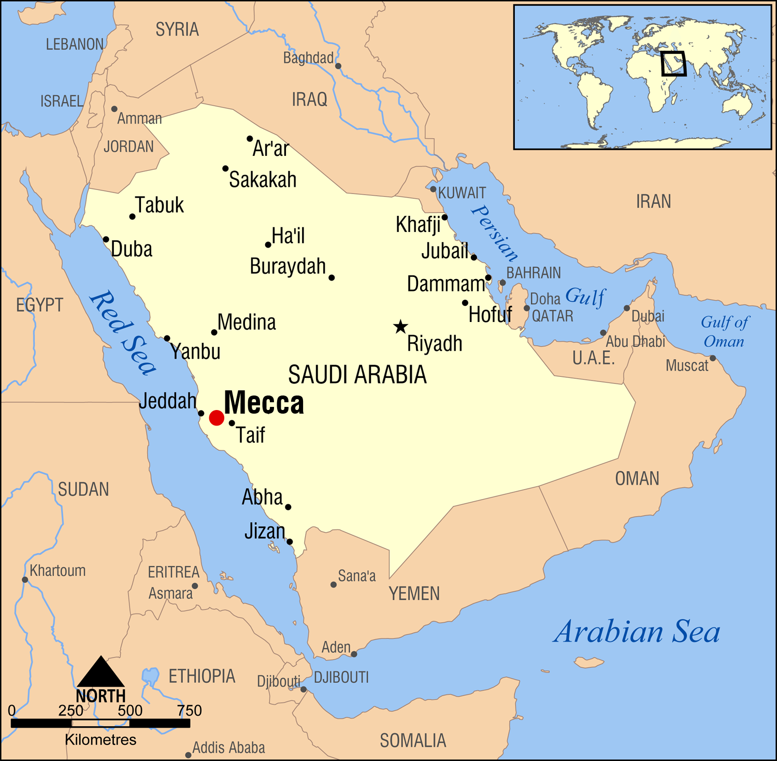

Slide 4
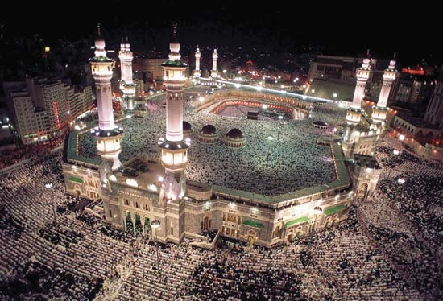
Fundamentals & Fallacies of ISLAM

Slide 5
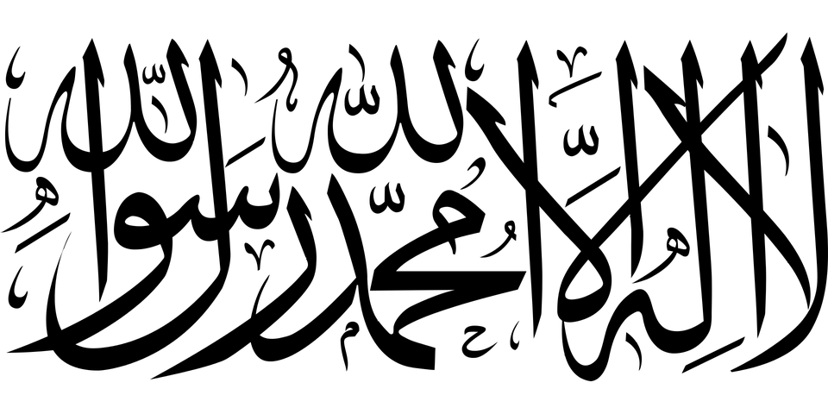
Fundamental Beliefs of Islam
“There is no God but Allah and Muhammad is his prophet”
The Quran is the perfect completion of God’s revelation in the Arabic language
Oral traditions of Muhammad (known as “Sunnah”) are also authoritative.

Slide 6
Basic Practices of Islam
The Five Pillars of Islam
Confession of Faith (shahada)
Prayer (salat)
Charity (zakat)
Fasting during Ramadan (sawm)
Pilgrimage to Mecca (hajj)

Slide 7
Fallacies of Islam
Its concept of the Nature and Name of God
Amos 5:8; Deut. 6:4; John 10:30
Its acceptance of Muhammad as a Prophet
Deut. 18:19; 13:1-3; John 3:2
Its acceptance of the Quran as Inspired
Quran 10:38; John 16:5-16; Mark 16:20; Hebrews 2:3; 2 Timothy 3:16
Its reliance on human traditions
Mark 7:9; Colossians 2:8
Its spread through violence (Jihad)
Compare Quran 9:5 with Isaiah 2:2-4; 9:7

