Slide 2
Serving My Neighbor
Church of Christ at medina
November 26th, 2017

Slide 3
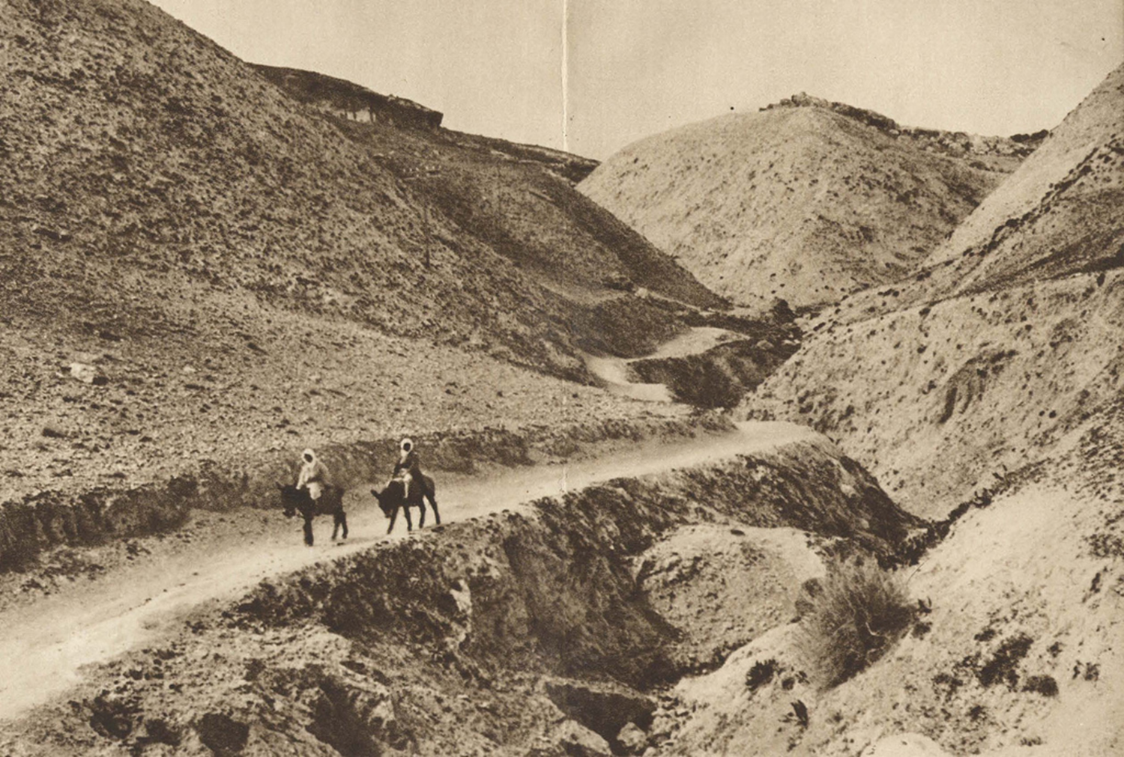
Jerusalem to Jericho
A man was travelling from Jerusalem to Jericho
This was a trip of about 15-22 miles
The trip was difficult…
A drop of over 3000 feet
Ravines, rocks, caves
Filled with criminals
Known as the “Way of Blood”

Slide 4
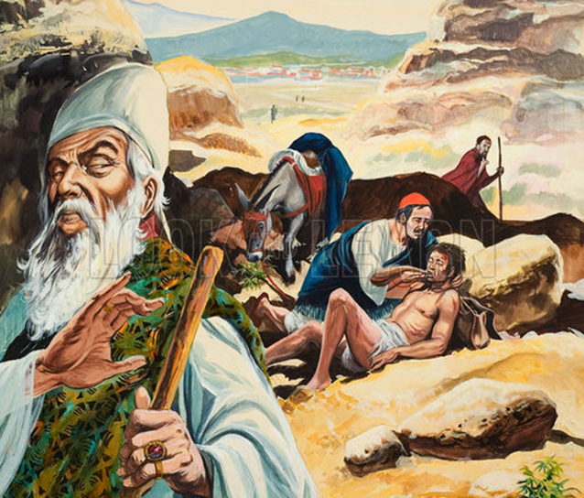
The Story
The man fell among robbers
Naked and very hurt, he is left in the desolate place with no chance of survival on his own
“By chance” a priest comes down that same road at the time that man has been attacked. The priest sees him, but passes by on the other side of the road.
Soon after, a Levite comes. He goes over to see the injured man, but then he returns to the other side of the way and passes by.

Slide 5
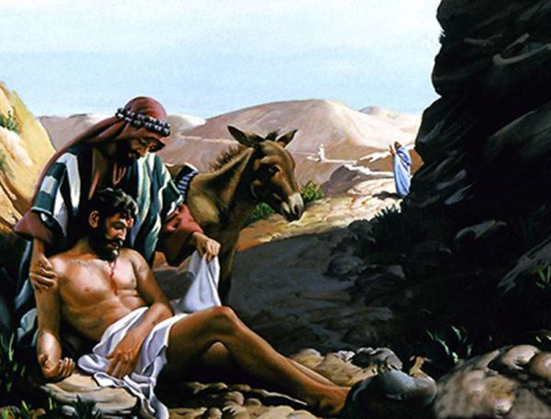
The Good Samaritan
Finally, a Samaritan comes upon the scene.
“³³But a Samaritan, as he journeyed, came to where he was, and when he saw him, he had compassion.
³⁴He went to him and bound up his wounds, pouring on oil and wine. Then he set him on his own animal and brought him to an inn and took care of him.
³⁵And the next day he took out two denarii and gave them to the innkeeper, saying, 'Take care of him, and whatever more you spend, I will repay you when I come back.’”

Slide 6
The Reason for the Parable
The lawyer originally asked – “Teacher, what shall I do to inherit eternal life?”.
Having answered his own question, Jesus commands him to go and do the law.
The lawyer wanted to justify himself, so he asked a further question – “And who is my neighbor?”
Give me the specifics. Who shall I help?

Slide 7
The Lesson of the Parable
Instead of providing a direct answer, Jesus provides the parable or story of the Good Samaritan. When He finished, he asked the teacher – “Which of these three, do you think, proved to be a neighbor to the man who fell among the robbers?"
The answer was obvious. Although the teacher could not bring himself to say “the Samaritan”, he did say “the one who showed him mercy.”
So what was the point?

Slide 8
The Lesson of the Parable
The point of the lesson was not who deserved to be the neighbor of the teacher. The teacher probably wanted more information about the person whom he should help…
Nationality
Religious Affiliation
Current Status
Rather, Jesus stresses the need to “prove” ourselves as neighbors.
It is not the qualification of the one being helped, but the one who has the opportunity and ability to help!

Slide 9
Conclusion
There are many great lessons from this story that we can apply in our lives…
Don’t put sacrifice or worship ahead of goodness (Hosea 6:6). One is just as important as the other.
To find eternal life, go back to the Scriptures. God has given us all we need to know.
However, the one we don’t need to overlook is that our “neighborhood” stretches to the point of our opportunity and ability to help. Neighbor love is not a response to the goodness in others, but to their need.

