Slide 2
Riches and the Kingdom
Matthew 19:16-26
Mark 10:17-22
Luke 18:18-23

Slide 3
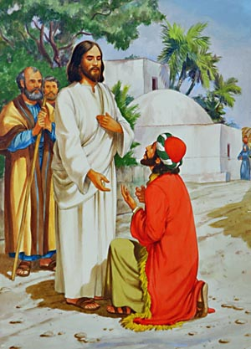
The Rich Young Ruler
He came to the right person.
He had the right attitude.
He asked the right questions.
He received the right answer.

Slide 4
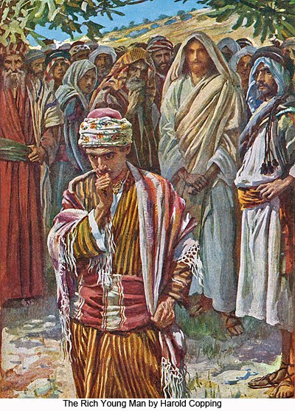
The Rich Young Ruler
He made the wrong decision.
When the young man heard this he went away sorrowful; for he had great possessions. And Jesus said to his disciples, "Truly, I say to you, it will be hard for a rich man to enter the kingdom of heaven. (Matthew 19:22-23 RSV)

Slide 5
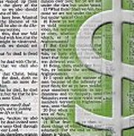
The Difficulty With Riches
Riches do not satisfy.
Deceitful promise of riches.
Foolish pride with riches.
Hardening selfishness with riches.
As for what was sown among thorns, this is he who hears the word, but the cares of the world and the delight in riches choke the word, and it proves unfruitful. (Matthew 13:22 RSV)

Slide 6
The Difficulty With Riches
Covetousness
Contentment
Sympathy for the rich
Faith in the power of God
But God said to him, 'Fool! This night your soul is required of you; and the things you have prepared, whose will they be?' So is he who lays up treasure for himself, and is not rich toward God." (Luke 12:20-21 RSV)

Slide 7
Resources
The Difficulty with Riches – Mark Copeland
Outline by Steve Higginbotham
Truth Commentary by Mark Stauffer
Commentary on Matthew by Kenneth L. Chumbley

