Slide 1
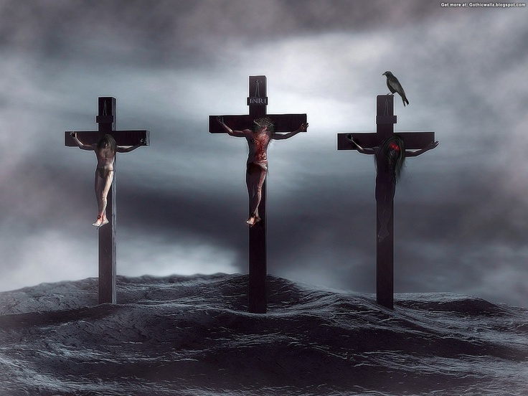
Why Three Crosses?
Matthew 27

Slide 2
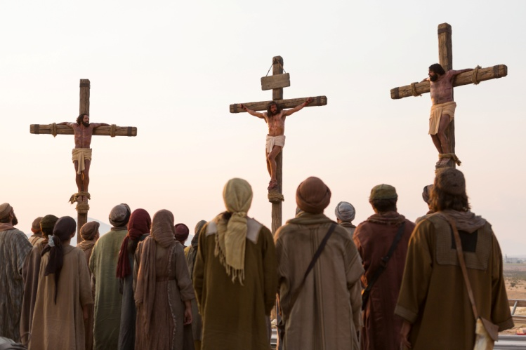
There Were Three Crosses
The Cross of Impenitence – One dying in sin!
Lawlessness
Hardness (Luke 23:40)
Carnality (Luke 23:39)
Rebellion
Sitting down, they kept watch over Him there. And they put up over His head the accusation written against Him: THIS IS JESUS THE KING OF THE JEWS. Then two robbers were crucified with Him, one on the right and another on the left. (Matthew 27:36-38 NKJV)

Slide 3
There Were Three Crosses
The Cross of Repentance – One dying to sin!
Righteous Indignation (Luke 23:40,41)
A sense of guilt
A desire for a place in the memory of Christ
The most popular thief in the world!
Sitting down, they kept watch over Him there. And they put up over His head the accusation written against Him: THIS IS JESUS THE KING OF THE JEWS. Then two robbers were crucified with Him, one on the right and another on the left. (Matthew 27:36-38 NKJV)

Slide 4
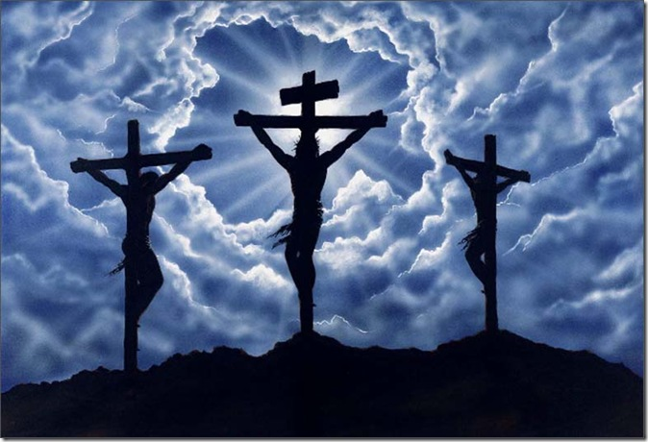
There Were Three Crosses
The Cross of Reconciliation – One dying for sin!
Sinlessness (2 Cor. 5:21)
Forgiveness (Luke 23:34)
1 Corinthians 15:3
Sitting down, they kept watch over Him there. And they put up over His head the accusation written against Him: THIS IS JESUS THE KING OF THE JEWS. Then two robbers were crucified with Him, one on the right and another on the left. (Matthew 27:36-38 NKJV)

Slide 5
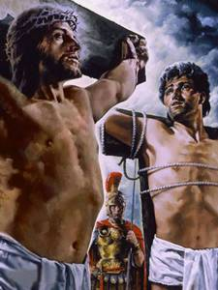
The Significance…
Two Attitudes To Jesus:
Impenitent who is untouched (Opposing God’s Word)
Penitent who breaks down in the presence of Jesus (Believing God’s Word)
And being found in appearance as a man, He humbled Himself and became obedient to the point of death, even the death of the cross. (Philippians 2:8 NKJV)

Slide 6
There Were Three Crosses
The one in the middle is the most important! The cross of Jesus is the
central event of human history. What Jesus did there was the event of the
ages. Nothing that happened before or since is as significant to humanity.
But the other two are also significant. They represent two kinds of men. All
of us can see ourselves on one of the two remaining two crosses, either the
thief that rebelled or the thief that repented.

Slide 7
Sources
Speaking Truth in Love by Bobby Thompson
Three Crosses – Outline by Johnny Felker

